Slide 2
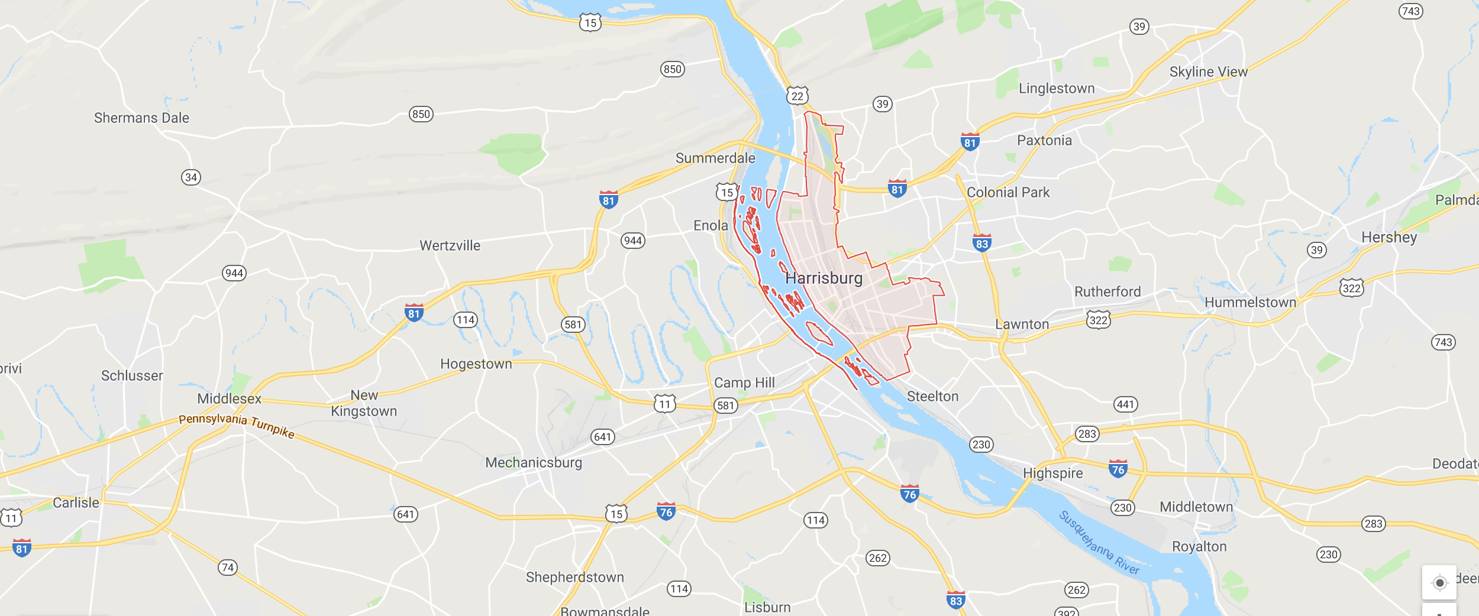

Slide 3
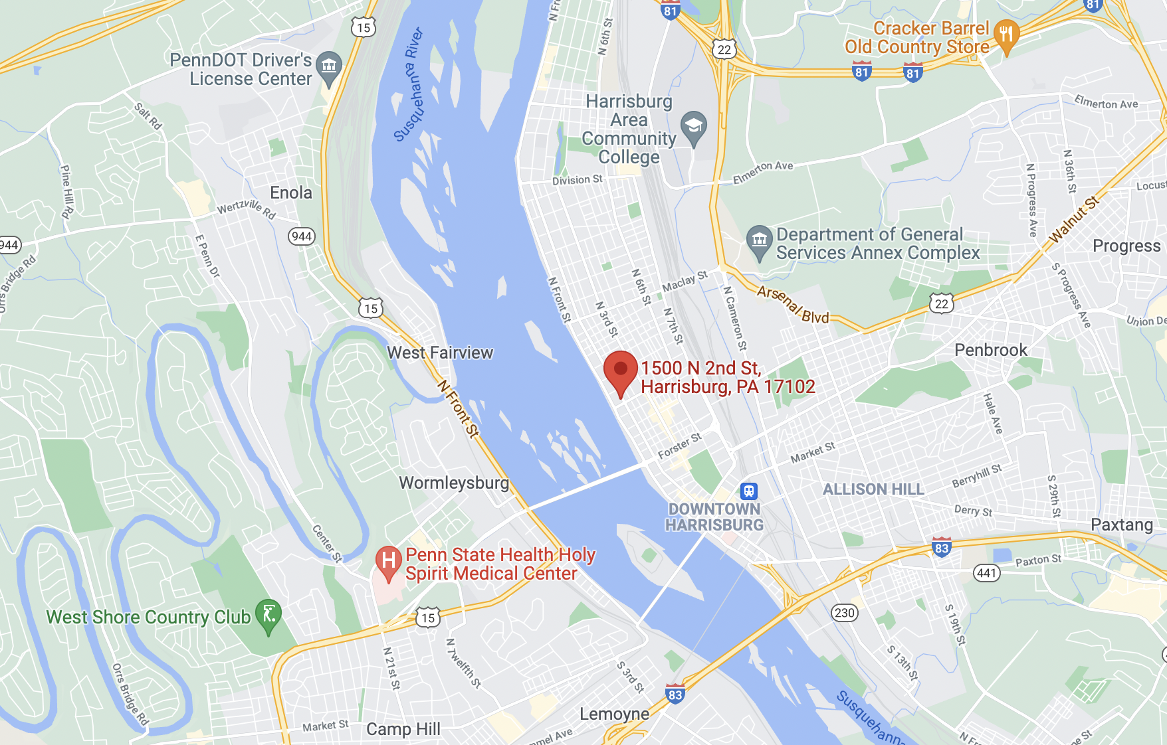

Slide 4
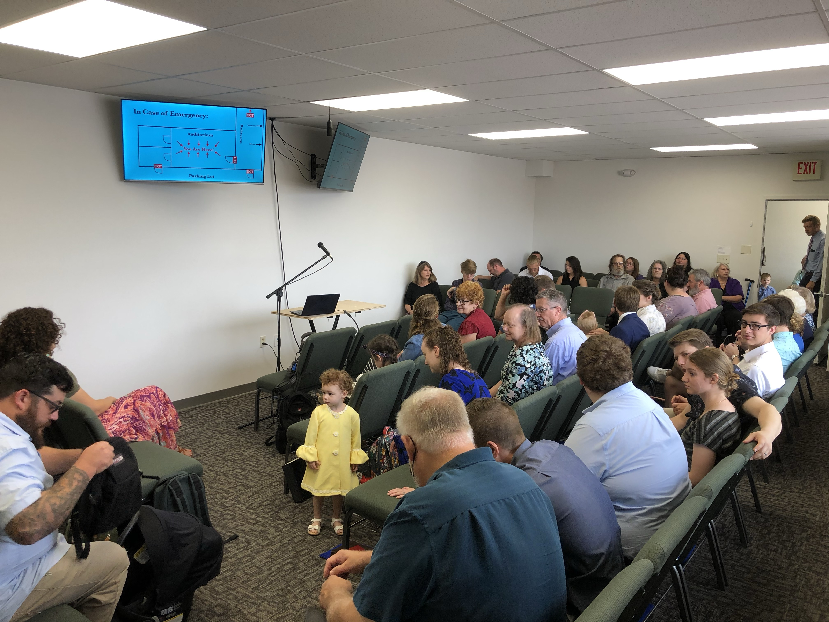

Slide 5
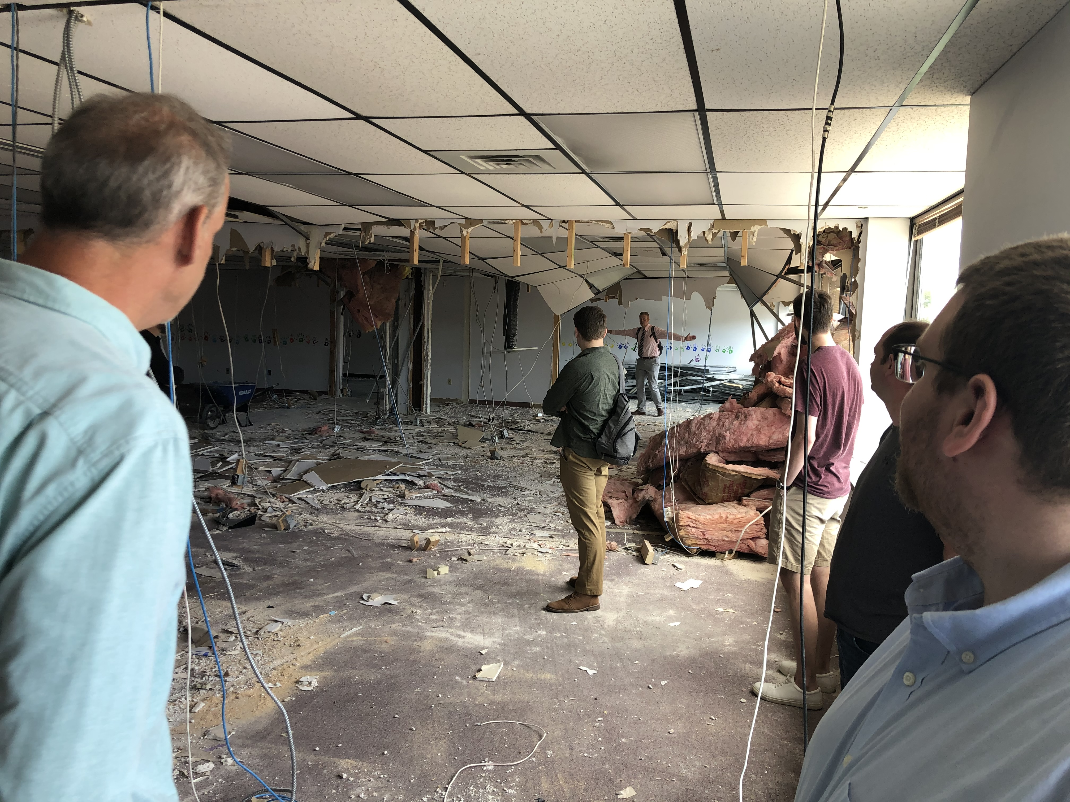

Slide 6
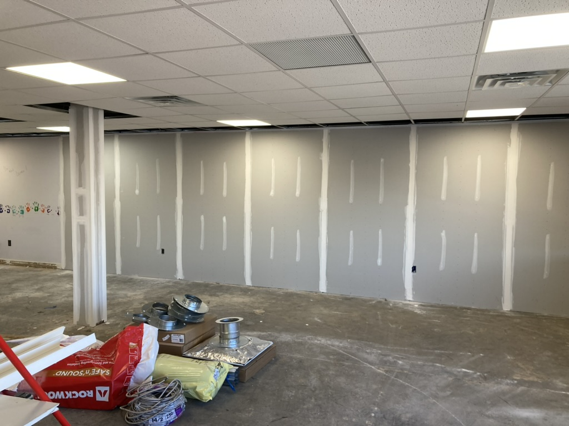

Slide 7
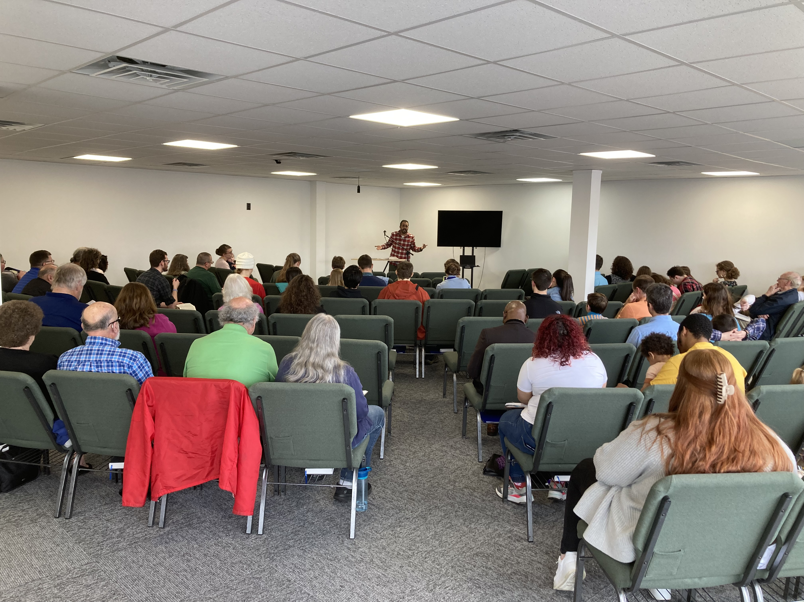

Slide 8
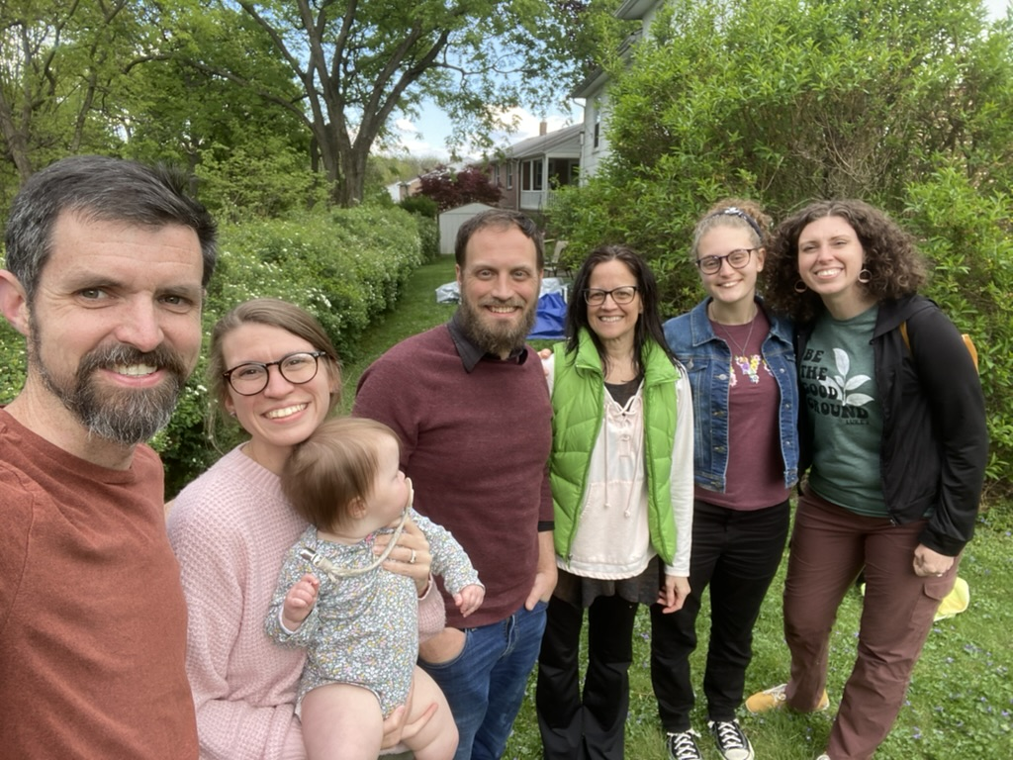

Slide 9
Heal Us All
Mark 1:32-34
Exton church of Christ | 9.10.23
Unless otherwise indicated, all Scripture quotations are from The ESV® Bible (The Holy Bible, English Standard Version®),
copyright © 2001 by Crossway, a publishing ministry of Good News Publishers. Used by permission. All rights reserved.

Slide 10
Heal Us All
Mark 1:32-34 - At sundown, Jesus heals all kinds of sickness
Mark 1-2: Demons, fever, leprosy, paralysis, sins
Why did Jesus heal people physically?
Not to save their life forever—temporary help
To show His power / prove who He is
To show what He can do for us spiritually/eternally
Mark 2:10-11,17 - Physical Healing → Spiritual Healing

Slide 11
Heal Us All
How do I seek spiritual healing from Jesus?
Mark 10:21 - Diagnosis: Confess your illness
2 Sam 12:7 - Sometimes hidden to others, hidden to self
Luke 19:8 - Medication: Make the radical changes
Matt 5:29 - It is worth whatever surgery it takes
Mark 5:19 - Proclaim: Tell about His mercy!
1 Tim 1:16 - Every Christian is a conversion

Slide 12
Heal Us All
by henry twells (1868)
At evening, when the sun had set,
The sick, O Lord, around You lay;
O, with how many pains they met!
O, with what joy they went away!
Once more ’tis eventide, and we,
Oppressed with various ills, draw near;
And though Your form we cannot see,
We know that You are ever near.
Mark 1:32-34
That evening at sundown they brought to him all who were sick or oppressed by demons. And the whole city was gathered together at the door. And he healed many who were sick with various diseases, and cast out many demons…

Slide 13
Heal Us All
by henry twells (1868)
Rev 2:4
But I have this against you, that you have abandoned the love you had at first.
O Savior Christ, our woes dispel;
For some are sick, and some are sad;
And some have never loved You well,
And some have lost the love they had.
And some are pressed with worldly care,
And some are tried with fear and doubt,
And some such grievous passions bear
That only You can cast them out.
Mark 9:28-29
“Why could we not cast it out?” And he said to them, “This kind cannot be driven out by anything but prayer.”

Slide 14
Heal Us All
Ecc 2:10-11
And whatever my eyes desired I did not keep from them… Then I considered all that my hands had done… and behold, all was vanity…
by henry twells (1868)
And some have found the world is vain,
Yet to the world they turn anew;
And some have friends who cause them pain,
Yet have not sought a friend in You.
And none, O Lord, have perfect rest,
For none are wholly free from sin;
And those who seek to serve You best
Are conscious most of wrong within.
Psalm 139:23-24
Search me, O God, and know my heart!…
And see if there be any grievous way in me,
and lead me in the way everlasting!

Slide 15
Heal Us All
1 Tim 2:5 (Ac 17:31)
there is one mediator between God and men, the man Christ Jesus
by henry twells (1868)
O Savior Christ, You too are man;
You have been troubled, tempted, tried;
Your kind but searching glance can scan
The very wounds that shame would hide.
Your touch still has its ancient power.
No word from You can fruitless fall;
Hear, in this solemn evening hour,
And in Your mercy heal us all.
Heb 2:18
For because he himself has suffered when tempted, he is able to help those who are being tempted.
Luke 4:40 - he laid his hands on every one of them and healed them.
Matt 8:16 - he cast out the spirits
with a word

Slide 21
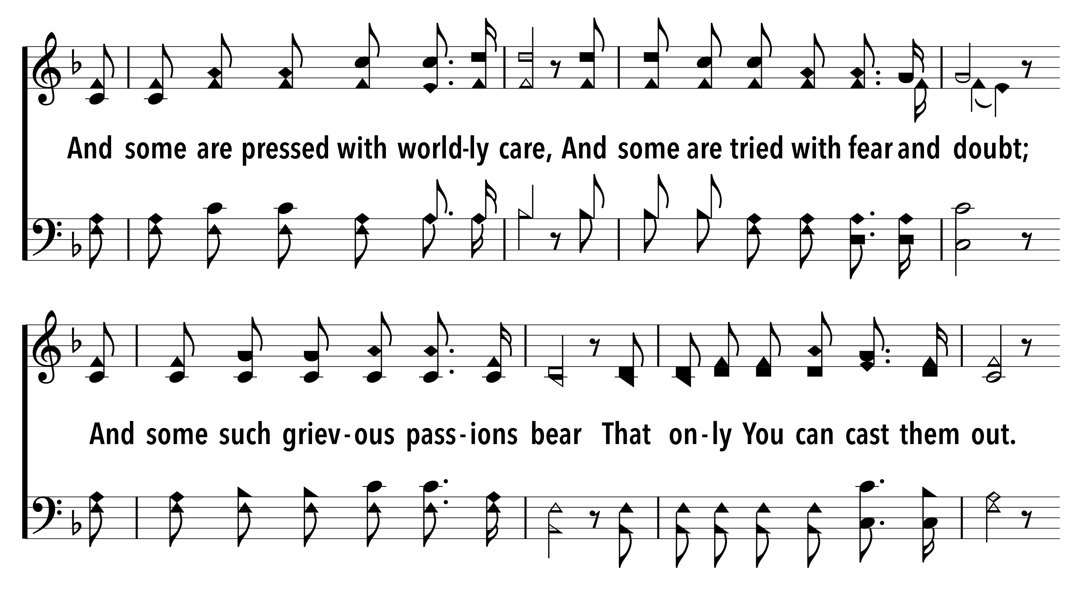

Slide 27
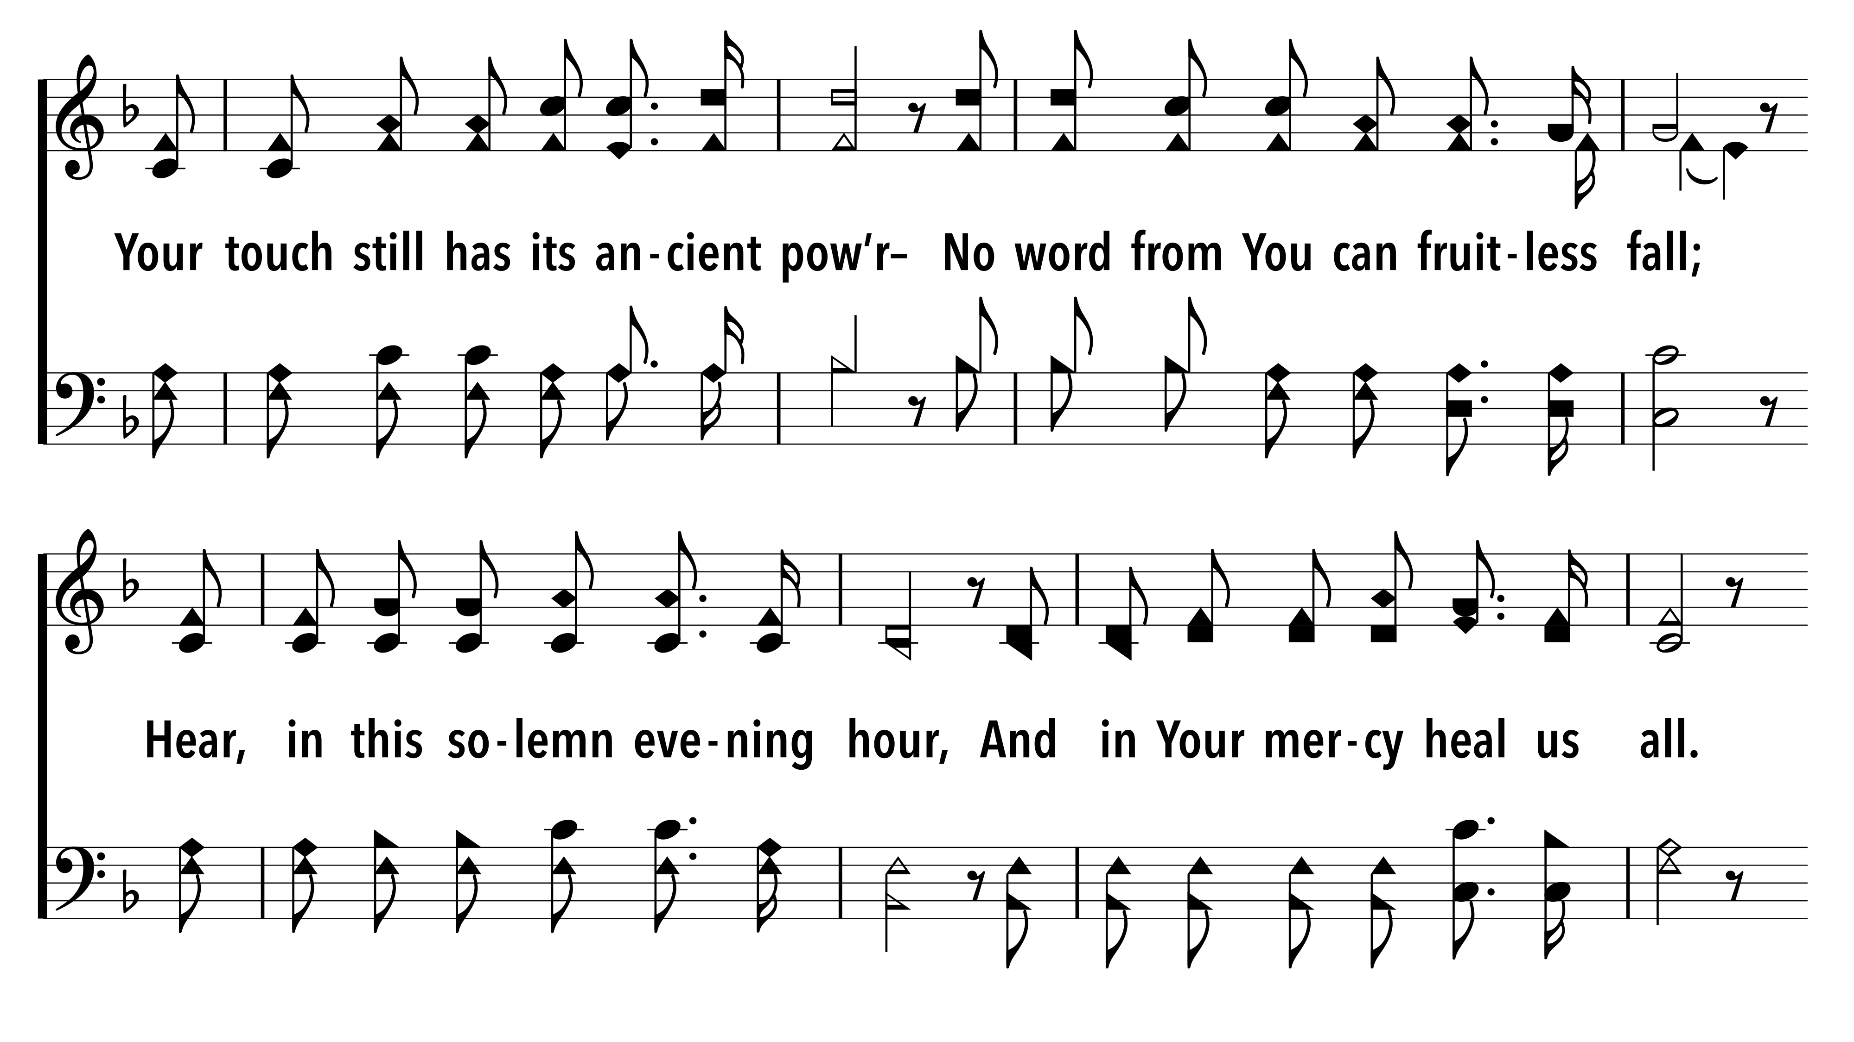

Slide 29
Heal Us All
Mark 1:32-34
Exton church of Christ | 9.10.23
Unless otherwise indicated, all Scripture quotations are from The ESV® Bible (The Holy Bible, English Standard Version®),
copyright © 2001 by Crossway, a publishing ministry of Good News Publishers. Used by permission. All rights reserved.

