Slide 1
Sermon
Heinrich Rutenkroger

Slide 2
TO LIE

Slide 3
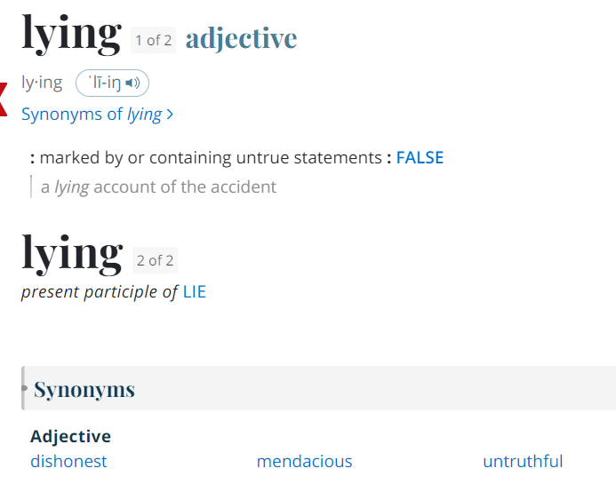
What is Lying?
Merriam
Webster
Dictionary

Slide 4
What is Lying?
Stanford Encyclopedia of Philosophy

Slide 5
What is Lying?
BIBLE (NKJV) John 8:44
You are of your father the devil, and the desires of your father you want to do. He was a murderer from the beginning, and does not stand in the truth, because there is no truth in him. When he speaks a lie, he speaks from his own resources, for he is a liar and the father of it.

Slide 6
Why do we lie?
TO MAXIMIZE PLEASURE | TO MINIMIZE PAIN

Slide 7
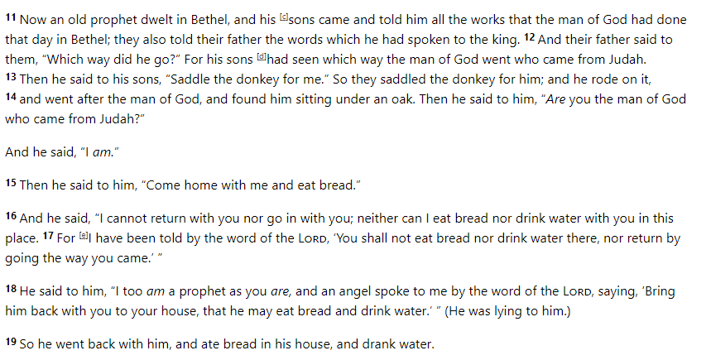
Why do we lie?
Maximizing pleasure ==> 1st Kings 13

Slide 8
Why do we lie?
Minimizing pain ==> David and Bathsheba
Second Samuel 11
Inquired about Bathsheba (V3)
Laid with her (V4)
Tried to get Uriah to sleep with her (V8)
Got Uriah drunk to get him to sleep with her (V13)
Murdered Uriah (V15)

Slide 9
Why do we lie?
TO MAXIMIZE PLEASURE | TO MINIMIZE PAIN
For Ourselves

Slide 10
Why do we lie?
TO MAXIMIZE PLEASURE | TO MINIMIZE PAIN
For Ourselves
The Old Prophet wanted to talk with the young man of God

Slide 11
Why do we lie?
TO MAXIMIZE PLEASURE | TO MINIMIZE PAIN
For Ourselves
The Old Prophet wanted to talk with the young man of God
David wanted to avoid the consequences of his sin with Bathsheba

Slide 12
What now?
Defined Lying
Pinpointed Why We Lie
How to Stop

Slide 13
DO
YOU
CARE

Slide 14
World view
TO MAXIMIZE PLEASURE | TO MINIMIZE PAIN
Me vs You
For Ourselves

Slide 15
God’s View
TO MAXIMIZE PLEASURE | TO ACCEPT PAIN
For OTHERS

Slide 16
Maximizing pleasure
Philippians 2

Slide 17
Accepting Pain
JOB
Upright man, fears God, as does his household
God allows Satan to “test” Job
In the course of one day, Job receives four messages, each bearing separate news that his livestock, servants, and ten children have all died due to marauding invaders or natural catastrophes.
Job is afflicted with horrible skin sores. His wife encourages him to curse God and to give up and die, but Job refuses

Slide 18
Do We Care?
TO MAXIMIZE PLEASURE | TO MINIMIZE PAIN
OR
TO MAXIMIZE PLEASURE | TO ACCEPT PAIN
For Ourselves
For OTHERS

Slide 19
Lying?
Defined Lying
Who’s more important?
God, or you?
Pinpointed Why We Lie
How to Stop

