Slide 1
Has the Bible been corrupted?

Slide 3
“But many people don’t realize that over the past 2,000 years, this sacred text has changed a great deal. No ‘first edition’ exists. What we have are copies, the first of which were made hundreds of years after the events supposedly took place.
For the first 100 to 200 years, copies of the Bible were made by hand … and not by professionals. This led to many errors, omissions, and — most importantly — changes.”
Joe Avella

Slide 4
Joe is a video producer in Los Angeles. He primarily focuses on food, marijuana, and movie-industry stories. He’s been
https://www.businessinsider.com/author/joe-avella

Slide 5
I’m a senior video producer for Insider and the co-host of UK vs. US Food Wars. I’ve also appeared in non-food videos getting my ears cleaned, or getting high at a cannabis cafe, or breaking props over my head, or perhaps going down a ski jump on an innertube.

Slide 6
How does the evidence for the NT compare?
An honest look at “errors”
Why?
What sort?
How to know how much has changed
You can easily compare what the Bible says today with what it said nearly two thousand years ago
Familiarity
with the
Evidence

Slide 7
How does the evidence for the NT compare?

Slide 8
No scriptures exist in the hand of the original writer
We have hand-written copies
These hand-written copies do contain errors such as found in hand-written copies of any writing
How many copies (“manuscripts”)?

Slide 9
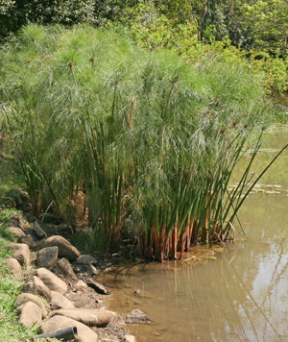
NEW TESTAMENT
As of 2012, more than 5,700
many of the oldest on papyrus, which wasn’t very durable

Slide 10
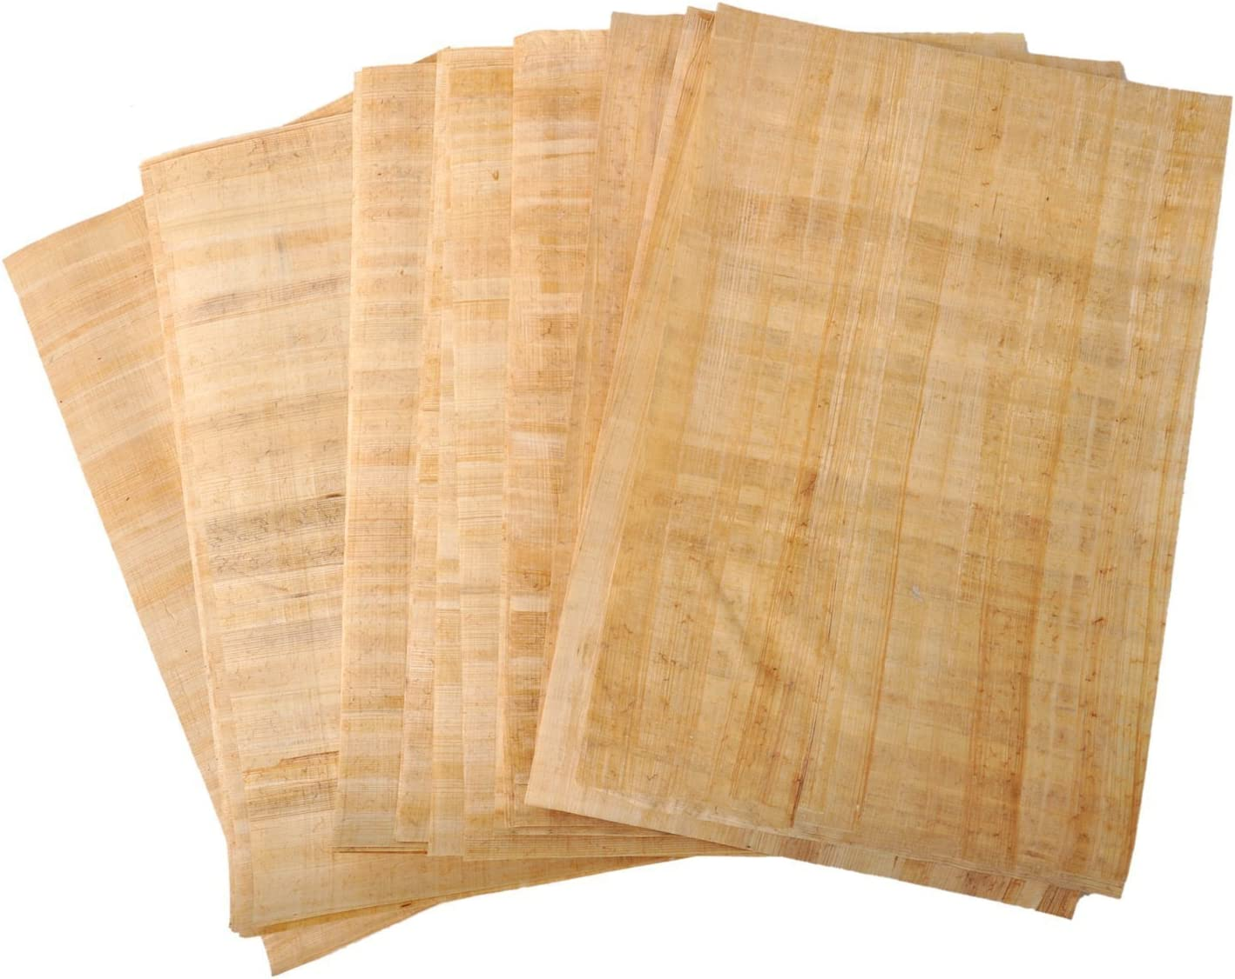
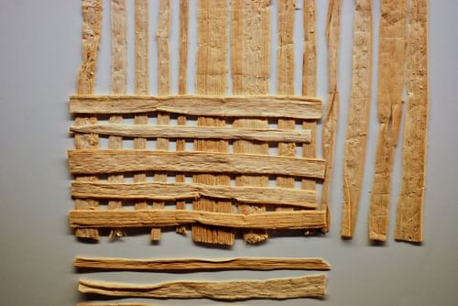
NEW TESTAMENT
As of 2012, more than 5,700
many of the oldest on papyrus, which wasn’t very durable

Slide 11
NEW TESTAMENT
As of 2012, more than 5,700
many of the oldest on papyrus, which wasn’t very durable
About 125 NT papyri exist today
Most are from the 3rd and 4th centuries
some from the 2nd century
some as late as the 7th, possibly 8th century

Slide 12
NEW TESTAMENT
As of 2012, more than 5,700
many of the oldest on papyrus, which wasn’t very durable
others on parchment
some (“ostraca”) on broken pottery pieces

Slide 13
NEW TESTAMENT
As of 2012, more than 5,700
hundreds are “uncials”
thousands are “minuscules”
UNCIALS
minuscules
100
200
300
400
500
600
700
800
900
1000
1100
1200
9th
cent

Slide 14
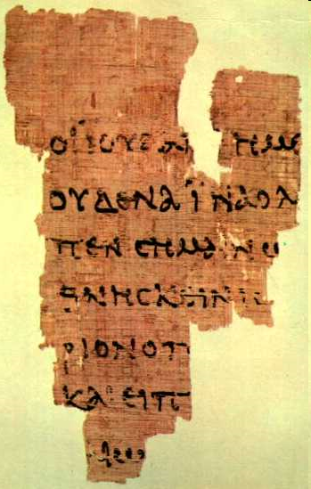
Some are mere fragments
P⁵²
^{John Rylands fragment}
^{c. A.D. 125}

Slide 15
Some are mere fragments
the Jew to us
no one that the w
poke signifying
to die. Entere
rium P
and sai
ew
P⁵²
^{John Rylands fragment}
^{c. A.D. 125}

Slide 16
Some are mere fragments
John 18:31-33
Said to him s is allowed
to kill ord of Jesus might
be fulfilled which he s the death
he was d therefore
the Praeto ilate, and called
Jesus d, are you the king of
the J s
the Jew to us
no one that the w
poke signifying
to die. Entere
rium P
and sai
ew
P⁵²
^{John Rylands fragment}
^{c. A.D. 125}

Slide 17
Some are mere fragments
Some contain a book, or a group of books
Some include virtually the entire Bible

Slide 18
those that include virtually the entire Bible
“But many people don’t realize that over the past 2,000 years, this sacred text has changed a great deal. No ‘first edition’ exists. What we have are copies, the first of which were made hundreds of years after the events supposedly took place.
For the first 100 to 200 years, copies of the Bible were made by hand … and not by professionals. This led to many errors, omissions, and — most importantly — changes.”
250 years
700 years

Slide 19
those that include virtually the entire Bible
250 years
Over 5700!
Only 2 manuscripts!
700 years

Slide 20
those that include virtually the entire Bible
250 years
Both are partial
700 years

Slide 21
those that include virtually the entire Bible
250 years
No passage has more than a single witness!
700 years

Slide 22
Printing press
1st Printed Greek NT
CENTURY

Slide 23
How does the evidence for the NT compare?
VERY FAVORABLY!
An honest look at “errors”
Why?
What sort?
“There is no body of ancient literature in the world which enjoys such a wealth of good textual attestation as the New Testament”
- F.F. Bruce
“the manuscripts from which our knowledge of the New Testament comes — are in far, far better shape than the manuscripts of any other work from the ancient world, by a very long way”
- N.T. Wright

Slide 24
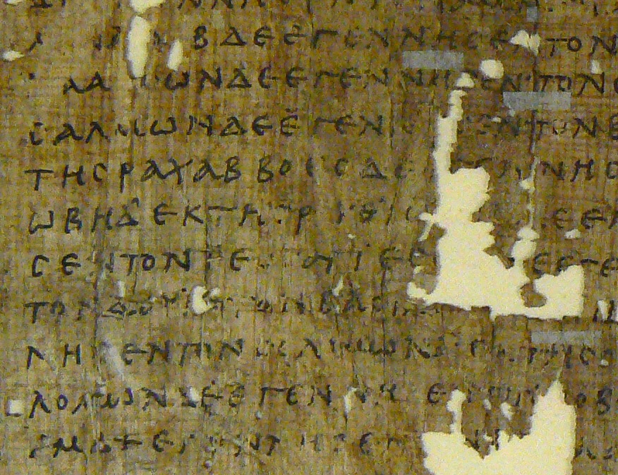
P¹
^{3rd century}
Penn Museum
ραχαβ
rachab
Rahab

Slide 25
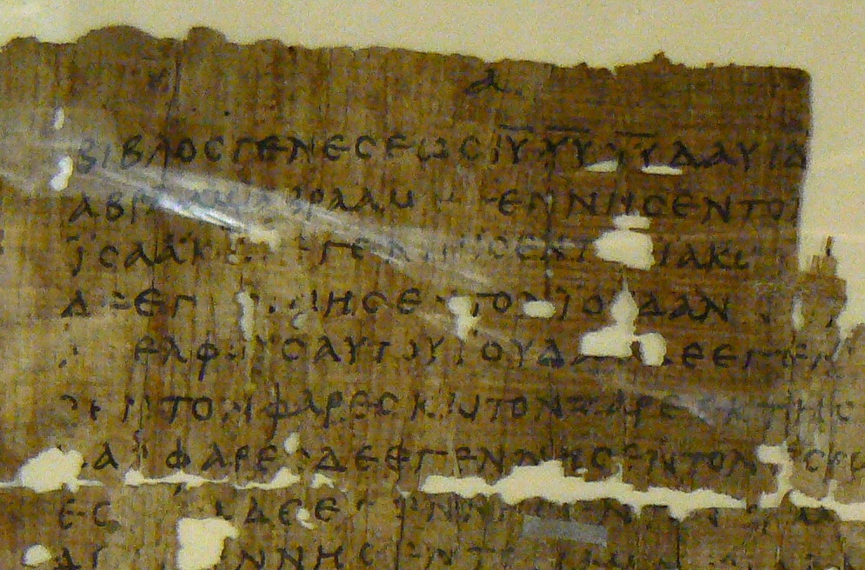
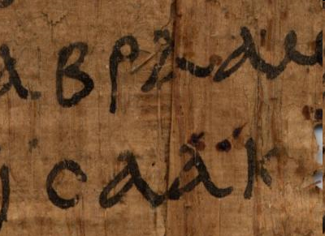
P¹
^{3rd century}
Penn Museum
abraAm
Isaak

Slide 26
P¹
^{3rd century}
Penn Museum
Abraham
Isaac

Slide 27
GENESIS
P¹
^{3rd century}
Penn Museum
of Jesus Christ Son
BIBLOS
genesews
DAUID
(of)

Slide 28
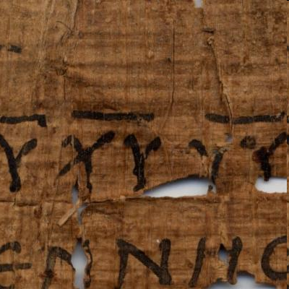
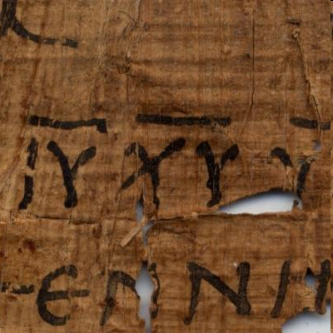
P¹
^{3rd century}
Penn Museum
IU CU UU

Slide 29
of Jesus Christ, Son
P¹
^{3rd century}
Penn Museum
IHSOU cRISTOU UIOU

Slide 30
of Jesus Christ, Son
P¹
^{3rd century}
Penn Museum
I U c U U U

Slide 31
of Jesus Christ, Son
P¹
^{3rd century}
Penn Museum
IU cU UU

Slide 32
P¹
^{3rd century}
Penn Museum
IU cU UU

Slide 33
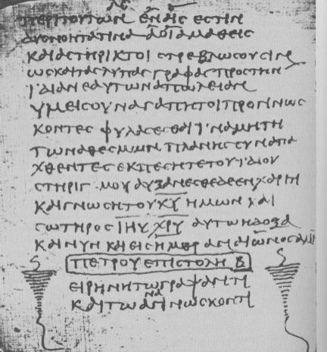
P⁷²
^{3rd/4th cent.}
(c. A.D. 300)

Slide 34
Codex Sanaiticus
(c. A.D. 350)

Slide 35
SIMILAR APPEARANCE
1 Timothy 3:16
God QEOS
He who OS
God was manifest in the flesh (KJV)
He who was manifested in the flesh (ASV)

Slide 36
SIMILAR APPEARANCE
1 Timothy 3:16
God QS
He who OS
God was manifest in the flesh (KJV)
He who was manifested in the flesh (ASV)
Was there a change?
Is there an “error”?
Is it significant?

Slide 37
OTHER CAUSES OF ERRORS
Harmonistic corruptions
Homonyms
Intentional changes
stylistic
doctrinal
alleviating difficulties
harmonization
Introduction of marginal notes
Similar line endings

Slide 38
P⁷²
^{3rd/4th cent.}
(c. A.D. 300)

Slide 39
P⁷²
^{3rd/4th cent.}
(c. A.D. 300)

Slide 40
Explanatory Notes
P⁷²
^{3rd/4th cent.}
(c. A.D. 300)

Slide 41
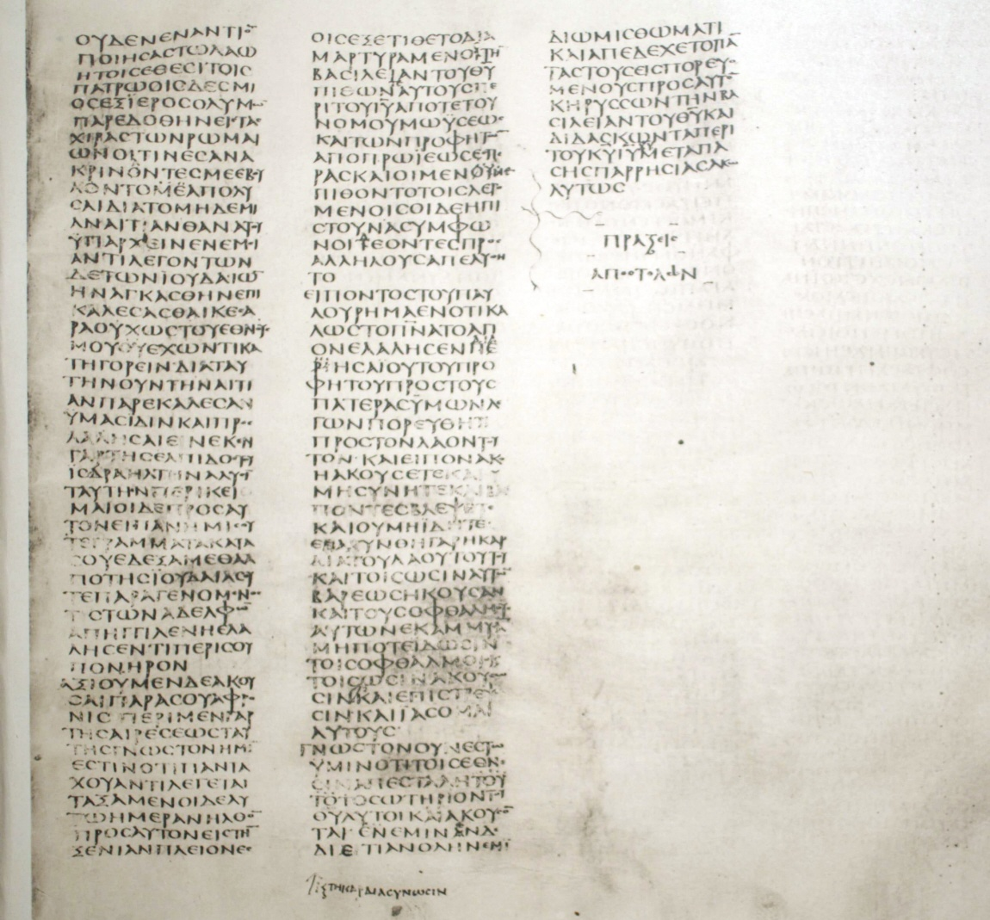
Explanatory Notes
Codex Sanaiticus
(c. A.D. 350)

Slide 42
Explanatory Notes
Codex Sanaiticus
(c. A.D. 350)

Slide 43
Explanatory Notes
Codex Sanaiticus
(c. A.D. 350)

Slide 44
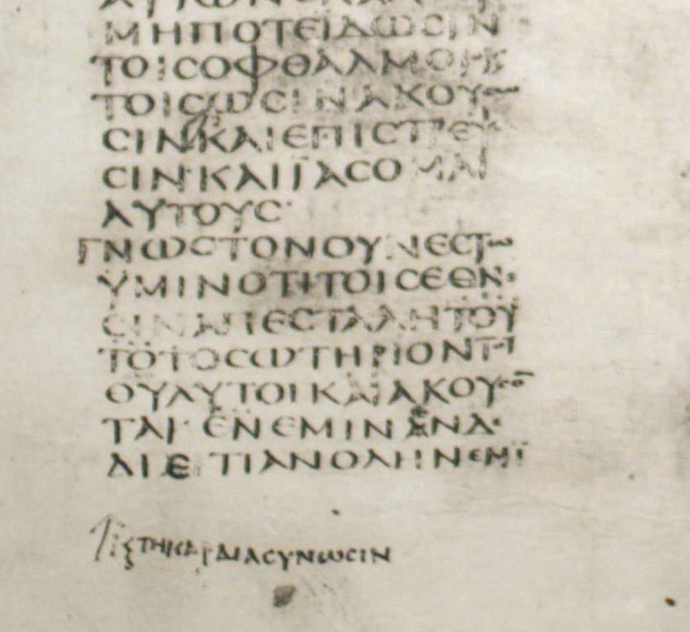
Explanatory Notes
Codex Sanaiticus
(c. A.D. 350)
understand with the heart

Slide 45
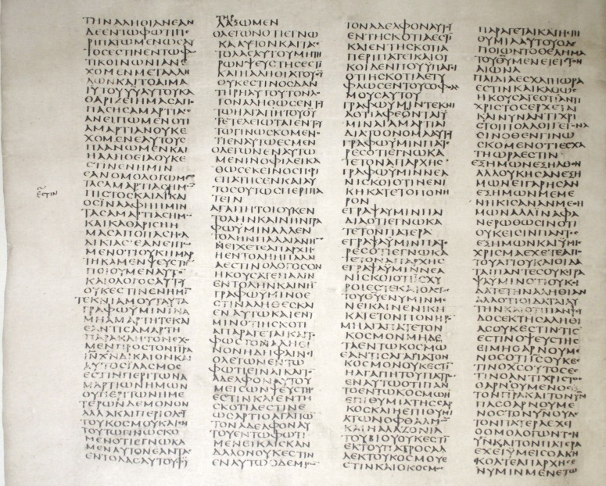
Explanatory Notes
Codex Sanaiticus
(c. A.D. 350)

Slide 46
Explanatory Notes
Codex Sanaiticus
(c. A.D. 350)
he is

Slide 47
SIMILAR LINE ENDINGS
(HOMOEOTELEUTON)
As a scribe copied from an exemplar in which a line ended with the same word or words as did a line farther down, after copying the first of the two lines, he looked back at the exemplar and resumed copying there, thus omitting some of the text.
As a scribe copied from an exemplar in which a line farther down, after copying the first of the two lines, he looked back at the exemplar and resumed copying there, thus omitting some of the text.

Slide 48
SIMILAR LINE ENDINGS
(HOMOEOTELEUTON)
I do not ask that you take them from the world, but that you keep them from the evil one
I do not ask that you take them from the evil one
John 17:15
Codex Vaticanus
c. A.D. 350

Slide 49
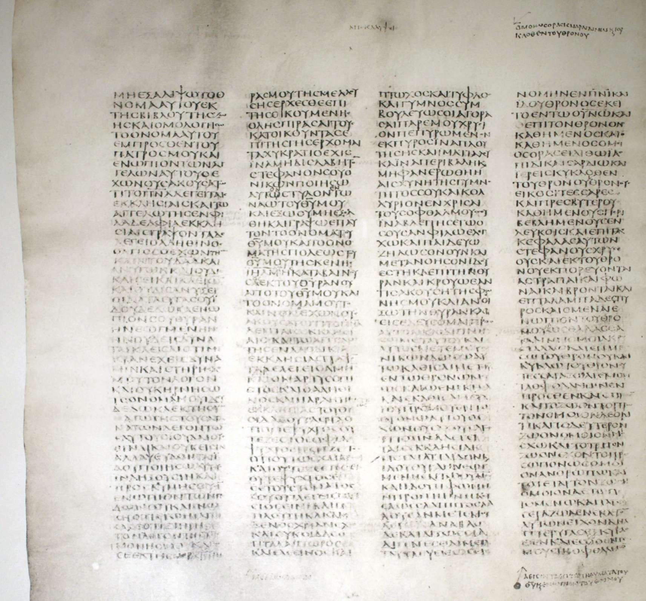
SIMILAR LINE ENDINGS
(HOMOEOTELEUTON)
Twice on one page!

Slide 50
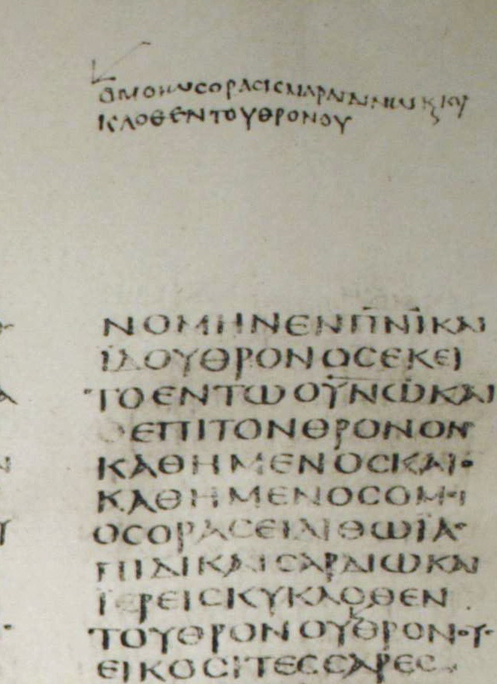
SIMILAR LINE ENDINGS
(HOMOEOTELEUTON)
and he who was sitting was like jasper and carnelian in appearance, and there was a rainbow surrounding the throne like an emerald in appearance, and surrounding the throne were twenty-four thrones, and seated on the thrones were twenty-four elders
like an emerald in appearance, and surrounding the throne

Slide 51
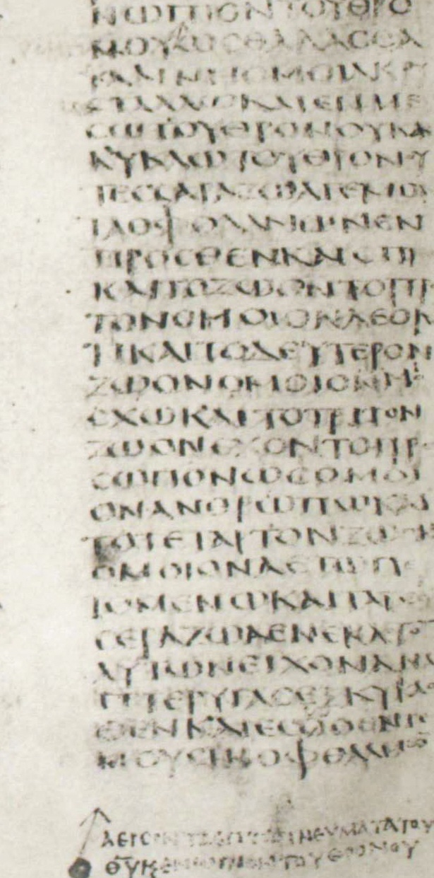
SIMILAR LINE ENDINGS
(HOMOEOTELEUTON)
And lightening and voices and thunder coming out of the throne, And seven lamps of fire burning before the throne which are the seven spirits of God, and before the throne as a sea of glass like crystal. four elders
which are the seven spirits of God, and before the throne

Slide 52
Once a scribe became accustomed to adding marginal notes back into the text, some notes got added that weren’t meant to be added

Slide 53
Explanatory Notes
Metzger, p. 194
2 Cor. 8:3-4
Because according to ability, I testify, even beyond ability, of their own accord, with much exhortation begging of us the favor and the sharing of the ministry unto the saints
Apparently, some manuscript had this marginal note…
“It is found thus in many of the copies”
us to receive.

Slide 54
Explanatory Notes
Metzger, p. 194
2 Cor. 8:3-4
Because according to ability, I testify, even beyond ability, of their own accord, with much exhortation begging of us the favor and the sharing of the ministry unto the saints us to receive. It is found thus in many of the copies, and not just as we had hoped...
Apparently, some manuscript had this marginal note…

Slide 55
Explanatory Notes
waiting for the moving of the water; for an angel of the Lord went down at certain seasons into the pool, and stirred the water: whoever stepped in first after the stirring of the water was healed of whatever disease he had.
John 5
Now there is in Jerusalem by the Sheep Gate a pool, in Aramaic called Bethesda, which has five roofed colonnades. In these lay a multitude of invalids—blind, lame, and paralyzed. One man was there who had been an invalid for thirty-eight years. When Jesus saw him lying there and knew that he had already been there a long time, he said to him, “Do you want to be healed?” The sick man answered him, “Sir, I have no one to put me into the pool when the water is stirred up, and while I am going another steps down before me.”
paralyzed, waiting for the moving of the water; for an angel of the Lord went down at certain seasons into the pool, and stirred the water: whoever stepped in first after the stirring of the water was healed of whatever disease he had. One man was there who had been an invalid for thirty-eight years. When Jesus saw him lying there and knew that he had already been there a long time, he said to him, “Do you want to be healed?” The sick man answered him, “Sir, I have no one to put me into the pool when the water is stirred up, and while I am going another steps down before me.”

Slide 56
How does the evidence for the NT compare?
An honest look at “errors”
Why?
What sort?
How to know how much has changed
You can easily compare what the Bible says today with what it said nearly two thousand years ago

Slide 57
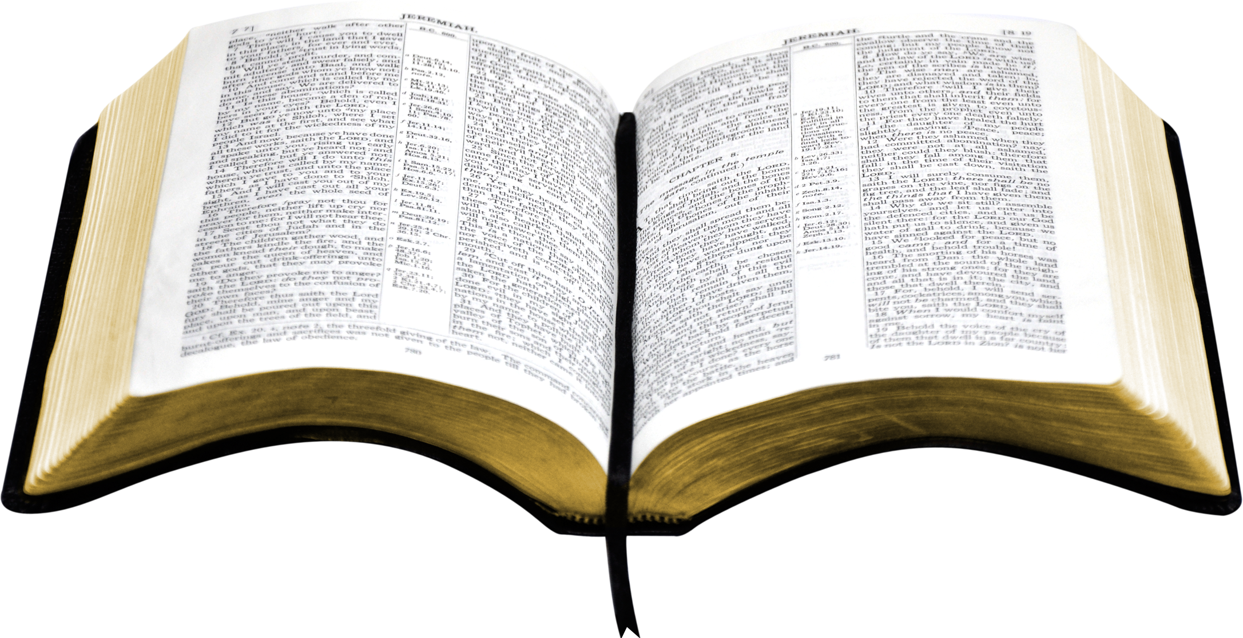
Basis of NAS, ESV, etc.
Basis of KJV
HOW MUCH CHANGE?
NAS, ESV, etc.
KJV
CENTURY

