Slide 1
The Bible as One Story

Slide 2
One Story
A Visual Framework
Evidence for Faith

Slide 4
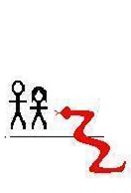

Slide 6
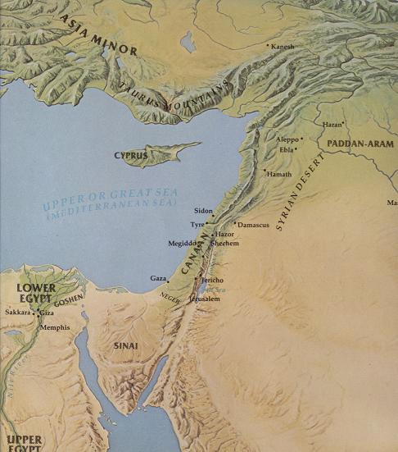
NATION
LAND
ALL FAMILIES BLESSED
“ISRAEL”

Slide 7
NATION
LAND
ALL FAMILIES BLESSED
PROBLEM
Sin
Death
SOLUTION
Jesus’ Death
Resurrection

Slide 8
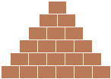

Slide 12
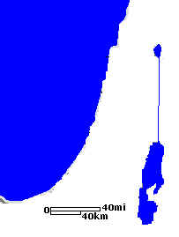

Slide 13
Jerusalem

Slide 17
NATION
LAND
ALL FAMILIES BLESSED

Slide 18
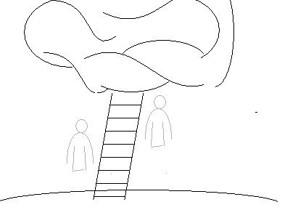

Slide 20
NATION
LAND
ALL FAMILIES BLESSED
VEIL
table
The Way
Bronze
altar
Ark
Laver

Slide 21
NATION
LAND
ALL FAMILIES BLESSED
Approximately 40 writers
1500 years

