Slide 1
An Overview of the Book of Song of Solomon

Slide 2
Overview of Song of Solomon
Titles Used
The Song of Songs, which is Solomon’s (Hebrew title)
The Song of Songs
Canticles (from Latin meaning songs)
Song of Solomon

Slide 3
Overview of Song of Solomon
The Song of Solomon is one of the shortest books in the Bible but it is also one of the most debated books.
There are two primary areas of debate:
The author of the book
The proper interpretation of the book
There are still more debates once a method of interpretation is decided.

Slide 4
Overview of Song of Solomon
Generally, the author of the book is accepted to be Solomon.
Some will argue that the book was written by another about Solomon
Reasons to accept Solomon as author
He wrote many songs (I Kings 4:32-33)
1:1 attributes the song to Solomon
Solomon is referenced (1:5, 3:7, 3:9, 3:11, 8:11-12)
No clear alternative

Slide 5
Overview of Song of Solomon
Interpreting the book
There have been many, many interpretations and volumes written on the book
First what there is little to no debate that
It is a book of Hebrew poetry that uses best Hebrew
And despite how one interprets the book:
It pictures the love between a man and woman
Courtship
The wedding of a man and a woman

Slide 6
Overview of Song of Solomon
The content of the book has caused many to struggle with its interpretation and has led to many interpretations.
There are five primary methods of interpretation used:
Allegory
Type/Antitype
Anthology of love poems
Literal
Literal/Allegorical

Slide 7
Overview of Song of Solomon
Interpreting Song of Solomon as an allegory.
An allegory is a representation of an abstract or spiritual meaning through concrete or material forms; figurative treatment of one subject under the guise of another. beginning to end (dictionary.com)
This a very popular method of interpretation among Jews and Christians and has been for centuries.
This view has the oldest recorded commentary

Slide 8
Overview of Song of Solomon
If the book is meant to be viewed as an allegory then what was the love between a man and woman representing?
God and Israel
God and any who love God
Christ and the Church
If the book is an allegory, there is no mention in the book as to what is being represented.

Slide 9
Overview of Song of Solomon
Why then is the idea of the book being an allegory so popular?
Several reasons but a few include:
It makes it easier for some to accept the book belongs in the Bible
Many struggle with the physical nature of the book if it is to be taken literally.
It becomes easier to explain difficult passages in the book as figurative.
The idea of God loving his people and his people loving him is a concept clearly taught throughout the Bible so it is not difficult to apply this book to the that concept through allegory.
Notes:
Difficult to see all as allegory for the same reason many want it to be allegory, the level of the physical nature

Slide 10
Overview of Song of Solomon
Interpreting Song of Solomon as type/antitype
Similar to an allegory in that the story of the love is a representative (type) of Christ’s love for the church (antitype)
Difference to allegory is that Solomon is accepted as a historical figure and not everything has to have a representation of something else
This view allows for some of the physical details in the story to not have spiritual interpretation
Notes:
Determining what to include and what to exclude as spiritual is not given so up to man. Problematic

Slide 11
Overview of Song of Solomon
Interpreting the Song of Solomon as an anthology
This idea seems to have started several centuries ago within Catholicism
The idea is basically there isn’t a unifying story running through the book instead it is a collection of some of the songs of Solomon that helps build one’s love through courtship and marriage
This type of collection of songs is found in other cultures from the time of Solomon
Notes:
Book seems to flow as a full story not a collection of thoughts and parts of stories.

Slide 12
Overview of Song of Solomon
Interpreting the book as both literal and allegorical
This method of interpretation takes the view that the events described did happen and that it was meant to teach about relationships between man and woman
And that we should also take the allegorical view to learn about our relationship with God
Notes:
Why can’t it just be a book teaching about relationships between man and woman? Again, which part is literal and which part allegory?

Slide 13
Overview of Song of Solomon
Interpreting the book as a literal historical event
The basic premise is that the book is an account of the courtship between Solomon and a woman
The book then would be teaching about a relationship between a man and woman
And the book demonstrates the proper concept of love and the physical relationship between a man and woman
The literal interpretation has even more diverging views on how to interpret the book than the allegorical interpretation
For example: who the woman was, where she was from exactly, when in Solomon’s reign these events occurred, etc.

Slide 14
Overview of Song of Solomon
Interpreting as literal
Reasons to take literal approach:
Nothing in the context suggests it anything more or less than a story of love between a woman and a man
No other Biblical writer or speaker ever referred to it as an allegory or type
As with anything in the Bible, the content should be considered literal unless it is necessary to consider otherwise
The approach doesn’t create contradiction with the rest of God’s word
Notes:
My belief is that the literal interpretation is the best

Slide 15
Overview of Song of Solomon
Regardless of method of interpretation, one additional point to interpret is how many main characters are in the book
There are two significant methods of interpretation that do have impact on how one views the book:
Two main characters – or –
Three main characters

Slide 16
Overview of Song of Solomon
The Two Views:
Two character view – Solomon and the Shulamite woman
Three character view - Solomon, the Shulamite woman, and a shepherd who is the Shulamite’s true love
Notes:
For the literal interpretation, both views are in general agreement that the primary purpose of the book is to demonstrate the proper concept of love and the physical relationship between a man and woman

Slide 17
Overview of Song of Solomon
The two character view would present a straight forward view of love between man and woman
The three character view would add the concept that no amount of money, prestige, or power should be able to change the love between a man and woman

Slide 18
Overview of Song of Solomon
The differences that arise between the two views center around who is stating what, who the statements were directed to, and the timing of events (and how some events should be viewed)
Both views have strong arguments supporting their method of interpretation
Neither view is free of difficult questions regarding interpretation of particular verses

Slide 19
Overview of Song of Solomon
Arguments for two character view
The three character view doesn’t have documented commentary until the 19th century
Counter response – the allegory view is the oldest on record
Two character method leads to easiest interpretation - two lovers speaking to and about one another
Doesn’t require decisions on which of the two male figures are intended in any given passage

Slide 20
Overview of Song of Solomon
Arguments for three character view
Daughters of Jerusalem ask in 5:9 “What is your beloved more than another beloved?”
Seems unlikely to ask if her beloved were Solomon
Twice the Shulamite describes herself as lovesick – 2:5 & 5:8
Shulamite unlikely to refer to Solomon as a “shepherd” even though he did own sheep
A marriage between Shulamite and Solomon as an example to others is problematic as Shulamite would have been just one of many wives of Solomon
Counter response – Solomon spoke of one wife (Eccl. 9:9, Prov. 5:15)

Slide 21
Summary of Song of Solomon (Two Character Method)
The book would be divided into six acts
Act 1 – 1:1-2:7 – The Shulamite with her beloved before traveling to Jerusalem
Act 2 – 2:8-3:5 – Recollection of earlier meetings and love growing
Act 3 – 3:6-5:1 – Wedding and Marriage
Act 4 – 5:2-6:9 – The Shulamite seeking her beloved and his return
Act 5 – 6:10-8:4 – Recollections of earlier meetings and home
Act 6 – 8:5-8:14 – A visit home
Note: Many Bibles will include headings that indicate the speaker and most utilize the two character method.
Notes:
The whole falls into the following six Acts: -
(1.) The mutual affection of the lovers, 1:2-2:7, with the conclusion, “I adjure you, ye daughters of Jerusalem.”
(2.) The mutual seeking and finding of the lovers, 2:8-3:5, with the conclusion, “I adjure you, ye daughters of Jerusalem.”
(3.) The fetching of the bride, and the marriage, 3:6-5:1, beginning with, “Who is this ... ?” and ending with, “Drink and be drunken, beloved.”
(4.) Love scorned, but won again, 5:2-6:9.
(5.) Shulamith the attractively fair but humble princess, 6:10-8:4, beginning with, “Who is this ... ?” and ending with, “I adjure you, ye daughters of Jerusalem.”
(6.) The ratification of the covenant of love in Shulamith's home, Son_8:5-14, beginning with, “Who is this ... ?”

Slide 22
Summary of Song of Solomon (Three Character Method)
The book would be divided in eight acts:
1:1-2:7 – Solomon trying to impress and woo the Shulamite
2:8-2:17 – The Shulamite remembering her beloved
3:1-5 – The Shulamite’s first dream of separation from her beloved
3:6-11 – The Shulamite goes to Jerusalem with Solomon
4:1-5:2 – The Shulamite in Jerusalem
5:2-6:3 – The Shulamite’s second dream and recollection of it
6:4-8:4 – Solomon’s final attempt to woo the Shulamite and her decision to go home
8:5-14 – The Shulamite and her beloved

Slide 23
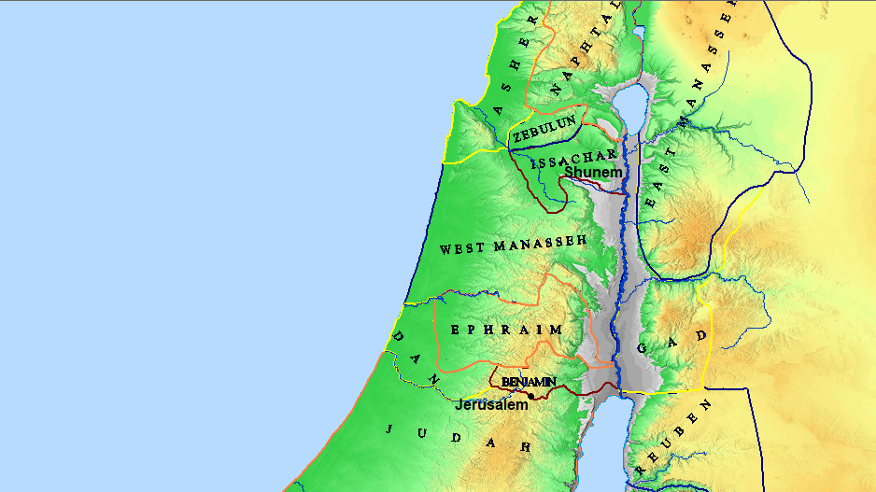
Where was the Shulamite woman from?
Likely Shunem
A city in the land of Issachar
About 50 miles north of Jerusalem

