Slide 1
Sermon
“The Difference between Christians and Churches”
Jeff Smelser

Slide 2
The Character of God’s People
Loving (John 13:35)
Compassionate Good Samaritan (Luke 10)
Care for widows & orphans (James 1:27)
Do Good (Galatians 6:10)
Serving Christians Household of Stephanus (1 Cor 16:15)
Hospitable Widows (1 Tim 5:10), All (Heb 13:2)
Hardworking Ephesians 4:28, 2 Thess 3:10
Have Fun? “games” 1 Corinthians 9
Appreciate Nature? Lilies & birds Mt 6

Slide 3
The Character of God’s People
Loving (John 13:35)
Compassionate Good Samaritan (Luke 10)
Care for widows & orphans (James 1:27)
Do Good (Galatians 6:10)
Serving Christians Household of Stephanus (1 Cor 16:15)
Hospitable Widows (1 Tim 5:10), All (Heb 13:2)
Hardworking Ephesians 4:28, 2 Thess 3:10
“if he has a hundred sheep”
Have Fun? “games” 1 Corinthians 9
Appreciate Nature? Lilies & birds Mt 6

Slide 6
Olive Festival!!

Slide 7
Ephesus Church Olive Festival!!

Slide 9
EphesusChurch Regatta!!

Slide 10
Ephesus
Church
Sailing
Team
WOULD YOU BE SURPRISED?

Slide 11
Ephesus
Church
Sailing
Team
WHY?

Slide 12
Is there a difference between
Christians doing something
and
a Church doing something as a Church Activity?
The Lord sees a difference

Slide 13
The Lord sees a difference
Matthew 18:15ff
“go and show him his fault, between you and him alone”
Is a Christian acting?
Is the church acting?
“take one or two more with you”
Is a group of Christians acting?
Is the church acting?
“tell it to the church…if he refuses to listen even to the church”
Now the church is acting!

Slide 14
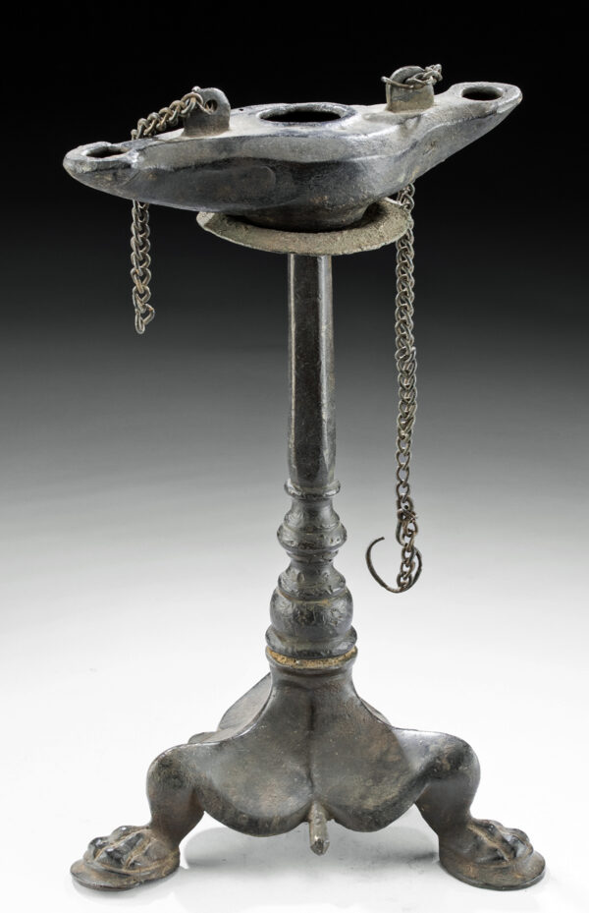
The Lord sees a church as a collective entity
“an entity with an identity”
Revelation 1:20
…the seven lampstands are the seven churches.

Slide 15
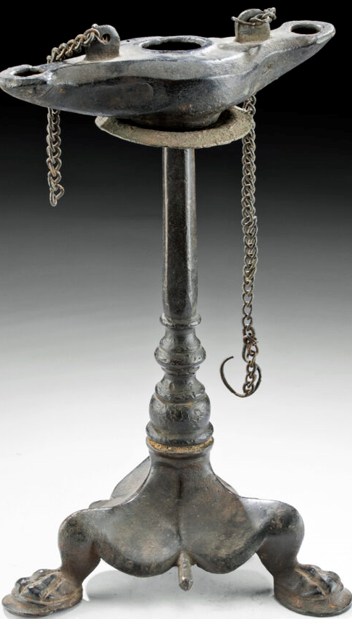
Revelation 1:20
…the seven lampstands are the seven churches.

Slide 16
Revelation 2:5
I am coming to you and will remove your lampstand out of its place, unless you repent

Slide 17
Revelation 3:1
“you are dead”

Slide 18
Revelation 3:4
But you have a few people in Sardis who have not soiled their garments; and they will walk with Me in white, for they are worthy.

Slide 19
This is not a foreign concept to us

Slide 20
So what do churches do?
Colossians 3:17
¹⁷ And whatever you do in word or deed, do all in the name of the Lord Jesus, giving thanks to God the Father through Him.

Slide 21
So what do churches do?
SOME EXAMPLES…
Acts 6:1-6 Appointed 7 men over business of taking care of widows
Acts 13:3 Sent Paul and Barnabas to preach
Acts 14:27 Heard Paul and Barnabas report on their work
Acts 15:22 Sent Paul, Barnabas, & others to clarify God’s word
1 Cor 5:4-5 “Deliver someone to Satan”
1 Cor 11 Come together to eat the Lord’s Supper (Acts 20:7)
1 Cor 14 Come together to edify by praying, singing, teaching…
1 Cor 16 Collected and Sent funds to needy saints
Phil 4:15f Sent funds to Paul
Rev 2:2 Evaluated those who profess to teach truth

Slide 23
The Church at Sardis had an identity: “Dead”
The Church at Laodicea had an identity: “Lukewarm”
The Church at Exton has an identity
Let’s not let part of that identity be: “Does It’s Own Thing”
Let’s make God’s mission for churches our mission

