Slide 1
Christians and Drinking
Sunday
July 2, 2023

Slide 2
Alcohol in the headlines
Alcohol Might Improve Heart Health by Reducing Your Stress
Yes, it's true: Wine is good for you — to a point
Even a Little Alcohol Can Harm Your Health
No, moderate drinking isn't good for your health
Red wine is good for you - as long as you drink as many different varieties as possible
A glass of wine or beer per day is fine for your health: new study
No amount of alcohol is healthy, Heart Foundation warns
Drinking alcohol weekly could be connected to 61 different diseases, study finds

Slide 3
Alcohol in the headlines
'Moderate' Drinking May Not Shorten Life Spans
Light alcohol consumption won't save us from obesity and diabetes
Small amounts of alcohol may turn down stress in the brain, benefiting the heart, new study finds
Research dispute claims that light alcohol consumption can protect against diabetes and obesity

Slide 4
Alcohol in the headlines
https://slate.com/technology/2023/04/alcohol-wine-drinking-healthy-dangerous-study.html

Slide 5
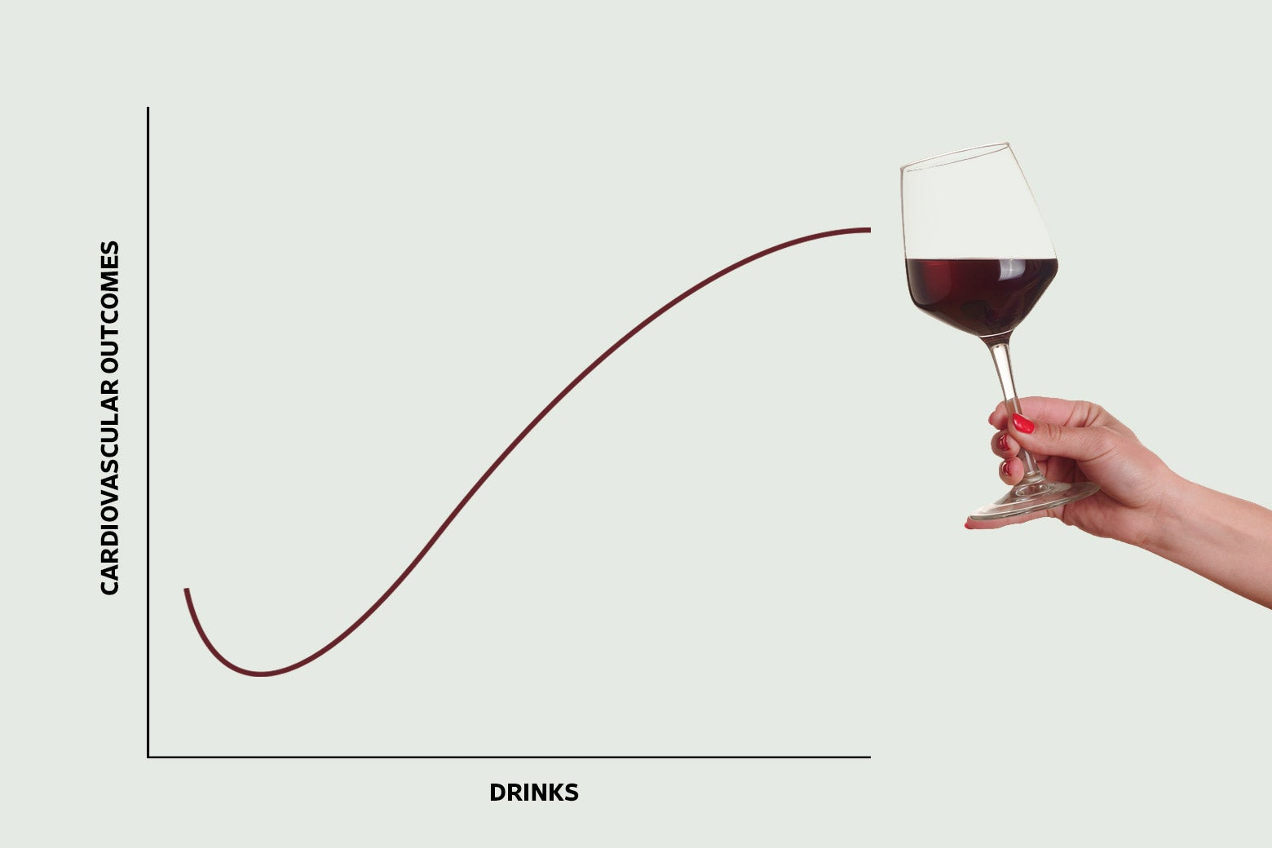
Alcohol in the headlines
WORSE
ABSTINENCE
MODERATION
MORE

Slide 6
Alcohol in the headlines
WORSE
MORE

Slide 7
Alcohol in the headlines
But that’s not the issue

Slide 8
Alcohol in the headlines
If that were the issue,
1 Timothy 5:23 would settle it
No longer drink water only, but use a little wine for the sake of your stomach and your frequent ailments.

Slide 9
But that’s not the Issue
A wife distraught due to husband’s drinking
A husband distraught due to wife’s drinking
Bad decisions concerning driving
Bad behavior in disagreements
Bad decisions concerning sexual conduct

Slide 10
The Bible: A Mixed Message?
John 2:3
And when the wine ran out, the mother of Jesus said to Him, “They have no wine.”
Romans 13:13
Let us walk properly as in the day, not in carousing and drunkenness, not in sexual promiscuity and sensuality, not in strife and jealousy.
Popular solution:
“It’s alright to drink, just don’t get drunk”
That’s Not the Whole Story

Slide 11
Wine in the Bible was Typically Heavily Diluted

Slide 12
Wine in the Bible was Typically Heavily Diluted
International Standard Bible Encyclopedia
At a later period, however, the Gr use of diluted wines had attained such sway that the writer of 2 Macc speaks (15 39) of undiluted wine as "distasteful" (polémion). This dilution is so normal in the following centuries that the Mish can take it for granted and, indeed, R. Eliezer even forbade saying the table-blessing over undiluted wine (B^{e}rākhōth 7 5). The proportion of water was large, only one-third or one-fourth of the total mixture being wine (Niddāh 2 7; P^{e}ṣāḥīm 108b).

Slide 13
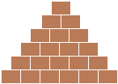
Wine in the Bible was Typically Heavily Diluted
Non-scripture writings
International Standard Bible Encyclopedia
At a later period, however, the Gr use of diluted wines had attained such sway that the writer of 2 Macc speaks (15 39) of undiluted wine as "distasteful" (polémion). This dilution is so normal in the following centuries that the Mish can take it for granted and, indeed, R. Eliezer even forbade saying the table-blessing over undiluted wine (B^{e}rākhōth 7 5). The proportion of water was large, only one-third or one-fourth of the total mixture being wine (Niddāh 2 7; P^{e}ṣāḥīm 108b).

Slide 14
Wine in the Bible was Typically Heavily Diluted
2 Maccabees 15:37-39
³⁷ …So I too will here end my story. ³⁸ If it is well told and to the point, that is what I myself desired; if it is poorly done and mediocre, that was the best I could do.
³⁹ For just as it is harmful to drink wine alone, or, again, to drink water alone, while wine mixed with water is sweet and delicious and enhances one’s enjoyment, so also the style of the story delights the ears of those who read the work. And here will be the end.

Slide 15
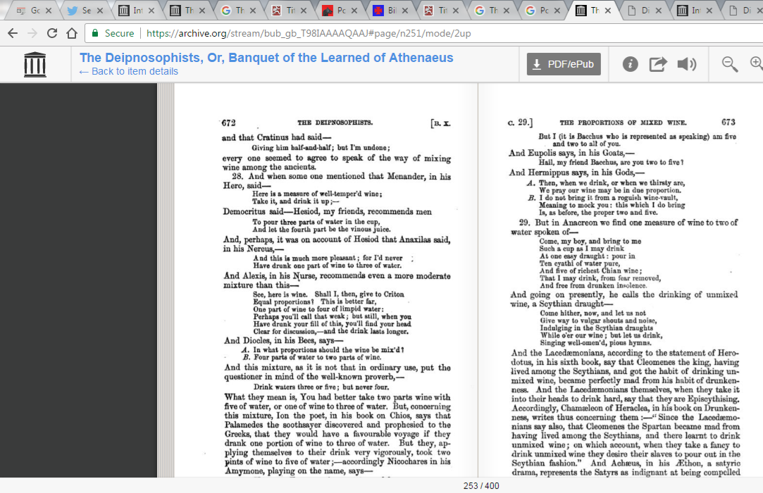
Wine to Water Proportions
3 water : 1 wine

Slide 16
Wine to Water Proportions
4 water : 1 wine

Slide 17
Wine to Water Proportions
4 water : 2 wine

Slide 18
Wine to Water Proportions
5 water : 2 wine
or
3 water : 1 wine

Slide 19
Wine to Water Proportions
5 water : 2 wine

Slide 20
Wine to Water Proportions
2 water : 1 wine

Slide 21
Wine to Water Proportions
2 water : 1 wine
If you want to rely on the fact that Christians in the 1st Century drank wine, note that it was heavily diluted wine

Slide 22
Even Diluted, Caution Among Christians
Titus 2
³ Older women likewise are to be reverent in their behavior, not malicious gossips nor enslaved to much wine, teaching what is good
1 Timothy 3
⁸ Deacons likewise must be men of dignity, not double-tongued, or addicted to much wine

Slide 23
Even Diluted, Caution Among Christians
1 Timothy 3
² An overseer, then, must be above reproach, the husband of one wife, temperate, prudent, respectable, hospitable, able to teach,
³ not addicted to wine
Pert. to being very moderate in the drinking of an alcoholic beverage, temperate, sober

Slide 24
Even Diluted, Caution Among Christians
1 Timothy 3
¹¹ Women must likewise be dignified, not malicious gossips, but temperate, faithful in all things.
Pert. to being very moderate in the drinking of an alcoholic beverage, temperate, sober

Slide 25
Even Diluted, Caution Among Christians
Titus 2
² Older men are to be temperate, dignified, sensible, sound in faith, in love, in perseverance.
Pert. to being very moderate in the drinking of an alcoholic beverage, temperate, sober

Slide 26
Even Diluted, Some Christians Abstained
Romans 14
²¹ It is good not to eat meat or to drink wine, or to do anything by which your brother stumbles.

Slide 27
Even Diluted, Some Christians Abstained
1 Timothy 5
²³ No longer drink water exclusively, but use a little wine for the sake of your stomach and your frequent ailments.

Slide 28
Even Diluted, Some Christians Abstained
Popular solution:
“It’s alright to drink, just don’t get drunk”

Slide 29
Even Diluted, Some Christians Abstained
“It’s alright to drink heavily diluted wine if you’re very cautious, and don’t get drunk”

Slide 30
Why Drink?
Coping Mechanism
Proverbs 31:1-7
⁶ Give strong drink to him who is perishing, And wine to those whose soul is bitter. ⁷ Let him drink and forget his poverty And he will not remember his trouble any longer.

Slide 31
Why Drink?
Coping Mechanism
Proverbs 31:1-7
⁶ Give strong drink to him who is perishing, And wine to those whose soul is bitter. ⁷ Let him drink and forget his poverty And he will not remember his trouble any longer.

Slide 32
Why Drink?
Coping Mechanism
Proverbs 31:1-7
“Perish”
Prov 1:32 complacency of fools will destroy them
Prov 10:28 But the hope of the wicked will perish
Prov 11:7 When a wicked man dies, his hope will perish
Prov 11:10 And when the wicked perish, there is joyful shouting.
Prov 19:9 And he who breathes out lies will perish
Prov 21:28 A false witness will perish
Prov 28:28 But when [the wicked] perish, the righteous increase
Prov 29:3 But he who befriends harlots destroys his wealth

Slide 33
Why Drink?
Coping Mechanism
Proverbs 31:1-7
“Poverty” USED ONLY IN PROVERBS!
Prov 6:11 Your poverty will come in like a vagabond
Prov 10:15 The ruin of the poor is their poverty
Prov 13:18 Poverty and disgrace come to him who neglects discipline
Prov 24:34 Then your poverty will come as a robber
Prov 28:19 he who pursues empty things will be satisfied with poverty
Prov 30:8 Keep worthlessness and every false word far from me,
Give me neither poverty nor riches

Slide 34
Why Drink?
Coping Mechanism
Proverbs 31:1-7
⁶ Give strong drink to him who is perishing, And wine to those whose soul is bitter. ⁷ Let him drink and forget his poverty And he will not remember his trouble any longer.

Slide 35
Why Drink?
Coping Mechanism
Escape in Alcohol is not how God’s People Cope

Slide 36
Why Drink?
Entertainment
Ephesians 4:18-19
And do not get drunk with wine, for that is dissipation, but be filled with the Spirit, speaking to one another in psalms and hymns and spiritual songs, singing and making melody with your heart to the Lord
1 Peter 4 ³ For the time already past is sufficient for you to have worked out the desire of the Gentiles, having pursued a course of sensuality, lusts, drunkenness, carousing, drinking parties, and abominable idolatries.

Slide 37
Why Drink?
Entertainment
Alcohol is not how God’s People Seek Entertainment

Slide 38
Big Picture Perspective
2 Timothy 4 ⁷ I have fought the good fight, I have finished the course, I have kept the faith.

Slide 39
Big Picture Perspective
2 Timothy 4 ⁷ I have fought the good fight, I have finished the course, I have kept the faith.
Let’s ask ourselves, “Will I be able to say that?”
What does that mean?

Slide 40
Big Picture Perspective
2 Timothy 4 ⁷ I have fought the good fight, I have finished the course, I have kept the faith.
1 Peter 2 ¹¹ Beloved, I urge you as sojourners and exiles to abstain from fleshly lusts which wage war against the soul
Does drinking help you resist fleshly lusts which wage war against the soul?
Does it improve your self control?

Slide 41
Big Picture Perspective
2 Timothy 4 ⁷ I have fought the good fight, I have finished the course, I have kept the faith.
1 Peter 2 ¹¹ Beloved, I urge you as sojourners and exiles to abstain from fleshly lusts which wage war against the soul
Galatians 5 ¹⁶ But I say, walk by the Spirit and you will not carry out the desire of the flesh.¹⁷ For the flesh sets its desire against the Spirit, and the Spirit against the flesh; for these are in opposition to one another…
Does drinking help you walk by the Spirit rather than obeying the desire of the flesh?

Slide 42
Big Picture Perspective
2 Timothy 4 ⁷ I have fought the good fight, I have finished the course, I have kept the faith.
1 Peter 2 ¹¹ Beloved, I urge you as sojourners and exiles to abstain from fleshly lusts which wage war against the soul
Galatians 5 ¹⁶ But I say, walk by the Spirit and you will not carry out the desire of the flesh.¹⁷ For the flesh sets its desire against the Spirit, and the Spirit against the flesh; for these are in opposition to one another… ¹⁹ Now the deeds of the flesh are evident, which are: sexual immorality, impurity, sensuality, ²⁰ idolatry, sorcery, enmities, strife, jealousy, outbursts of anger, selfish ambition, dissensions, factions, ²¹ envying, drunkenness, carousing, and things like these
Does drinking reduce the likelihood of these behaviors?

Slide 43
Big Picture Perspective
2 Timothy 4 ⁷ I have fought the good fight, I have finished the course, I have kept the faith.
1 Peter 2 ¹¹ Beloved, I urge you as sojourners and exiles to abstain from fleshly lusts which wage war against the soul
Galatians 5 ¹⁶ But I say, walk by the Spirit and you will not carry out the desire of the flesh.¹⁷ For the flesh sets its desire against the Spirit, and the Spirit against the flesh; for these are in opposition to one another…
2 Corinthians 10 ⁴ for the weapons of our warfare are not of the flesh, but divinely powerful for the tearing down of strongholds, ⁵ as we tear down speculations and every lofty thing raised up against the knowledge of God, and take every thought captive to the obedience of Christ
Does drinking assist in bringing every thought captive to the obedience of Christ?

Slide 44
Big Picture Perspective
2 Timothy 4 ⁷ I have fought the good fight, I have finished the course, I have kept the faith.

