Slide 1
Sermon
“The Text of the OLD TESTAMENT”
Jeff Smelser

Slide 2
The Text of the Old Testament
FIRST: Review of The Text of the NEW Testament

Slide 3
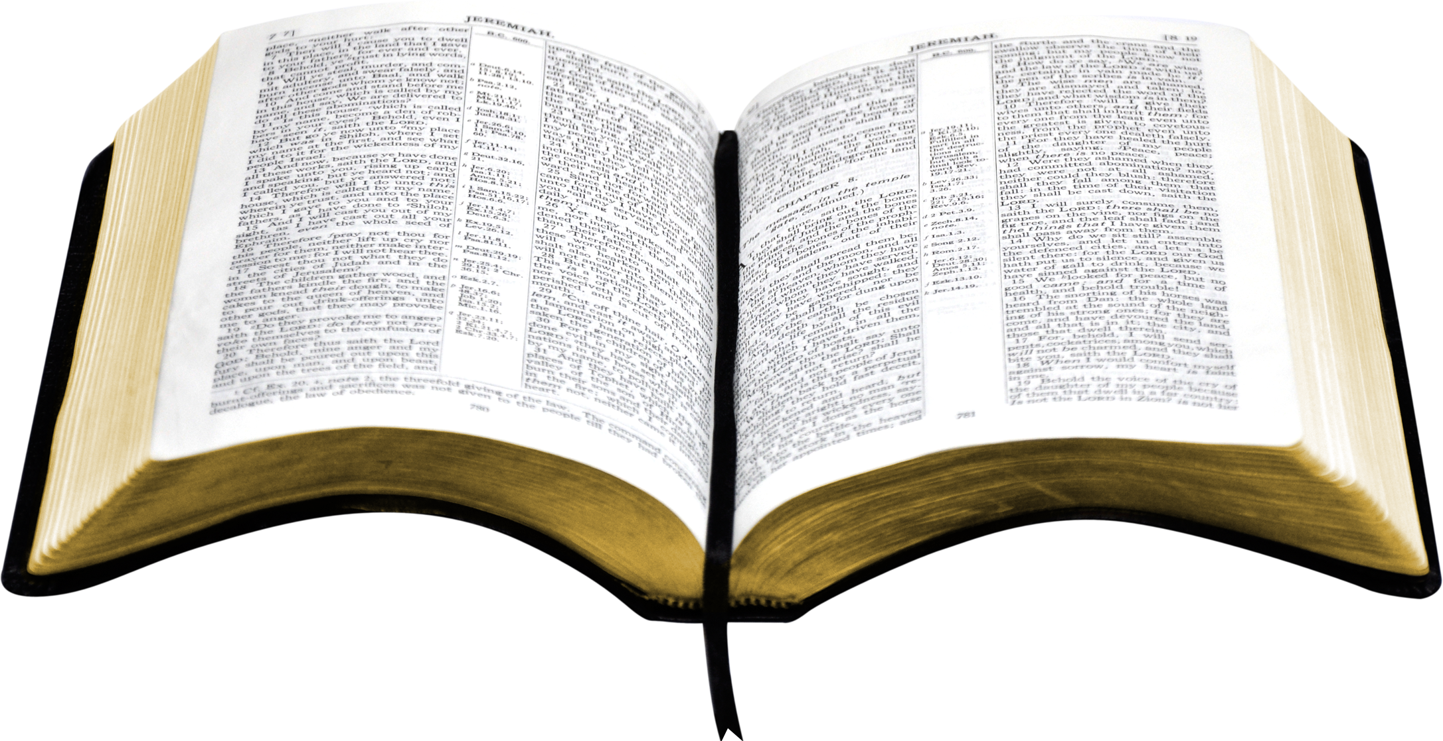
Basis of NAS, ESV, etc.
Basis of KJV
HOW MUCH CHANGE?
NAS, ESV, etc.
KJV
CENTURY

Slide 4
Old Testament
completed
We’ll do this in three pieces
HOW MUCH CHANGE?

Slide 5
Old Testament
completed
We’ll do this in three pieces
A.D. 500
Last 1500 years

Slide 6
Old Testament
completed
We’ll do this in three pieces
A.D. 500
→100 BC
100 BC – AD 500
Last 1500 years

Slide 7
Old Testament
completed
We’ll do this in three pieces
A.D. 500
Last 1500 years

Slide 8
Old Testament
completed
Masoretes Carefully Preserved the Scriptures
A.D. 500
A.D. 1100
Masoretes
Last 1500 years

Slide 9
Old Testament
completed
Masoretes Carefully Preserved the Scriptures
A.D. 500
A.D. 1100
Masoretes

Slide 10
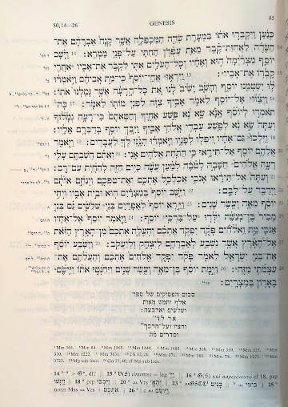
Old Testament
completed
Masoretes Carefully Preserved the S
Masoretes

Slide 11
Old Testament
completed
Masoretes Carefully Preserved the scriptures
the number of verses of the book
one thousand and five hundred
and thirty-four
1,534
and its midpoint Genesis 27:40
and paragraphs 605
Masoretes

Slide 12
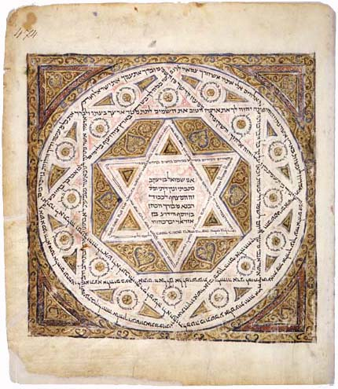
Old Testament
completed
Masoretes Carefully Preserved the Scriptures
“the oldest dated manuscript of the complete Hebrew Bible”
Leningrad Codex
A.D. 500
A.D. 1100
A.D. 1009
Masoretes

Slide 13
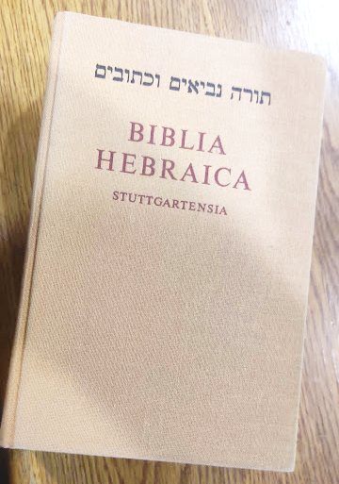
Old Testament
completed
Masoretes Carefully Preserved the Scriptures
Leningrad Codex
A.D. 500
A.D. 1100
A.D. 1009
Masoretes

Slide 14
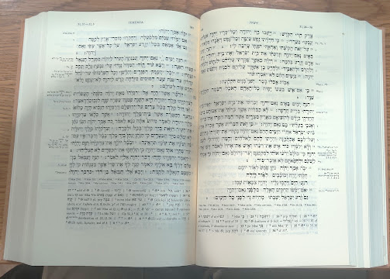
Old Testament
completed
Masoretes Carefully Preserved the Scriptures
Leningrad Codex
A.D. 500
A.D. 1100
A.D. 1009
Masoretes

Slide 15
Old Testament
completed
Masoretes Carefully Preserved the Scriptures
Leningrad Codex
A.D. 500
A.D. 1100
A.D. 1009
[ ??? ]
[ Essentially No Change ]
Masoretes

Slide 16
Old Testament
completed
A.D. 500
[ ??? ]
[ Essentially No Change ]
100 BC – AD 500
Last 1500 years

Slide 17
Old Testament
completed
Quotations, Ancient Translations, Dead Sea Scrolls, attest to the text in ancient times
A.D. 500
[ ??? ]

Slide 18
Old Testament
completed
Quotations, Ancient Translations, Dead Sea Scrolls attest to the text in ancient times
Discovered in 11 caves
A.D. 500
[ ??? ]

Slide 19
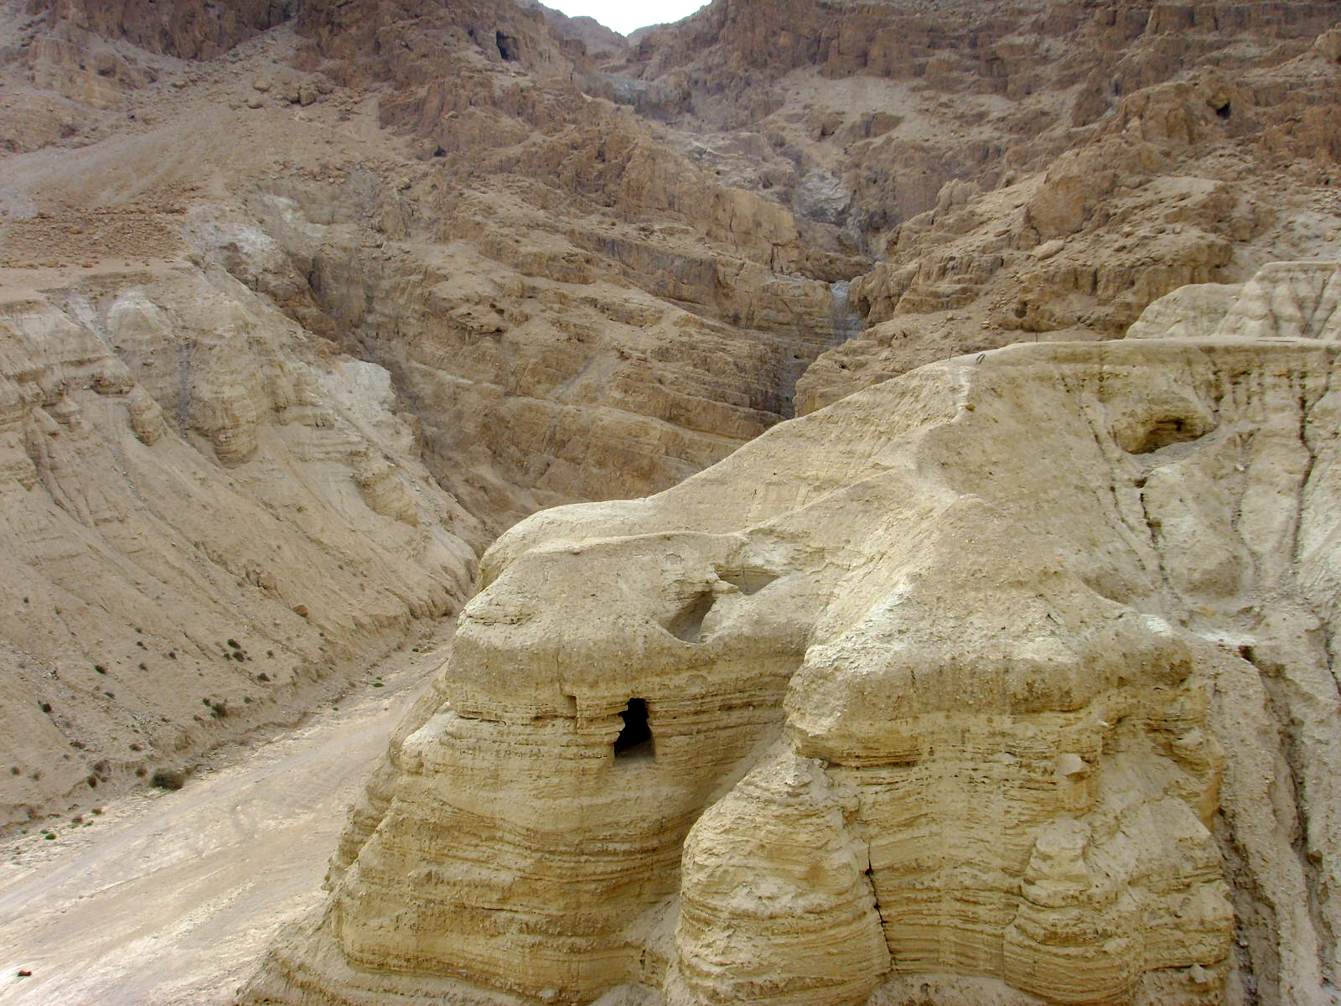
Old Testament
completed
Dead Sea Scrolls
Book(s) | # of mss |  | Book(s) | # of mss
Genesis | 24 |  | Job | 6
Exodus | 18 |  | Psalms | 39
Leviticus | 17 |  | Ecclesiastes | 2
Numbers | 11 |  | Song of Solomon | 4
Deuteronomy | 33 |  | Isaiah | 22
Joshua | 2 |  | Jeremiah | 6
Judges | 4 |  | Lamentations | 4
Ruth | 4 |  | Ezekiel | 6
Samuel | 4 |  | Daniel | 8
Kings | 4 |  | Minor Prophets | 10
Discovered in 11 caves from 1946 - 1956
981 different manuscripts
40% are Hebrew Scriptures
Every OT book other than Esther and Nehemiah
A.D. 500
[ ??? ]

Slide 20
Old Testament
completed
Dead Sea Scrolls
Discovered in 11 caves from 1946 - 1956
981 different manuscripts
40% are Hebrew Scriptures
Every OT book other than Esther and Nehemiah
Date from 200 B.C. – 70 A.D.
A.D. 500
[ ??? ]

Slide 21
Old Testament
completed
Dead Sea Scrolls
Discovered in 11 caves from 1946 - 1956
981 different manuscripts
40% are Hebrew Scriptures
Every OT book other than Esther and Nehemiah
Date from 200 B.C. – 70 A.D.
A.D. 500
The Masoretic manuscripts among the Dead Sea Scrolls are astonishingly similar to the standard Hebrew texts 1,000 years later, proving that Jewish scribes were accurate in preserving and transmitting the Masoretic Scriptures.
https://news.nd.edu/news/dead-sea-scrolls-yield-major-questions-in-old-testament-understanding/#:~:text=The%20Masoretic%20manuscripts%20among%20the,and%20transmitting%20the%20Masoretic%20Scriptures.
[ ??? ]

Slide 22
Old Testament
completed
Dead Sea Scrolls
Discovered in 11 caves from 1946 - 1956
981 different manuscripts
40% are Hebrew Scriptures
Every OT book other than Esther and Nehemiah
Date from 200 B.C. – 70 A.D.
A.D. 500
While the Masoretic text and the Dead Sea Scrolls were transcribed a thousand years apart, they are amazingly similar proving that the copying methods employed by the Jewish scribes over the centuries were very sophisticated and successful.
https://www.ancient-hebrew.org/dss/great-isaiah-scroll-and-the-masoretic-text.htm
[ ??? ]

Slide 23
Old Testament
completed
Dead Sea Scrolls
Discovered in 11 caves from 1946 - 1956
981 different manuscripts
40% are Hebrew Scriptures
Every OT book other than Esther and Nehemiah
Date from 200 B.C. – 70 A.D.
The discovery of the Dead Sea Scrolls allowed scholars to see how much the biblical text had changed in over 1000 years of transmission. They discovered that very little had changed and that the Hebrew Bible had been transmitted with incredible accuracy over a millennium.
https://biblearchaeologyreport.com/2019/02/06/the-three-oldest-biblical-texts/
A.D. 500
[ ??? ]

Slide 24
A
B
G
D
H
א
ב
ג
ד
ה
Old Testament
completed
Ps 145
¹ I will exalt You, my God, the King, And I will bless Your name forever and ever. ² Every day I will bless You, And I will praise Your name forever and ever. ³ Great is the Lord, and highly to be praised; And His greatness is unsearchable. ⁴ One generation will praise Your works to another, And will declare Your mighty acts. ⁵ On the glorious splendor of Your majesty And on Your wonderful works, I will meditate.
A.D. 500
[ Little Change ]
[ Essentially No Change ]
100 BC – AD 500
Last 1500 years

Slide 25
L
M
N
S
ל
מ
נ
ס
Old Testament
completed
Ps 145
¹² To make known to the sons of mankind Your mighty acts, And the glory of the majesty of Your kingdom. ¹³ Your kingdom is an everlasting kingdom, And Your dominion endures throughout all generations. The Lord is faithful in His words, And holy in all His works.
¹⁴ The Lord supports all who fall, And raises up all who are bowed down.
A.D. 500
[ Little Change ]
[ Essentially No Change ]
100 BC – AD 500
Last 1500 years

Slide 26
L
M
N
S
ל
מ
נ
ס
Old Testament
completed
Ps 145
¹² To make known to the sons of mankind Your mighty acts, And the glory of the majesty of Your kingdom. ¹³ Your kingdom is an everlasting kingdom, And Your dominion endures throughout all generations. The Lord is faithful in His words, And holy in all His works.
¹⁴ The Lord supports all who fall, And raises up all who are bowed down.
A.D. 500
[ Little Change ]
[ Essentially No Change ]
100 BC – AD 500
Last 1500 years

Slide 27
L
M
N
S
ל
מ
נ
ס
Old Testament
completed
Ps 145
¹² To make known to the sons of mankind Your mighty acts, And the glory of the majesty of Your kingdom. ¹³ Your kingdom is an everlasting kingdom, And Your dominion endures throughout all generations. The Lord is faithful in His words, And holy in all His works.
¹⁴ The Lord supports all who fall, And raises up all who are bowed down.
A.D. 500
[ Little Change ]
[ Essentially No Change ]
100 BC – AD 500
Last 1500 years

Slide 28
L
M
N
S
ל
מ
נ
ס
Old Testament
completed
Ps 145
¹² To make known to the sons of mankind Your mighty acts, And the glory of the majesty of Your kingdom. ¹³ Your kingdom is an everlasting kingdom, And Your dominion endures throughout all generations. The Lord is faithful in His words, And holy in all His works.
¹⁴ The Lord supports all who fall, And raises up all who are bowed down.
A.D. 500
[ Little Change ]
[ Essentially No Change ]
100 BC – AD 500
Last 1500 years

Slide 29
L
M
N
S
ל
מ
נ
ס
Old Testament
completed
Ps 145
¹² To make known to the sons of mankind Your mighty acts, And the glory of the majesty of Your kingdom. ¹³ Your kingdom is an everlasting kingdom, And Your dominion endures throughout all generations. The Lord is faithful in His words, And holy in all His works.
¹⁴ The Lord supports all who fall, And raises up all who are bowed down.
Based on Dead Sea Scroll, LXX, Syriac
A.D. 500
[ Little Change ]
[ Essentially No Change ]
100 BC – AD 500
Last 1500 years

Slide 30
“In the beginning God created the heavens and the earth. And the earth was formless and void; and darkness was upon the face of the deep; And the spirit of God moved upon the face of the waters...”

Slide 31
Old Testament
completed
A.D. 500
[ Little Change ]
[ Essentially No Change ]
→100 BC
100 BC – AD 500
Last 1500 years

Slide 32
Deuteronomy 31
⁹ So Moses wrote this Law and gave it to the priests, the sons of Levi who carried the ark of the covenant of the Lord, and to all the elders of Israel. ¹⁰ Then Moses commanded them, saying, “At the end of every seven years, at the time of the year of the release of debts, at the Feast of Booths, ¹¹ when all Israel comes to appear before the Lord your God at the place which He will choose, you shall read this Law before all Israel so that they hear it.
Old Testament
completed
1400 years
→100 BC

Slide 33
Deuteronomy 31
¹² Assemble the people, the men, the women, the children, and the stranger who is in your town, so that they may hear and learn and fear the Lord your God, and be careful to follow all the words of this Law. ¹³ And their children, who have not known, will hear and learn to fear the Lord your God, as long as you live on the land which you are about to cross the Jordan to possess.”
Old Testament
completed
→100 BC

Slide 34
Deuteronomy 31
²⁴ It came about, when Moses finished writing the words of this Law in a book until they were complete, ²⁵ that Moses commanded the Levites who carried the ark of the covenant of the Lord, saying, ²⁶ “Take this Book of the Law and place it beside the ark of the covenant of the Lord your God, so that it may remain there as a witness against you.
Old Testament
completed
→100 BC

Slide 35
2 Kings 22
⁸ Then Hilkiah the high priest said to Shaphan the scribe, “I have found the Book of the Law in the house of the Lord.”
Old Testament
completed
→100 BC

Slide 36
Old Testament
completed
Jesus and NT writers believed they had the scriptures
→100 BC

Slide 37
Old Testament
completed
Jesus and NT writers believed they had the scriptures
Luke 24
²⁷ Then beginning with Moses and with all the Prophets, He explained to them the things written about Himself in all the Scriptures.
³² They said to one another, “Were our hearts not burning within us when He was speaking to us on the road, while He was explaining the Scriptures to us?”
⁴⁴ Now He said to them, “These are My words which I spoke to you while I was still with you, that all the things that are written about Me in the Law of Moses and the Prophets and the Psalms must be fulfilled.”
There was a recognized collection known as “the scriptures”
3 major sections

Slide 38
Old Testament
completed
Jesus and NT writers believed they had the scriptures
THE LAW
Luke 24:44
the Law of Moses
and the Prophets
and the Psalms
3 major sections

Slide 39
Old Testament
completed
Jesus and NT writers believed they had the scriptures
THE PROPHETS
Luke 24:44
THE PROPHETS
the Law of Moses
and the Prophets
and the Psalms
HOW MUCH CHANGE?
3 major sections

Slide 40
Old Testament
completed
Jesus and NT writers believed they had the scriptures
Luke 24:44
THE PSALMS
the Law of Moses
and the Prophets
and the Psalms
HOW MUCH CHANGE?
3 major sections

Slide 41
Old Testament
completed
We did this in three pieces
HOW MUCH CHANGE?

Slide 42
Old Testament
completed
Masoretes Carefully Preserved the Scriptures
A.D. 500
Last 1500 years

Slide 43
Old Testament
completed
Masoretes Carefully Preserved the Scriptures
Quotations, Ancient Translations, Dead Sea Scrolls, attest to the text in ancient times
A.D. 500
100 BC – AD 500
Last 1500 years

Slide 44
Old Testament
completed
Masoretes Carefully Preserved the Scriptures
Dead Sea Scrolls attest to the text in ancient times
A.D. 500
100 BC – AD 500
Last 1500 years

Slide 45
Old Testament
completed
Masoretes Carefully Preserved the scriptures
Dead Sea Scrolls attest to the text in ancient times
Jesus and NT writers believed they had the Scriptures
A.D. 500
→100 BC
100 BC – AD 500
Last 1500 years

Slide 46
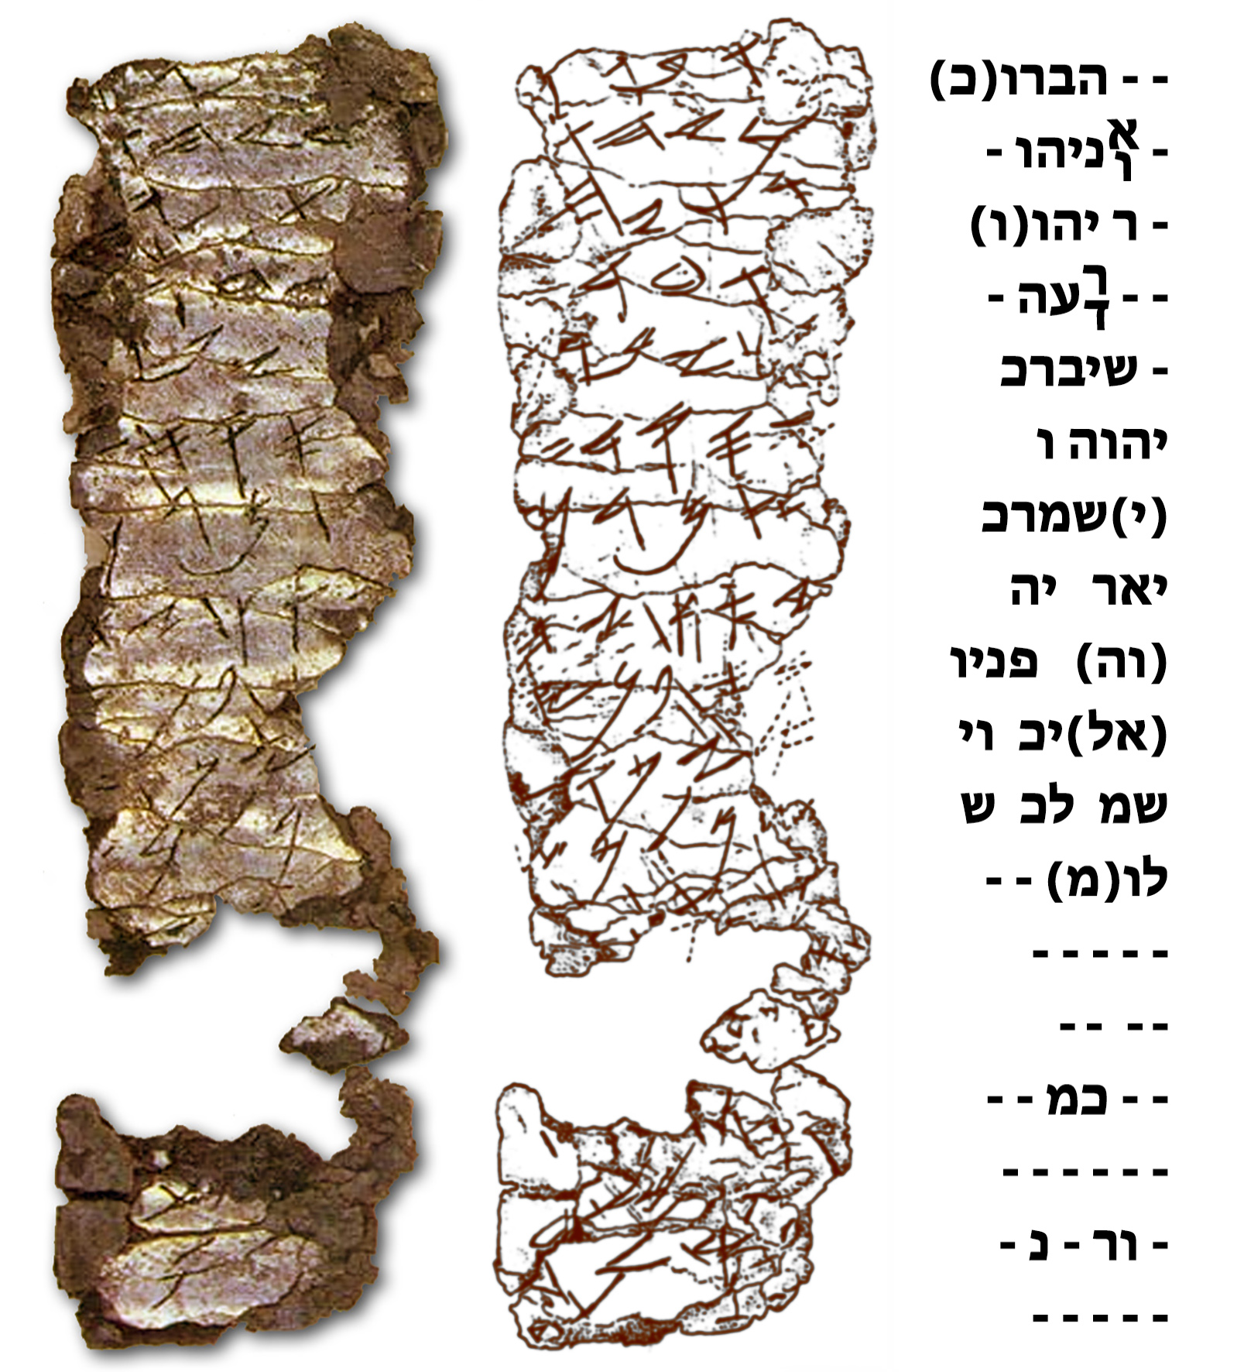
Hinnom Scrolls
Rolled-up pieces of silver discovered in 1979-80
7th century B.C.
Josiah’s century
Numbers 6 ²⁴ The Lord bless you, and keep you;
²⁵ The Lord cause His face to shine on you, And be gracious to you;
²⁶ The Lord lift up His face to you, And give you peace.

Slide 47
Proverbs 31¹⁰ An excellent wife, who can find…?
Ruth 3¹¹ …all my people in the city know that you are a woman of excellence.

