Slide 1
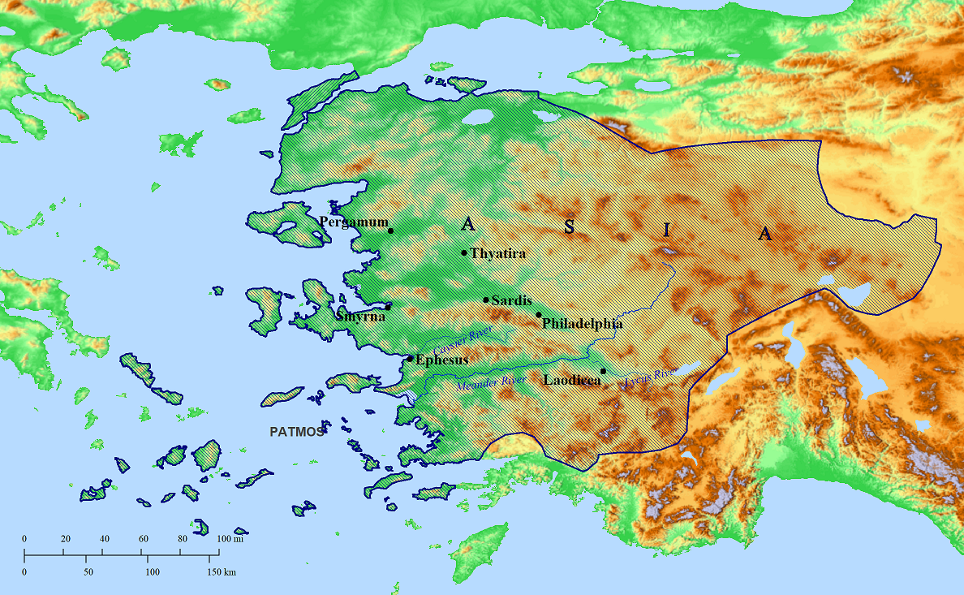
Introduction to Revelation

Slide 2
In Revelation 1:1-3, what two phrases indicate the time frame of the events described in this book?
According to Revelation 1:4, to whom is John writing?
According to Revelation 1:4-5, from whom is John’s message? He says, “Grace to you and peace from…”
…from ___________________________
…and from ________________________
…and from ________________________
Who had told John to write to the seven churches? See verses 10-11. (You may need to read all the way down to verse 18 to be sure of the answer.)
Notice the use of “seven” in this context. Does it appear to be a “counting number” literally referring to seven of something, or is it a symbolic number?

Slide 3
Jesus was standing in the midst of what?
He explained those as being what? (1:20)
What did Jesus have in his right hand?
He explained those as being what? (1:20)

Slide 4
According to Revelation 1:9, John shared in what three things with those to whom he was writing?
______________________
______________________
______________________
Notice John’s statement about why he was on the island called Patmos: “for the word of God and the testimony of Jesus.” Compare that with the similar phrase in Revelation 6:9. Does John’s presence on Patmos have anything to do with one of the three things in your answer to question 9?
John says he is a “fellow participant” (“partaker,” “partner,” “companion”) in this with those to whom he is writing. In chapter 2, find things that show how his readers were participants in this.

Slide 5
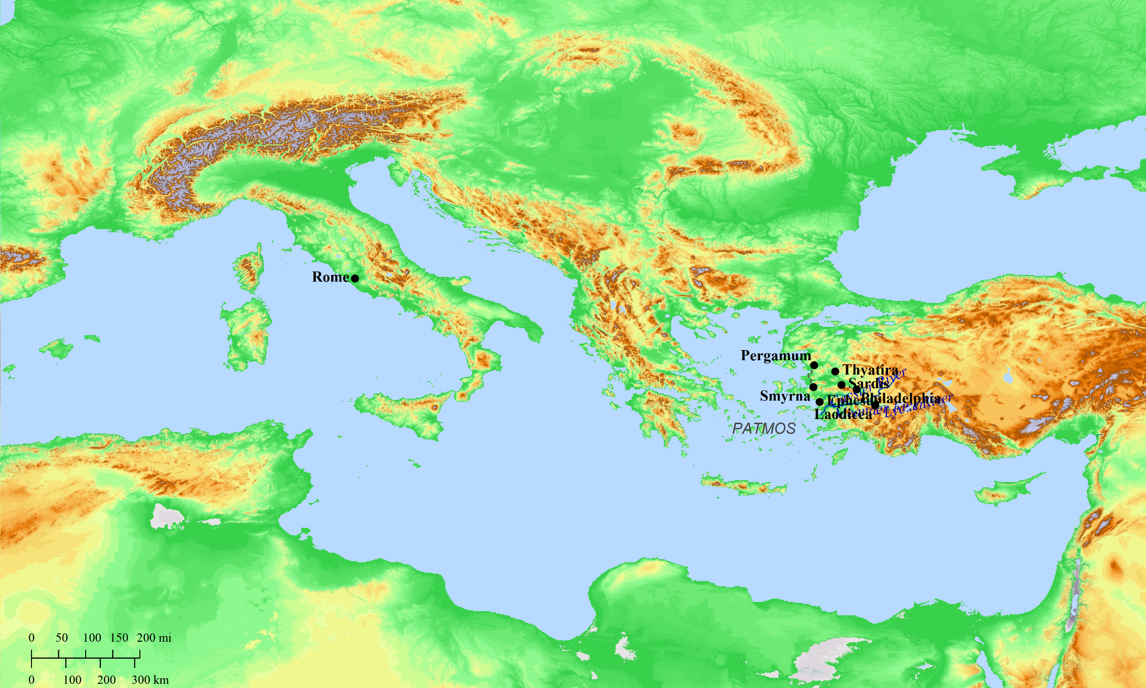
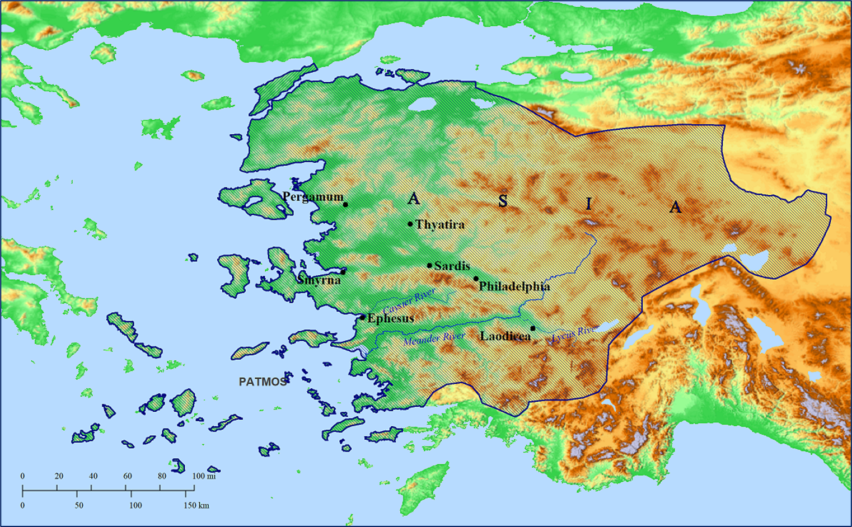

Slide 6
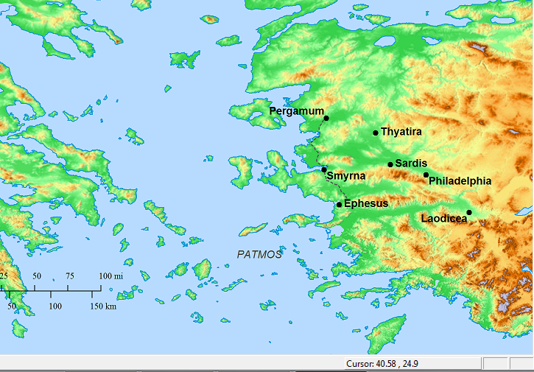

Slide 7
37 cities designated Neokoros, having a temple for the deification of one emperor or another
31 in “Asia Minor”
over 3 centuries
Neokoroi, Greek Cities and Roman Emperors
by Barbara Burrell

Slide 8
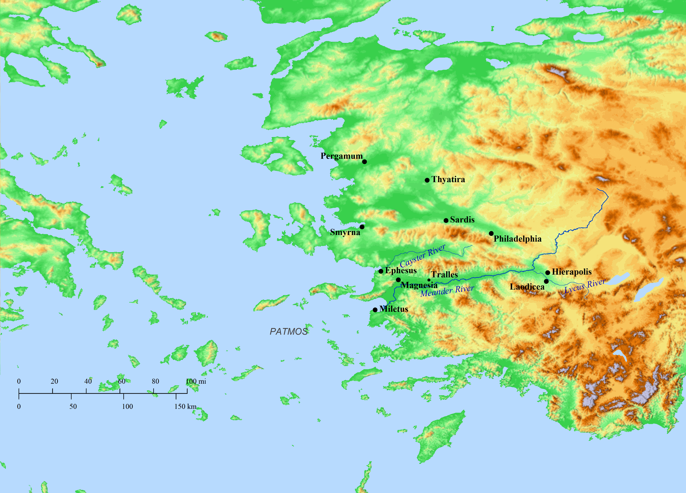
14 of them were in Asia
Kyzikos
Antandros
Aizanoi
Synnada

Slide 9
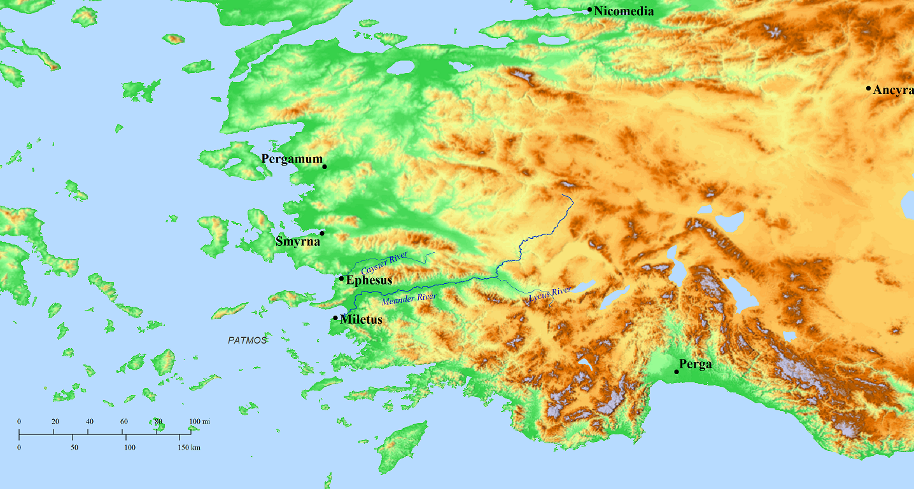
Only 7 existed in the 1st Century
Of those 7, 4 were in Asia
They were
Ephesus
Smyrna
Pergamum
Miletus
the others were Nikomedia in Bythinia, Ankyra in Galatia (both dedicated to Augustus), and Perge in Pamphylia (to Vespasian)

Slide 10
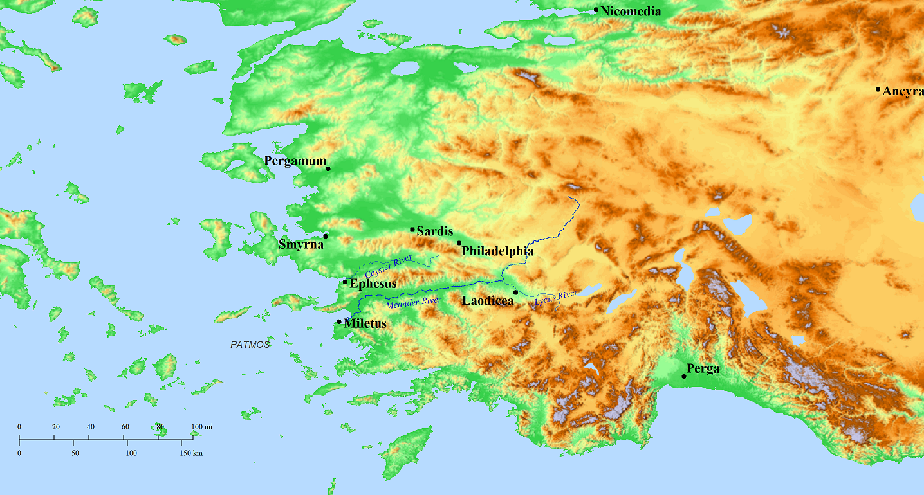
Besides Ephesus, Smyrna, and Pergamos which were Neokoroi in the 1st century, Sardis (2nd c.), Philadelphia (early 3rd c.) and Laodicea (2nd c.) would also become Neokoroi.
2nd c.
3rd c.
2nd c.

Slide 11
Summary of Chapter 1: Revelation begins with John writing to seven churches in Asia, not far from the island to which he has been exiled. He says he is sharing with them in tribulation (“suffering” according to the NIV). Jesus had appeared to him while he was “in the Spirit” and told him to write to those seven churches about the things John saw in a vision, things that “are,” and things “that shall come to pass hereafter.”
Chapters 2 and 3 will include a brief message to each of the 7 churches and each message will give a picture of the condition of each church at the time John writes, in other words, “the things that are.” Near the end of each message, there is an exhortation—something like, “to him that __________, I will give…” What did they need to overcome?
Then, according to Chapter 4:1, John was shown the things that _______________________________.

Slide 12
Revelation 2 - 3
EPHESUS
The one who is speaking identifies himself as walking in the midst of what?
In Revelation 2:5, what does he say he will do if there is no repentance?
SMYRNA
Although addressed to the angel of the church, the message is clearly intended for whom? (See the phrase “some of you” in verse 10.)
The one who is speaking identifies himself as the one “who was _______ and _____________________.”
He calls upon the saints at Smyrna to be faithful to what degree?
Are your answers to the last two questions interrelated?

Slide 13
Revelation 2 - 3
There is evidence that in those cities where the emperor was honored as a god, the pressure on Christians to conform could be great.
A few decades after Revelation was written, about A.D. 155 or 156, a man named Polycarp, an overseer of the church in Smyrna, was put to death because he would not honor Caesar is a god. After he was arrested, some officials tried to convince him to save his life, asking, “For what harm is there in saying, ‘Caesar is Lord,’ and to make an offering, and to save yourself?”
What phrases do you see in chapters 2 and 3 that suggest that, even in the churches, there were people who were not only willing to compromise but were also urging others to compromise?

Slide 14
Revelation 2 - 3
PERGAMOS
The one who is speaking identifies himself as the one who has what?
If the saints at Pergamos did not repent, what would He come and do to them?
Of what things did they need to repent?
What had happened to Antipas?
Pergamos was the first city in Asia to honor an emperor as a god and have a temple dedicated to him. A temple of the Imperial cult was built at Pergamos in honor of Rome and Augustus in about 29 B.C. What phrase in Revelation 2:13 likely alludes to this temple? (Who was the emperor when Jesus was born? See Luke 2:1.)

Slide 15
Revelation 2 - 3
THYATIRA
Undoubtedly, the woman mentioned in Revelation 2:20 was not actually named Jezebel. This is an example of something we see frequently in the book of Revelation—the name of a person, place, or thing from the Old Testament used to represent the present person, place, or thing under consideration. Read 1 Kings 16:29-31, 18:19, and 21:1-16 to learn about the Old Testament Jezebel.
By referring to the woman at Thyatira as “Jezebel,” do you think you learn more, or less, about this woman than if her actual name had been given?

