Slide 1
Sermon
JONAH
Jeff Smelser

Slide 2
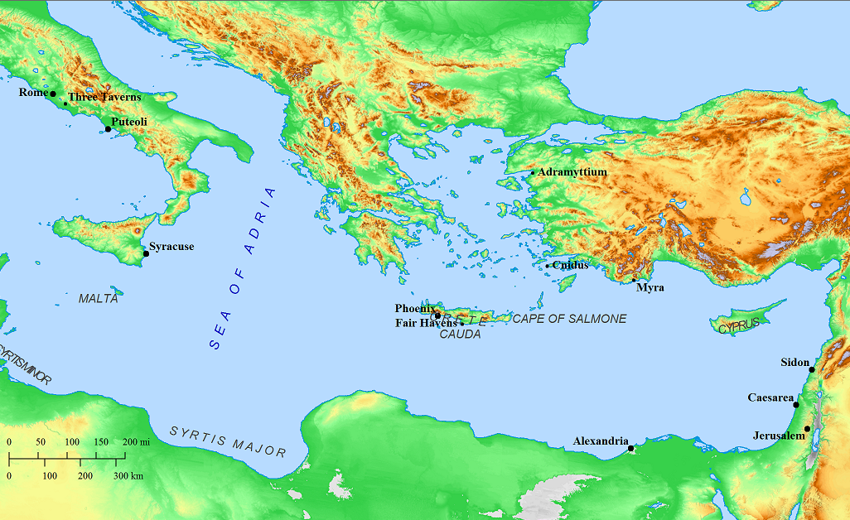
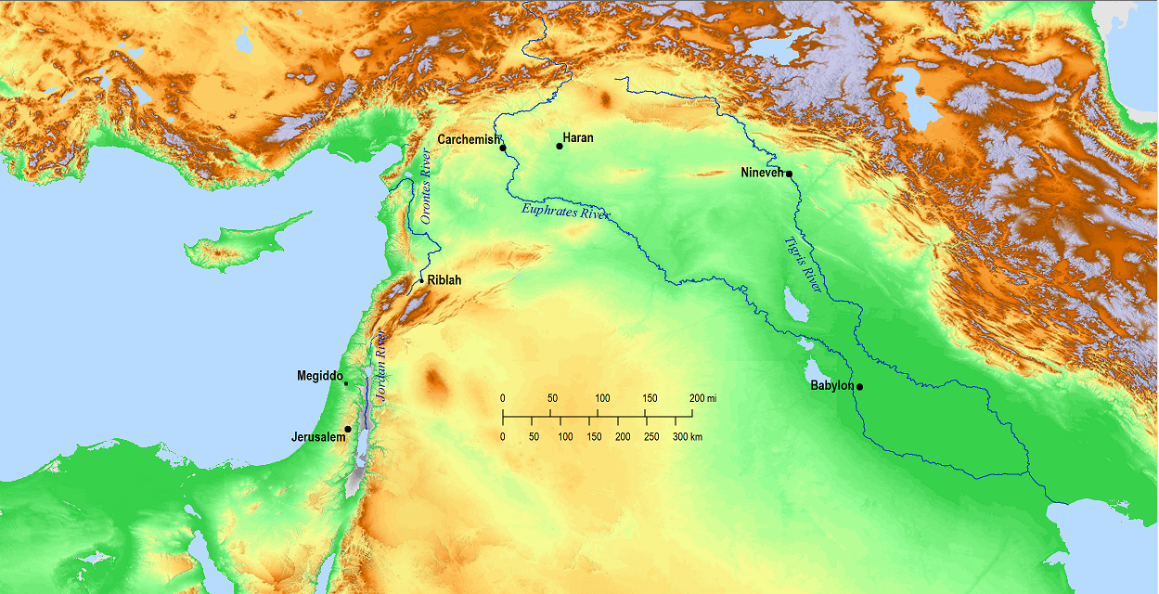
Jonah
The Story
Assyria

Slide 4
Jonah
Did it Really Happen?
1¹⁷ And Jehovah prepared a great fish to swallow up Jonah; and Jonah was in the belly of the fish three days and three nights.
4⁶ And Jehovah God prepared a gourd, and made it to come up over Jonah, that it might be a shade over his head
4⁷ But God prepared a worm when the morning rose the next day, and it smote the gourd, that it withered.
4⁸ And it came to pass, when the sun arose, that God prepared a sultry east wind; and the sun beat upon the head of Jonah, that he fainted

Slide 5
Jonah
Did it Really Happen?
³⁹ But He answered and said to them, “An evil and adulterous generation craves a sign; and so no sign will be given to it except the sign of Jonah the prophet; ⁴⁰ for just as Jonah was in the stomach of the sea monster for three days and three nights, so will the Son of Man be in the heart of the earth for three days and three nights.

Slide 6
Jonah
Practical Lessons
1:3 But Jonah got up to flee
2:1 Then Jonah prayed to the Lord his God
3:3 So Jonah got up and went to Nineveh according to the word of the Lord.
4:1 But it greatly displeased Jonah, and he became angry.
Running away from God
Turning to God
Walking with God
Getting ahead of God

Slide 7
Jonah
Practical Lessons
DON’T BLAME THE MESSENGER
Matthew 12⁴¹ The men of Nineveh will stand up with this generation at the judgment, and will condemn it because they repented at the preaching of Jonah; and behold, something greater than Jonah is here.

Slide 8
Jonah
Faith Building Lesson
Asleep in the boat
Jonah and Jesus 3 days
In Sheol
Gates of Hades/Sheol don’t Prevail

Slide 9
Jonah
Faith Building Lesson
Asleep in the boat
Jonah and Jesus 3 days
In Sheol
Gates of Hades/Sheol don’t Prevail

Slide 10
Jonah
Faith Building Lesson
Jonah 1:4-5
and there was a great storm on the sea, so that the ship was about to break up. ⁵ Then the sailors became afraid….But Jonah had gone below into the stern of the ship, had lain down, and fallen sound asleep.
Matthew 8:24-25
²⁴ And behold, a violent storm developed on the sea, so that the boat was being covered by the waves; but Jesus Himself was asleep. ²⁵ And they came to Him and woke Him, saying, “Save us, Lord; we are perishing!”

Slide 11
Jonah
Faith Building Lesson
Jonah 1:4-5
and there was a great storm on the sea, so that the ship was about to break up. ⁵ Then the sailors became afraid….But Jonah had gone below into the stern of the ship, had lain down, and fallen sound asleep.
Matthew 8:24-25
²⁴ And behold, a violent storm developed on the sea, so that the boat was being covered by the waves; but Jesus Himself was asleep. ²⁵ And they came to Him and woke Him, saying, “Save us, Lord; we are perishing!”

Slide 12
Jonah
Faith Building Lesson
Jonah 1:4-5
and there was a great storm on the sea, so that the ship was about to break up. ⁵ Then the sailors became afraid….But Jonah had gone below into the stern of the ship, had lain down, and fallen sound asleep.
Matthew 8:24-25
²⁴ And behold, a violent storm developed on the sea, so that the boat was being covered by the waves; but Jesus Himself was asleep. ²⁵ And they came to Him and woke Him, saying, “Save us, Lord; we are perishing!”

Slide 13
Jonah
Faith Building Lesson
Jonah 1:4-5
and there was a great storm on the sea, so that the ship was about to break up. ⁵ Then the sailors became afraid….But Jonah had gone below into the stern of the ship, had lain down, and fallen sound asleep.
Matthew 8:24-25
²⁴ And behold, a violent storm developed on the sea, so that the boat was being covered by the waves; but Jesus Himself was asleep. ²⁵ And they came to Him and woke Him, saying, “Save us, Lord; we are perishing!”
Mark 4:38
And yet Jesus Himself was in the stern, asleep on the cushion

Slide 14
Jonah
Faith Building Lesson
Asleep in the boat
Jonah and Jesus 3 days
In Sheol
Gates of Hades/Sheol don’t Prevail

Slide 15
Jonah
Faith Building Lesson
Asleep in the boat
Jonah and Jesus 3 days
In Sheol
Gates of Hades/Sheol don’t Prevail
Jonah 2:2
“I called out of my distress to the Lord, And He answered me. I called for help from the depth of Sheol;

Slide 16
Jonah
Faith Building Lesson
Asleep in the boat
Jonah and Jesus 3 days
In Sheol
Gates of Hades/Sheol don’t Prevail
Psalm 16:10
For You will not abandon my soul to Sheol; You will not allow Your Holy One to undergo decay.

Slide 17
Jonah
Faith Building Lesson
Asleep in the boat
Jonah and Jesus 3 days
In Sheol
Gates of Hades/Sheol don’t Prevail
Acts 2:27
For You will not abandon my soul to Hades, Nor will You allow Your Holy One to undergo decay.
Acts 2:31
[David] looked ahead and spoke of the resurrection of the Christ, that He was neither abandoned to Hades, nor did His flesh suffer decay.

Slide 18
Jonah
Faith Building Lesson
Asleep in the boat
Jonah and Jesus 3 days
In Sheol
Gates of Hades/Sheol don’t Prevail
Jonah 2:6
The earth with its bars was around me forever, But You have brought up my life from the pit, Lord my God.
NET BIBLE
Heb “the earth.”
…here refers to the “netherworld” Isa 26:19…
This refers to the place of the dead (along with “belly of Sheol” [v. 2] and “the grave” [v. 6]), which is sometimes described as having “gates” (Job 38:17; Ps 107:18).

Slide 19
Jonah
Faith Building Lesson
Asleep in the boat
Jonah and Jesus 3 days
In Sheol
Gates of Hades/Sheol don’t Prevail
Jonah 2:6
The earth with its bars was around me forever, But You have brought up my life from the pit, Lord my God.
Matthew 12:40
so will the Son of Man be in the heart of the earth for three days and three nights.

Slide 20
Jonah
Faith Building Lesson
Asleep in the boat
Jonah and Jesus 3 days
In Sheol
Gates of Hades/Sheol don’t Prevail
Jonah 2:6
The earth with its bars was around me forever, But You have brought up my life from the pit, Lord my God.
Revelation 1:18
I was dead, and behold, I am alive forevermore, and I have the keys of death and of Hades.

Slide 21
Jonah
Faith Building Lesson
Asleep in the boat
Jonah and Jesus 3 days
In Sheol
Gates of Hades/Sheol don’t Prevail
Jonah 2:6
The earth with its bars was around me forever, But You have brought up my life from the pit, Lord my God.
Matthew 16:18
upon this rock I will build My church; and the gates of Hades will not overpower it.

