Slide 2
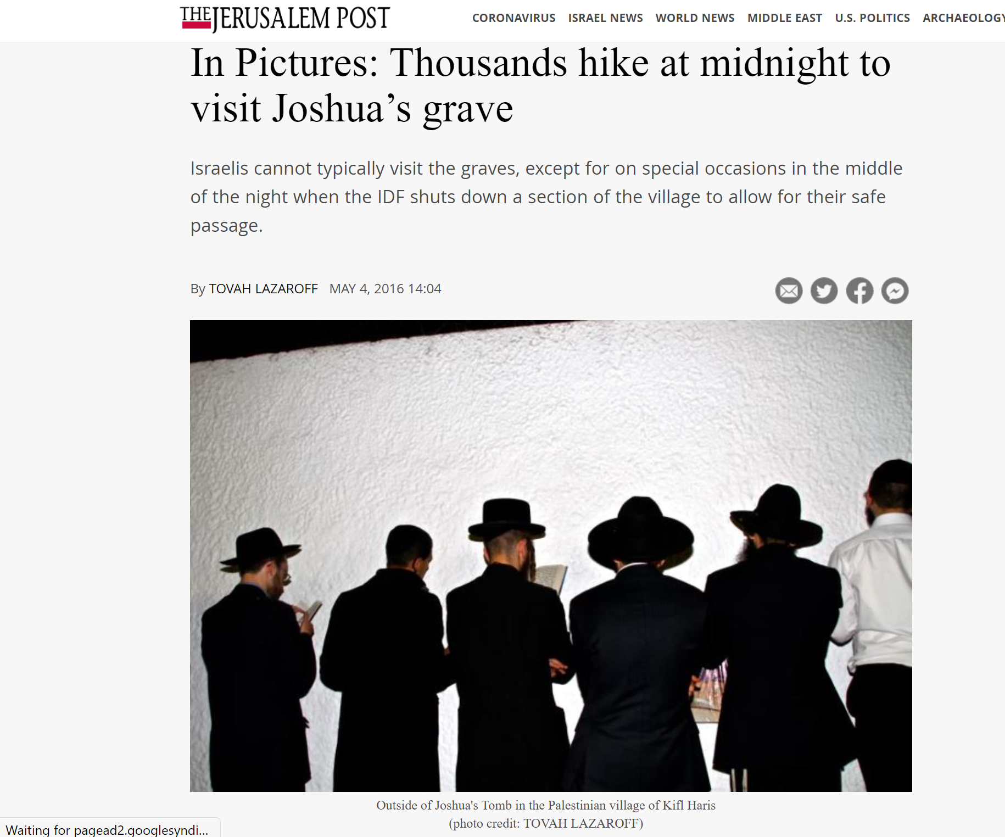

Slide 3
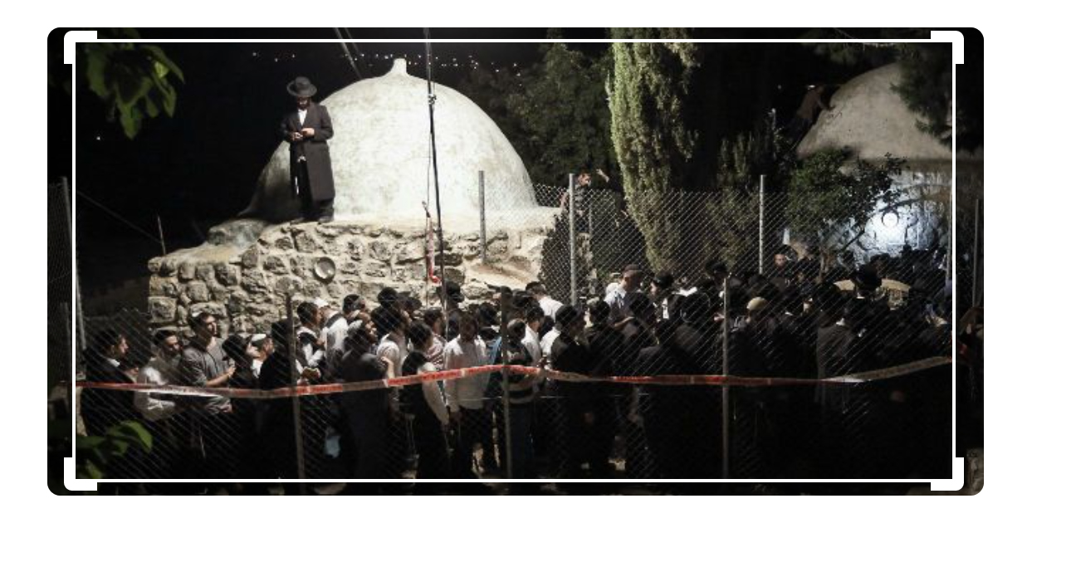

Slide 4
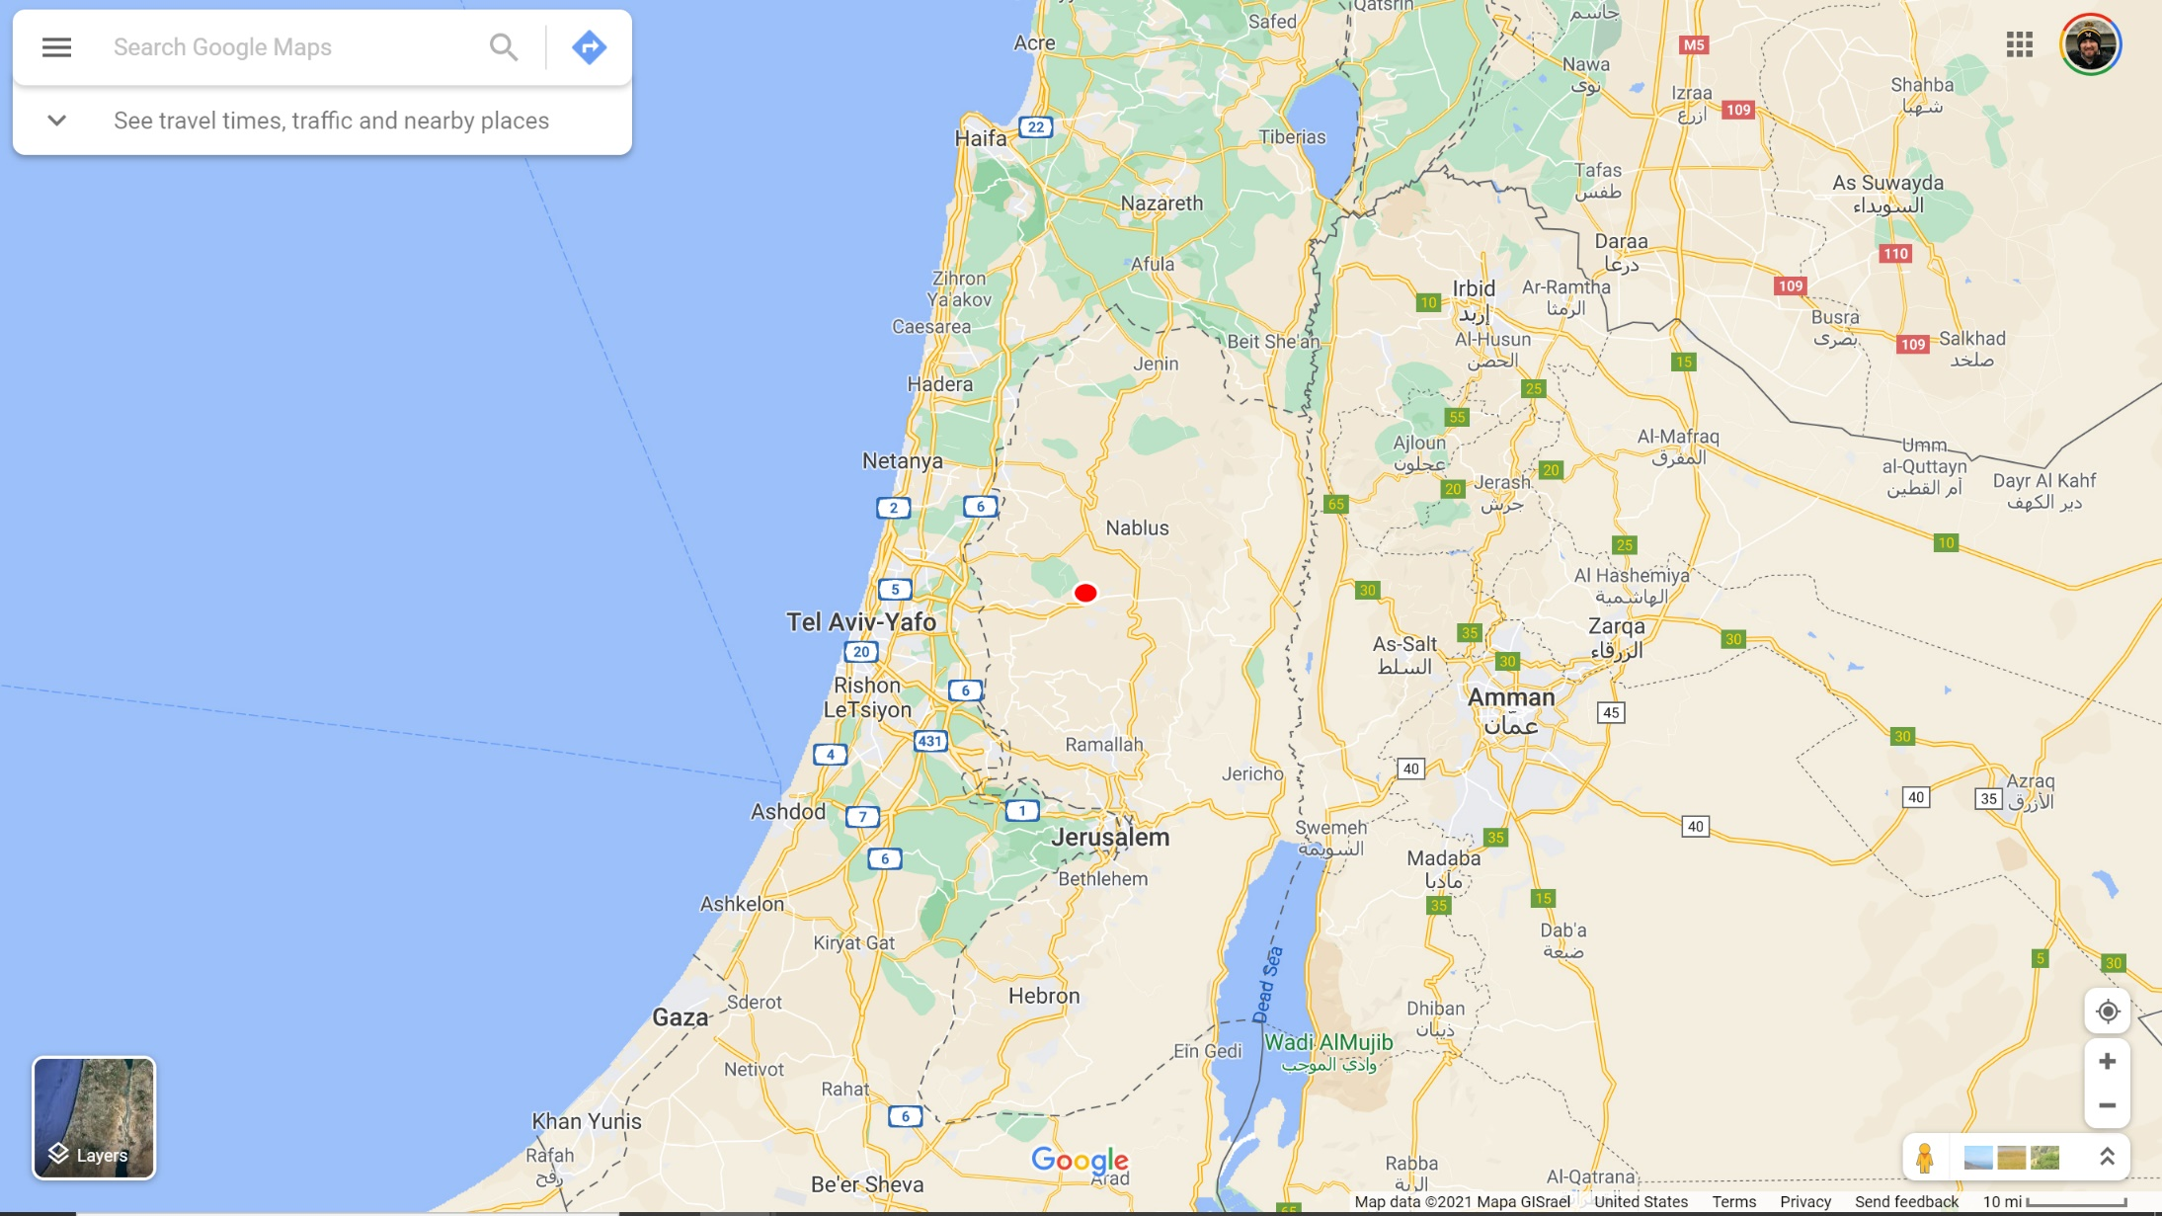

Slide 5
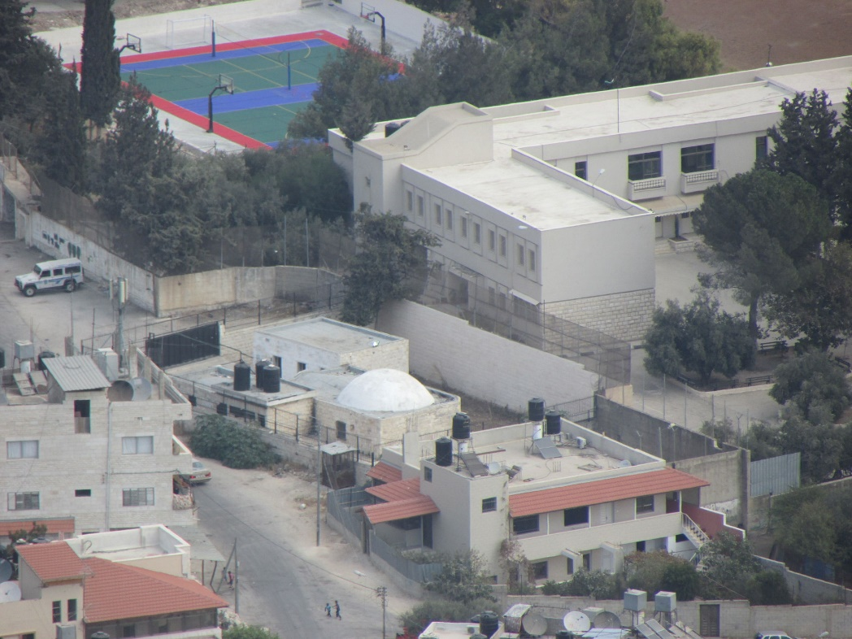
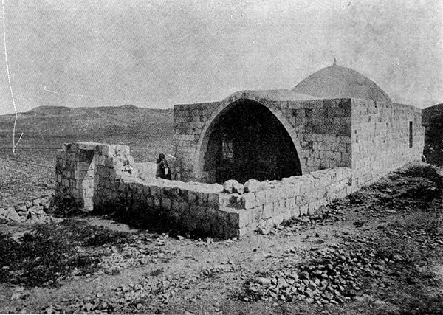

Slide 6
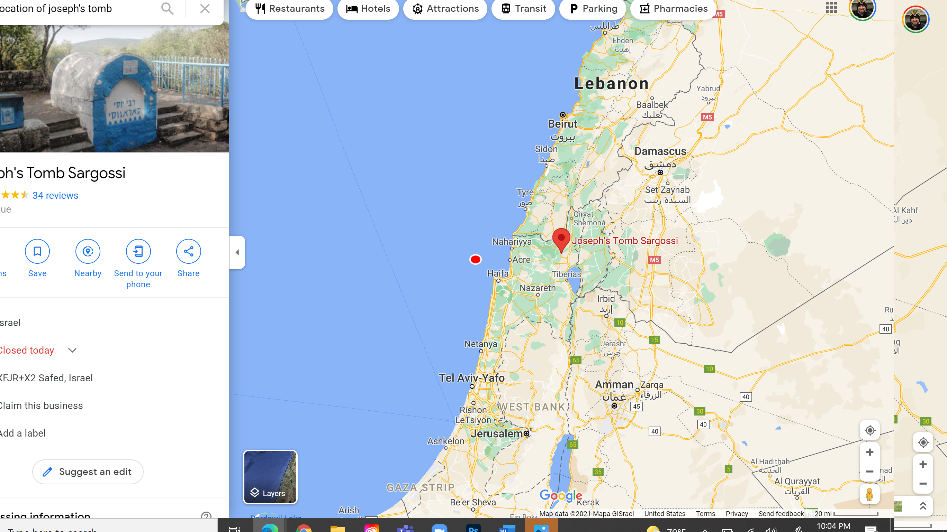

Slide 7
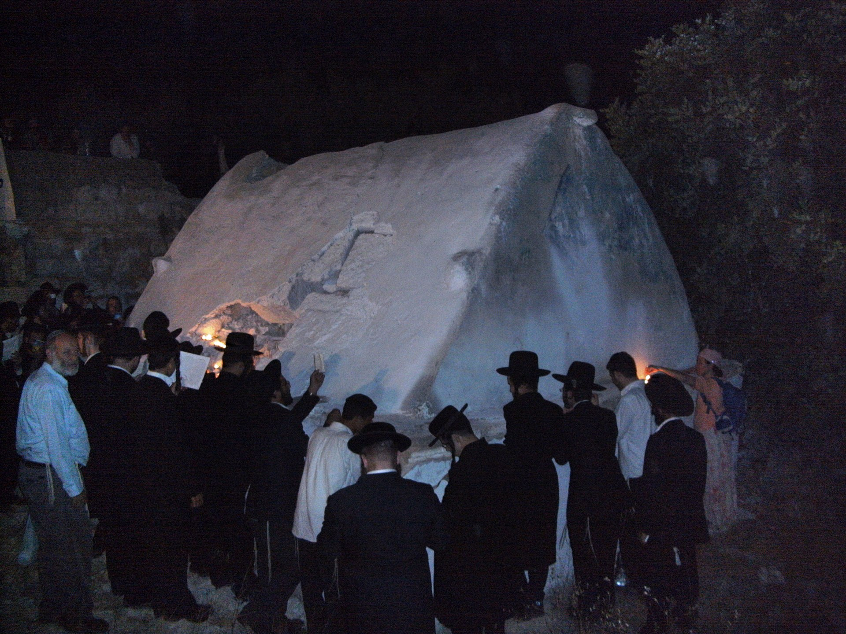

Slide 8
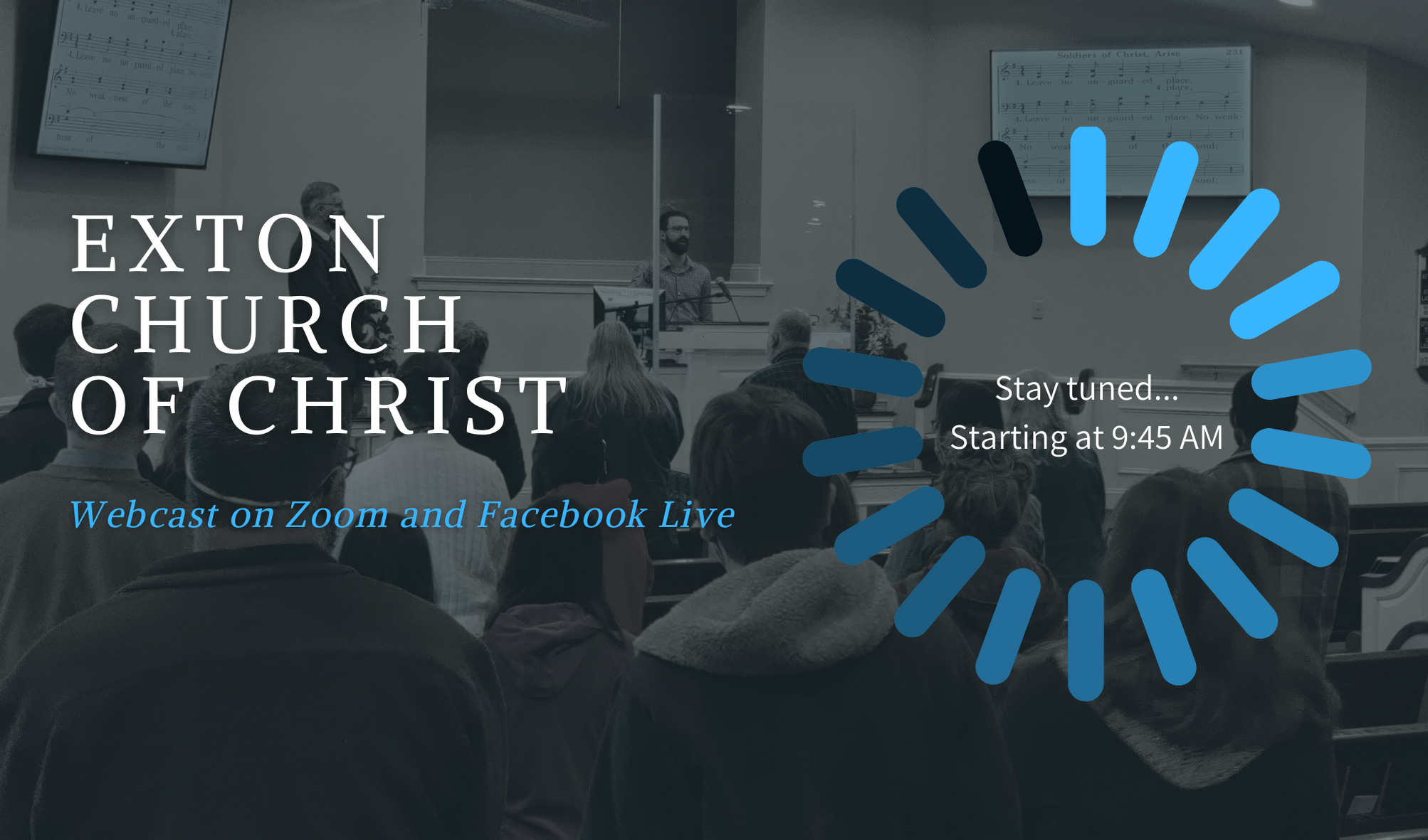
TRANSLATION CODE
CÓDIGO DE TRADUCCIÓN
รหัสการแปล
PEZUX

Slide 9
Please silence your cell phone
TRANSLATION CODE
CÓDIGO DE TRADUCCIÓN
รหัสการแปล
PEZUX

Slide 10
Prayer
Phil O’Banion

Slide 11
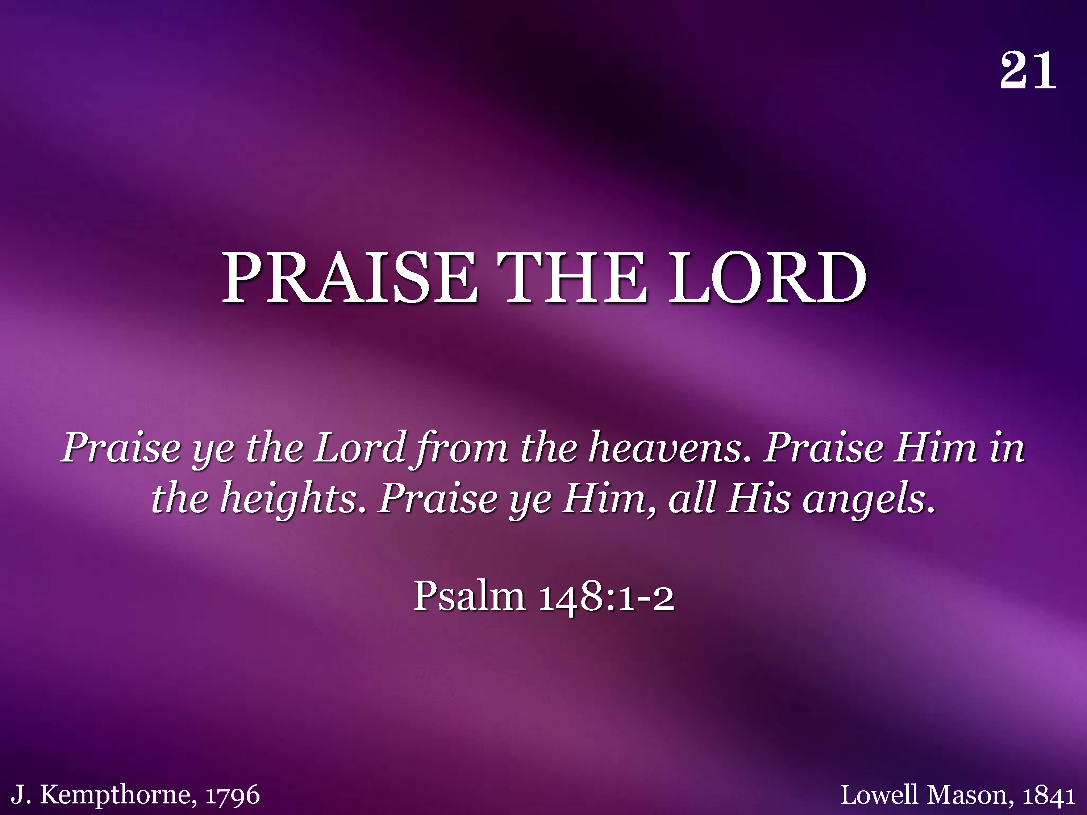
021 - Praise The Lord - Title

Slide 12
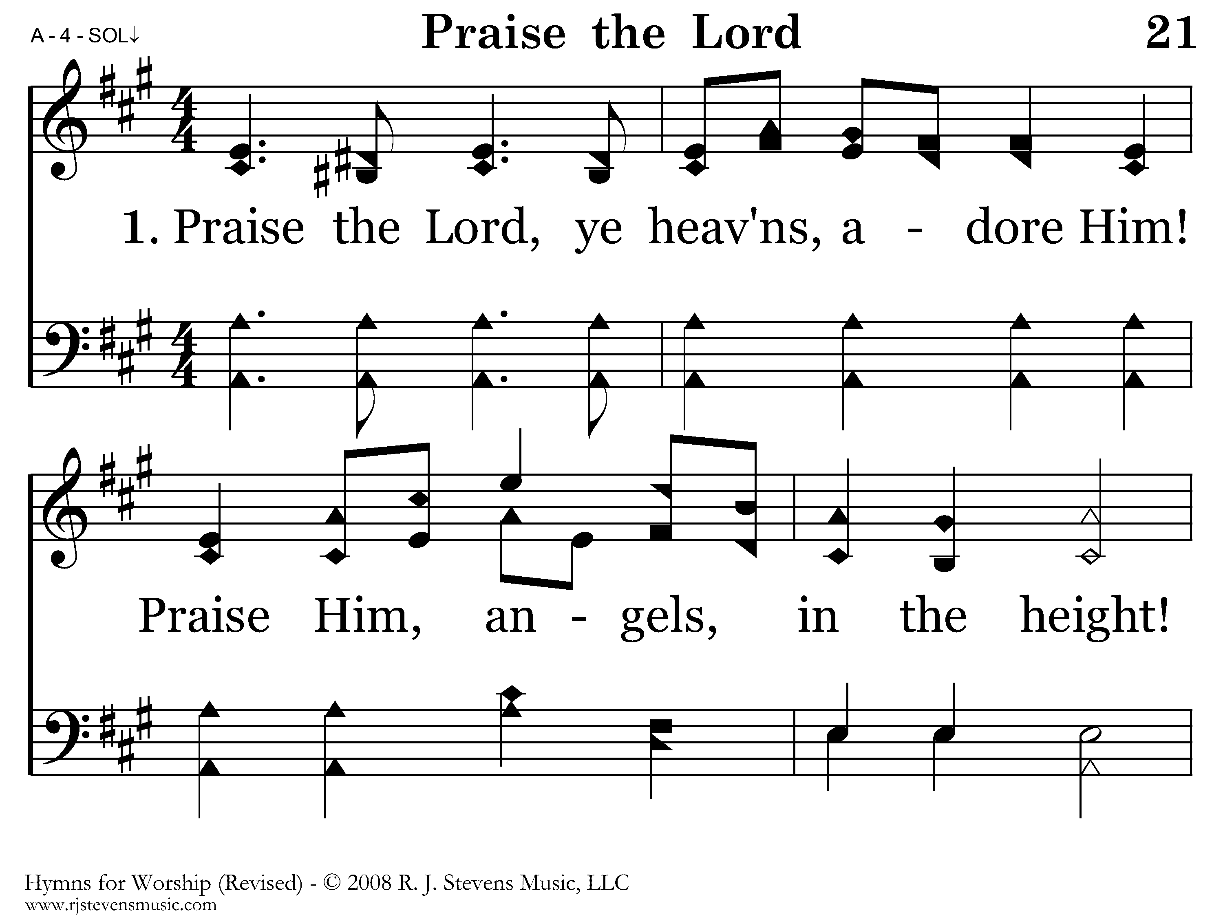
021 - Praise The Lord - 1.1

Slide 13
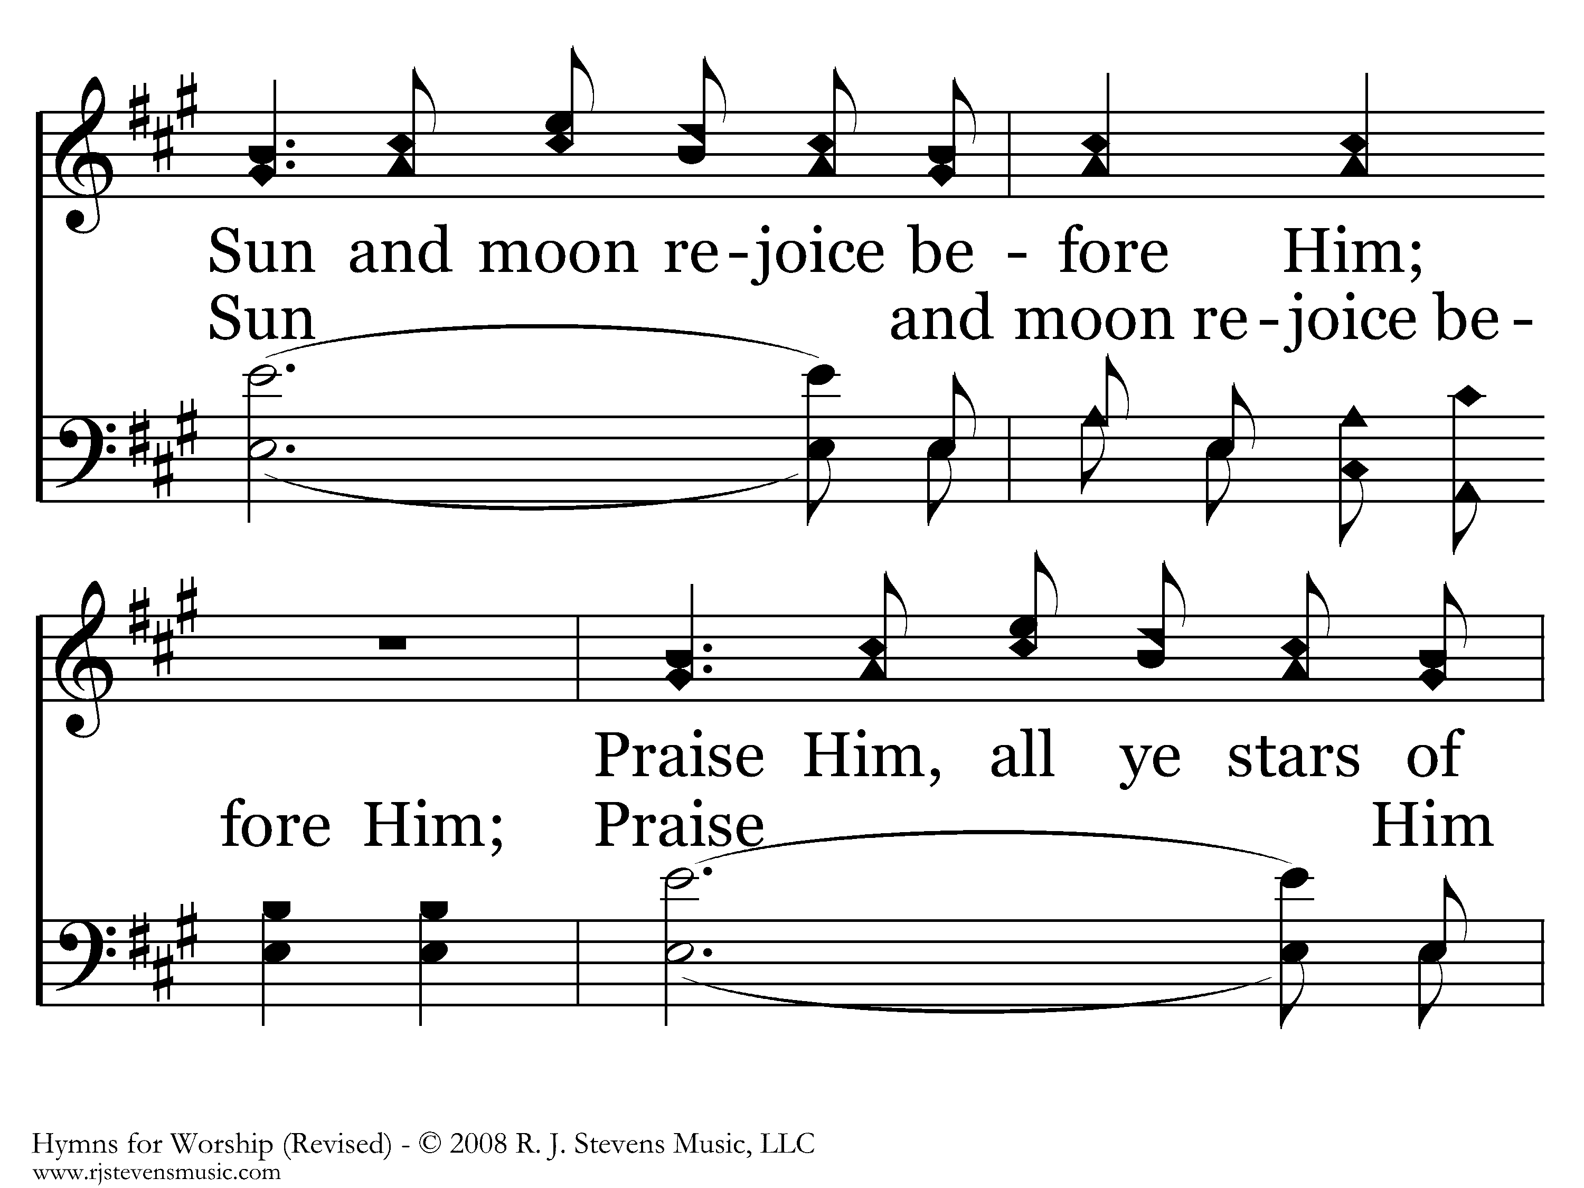
021 - Praise The Lord - 1.2

Slide 14
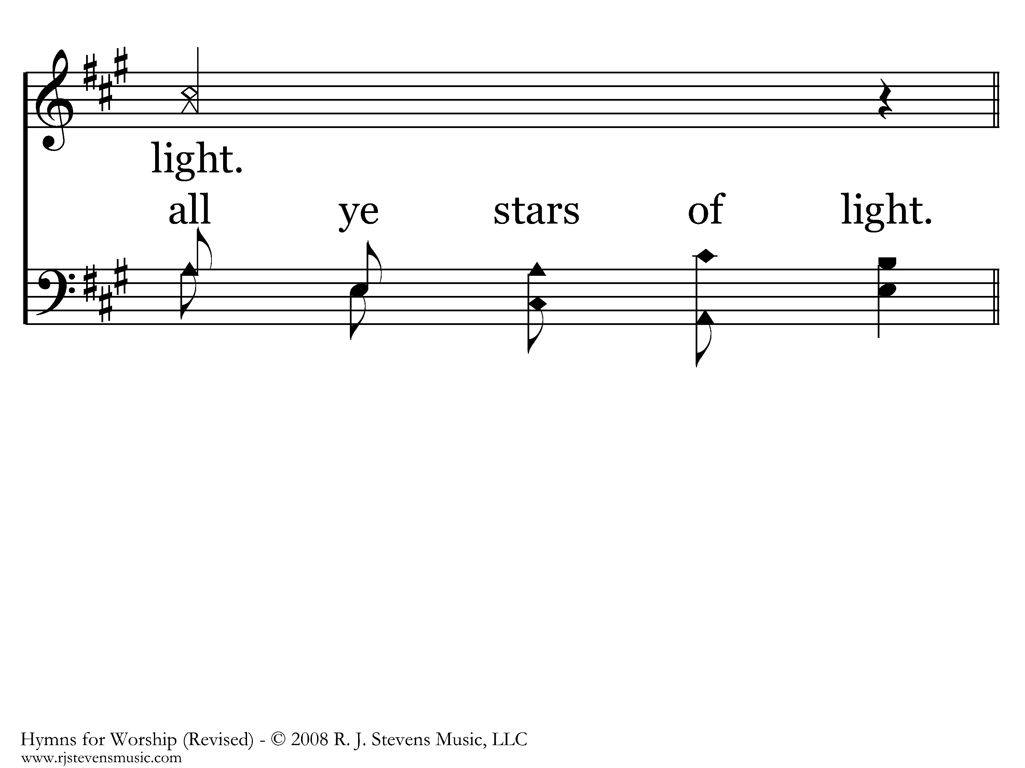
021 - Praise The Lord - 1.3

Slide 15
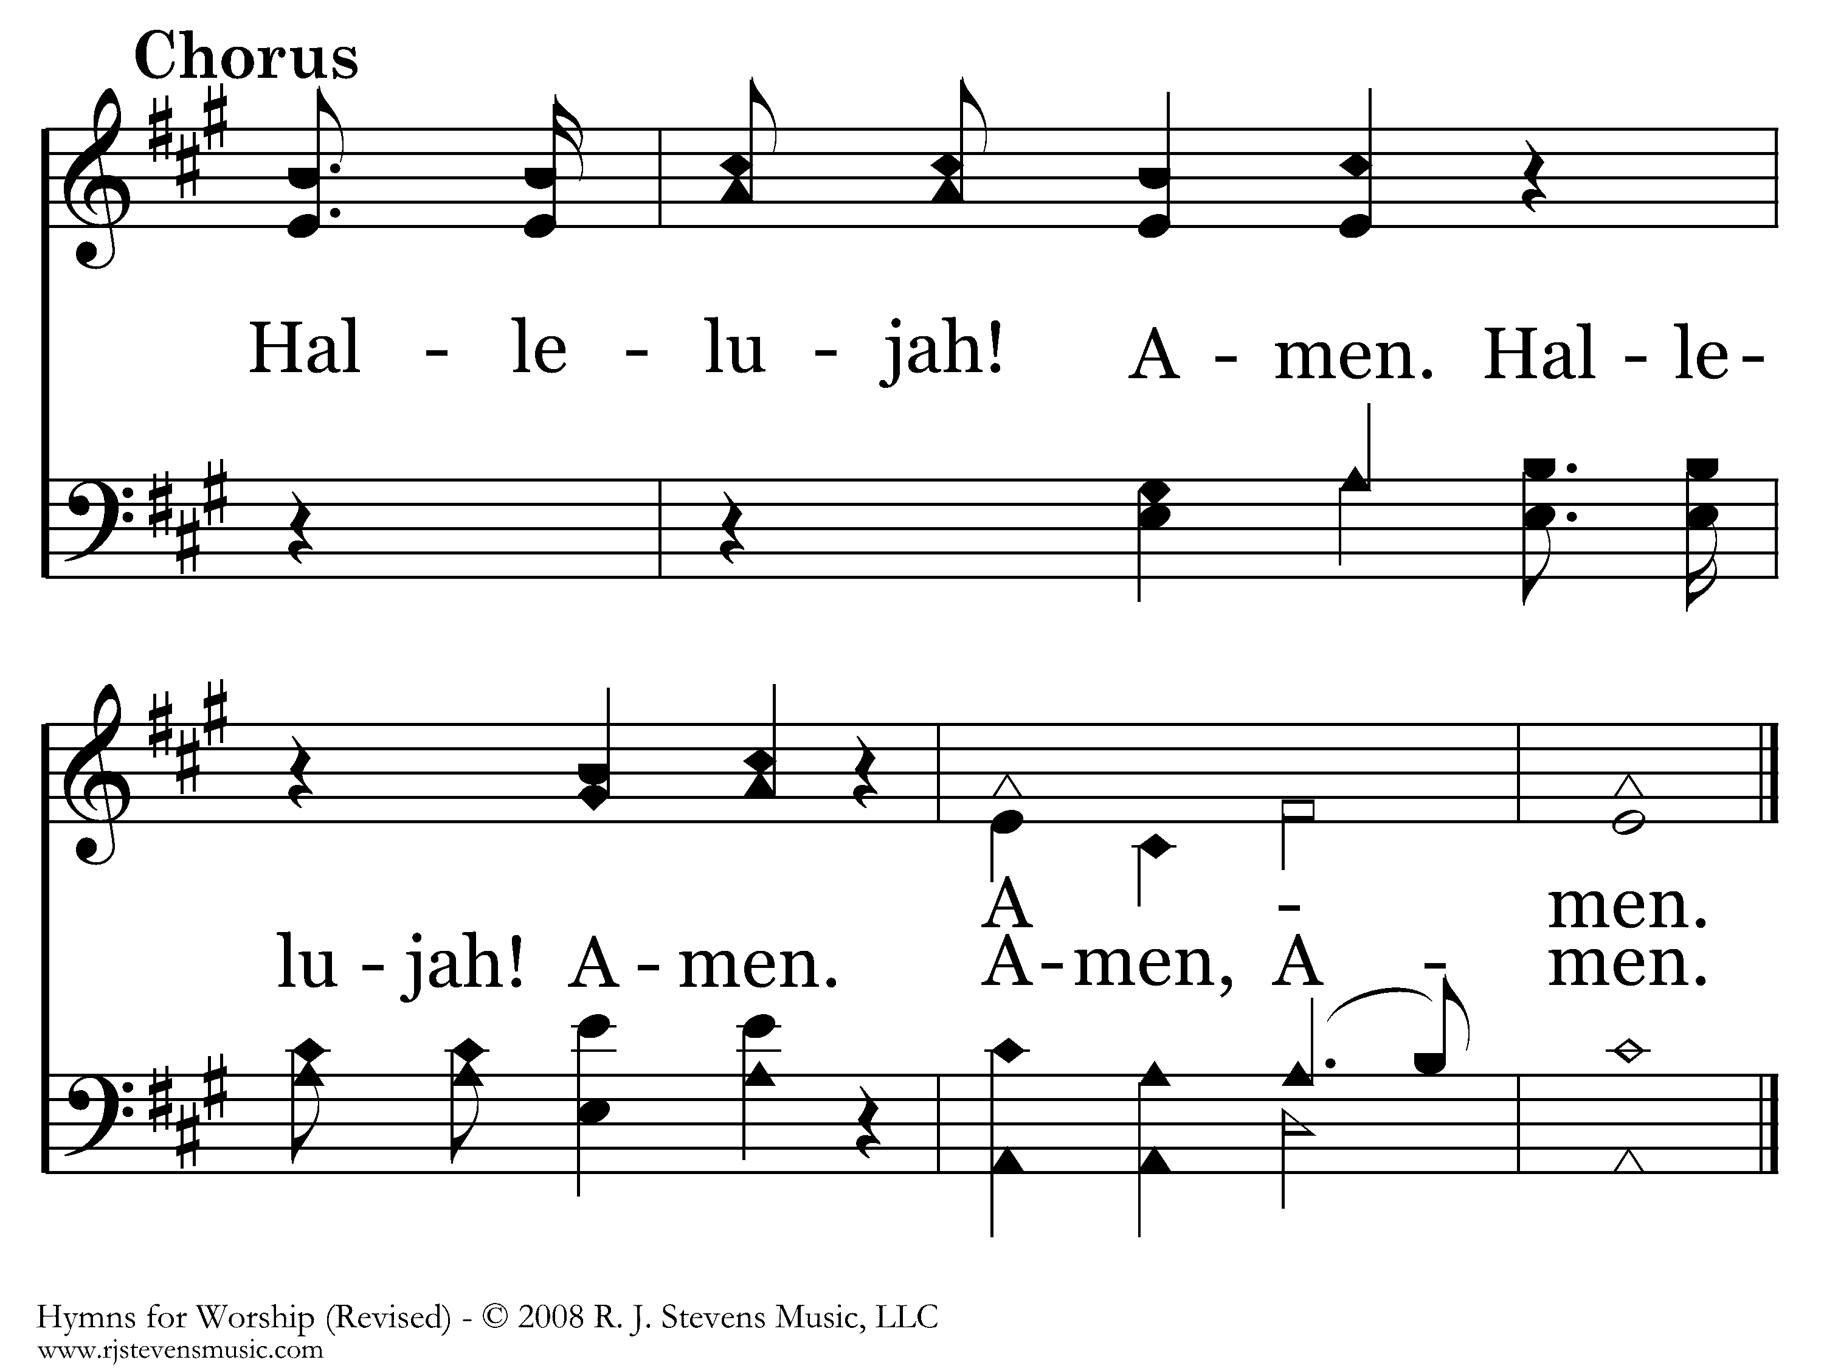
021 - Praise The Lord - C.1
End of Verse 1

Slide 16
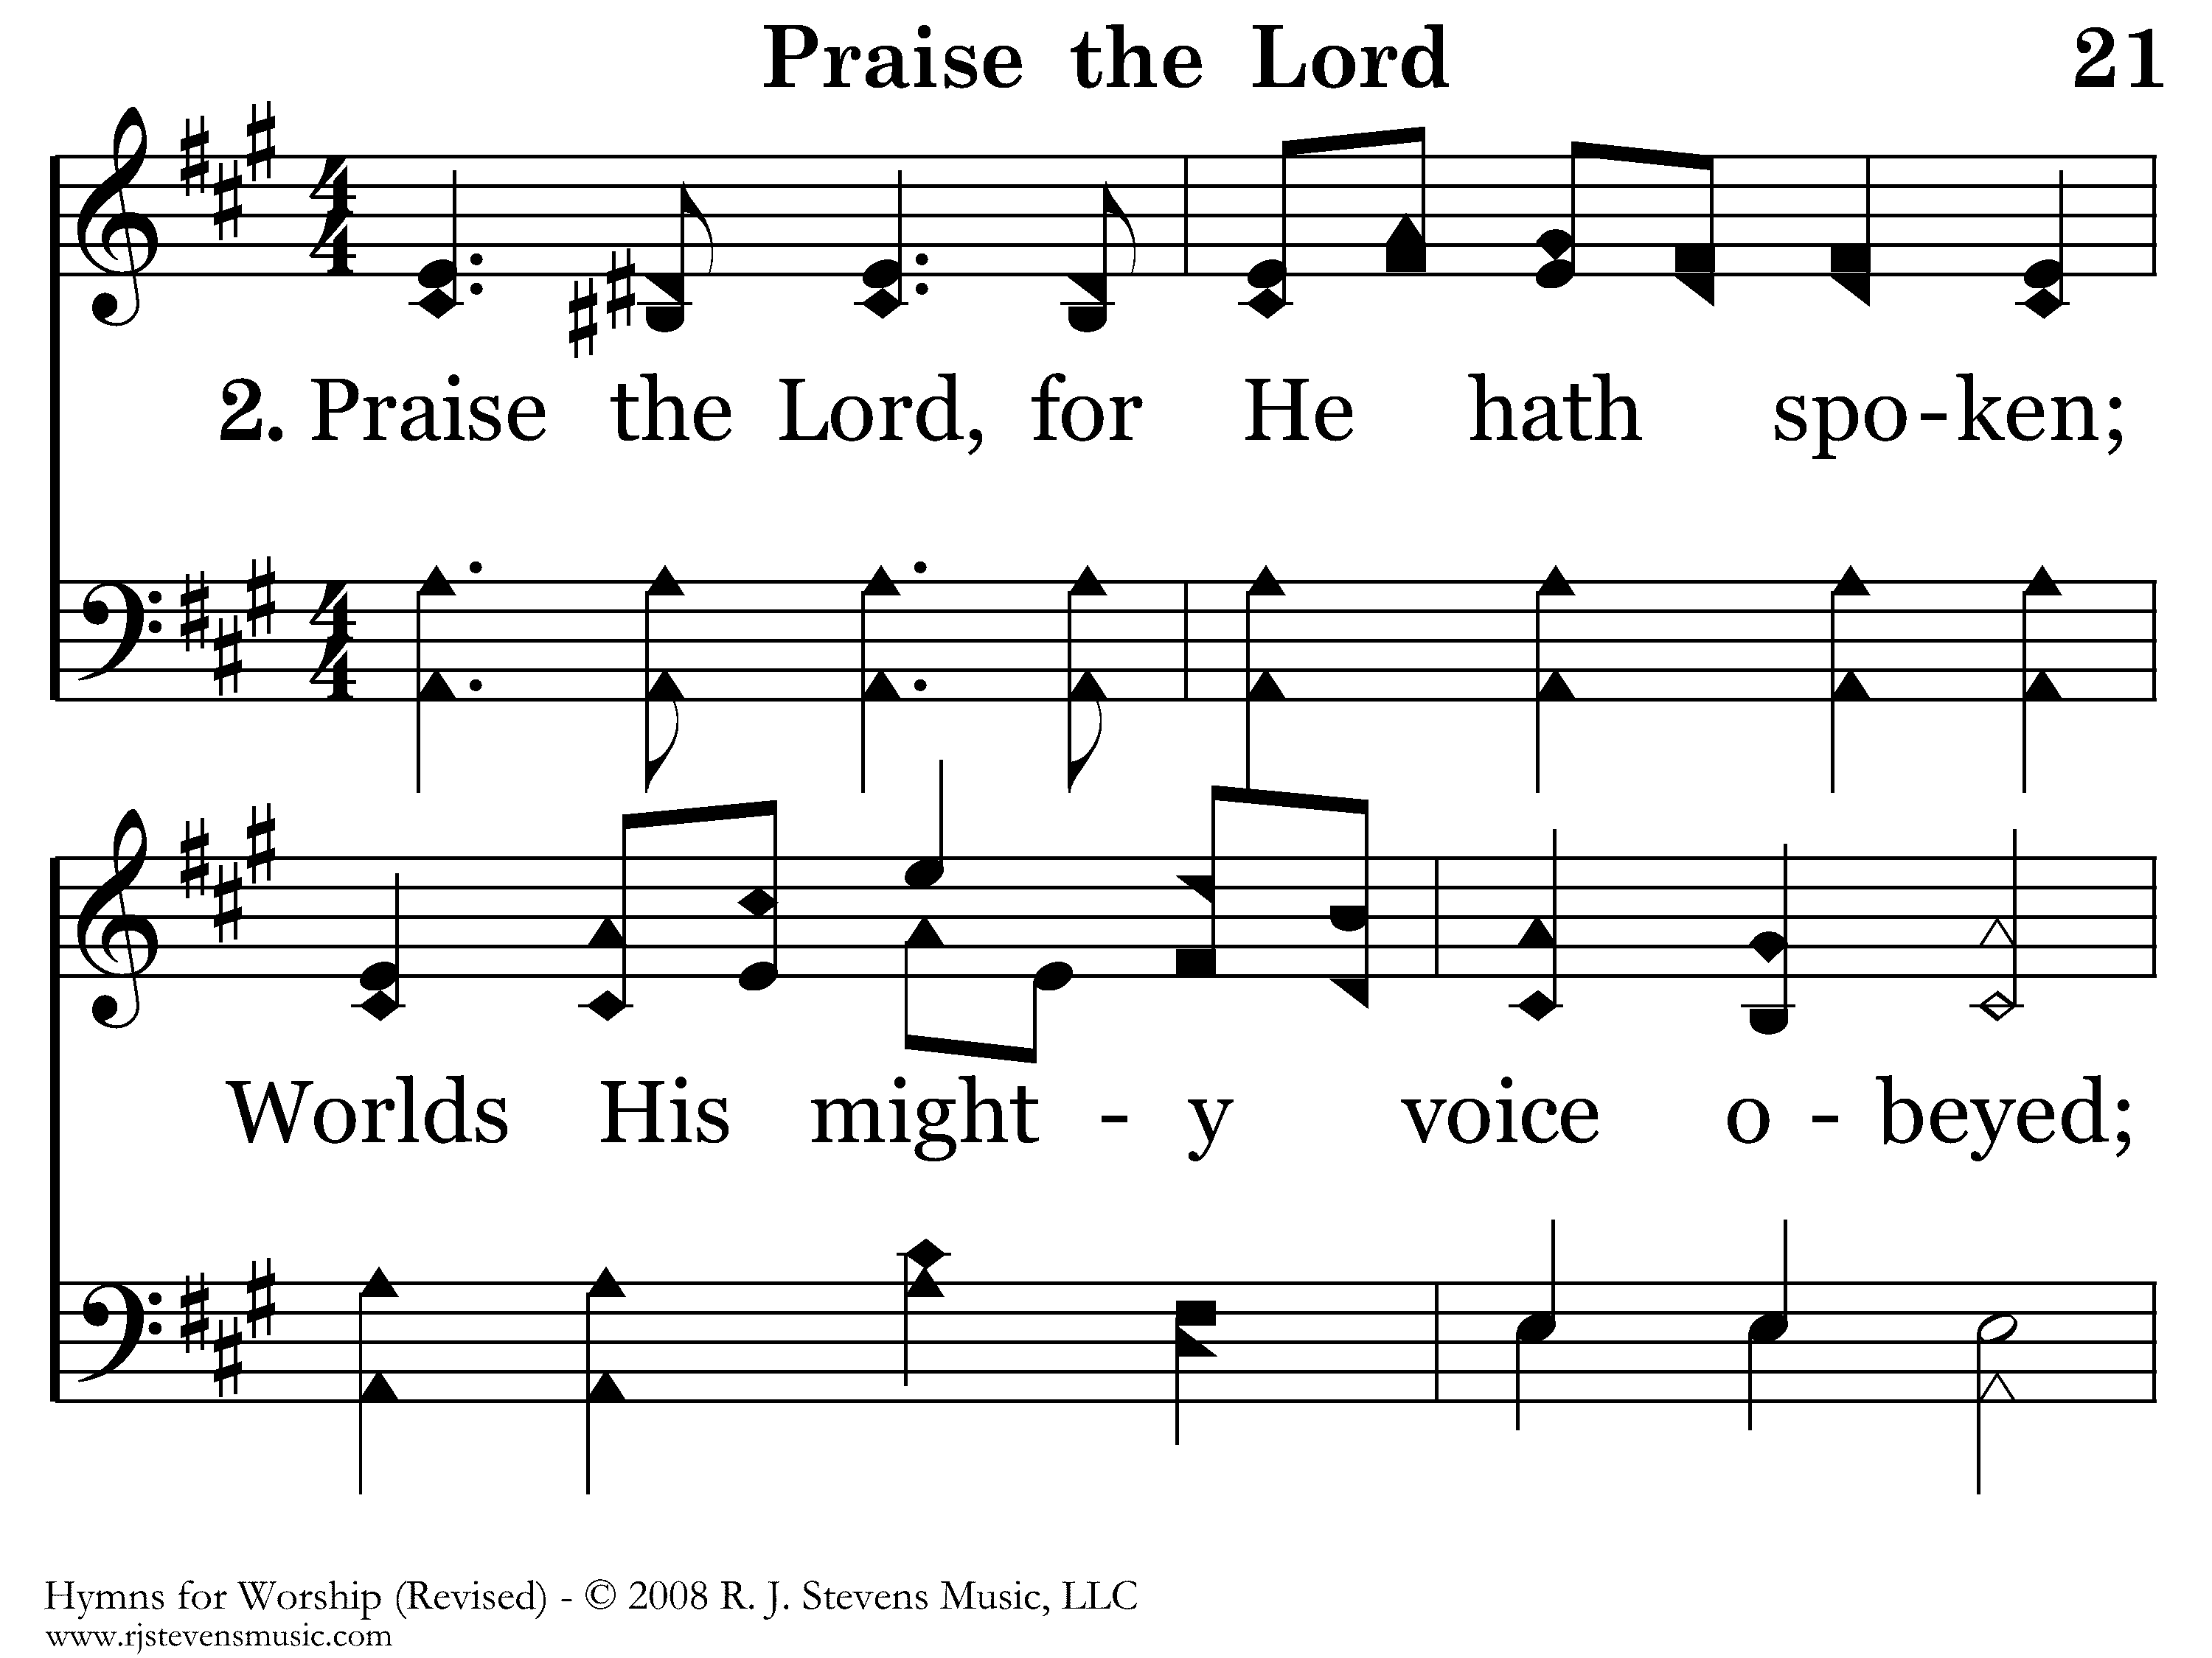
021 - Praise The Lord - 2.1

Slide 17
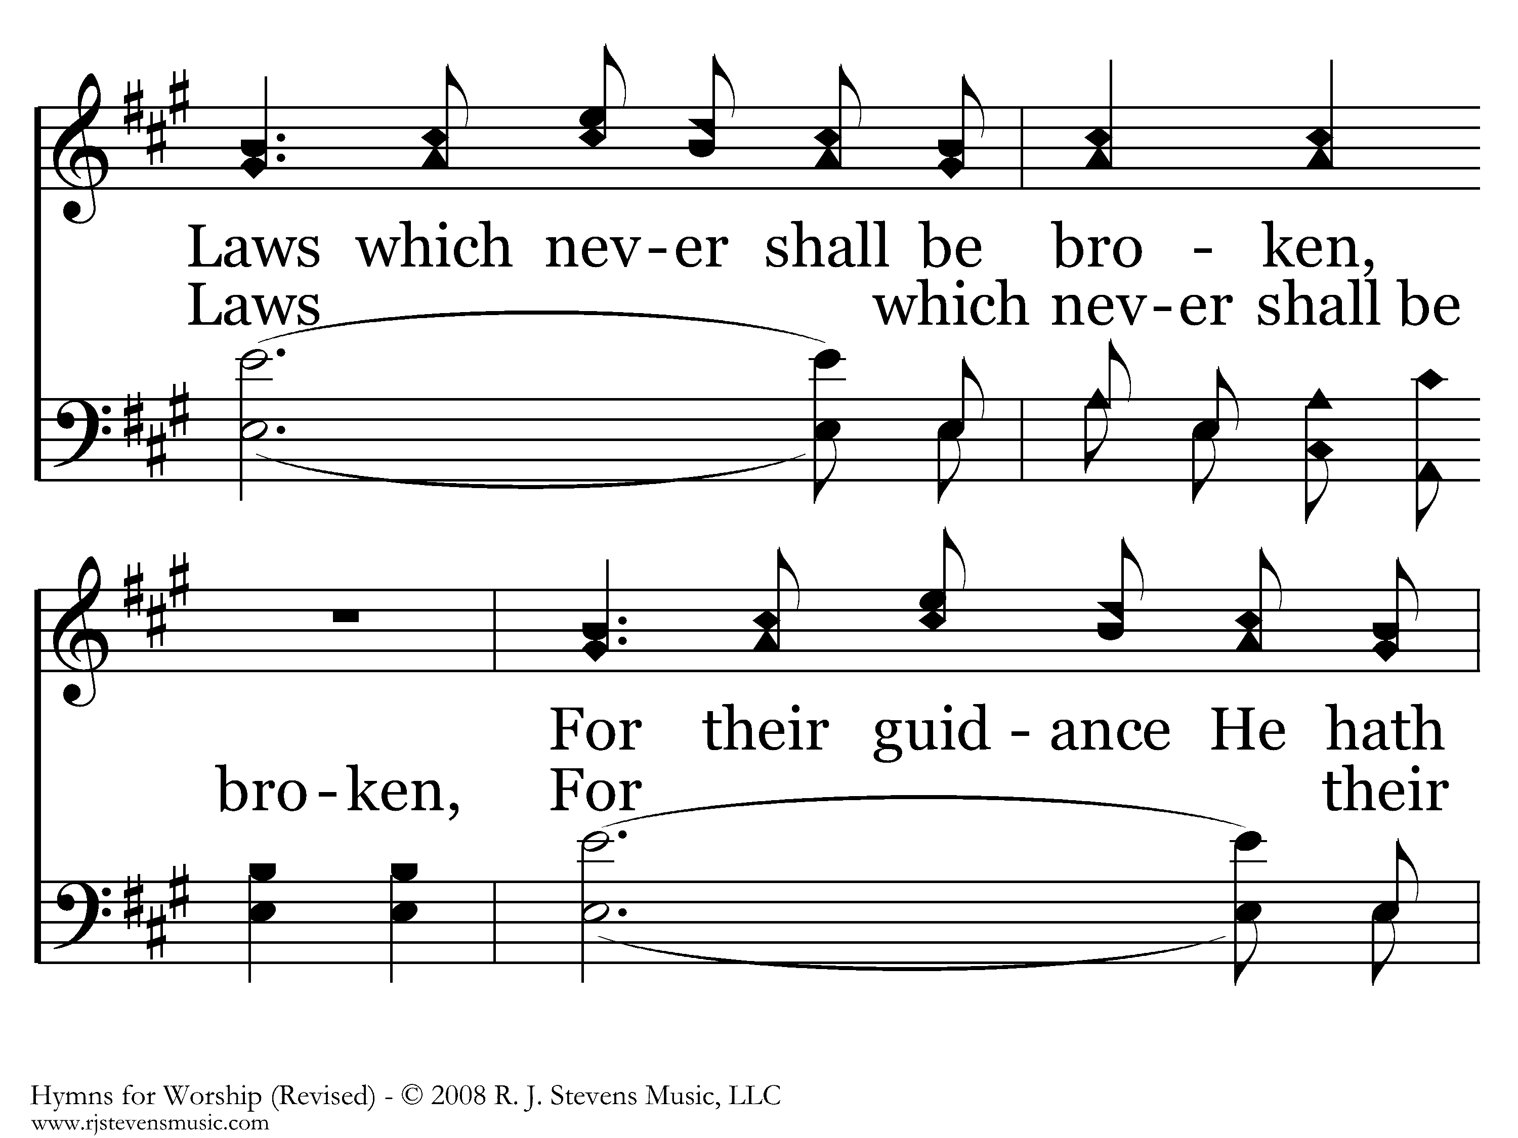
021 - Praise The Lord - 2.2

Slide 18
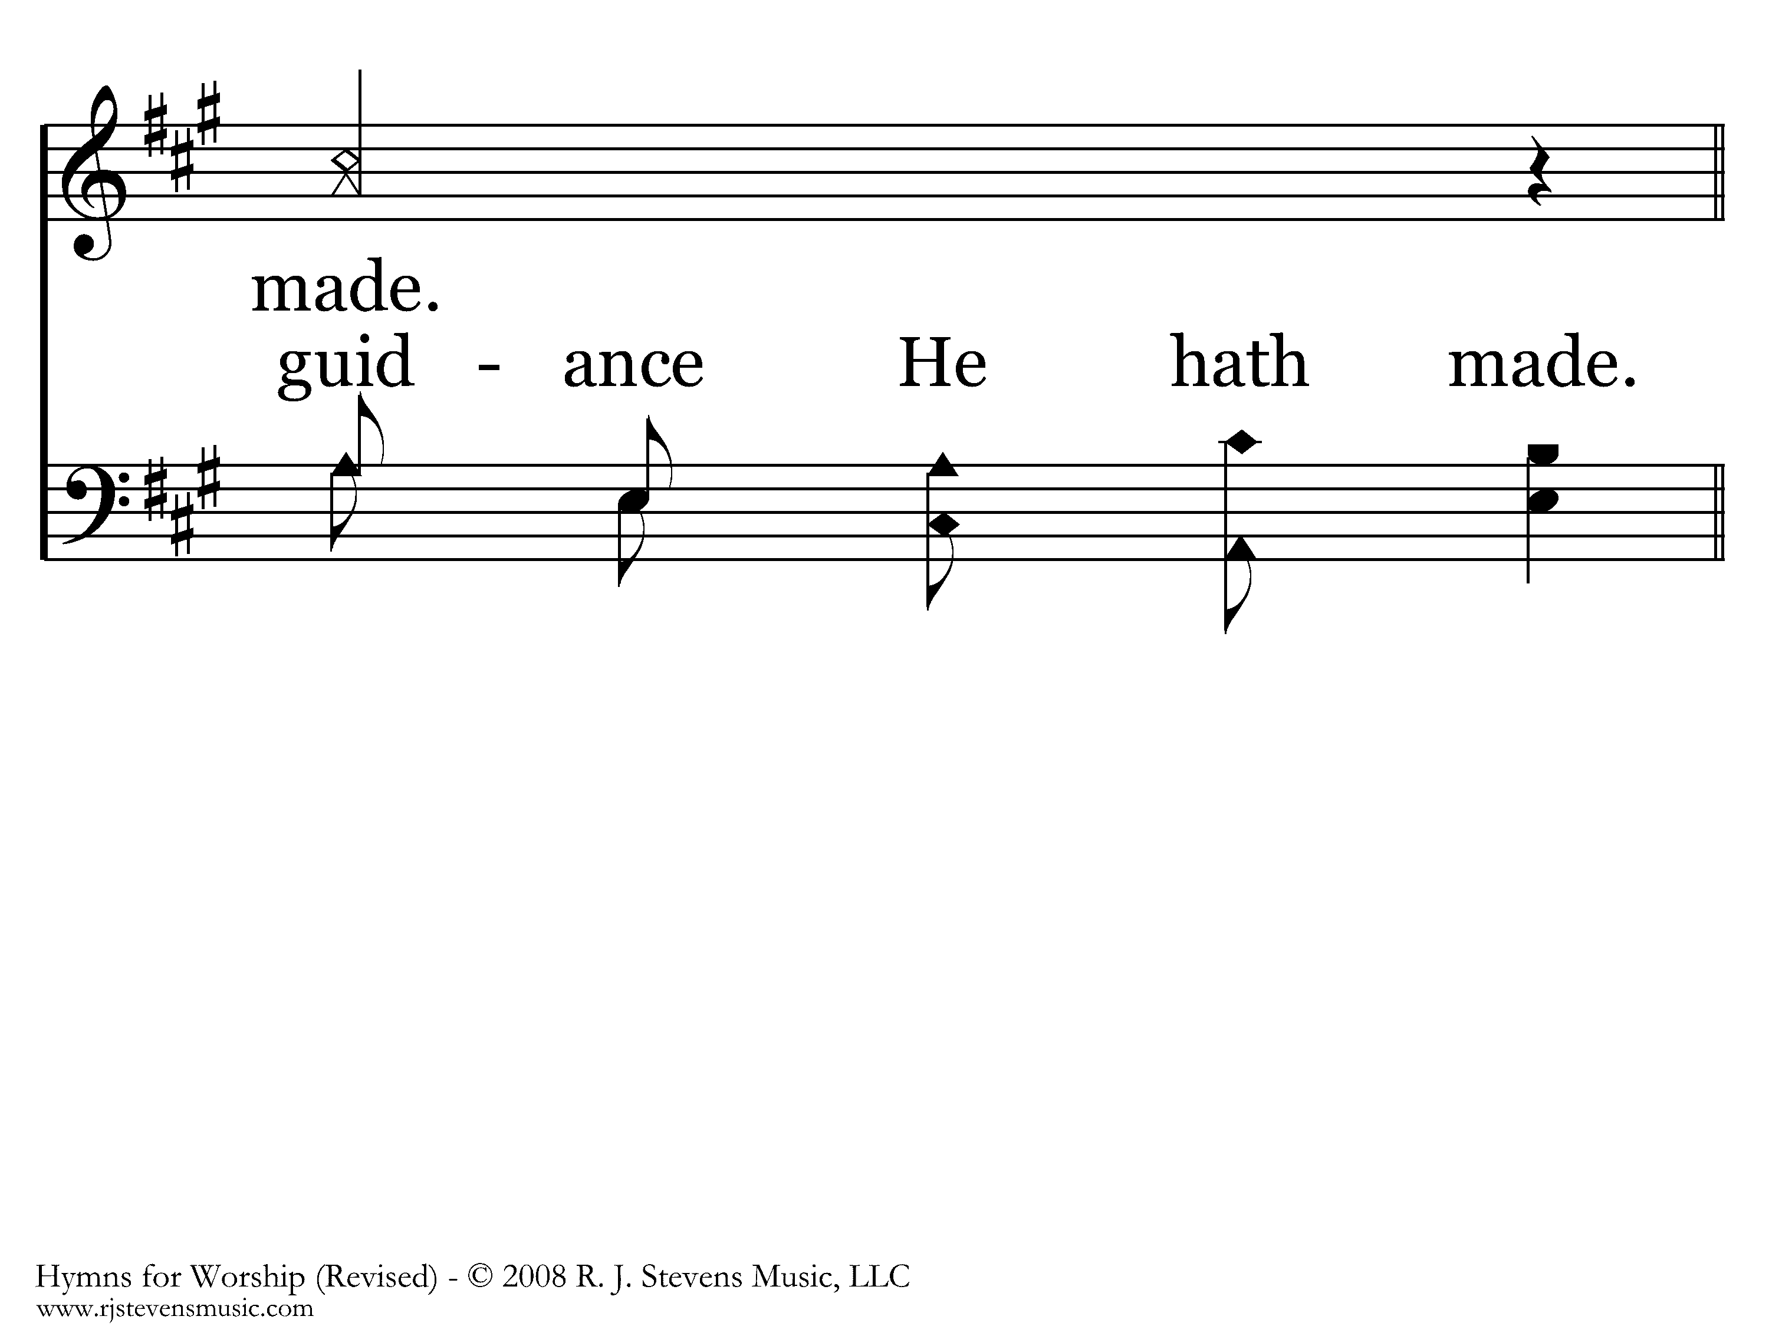
021 - Praise The Lord - 2.3

Slide 19
021 - Praise The Lord - C.1
End of Verse 2

Slide 20
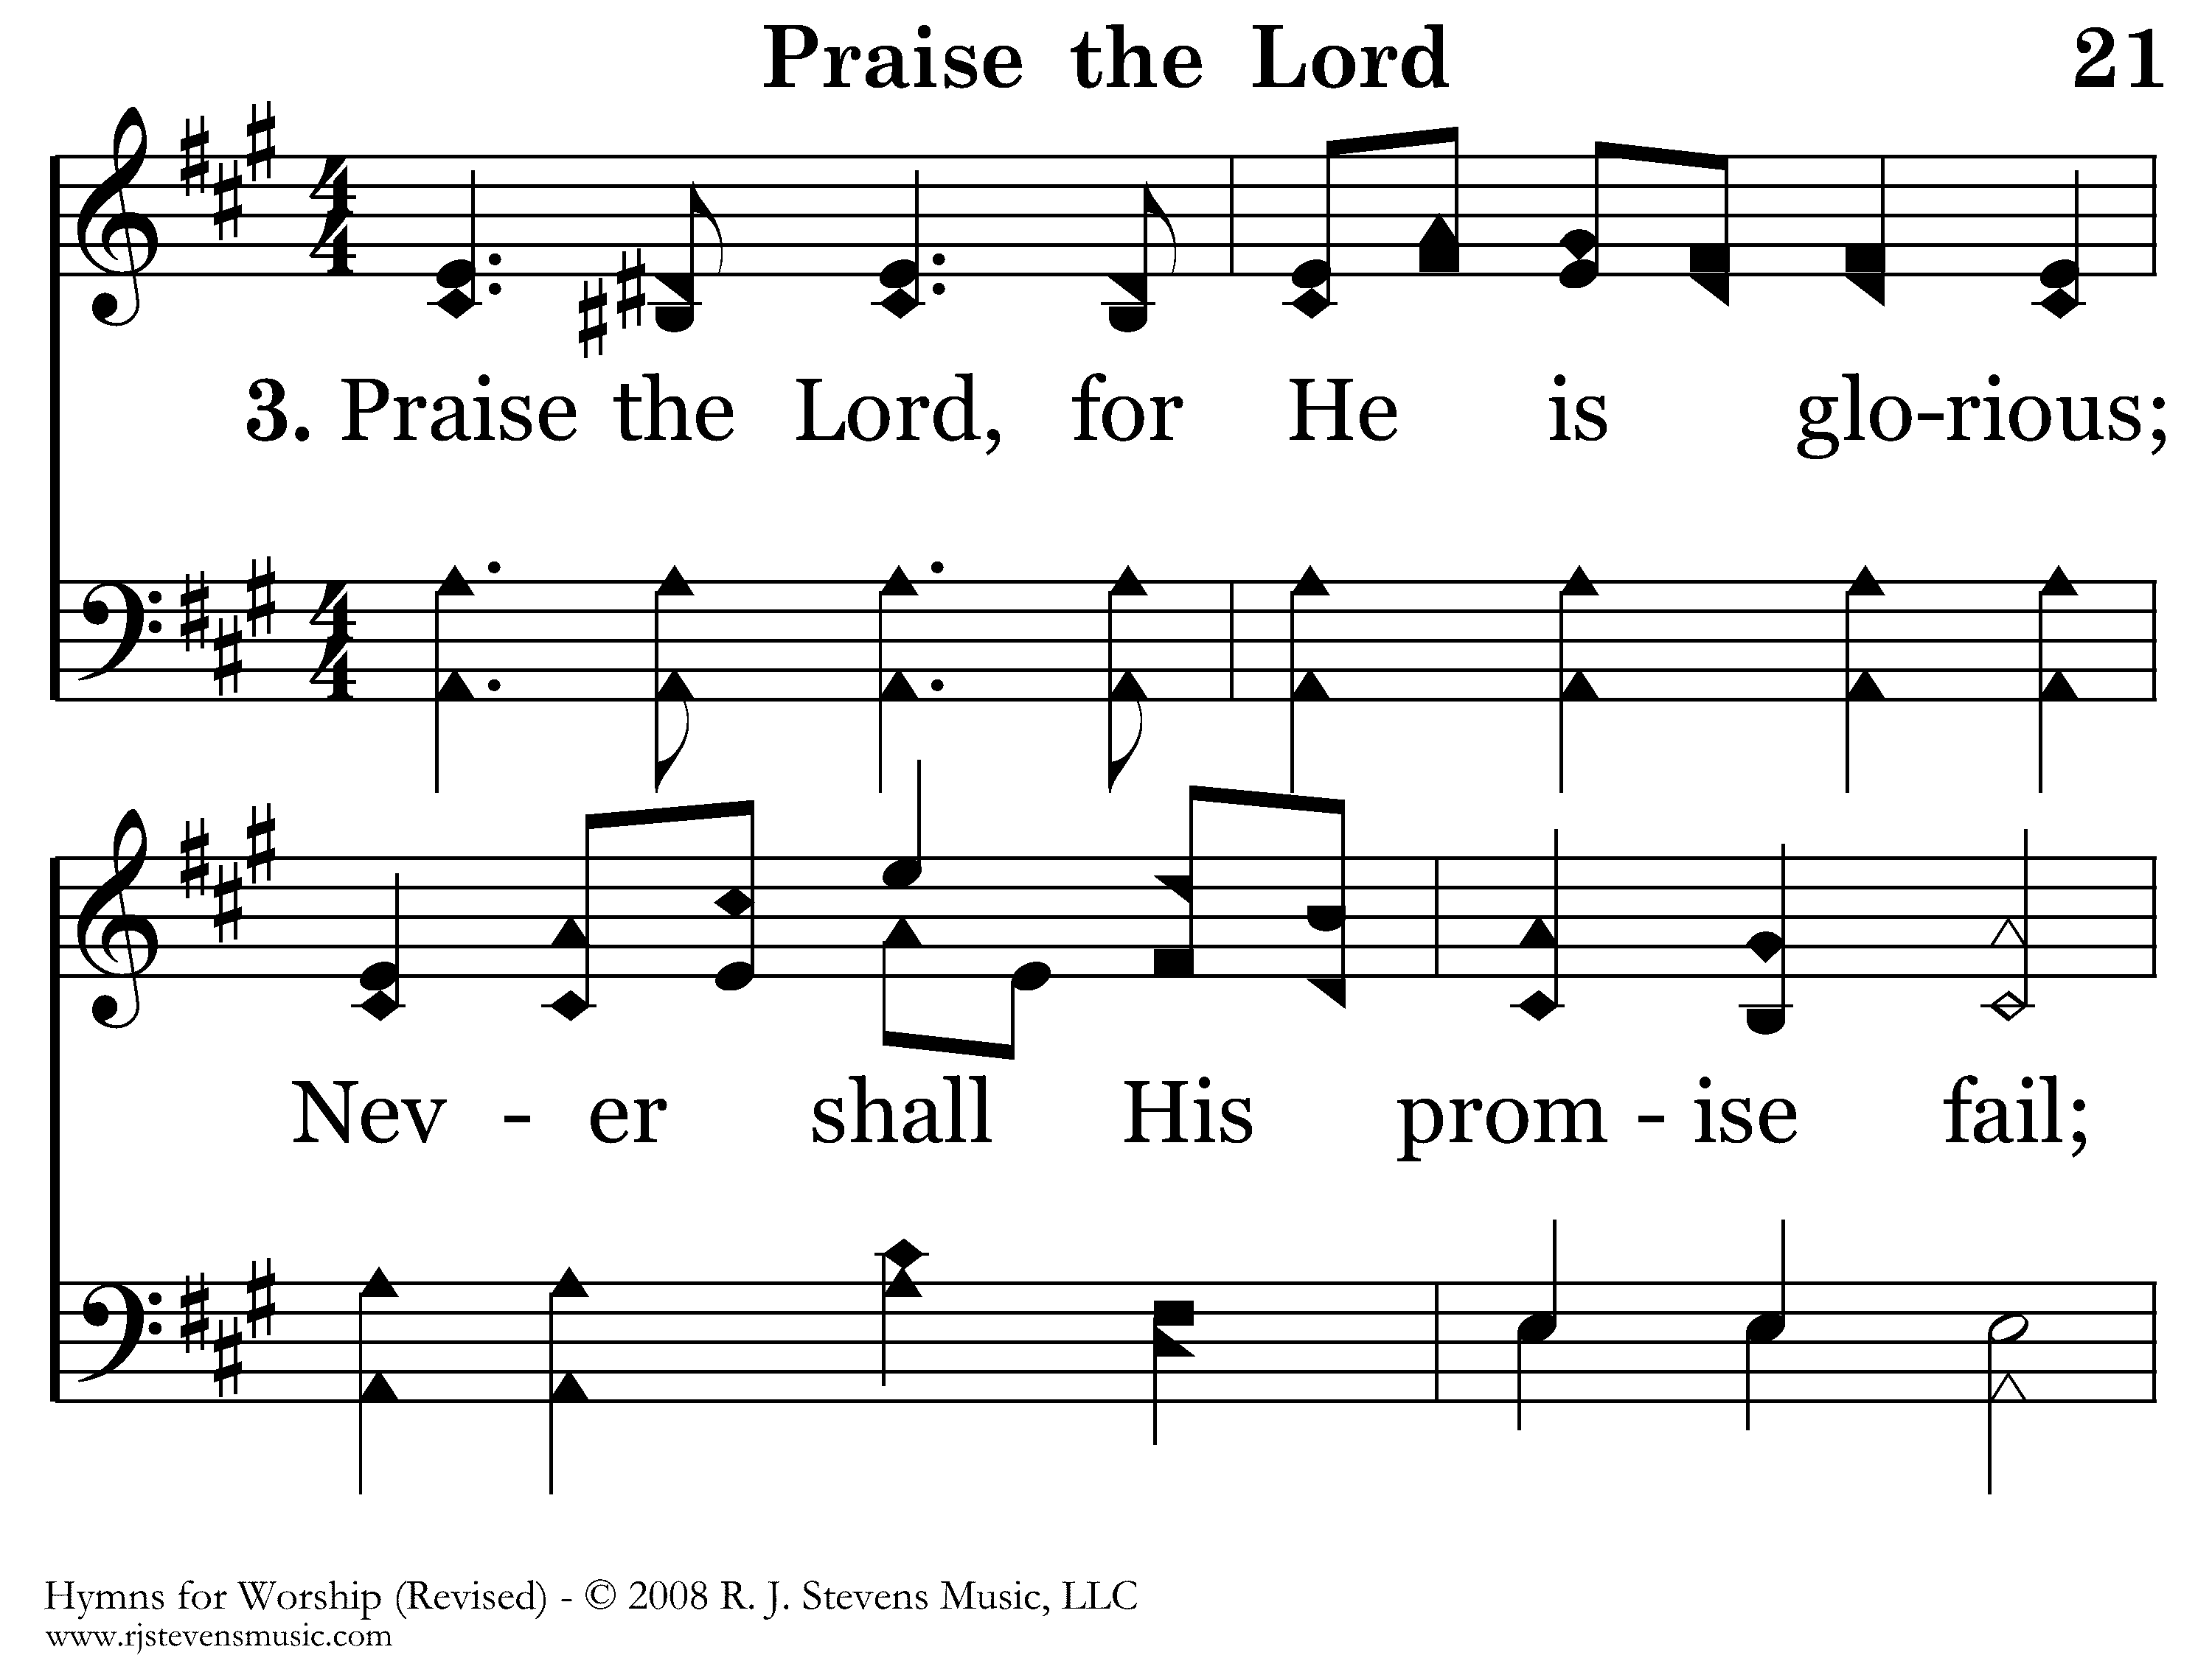
021 - Praise The Lord - 3.1

Slide 21
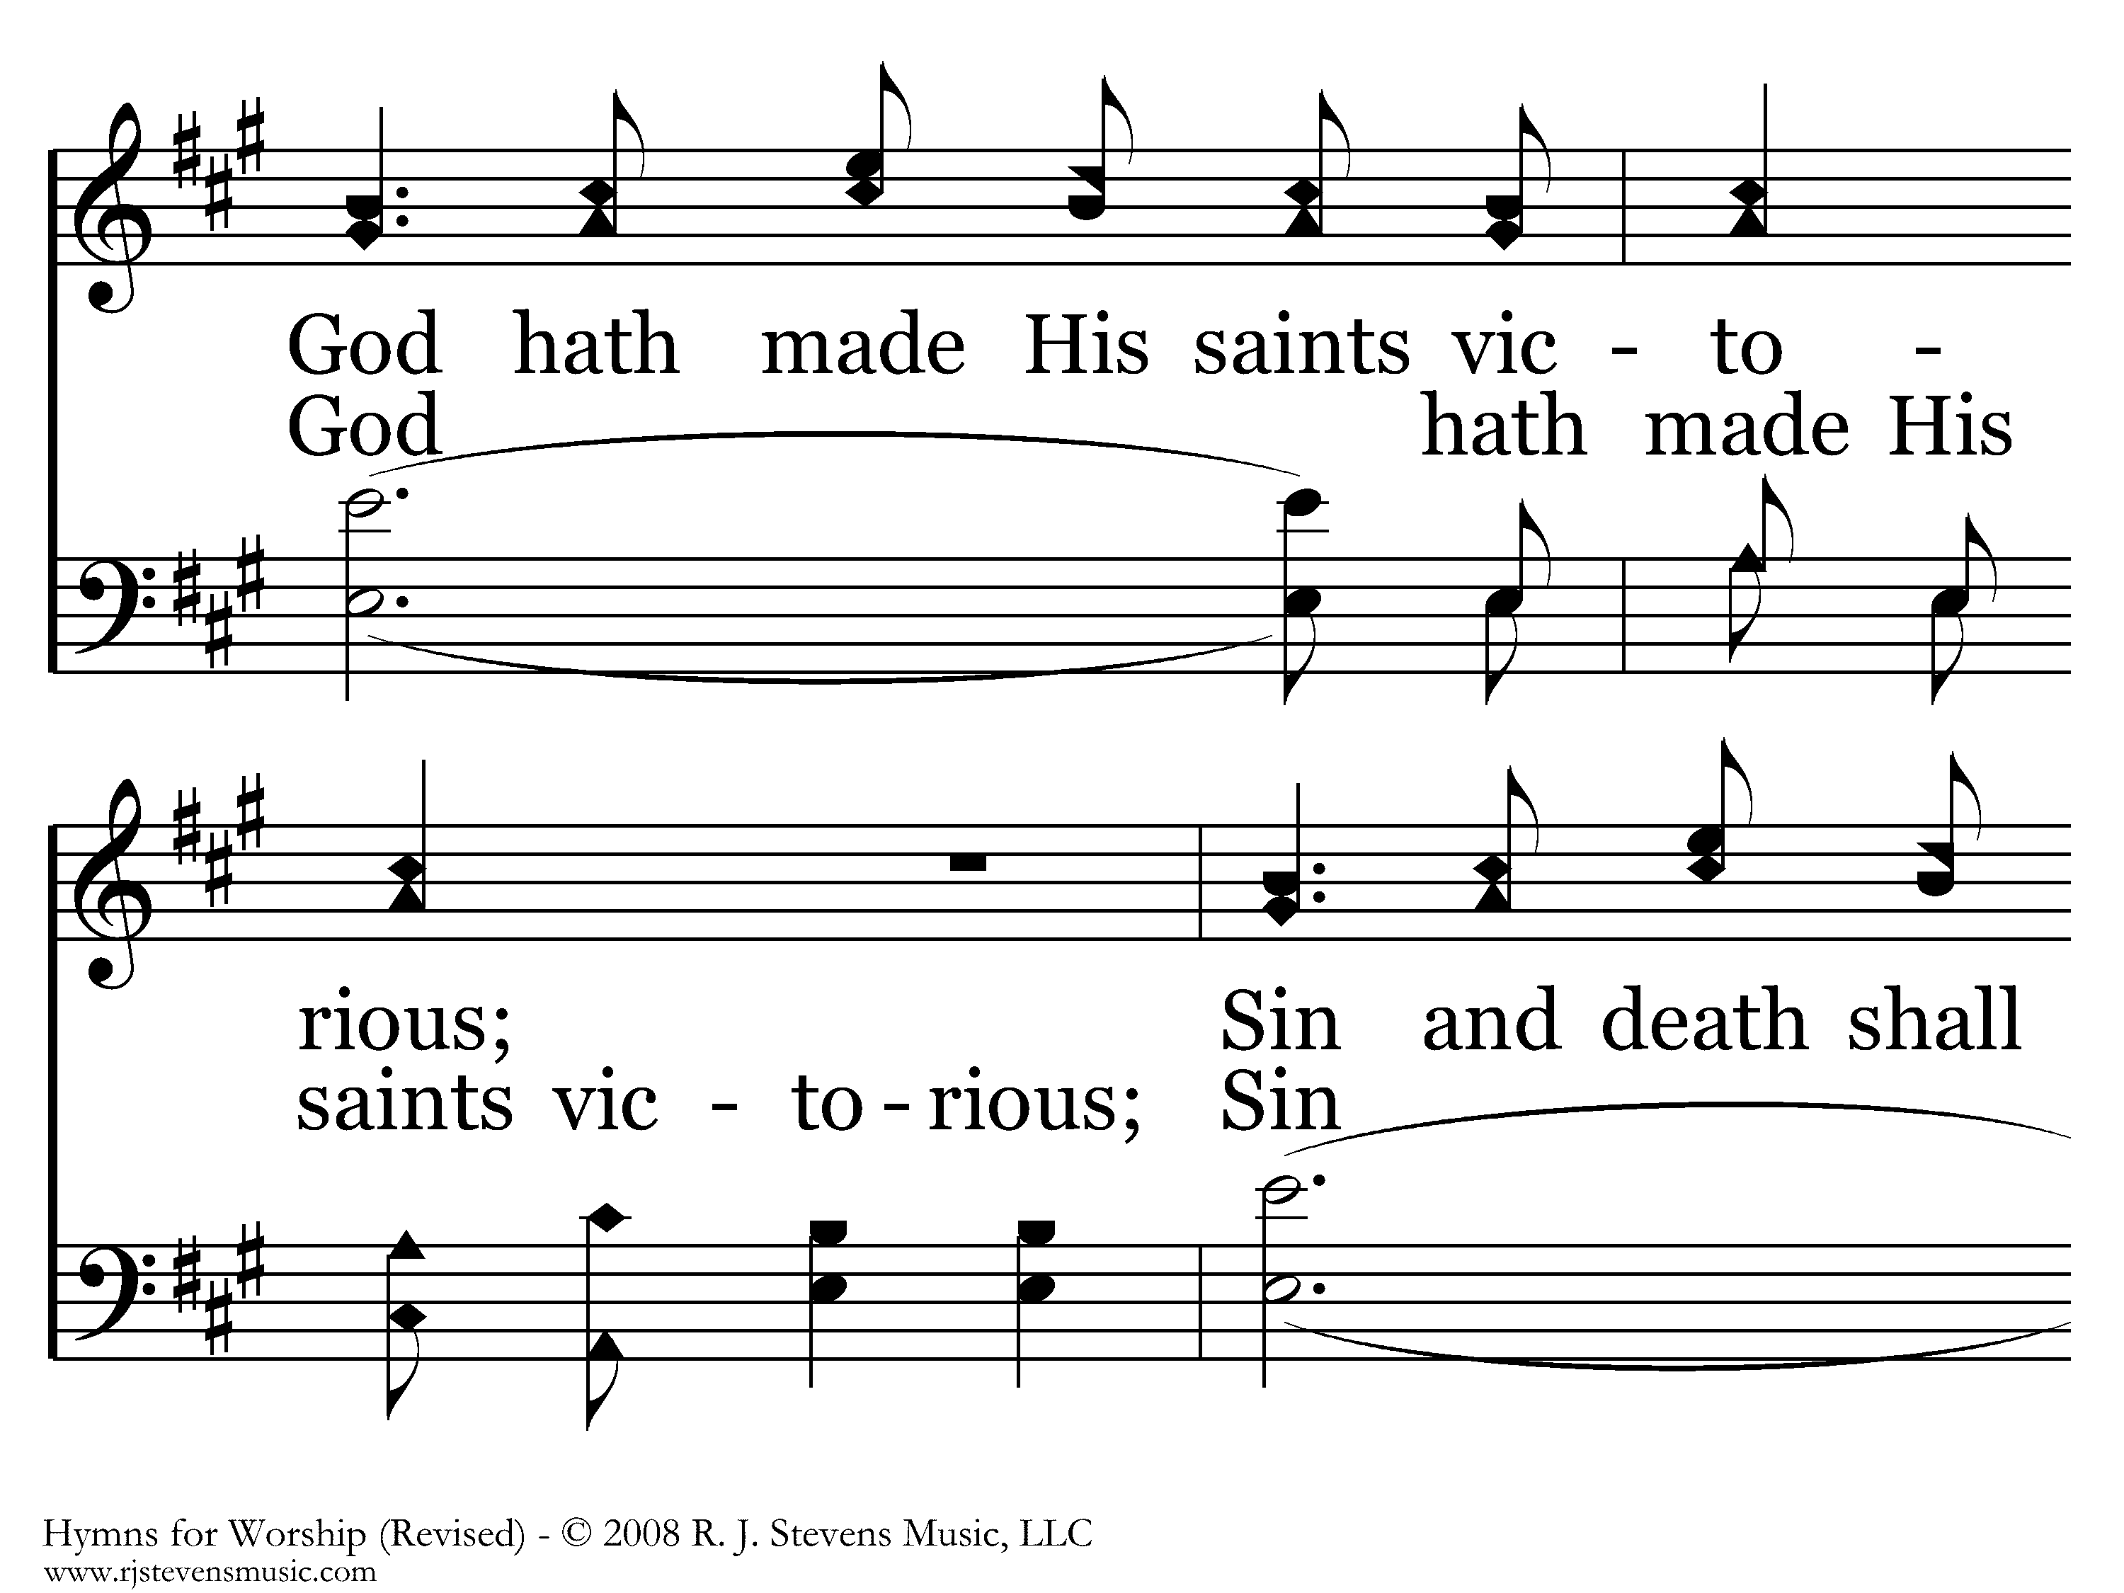
021 - Praise The Lord - 3.2

Slide 22
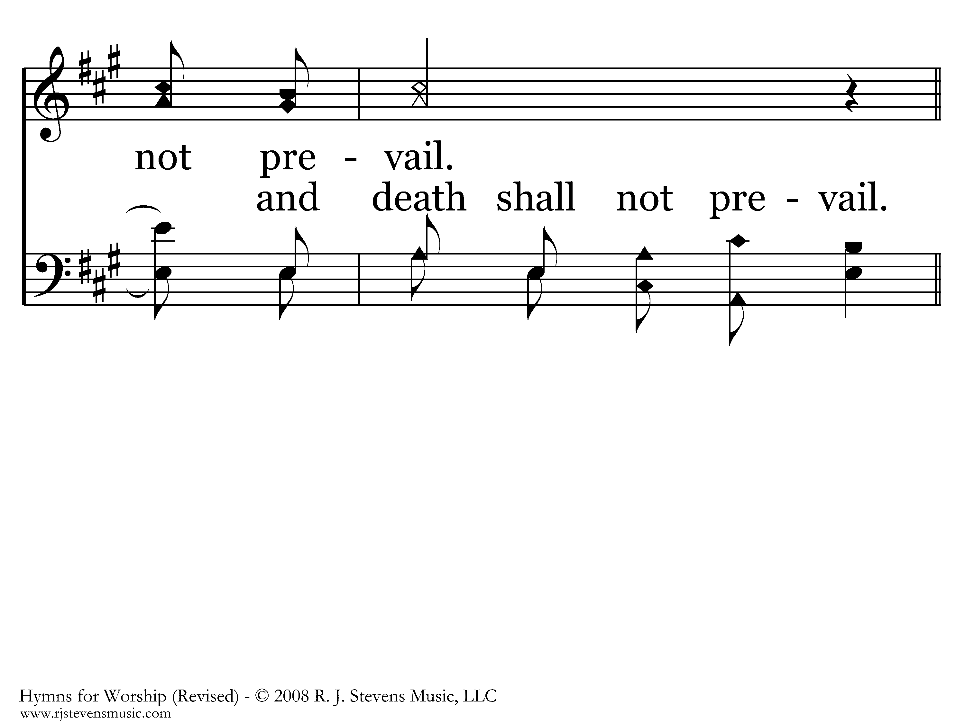
021 - Praise The Lord - 3.3

Slide 23
021 - Praise The Lord - C.1
End of Verse 3

Slide 24
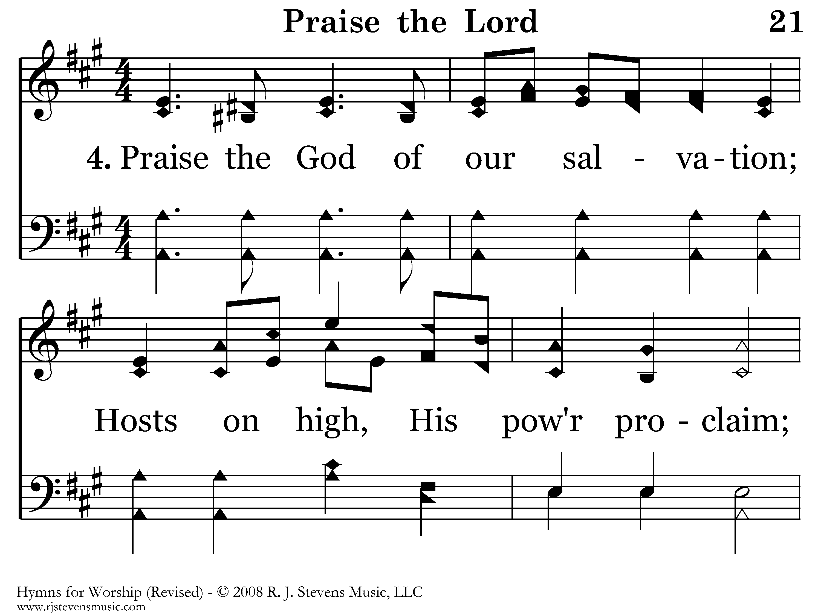
021 - Praise The Lord - 4.1

Slide 25
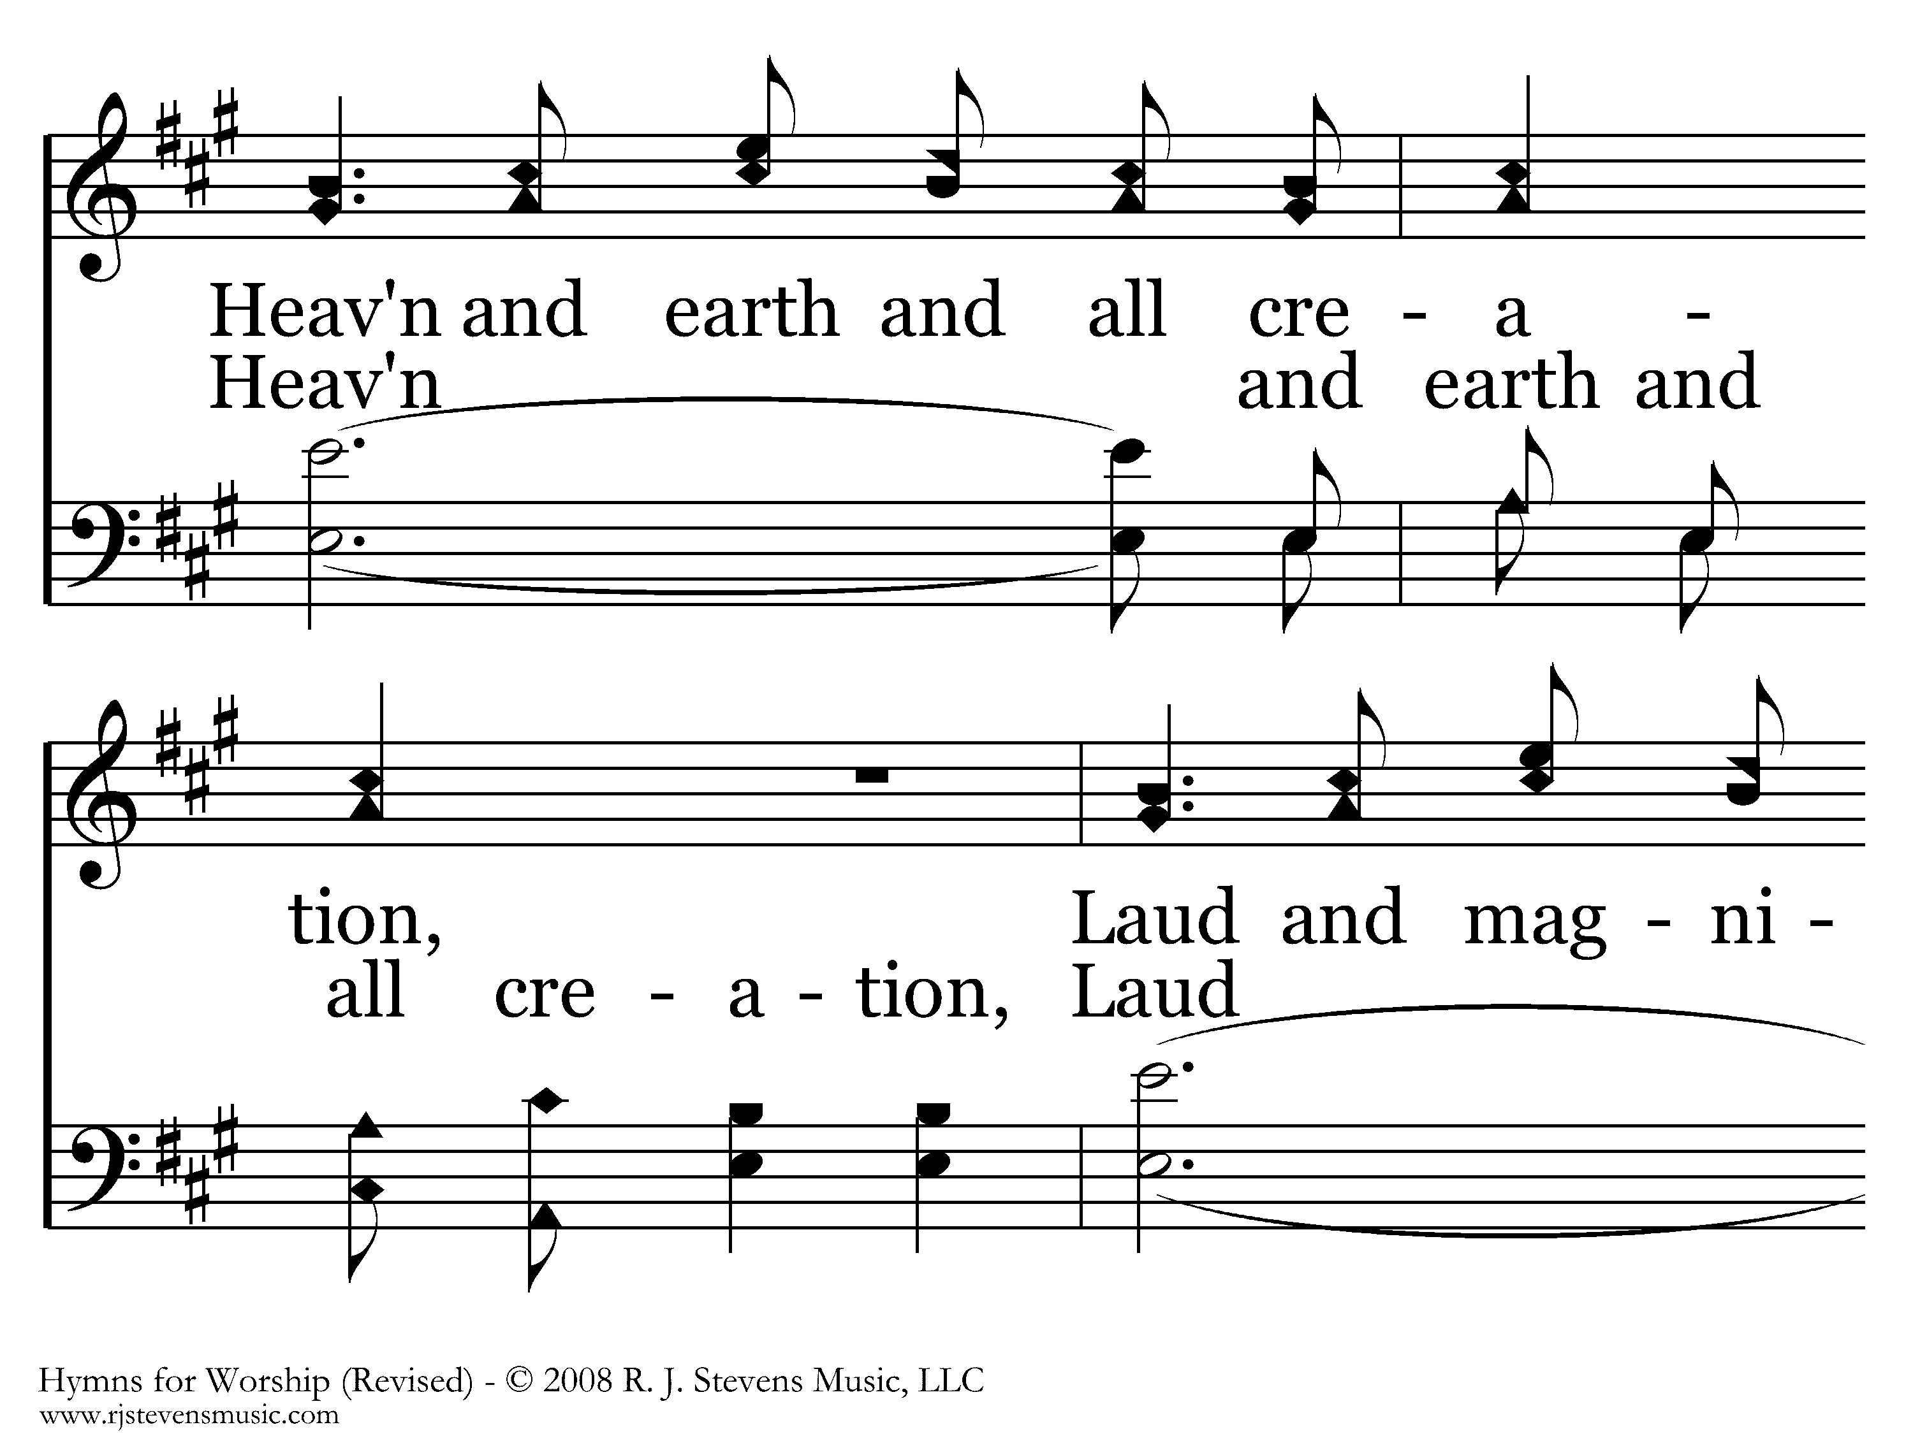
021 - Praise The Lord - 4.2

Slide 26
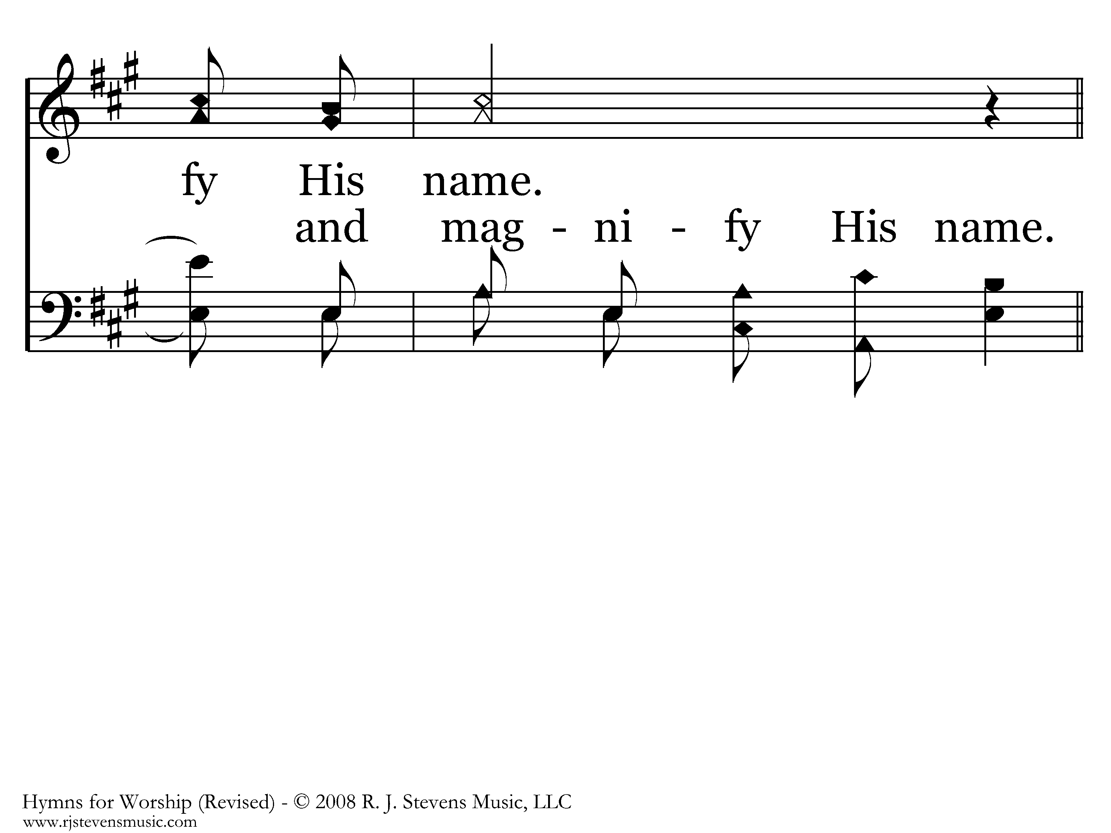
021 - Praise The Lord - 4.3

Slide 27
021 - Praise The Lord - C.1
End of Song

Slide 28
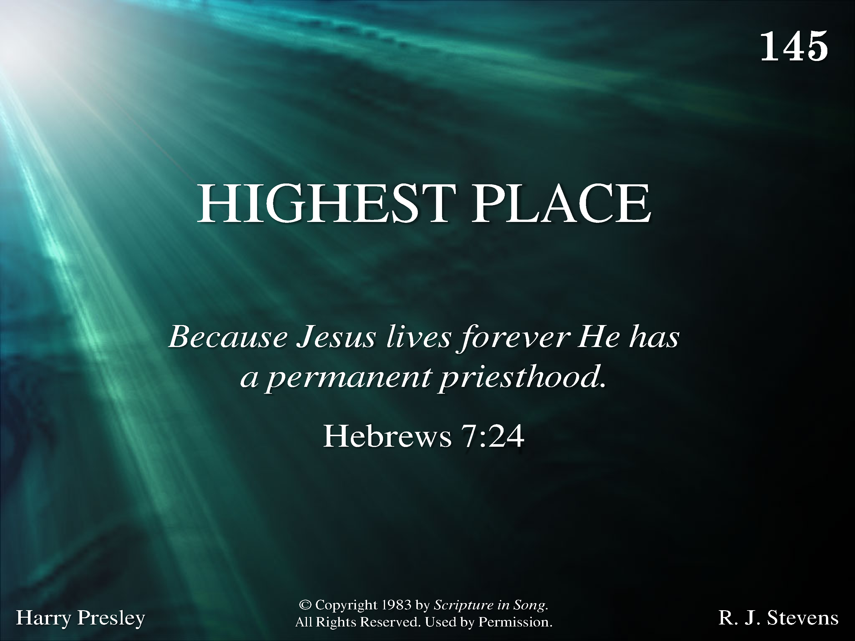
1145 - Highest Place - Title

Slide 29
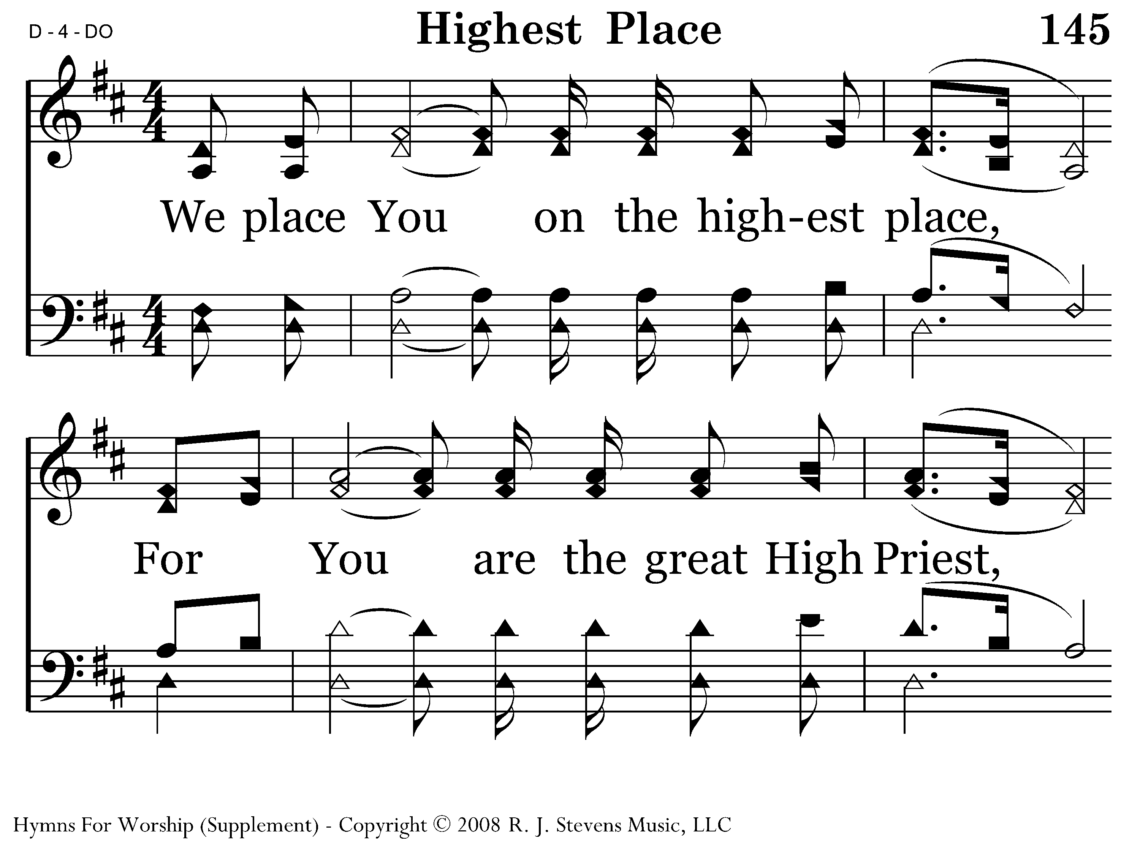
1145 - Highest Place - 1.1

Slide 30
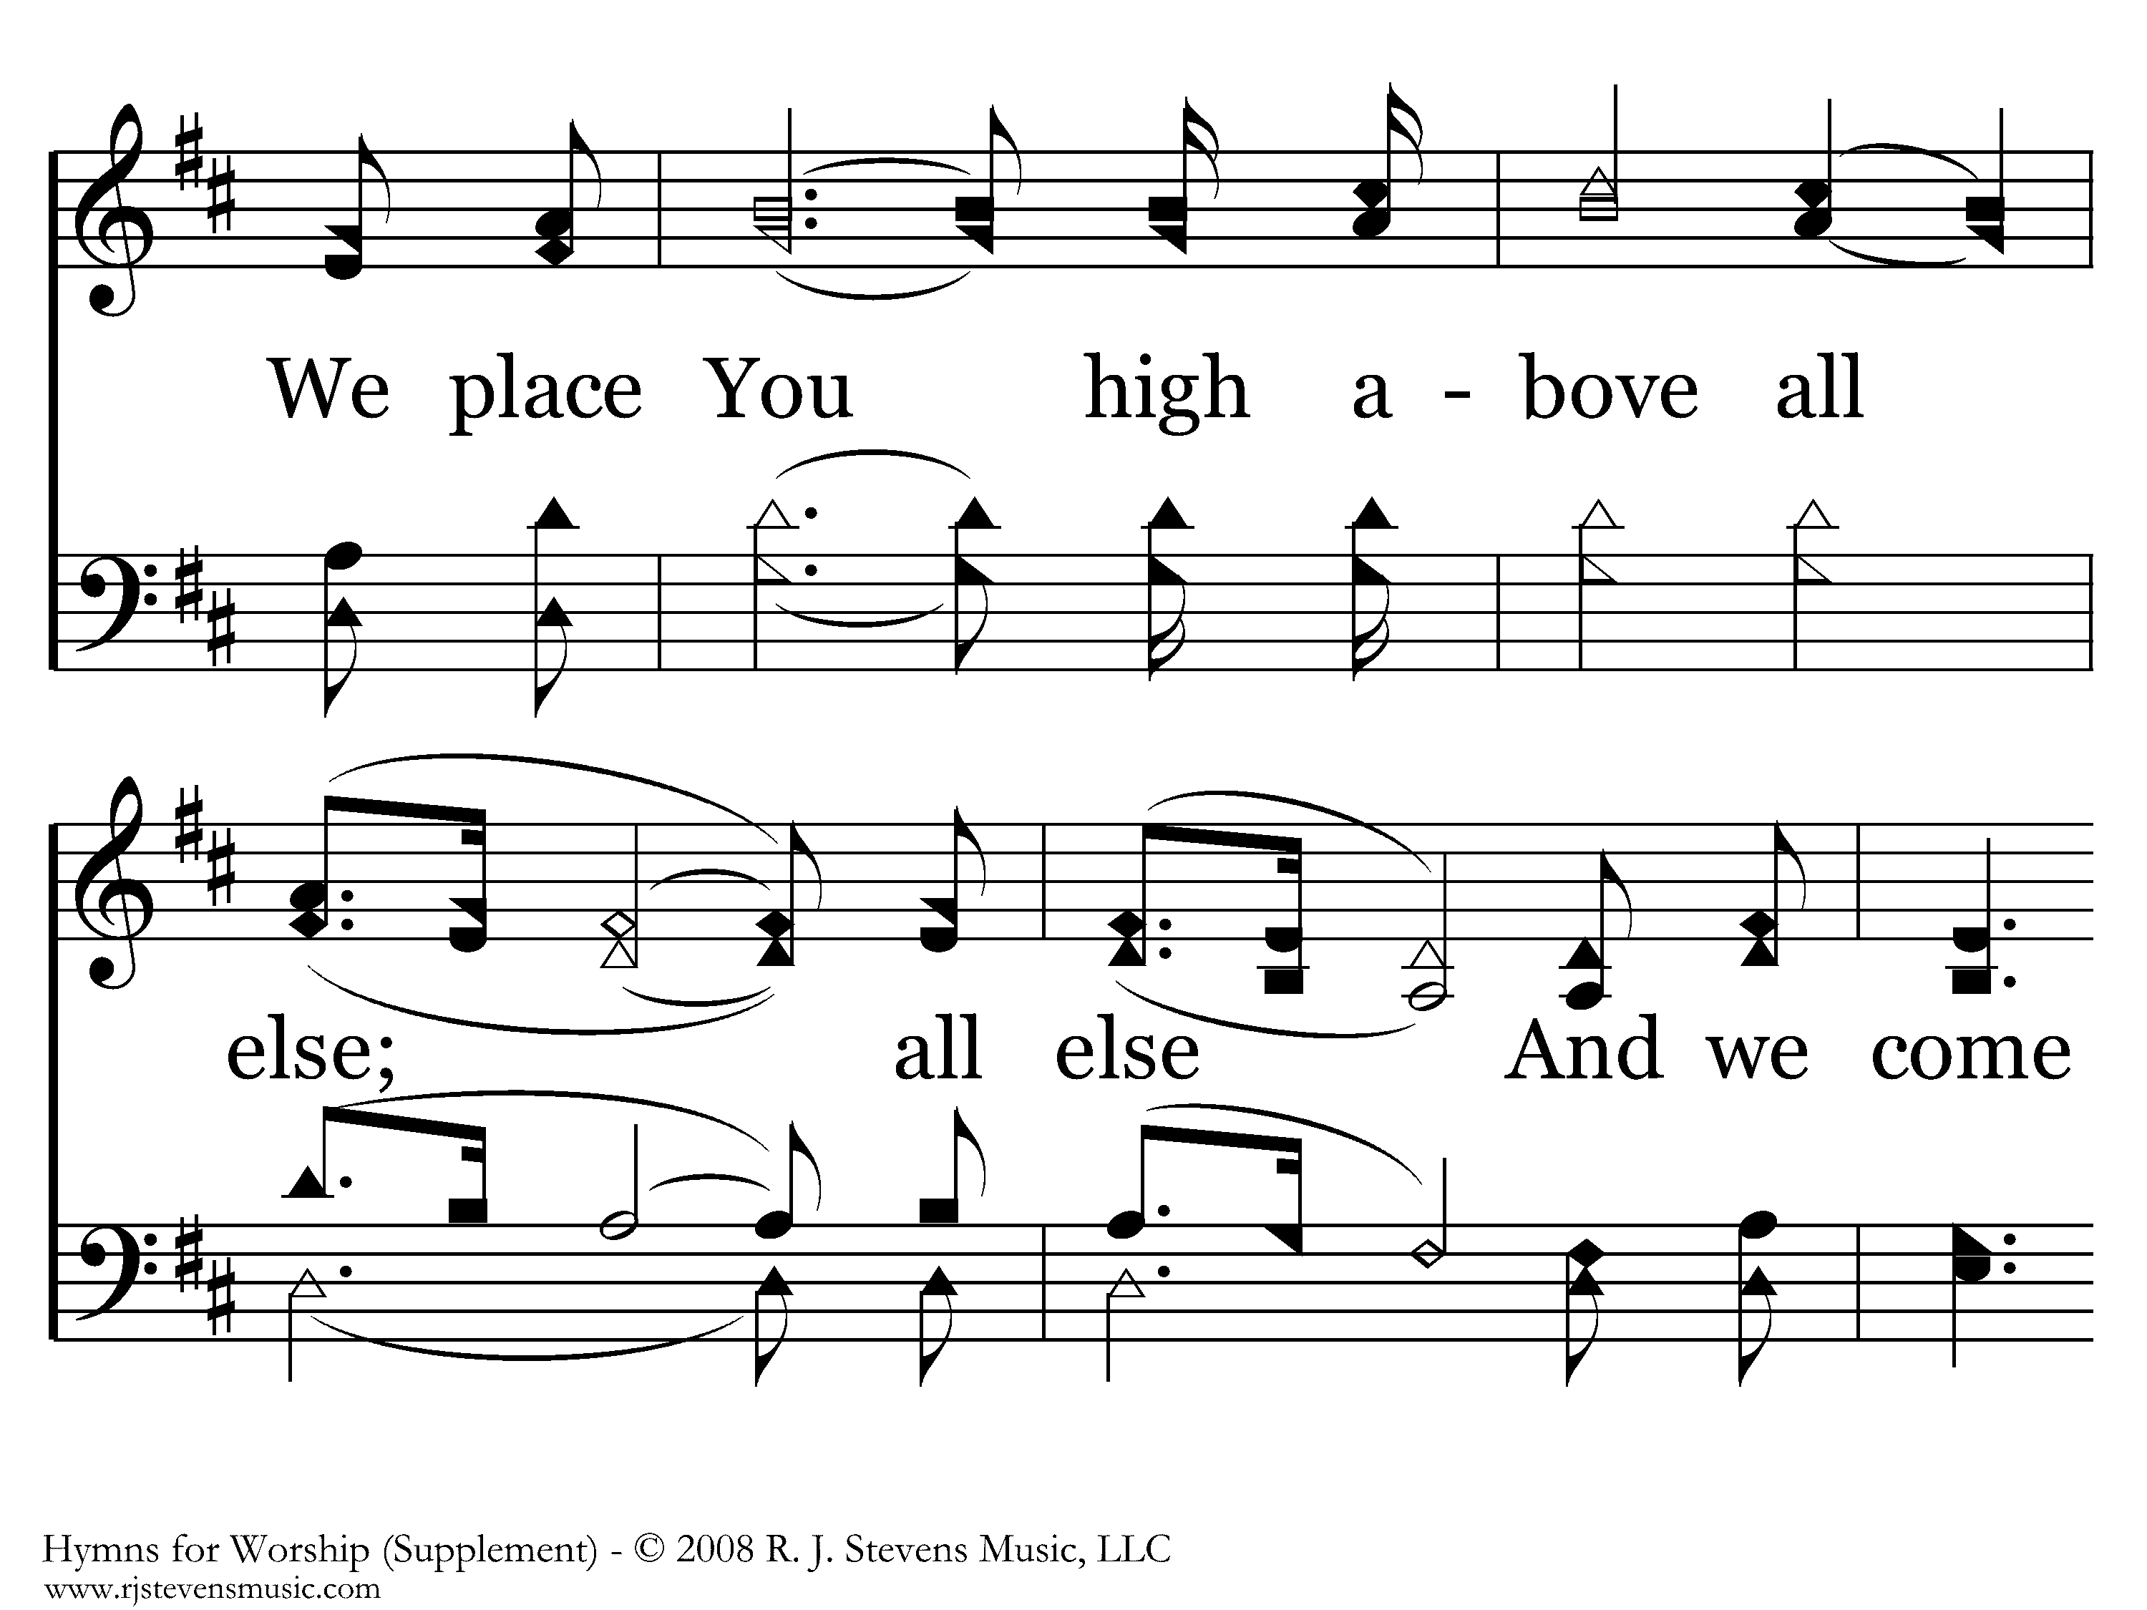
1145 - Highest Place - 1.2

Slide 31
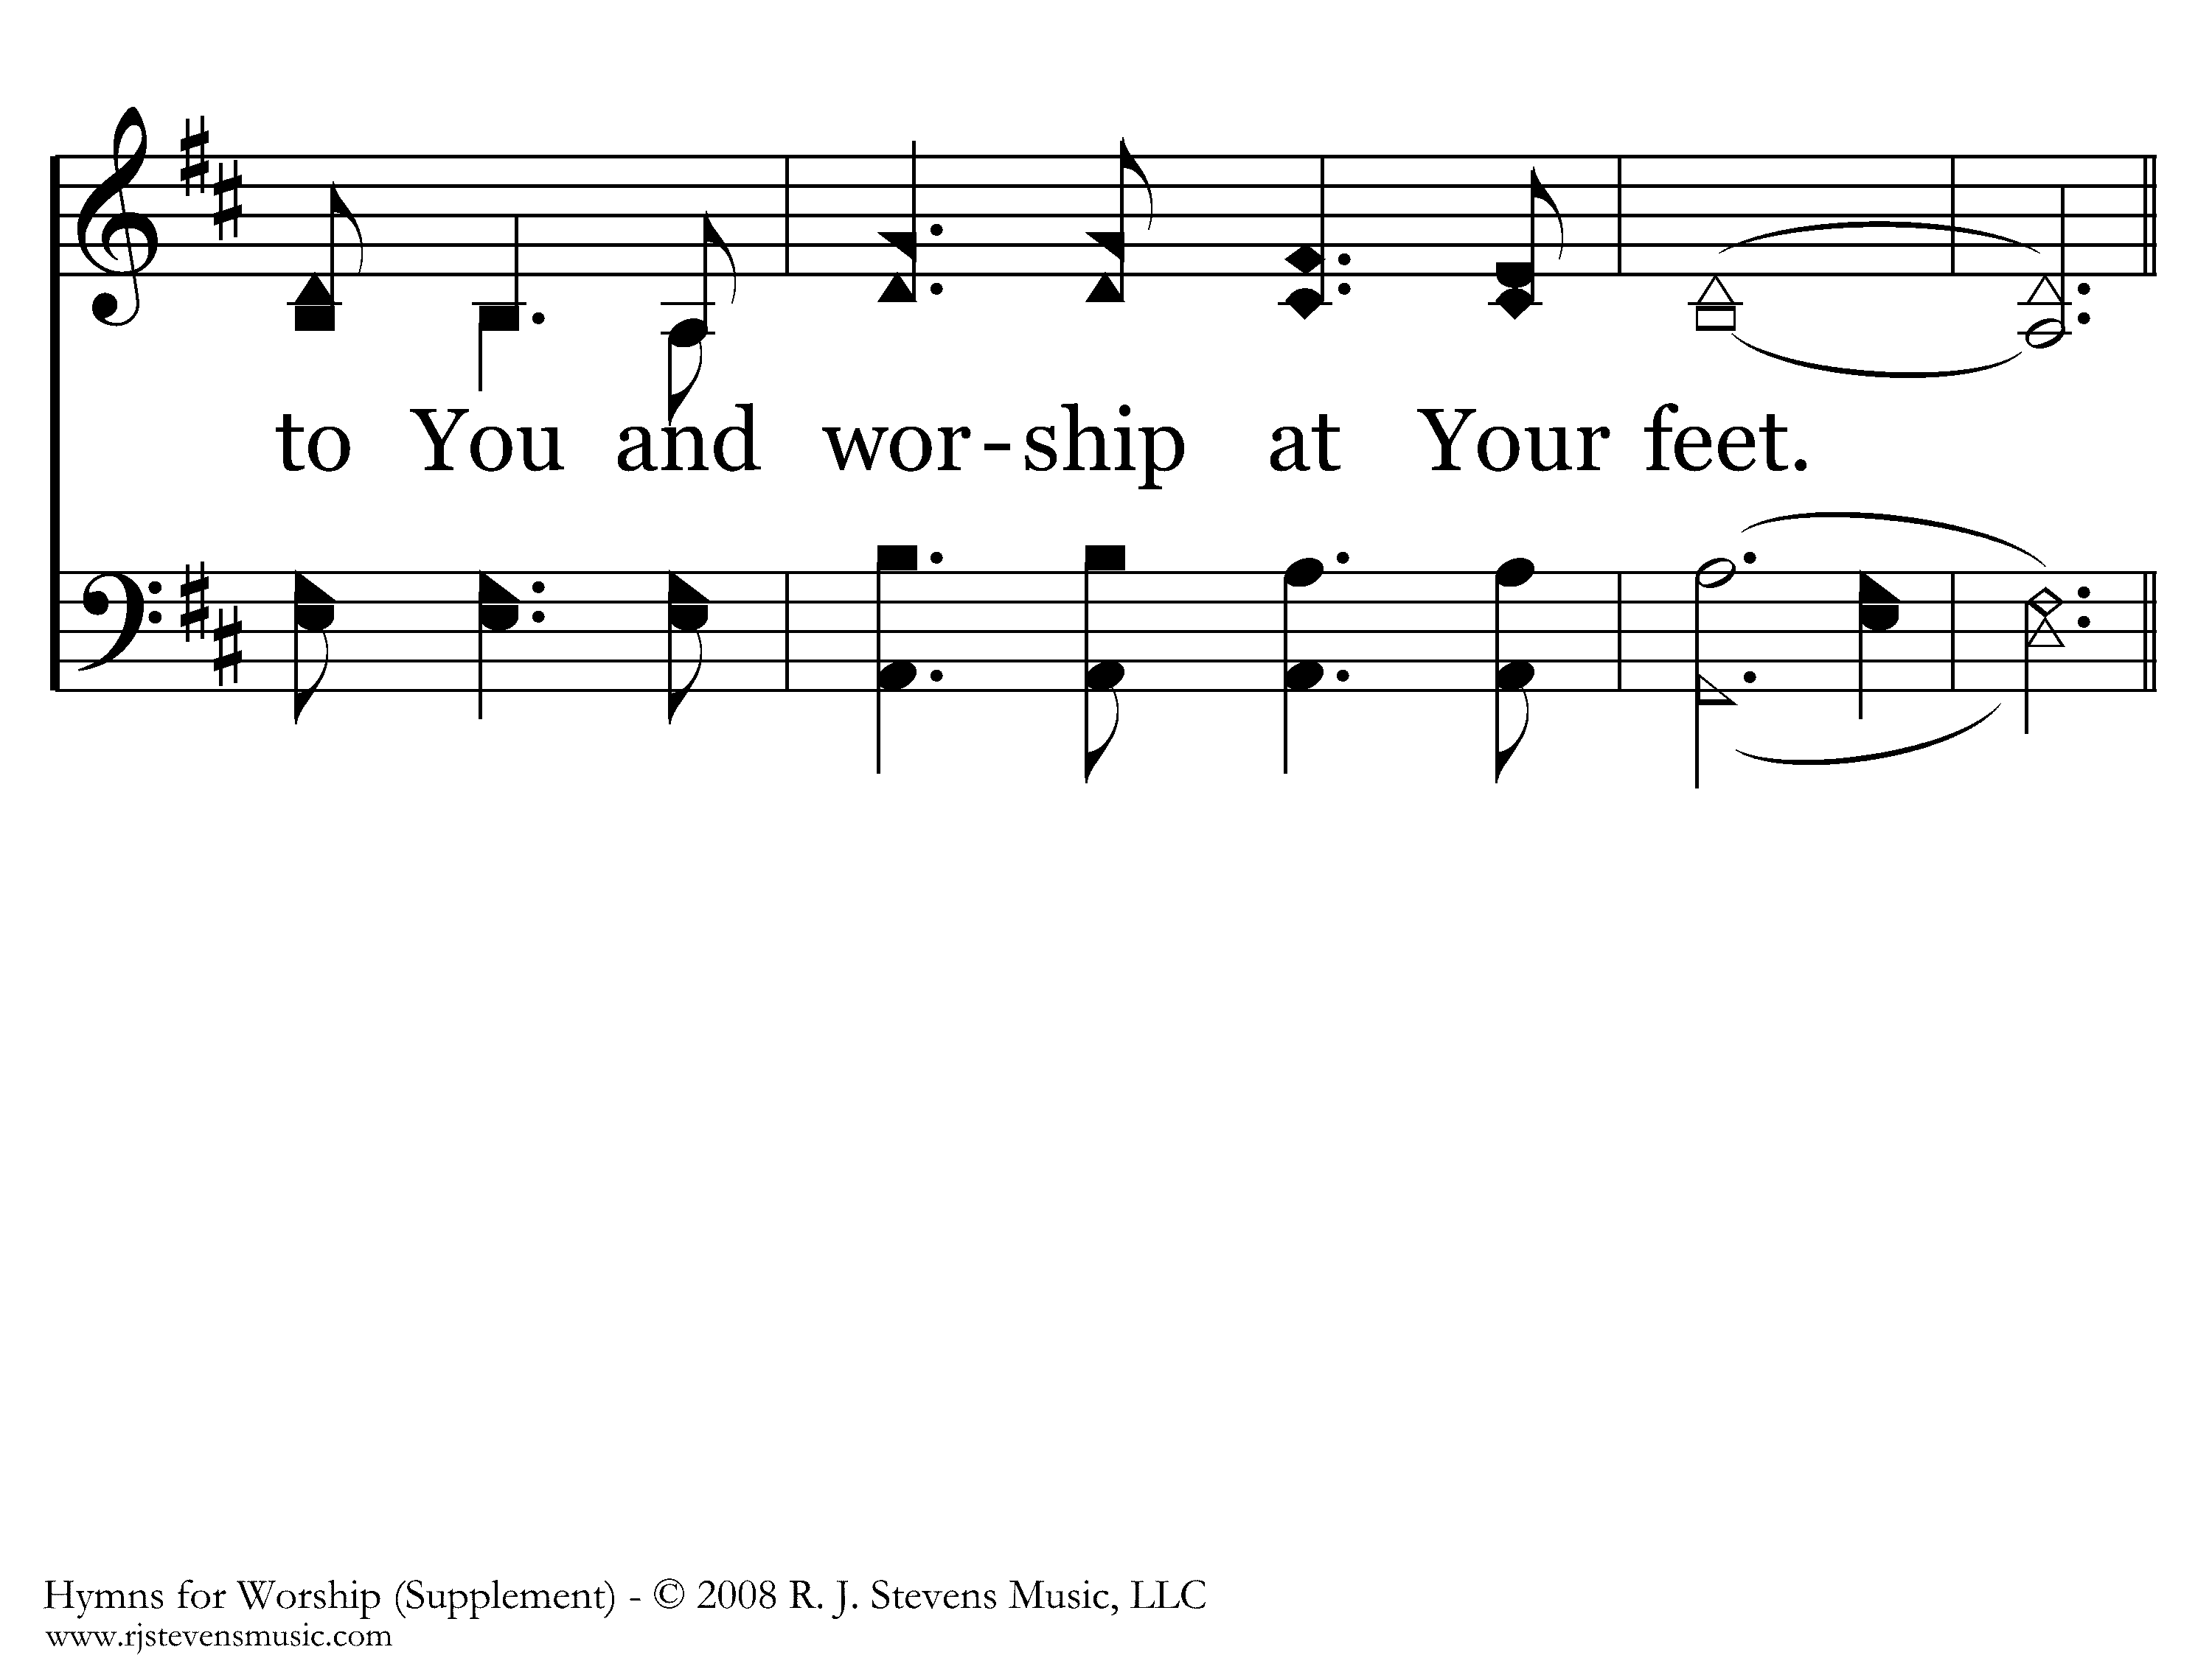
1145 - Highest Place - 1.3

Slide 32
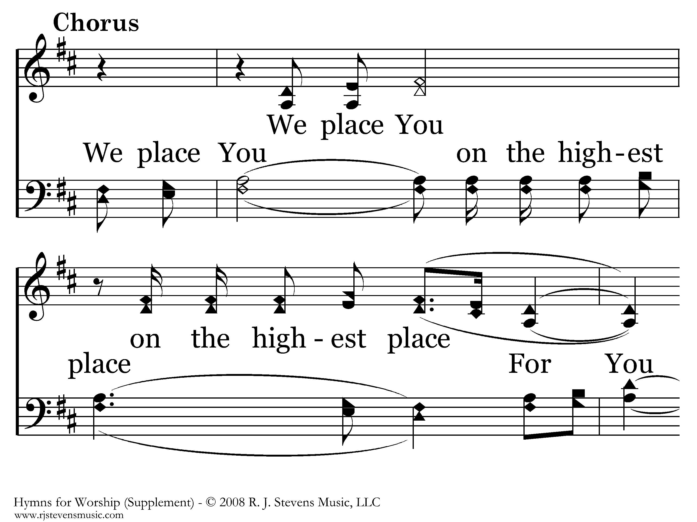
1145 - Highest Place - C.1

Slide 33
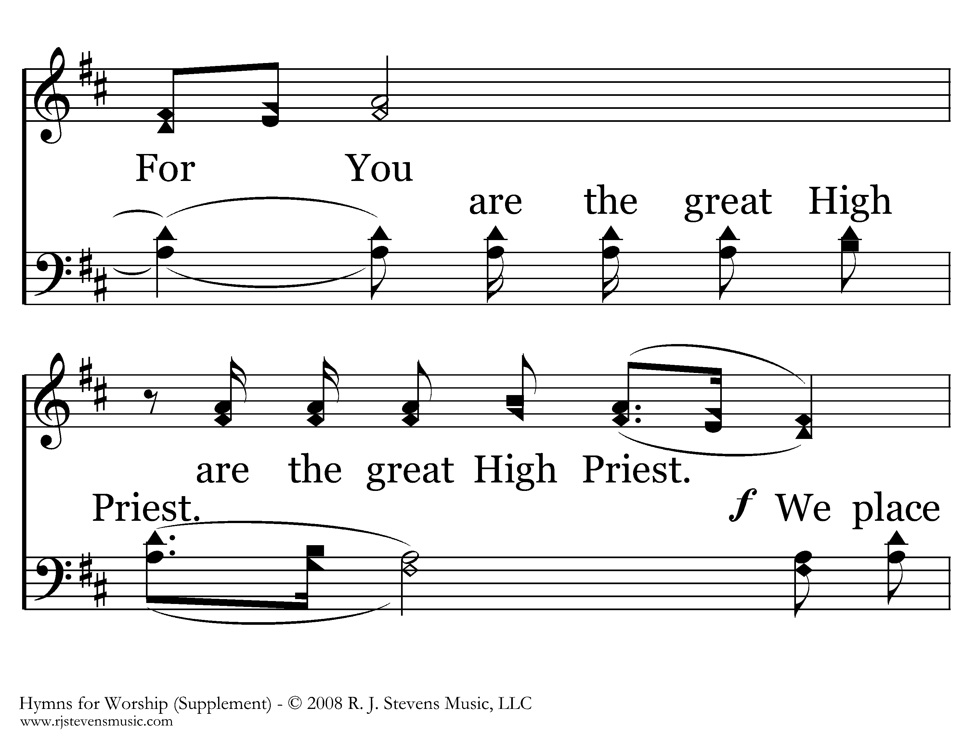
1145 - Highest Place - C.2

Slide 34
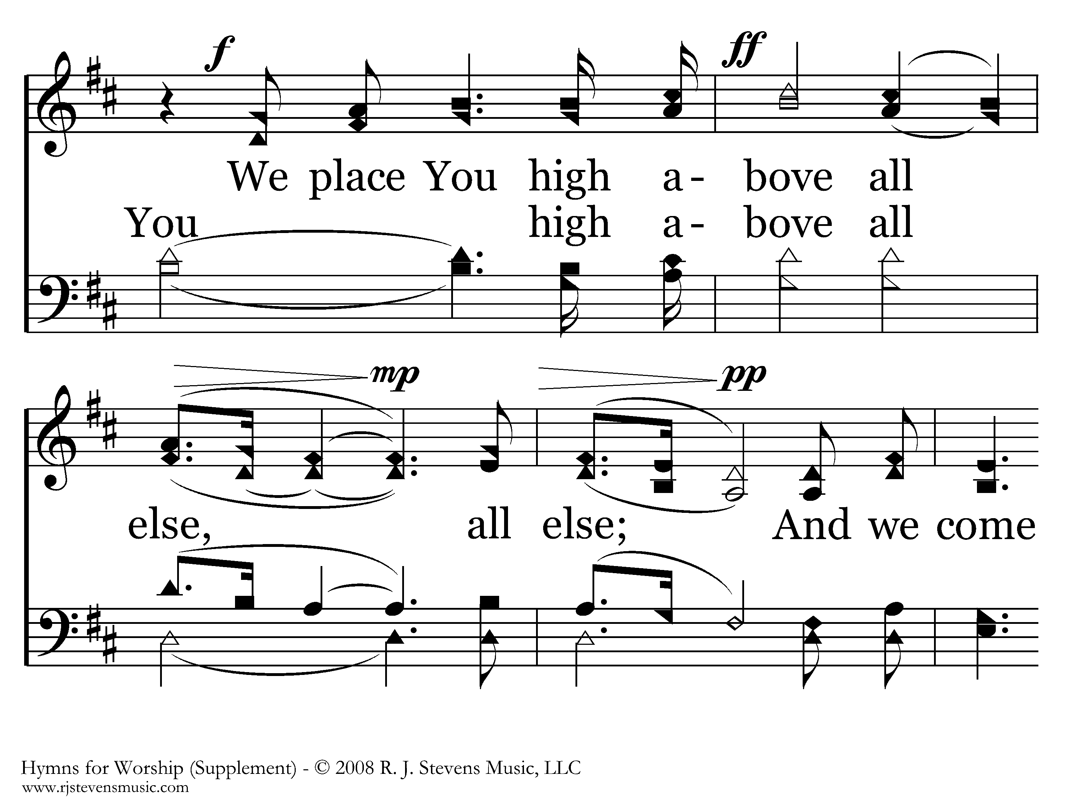
1145 - Highest Place - C.3

Slide 35
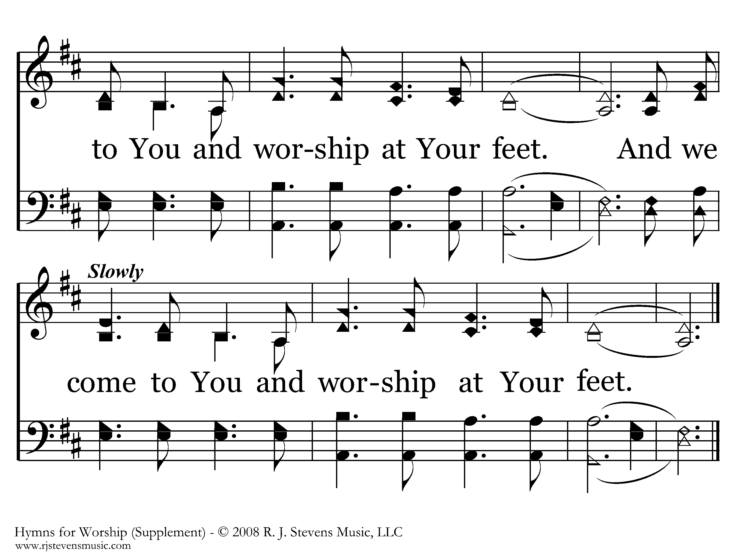
1145 - Highest Place - C.4
End of Song

Slide 36
Reading
Genesis 4:1-10
Brady Roy

Slide 37
“Crying Out for Vengeance”
Jeff Smelser

Slide 38
Crying out for Vengeance
A God of Vengeance, Wrath
Two Populations: One Subject to Wrath, & One Not
Crying Out for Vengeance
Be Careful What You Ask!
Mis-understanding Why Some Are Spared God’s Wrath
Don’t Be Among those Subject to Wrath

Slide 39
A God of Wrath and Vengeance
Romans 1:18
For the wrath of God is revealed from heaven against all ungodliness and unrighteousness of people who suppress the truth in unrighteousness
Romans 12:19
Never take your own revenge, beloved, but leave room for the wrath of God, for it is written: “Vengeance is Mine, I will repay,” says the Lord.

Slide 40
A God of Wrath and Vengeance
Romans 12:19
Never take your own revenge, beloved, but leave room for the wrath of God, for it is written: “Vengeance is Mine, I will repay,” says the Lord.

Slide 41
God Sees Two Populations:
One Subject to His Wrath, One Not
Romans 12:19
Never take your own revenge, beloved, but leave room for the wrath of God, for it is written: “Vengeance is Mine, I will repay,” says the Lord.

Slide 42
God Sees Two Populations:
One Subject to His Wrath, One Not
Deuteronomy 32
³⁵ Vengeance is Mine, and retribution;
In due time their foot will slip.
For the day of their disaster is near,
And the impending things are hurrying to them.’
³⁶ For the Lord will vindicate His people,
And will have compassion on His servants,
When He sees that their strength is gone,
And there is none remaining, bond or free.

Slide 43
God Sees Two Populations:
One Subject to His Wrath, One Not
Deuteronomy 32
³⁵ Vengeance is Mine, and retribution;
In due time their foot will slip.
For the day of their disaster is near,
And the impending things are hurrying to them.’
³⁶ For the Lord will vindicate His people,
And will have compassion on His servants,
When He sees that their strength is gone,
And there is none remaining, bond or free.

Slide 44
God Sees Two Populations:
One Subject to His Wrath, One Not
Deuteronomy 32
³⁵ Vengeance is Mine, and retribution;
In due time their foot will slip.
For the day of their disaster is near,
And the impending things are hurrying to them.’
³⁶ For the Lord will vindicate His people,
And will have compassion on His servants,
When He sees that their strength is gone,
And there is none remaining, bond or free.

Slide 45
God Sees Two Populations:
One Subject to His Wrath, One Not
In Revelation:
“Those who live on the earth”
vs.
Those who dwell in heaven

Slide 46
God Sees Two Populations:
One Subject to His Wrath, One Not
3:10 that hour which is about to come upon the whole world, to test those who live on the earth.
6:10 judging and avenging our blood on those who live on the earth
8:13 Woe, woe, woe to those who live on the earth
11:10 And those who live on the earth will rejoice… because these two prophets tormented those who live on the earth.
13:8 All who live on the earth will worship him [the beast]
13:12 He makes the earth and those who live on it worship the first beast
13:14 deceives those who live on the earth because of the signs which it was given him to perform in the presence of the beast, telling those who live on the earth to make an image to the beast
17:2 those who live on the earth became drunk with the wine of her sexual immorality.
17:8 those who live on the earth, whose names have not been written in the book of life

Slide 47
God Sees Two Populations:
One Subject to His Wrath, One Not
3:10 that hour which is about to come upon the whole world, to test those who live on the earth.
6:10 judging and avenging our blood on those who live on the earth
8:13 Woe, woe, woe to those who live on the earth
11:10 And those who live on the earth will rejoice… because these two prophets tormented those who live on the earth.
13:8 All who live on the earth will worship him
13:12 He makes the earth and those who live on it worship the first beast
13:14 deceives those who live on the earth because of the signs which it was given him to perform in the presence of the beast, telling those who live on the earth to make an image to the beast
17:2 those who live on the earth became drunk with the wine of her sexual immorality.
17:8 those who live on the earth, whose names have not been written in the book of life
13:6 those who dwell in heaven
Those Who Live on the Earth
Ephesians 2:6 raised us up with Him, and seated us with Him in the heavenly places in Christ Jesus

Slide 48
Crying out for Vengeance
Genesis 4
¹⁰ Then He said, “What have you done? The voice of your brother’s blood is crying out to Me from the ground.”
Revelation 6:10
“How long, O Lord, holy and true, will You refrain from judging and avenging our blood on those who live on the earth?”

Slide 49
Crying out for Vengeance
Luke 18
³ Now there was a widow in that city, and she kept coming to him, saying, ‘Give me justice against my opponent.’ ⁴ For a while he was unwilling; but later he said to himself, ‘Even though I do not fear God nor respect any person, ⁵ yet because this widow is bothering me, I will give her justice; otherwise by continually coming she will wear me out.’” ⁶ And the Lord said, “Listen to what the unrighteous judge said; ⁷ now, will God not bring about justice for His elect who cry out to Him day and night, and will He delay long for them? ⁸ I tell you that He will bring about justice for them quickly.

Slide 50
Crying out for Vengeance
Luke 18
³ Now there was a widow in that city, and she kept coming to him, saying, ‘Give me justice against my opponent.’ ⁴ For a while he was unwilling; but later he said to himself, ‘Even though I do not fear God nor respect any person, ⁵ yet because this widow is bothering me, I will give her justice; otherwise by continually coming she will wear me out.’” ⁶ And the Lord said, “Listen to what the unrighteous judge said; ⁷ now, will God not bring about justice for His elect who cry out to Him day and night, and will He delay long for them? ⁸ I tell you that He will bring about justice for them quickly.

Slide 51
Crying out for Vengeance
Luke 18
³ Now there was a widow in that city, and she kept coming to him, saying, ‘Give me justice against my opponent.’ ⁴ For a while he was unwilling; but later he said to himself, ‘Even though I do not fear God nor respect any person, ⁵ yet because this widow is bothering me, I will give her justice; otherwise by continually coming she will wear me out.’” ⁶ And the Lord said, “Listen to what the unrighteous judge said; ⁷ now, will God not bring about justice for His elect who cry out to Him day and night, and will He delay long for them? ⁸ I tell you that He will bring about justice for them quickly.

Slide 52
Crying out for Vengeance
Psalm 58
¹⁰ The righteous will rejoice when he sees vengeance;
He will wash his feet in the blood of the wicked.
¹¹ And people will say, “There certainly is a reward for the righteous;
There certainly is a God who judges on the earth!”
Be Careful What You Ask!
or
If You Ask, Be Careful Who You Are!

Slide 53
Dreadful Mistake:
Being on the Wrong Side
Perhaps this is why people don’t like to think about a Vengeful God, a God of Justice…
Be Careful What You Ask!
or
If You Ask, Be Careful Who You Are!
They know they’re on the wrong side of justice, and don’t want to do anything about it! They just want God to be less just

Slide 54
Mis-understanding Why Some Are Spared God’s Wrath
Dreadful Mistake:
Being on the Wrong Side
Luke 18
³ Now there was a widow in that city, and she kept coming to him, saying, ‘Give me justice against my opponent.’ ⁴ For a while he was unwilling; but later he said to himself, ‘Even though I do not fear God nor respect any person, ⁵ yet because this widow is bothering me, I will give her justice; otherwise by continually coming she will wear me out.’” ⁶ And the Lord said, “Listen to what the unrighteous judge said; ⁷ now, will God not bring about justice for His elect who cry out to Him day and night, and will He delay long for them? ⁸ I tell you that He will bring about justice for them quickly. However, when the Son of Man comes, will He find faith on the earth?”
⁹ Now He also told this parable to some people who trusted in themselves that they were righteous, and viewed others with contempt: ¹⁰ “Two men went up into the temple to pray, one a Pharisee and the other a tax collector. ¹¹ The Pharisee stood and began praying this in regard to himself: ‘God, I thank You that
I am not like other people: swindlers, crooked, adulterers, or even like this tax collector. ¹² I fast twice a week; I pay tithes of all that I get.’ ¹³ But the tax collector, standing some distance away, was even unwilling to raise his eyes toward heaven, but was beating his chest, saying, ‘God, be merciful to me, the sinner!’ ¹⁴ I tell you, this man went to his house justified rather than the other one; for everyone who exalts himself will be humbled, but the one who humbles himself will be exalted.”
Psalm 130
³ If You, Lord, were to keep account of guilty deeds,
Lord, who could stand?
Can I trust in myself that I’m righteous?

Slide 55
Mis-understanding Why Some Are Spared God’s Wrath
Abram’s nephew, Lot
“already he is acting like a judge”
Was Lot righteous?
chose to live at wicked Sodom
offered his daughters
hesitated

Slide 56
Mis-understanding Why Some Are Spared God’s Wrath
Abram’s nephew, Lot
“already he is acting like a judge”
Was Lot righteous?
2 Peter 2 ⁶ and if He condemned the cities of Sodom and Gomorrah to destruction by reducing them to ashes, having made them an example of what is coming for the ungodly; ⁷ and if He rescued righteous Lot, who was oppressed by the perverted conduct of unscrupulous people ⁸ (for by what he saw and heard that righteous man, while living among them, felt his righteous soul tormented day after day by their lawless deeds)…
Why he and not they?
Nature of their perversion?
1 Corinthians 6:9-11

Slide 57
Mis-understanding Why Some Are Spared God’s Wrath
Abram himself…
Romans 4
³ For what does the Scripture say? “Abraham believed God, and it was credited to him as righteousness.”
…
⁶ just as David also speaks of the blessing of the person to whom God credits righteousness apart from works:
⁷ “Blessed are those whose lawless deeds have been forgiven,
And whose sins have been covered.
⁸ Blessed is the man whose sin the Lord will not take into account.”
GOD CREDITS THOSE IN JESUS WITH RIGHTEOUSNESS

Slide 58
Mis-understanding Why Some Are Spared God’s Wrath
1 ¹⁸ For the wrath of God is revealed from heaven against all ungodliness and unrighteousness
2 ¹Therefore you have no excuse, you foolish person, everyone of you who passes judgment; for in that matter in which you judge someone else, you condemn yourself; for you who judge practice the same things.
¹⁷ But if you call yourself a Jew and rely upon the Law and boast in God, ¹⁸ and know His will and distinguish the things that matter, being instructed from the Law, ¹⁹ and are confident that you yourself are a guide to people who are blind, a light to those in darkness, ²⁰ a corrector of the foolish, a teacher of the immature, possessing in the Law the embodiment of knowledge and of the truth— ²¹ you, therefore, who teach someone else, do you not teach yourself? You who preach that one is not to steal, do you steal? ²² You who say that one is not to commit adultery, do you commit adultery? You who loathe idols, do you rob temples? ²³ You who boast in the Law, through your breaking the Law, do you dishonor God?
3 ⁹ What then? Are we better than they? Not at all; for we have already charged that both Jews and Greeks are all under sin
²¹ But now apart from the Law the righteousness of God has been revealed, being witnessed by the Law and the Prophets, ²² but it is the righteousness of God through faith in Jesus Christ for all those who believe; for there is no distinction, ²³ for all have sinned and fall short of the glory of God, ²⁴ being justified as a gift by His grace through the redemption which is in Christ Jesus
²¹ But now apart from the Law the righteousness of God has been revealed, being witnessed by the Law and the Prophets, ²² but it is the righteousness of God through faith in Jesus Christ for all those who believe; for there is no distinction, ²³ for all have sinned and fall short of the glory of God, ²⁴ being justified as a gift by His grace through the redemption which is in Christ Jesus ²⁵ whom God displayed publicly as a propitiation in His blood through faith. This was to demonstrate His righteousness, because in God’s merciful restraint He let the sins previously committed go unpunished; ²⁶ for the demonstration, that is, of His righteousness at the present time, so that He would be just and the justifier of the one who has faith in Jesus.
BUT THEN WHAT ABOUT GOD’S RIGHTEOUS WRATH?

Slide 59
Mis-understanding Why Some Are Spared God’s Wrath
²¹ But now apart from the Law the righteousness of God has been revealed, being witnessed by the Law and the Prophets, ²² but it is the righteousness of God through faith in Jesus Christ for all those who believe; for there is no distinction, ²³ for all have sinned and fall short of the glory of God, ²⁴ being justified as a gift by His grace through the redemption which is in Christ Jesus ²⁵ whom God displayed publicly as a propitiation in His blood through faith. This was to demonstrate His righteousness, because in God’s merciful restraint He let the sins previously committed go unpunished; ²⁶ for the demonstration, that is, of His righteousness at the present time, so that He would be just and the justifier of the one who has faith in Jesus.
Our Sins Don’t Escape God’s Wrath
They are Punished in Jesus’ Suffering
1
2
BUT THEN WHAT ABOUT GOD’S RIGHTEOUS WRATH?

Slide 60
Mis-understanding Why Some Are Spared God’s Wrath
Two Populations
Those in Christ
Those not in Christ
Our Sins Don’t Escape God’s Wrath
They are Punished in Jesus’ Suffering
BUT THEN WHAT ABOUT GOD’S RIGHTEOUS WRATH?

Slide 61
Mis-understanding Why Some Are Spared God’s Wrath
Ephesians 2
⁵ even when we were dead in our wrongdoings, made us alive together with Christ (by grace you have been saved), ⁶ and raised us up with Him, and seated us with Him in the heavenly places in Christ Jesus

Slide 62
Mis-understanding Why Some Are Spared God’s Wrath
Ephesians 2
⁵ even when we were dead in our wrongdoings, made us alive together with Christ (by grace you have been saved), ⁶ and raised us up with Him, and seated us with Him in the heavenly places in Christ Jesus, ⁷ so that in the ages to come He might show the boundless riches of His grace in kindness toward us in Christ Jesus. ⁸ For by grace you have been saved through faith; and this is not of yourselves, it is the gift of God; ⁹ not a result of works, so that no one may boast.
BUT THEN WHAT ABOUT GOD’S RIGHTEOUS WRATH?

Slide 63
Don’t Be Among those Subject to Wrath
Be One of Those in Christ
2 Thessalonians 1:7-8
…when the Lord Jesus will be revealed from heaven with His mighty angels in flaming fire, dealing out retribution to those who do not know God, and to those who do not obey the gospel of our Lord Jesus.
BUT THEN WHAT ABOUT GOD’S RIGHTEOUS WRATH?

Slide 64
Prayer
Thoma Cobo

Slide 65
The Power of the Cross
236
Hymn: Keith Getty (2003); Stuart Townend (2003)
Tune: Keith Getty (2003); Stuart Townend (2003); arr. Charles L. Willis (2011)
© 2005 Thankyou Music (admin. by EMI Christian Music Publishing)

Slide 66
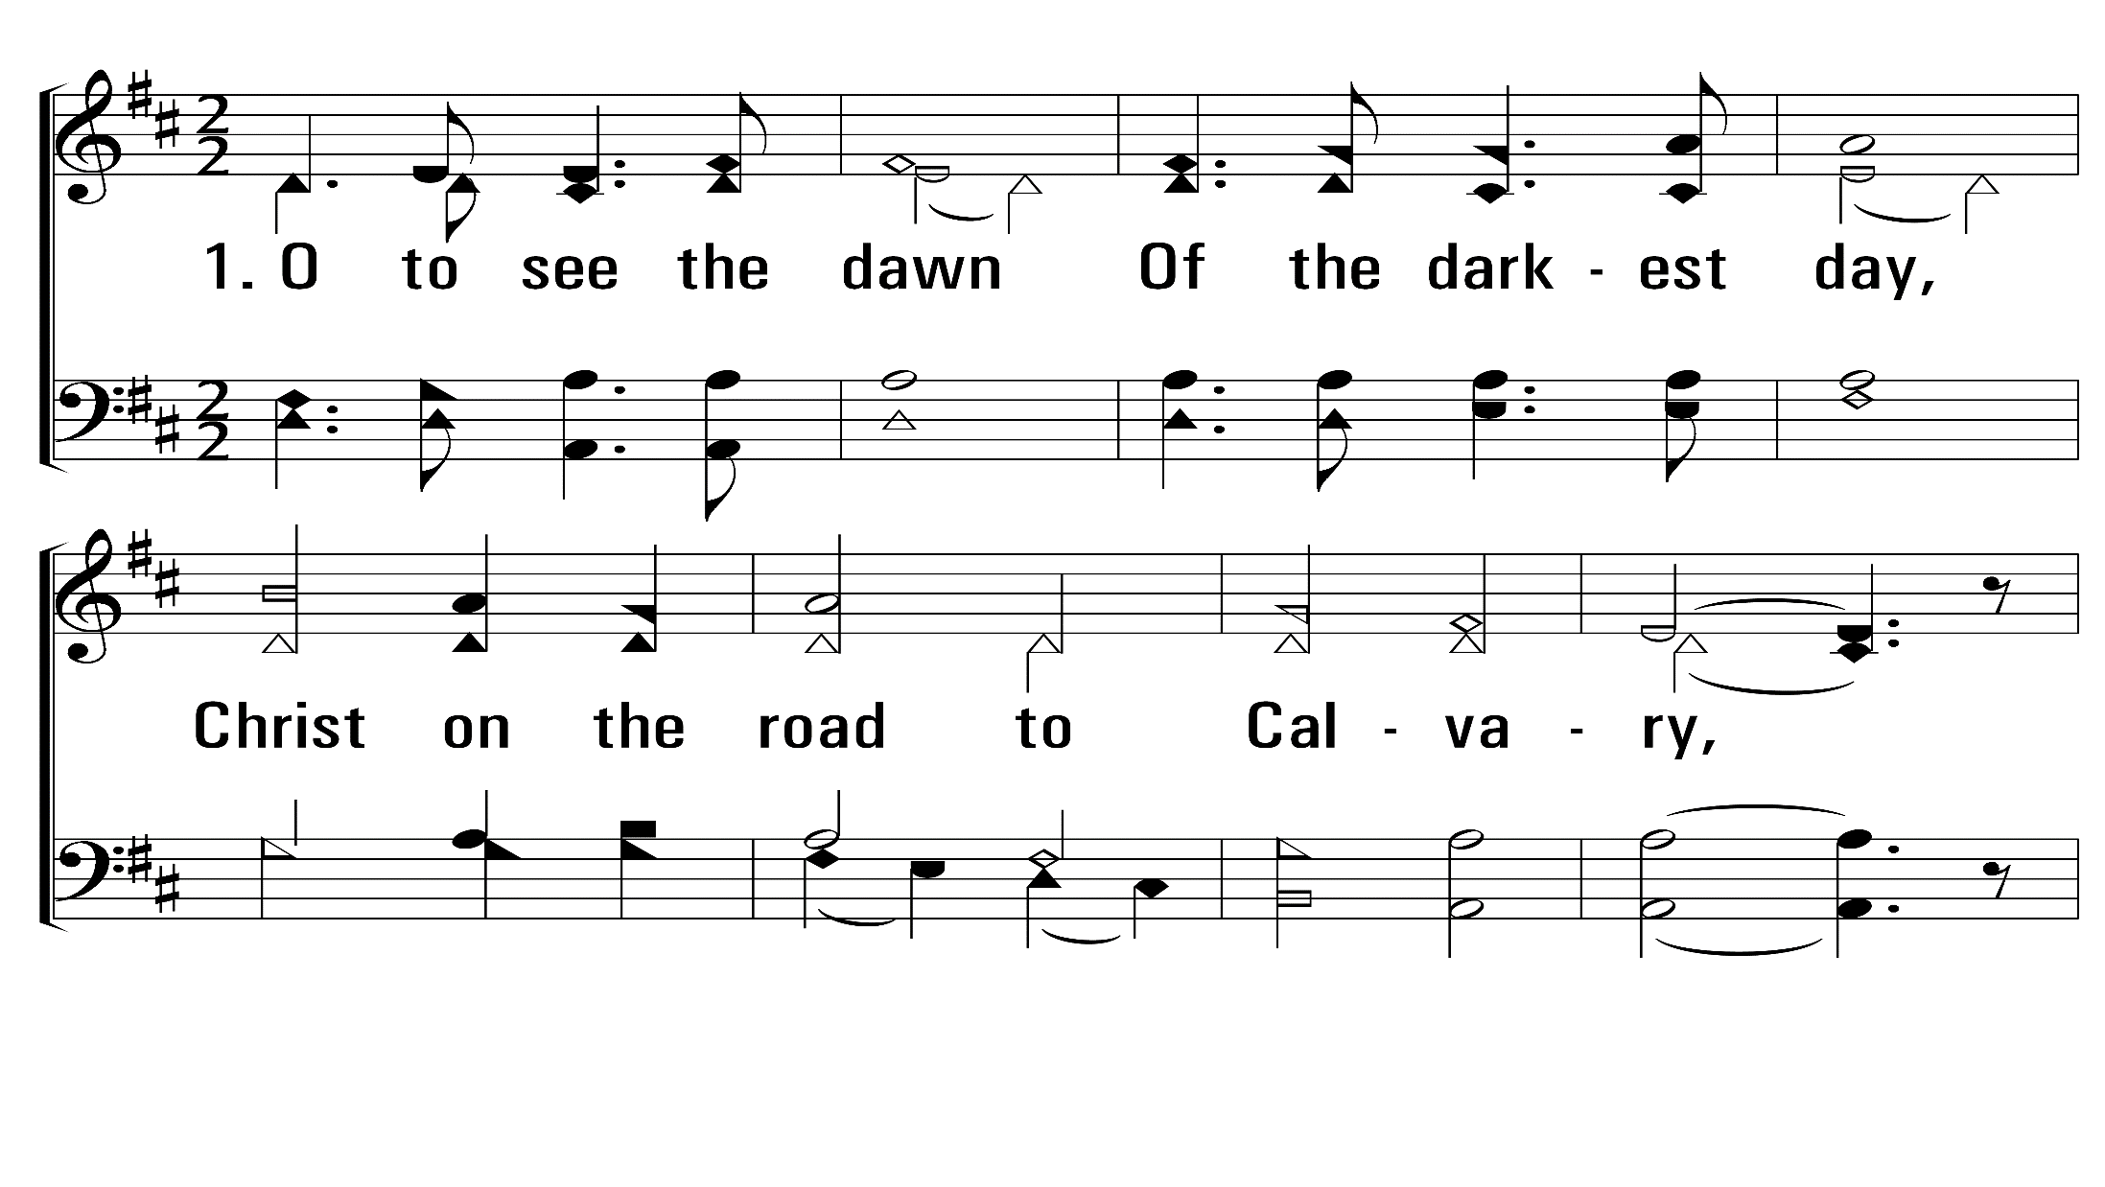
ThePowerOfTheCross_st1_a
Vs 1
© 2014 Sumphonia Productions, LLC

Slide 67
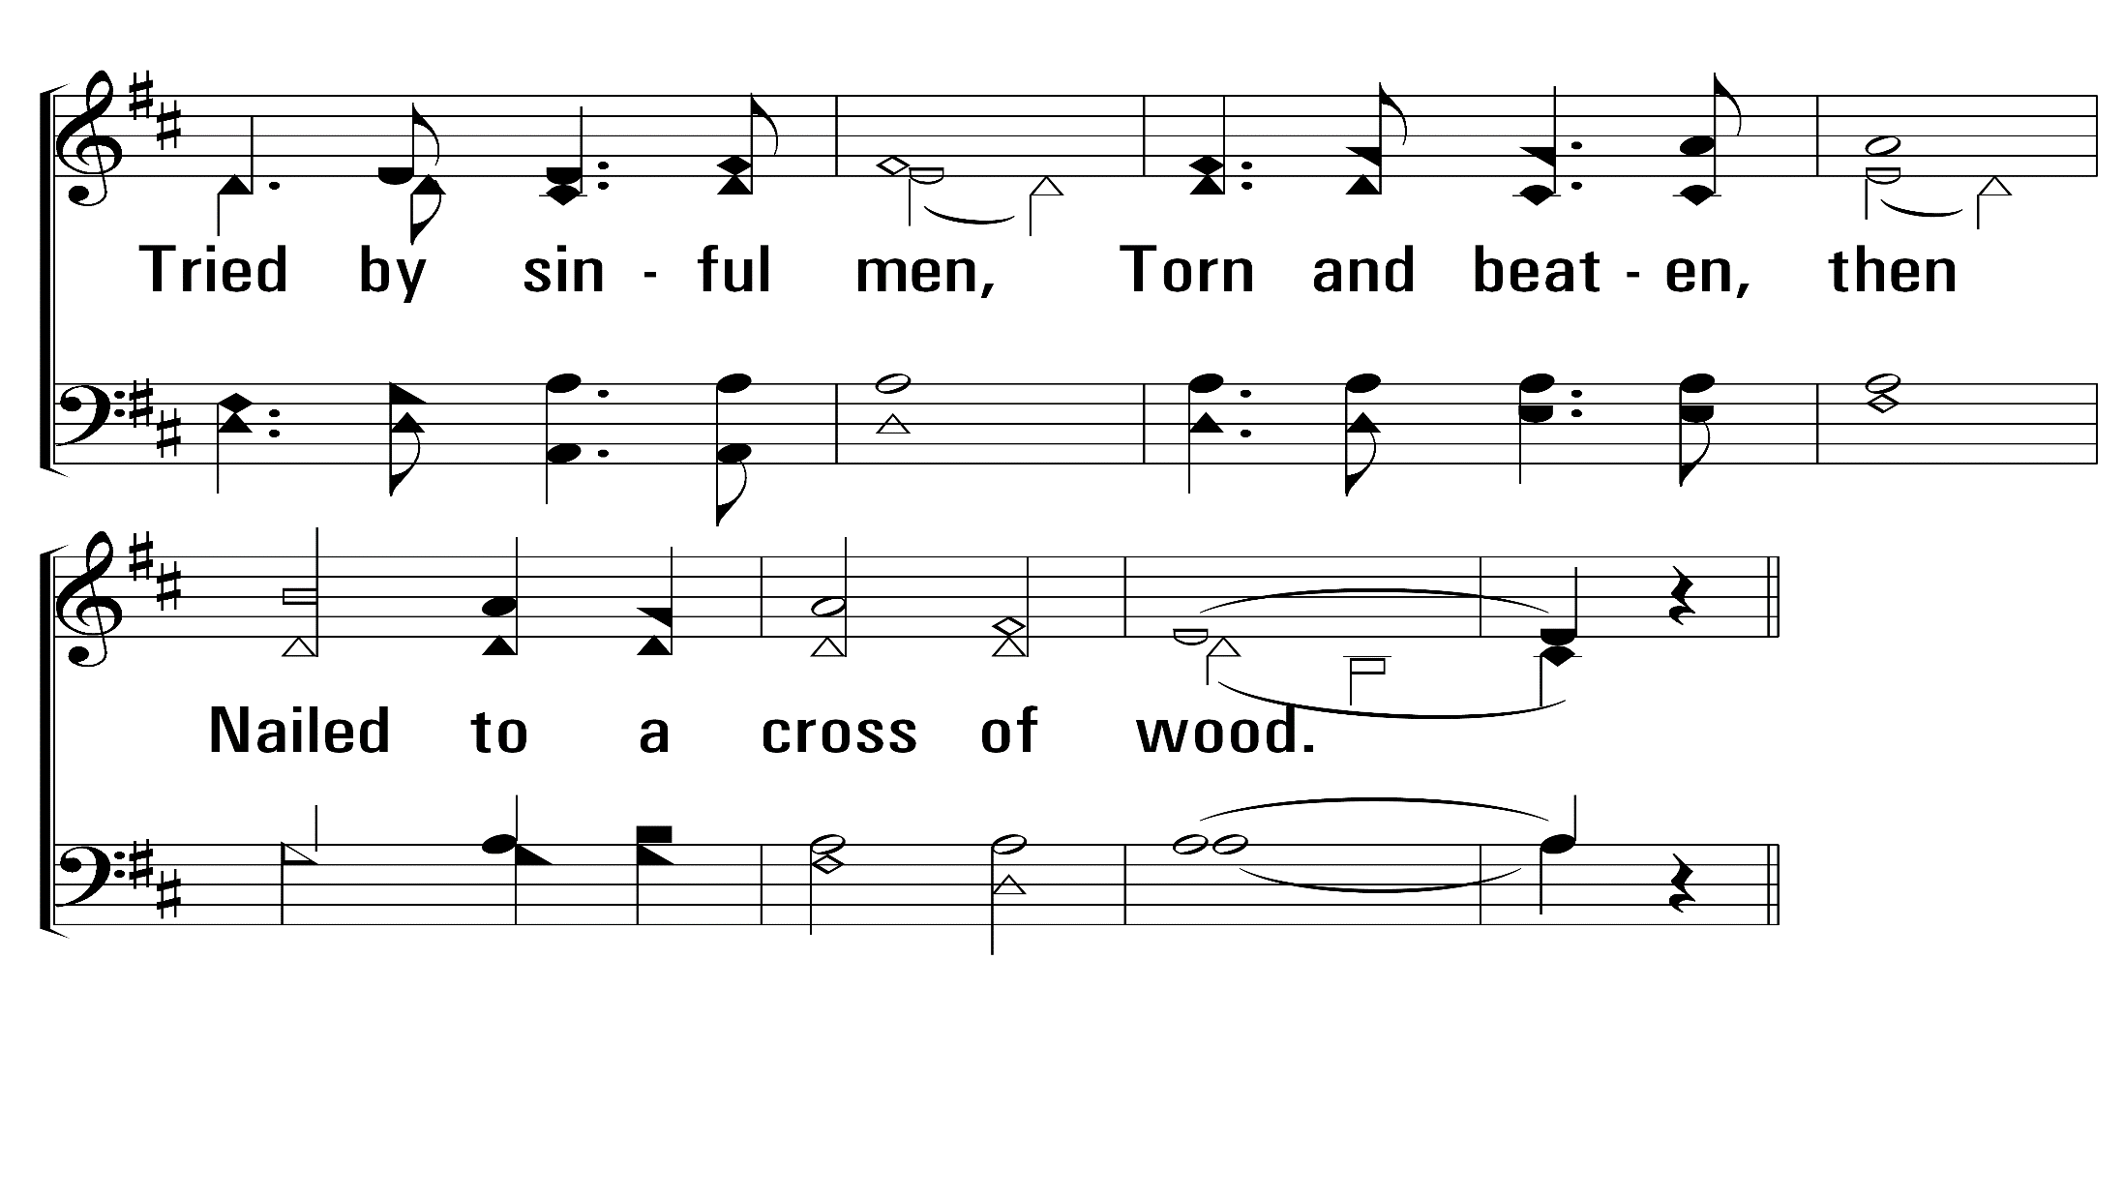
ThePowerOfTheCross_st1_b
Vs 1
© 2014 Sumphonia Productions, LLC

Slide 68
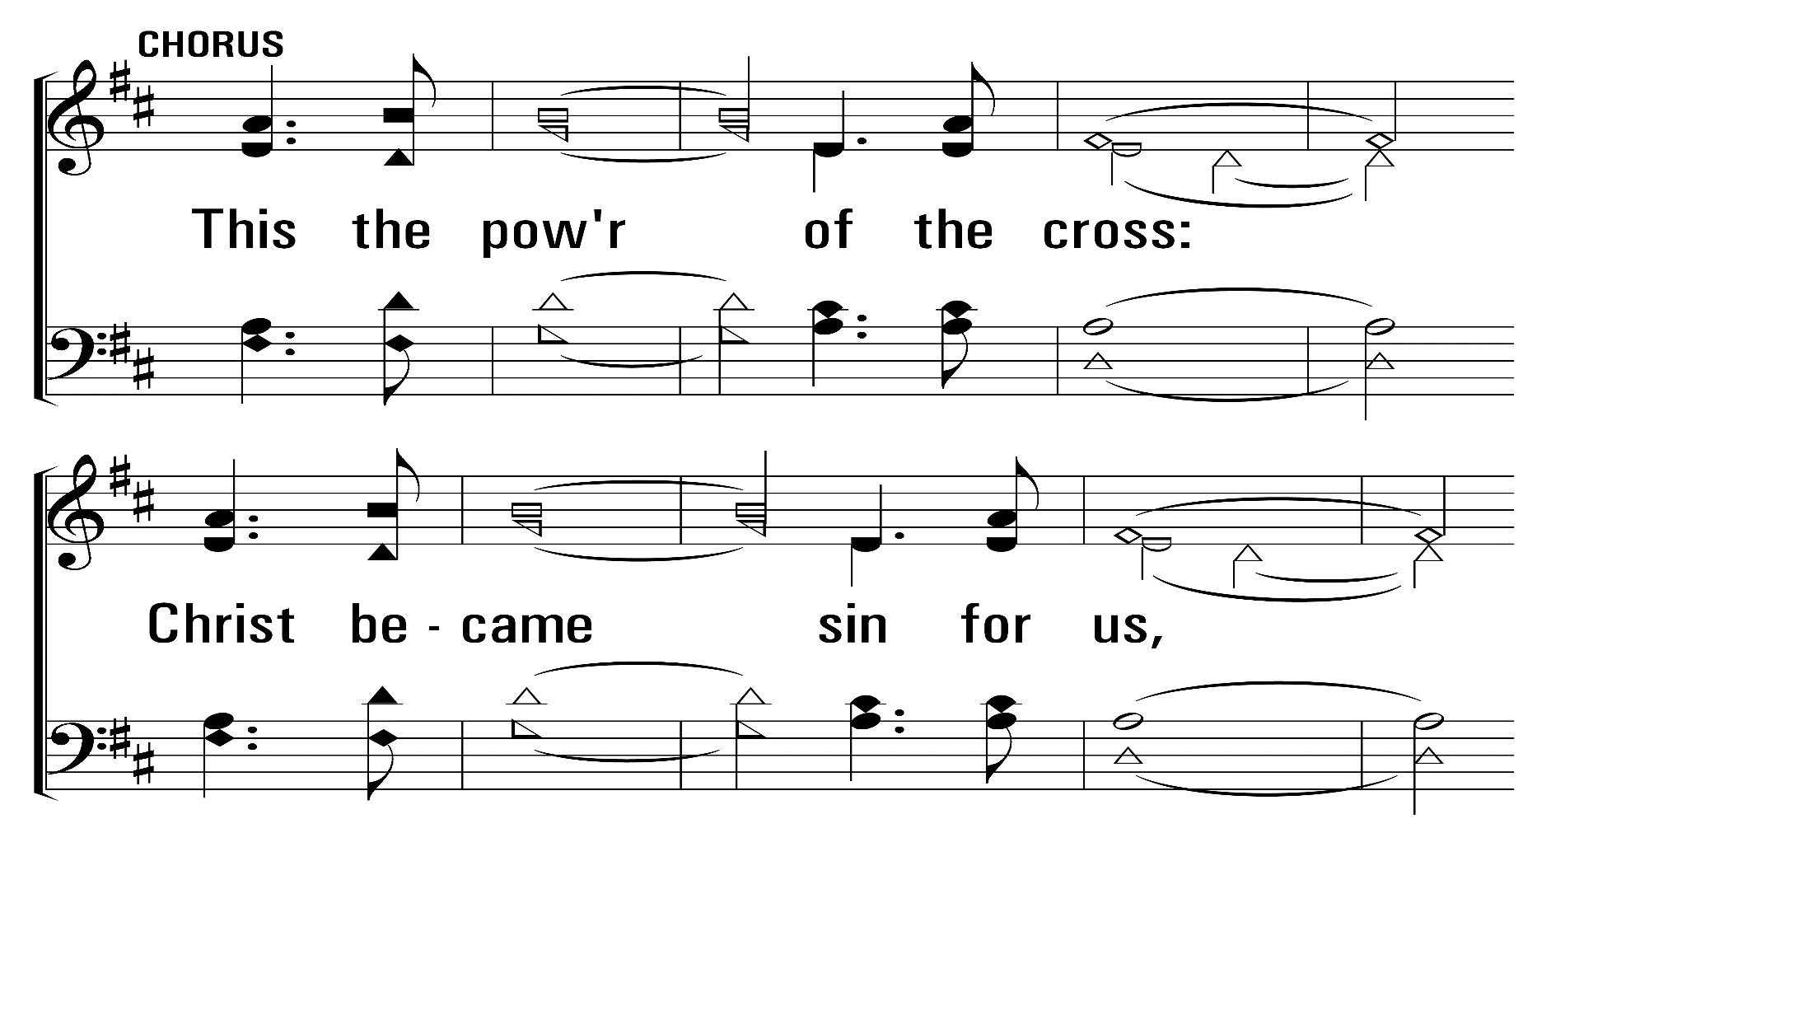
ThePowerOfTheCross_st1_c
Vs 1
© 2014 Sumphonia Productions, LLC

Slide 69
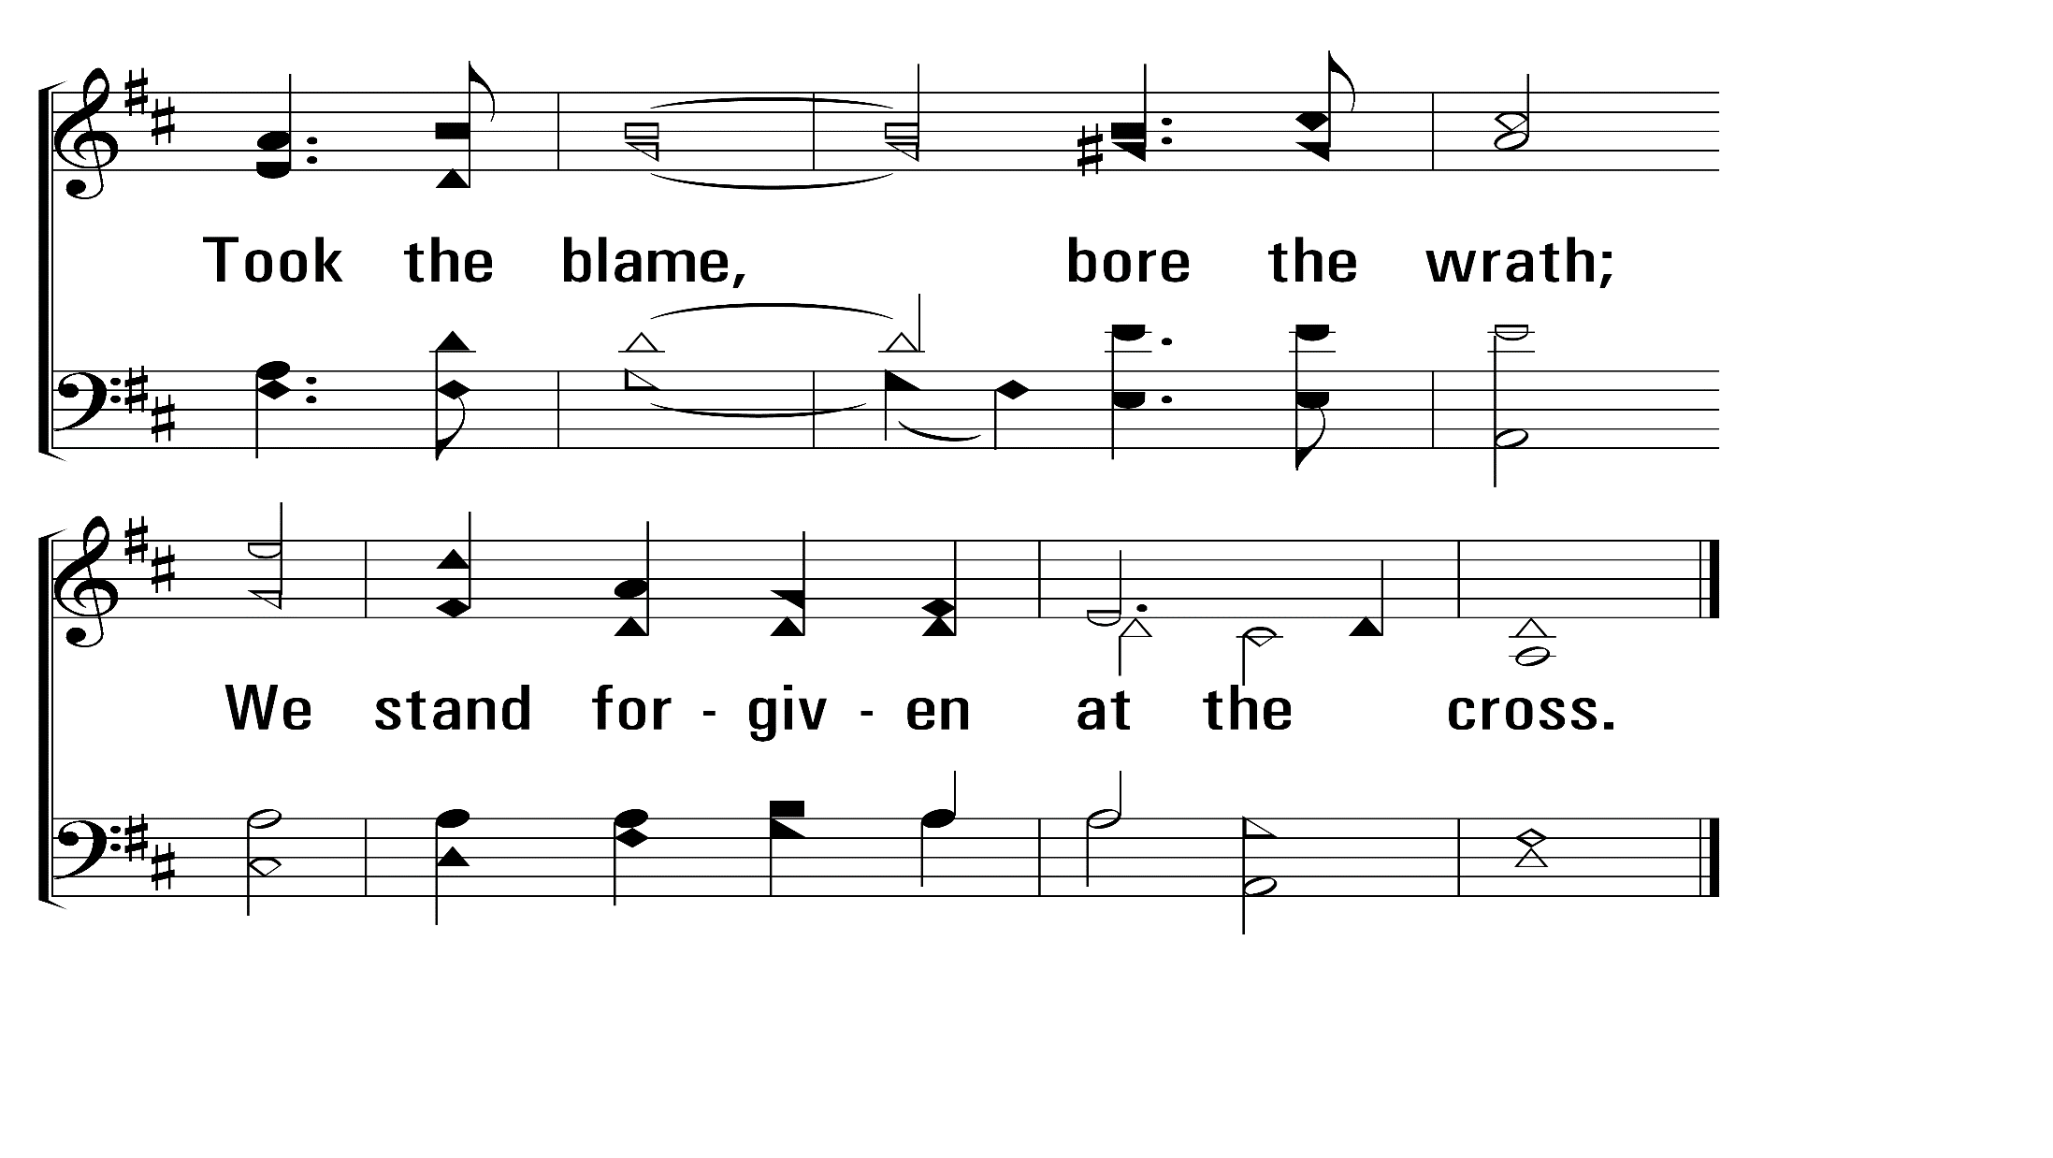
ThePowerOfTheCross_st1_d
Vs 1
© 2014 Sumphonia Productions, LLC

Slide 70
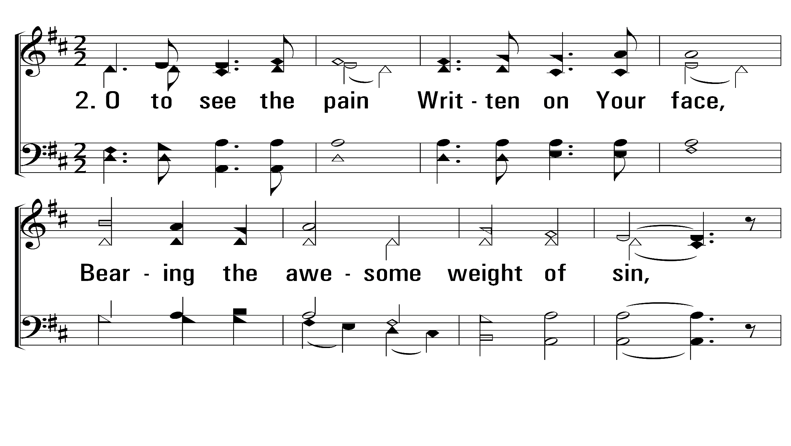
ThePowerOfTheCross_st2_a
Vs 2
© 2014 Sumphonia Productions, LLC

Slide 71
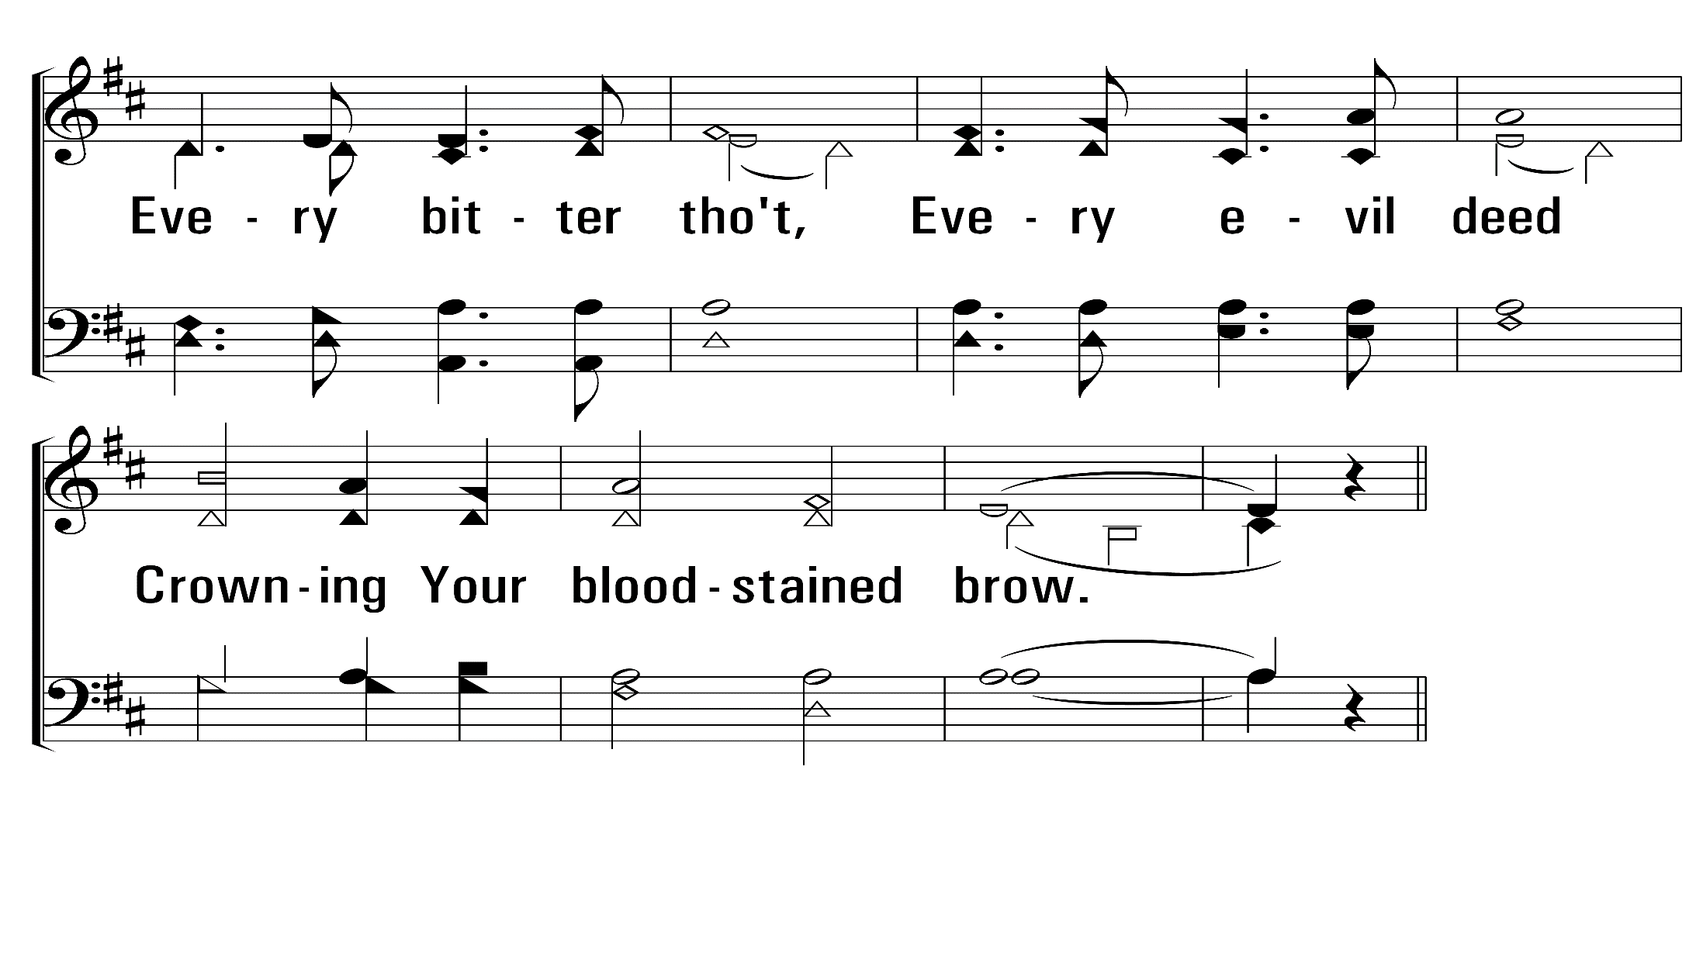
ThePowerOfTheCross_st2_b
Vs 2
© 2014 Sumphonia Productions, LLC

Slide 72
ThePowerOfTheCross_st2_c
Vs 2
© 2014 Sumphonia Productions, LLC

Slide 73
ThePowerOfTheCross_st2_d
Vs 2
© 2014 Sumphonia Productions, LLC

Slide 74
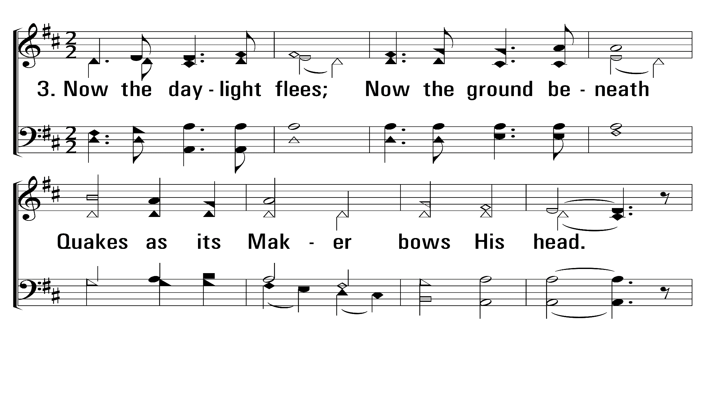
ThePowerOfTheCross_st3_a
Vs 3
© 2014 Sumphonia Productions, LLC

Slide 75
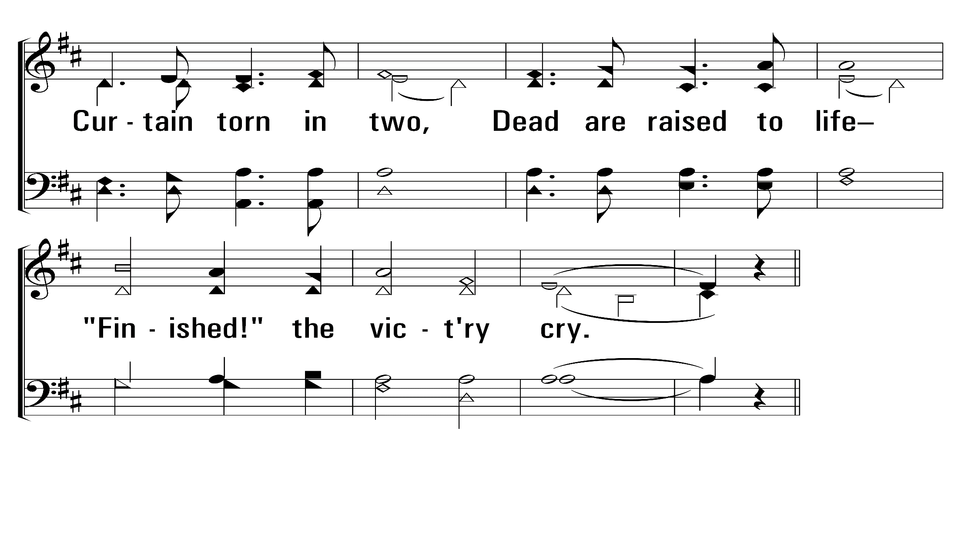
ThePowerOfTheCross_st3_b
Vs 3
© 2014 Sumphonia Productions, LLC

Slide 76
ThePowerOfTheCross_st3_c
Vs 3
© 2014 Sumphonia Productions, LLC

Slide 77
ThePowerOfTheCross_st3_d
Vs 3
© 2014 Sumphonia Productions, LLC

Slide 78
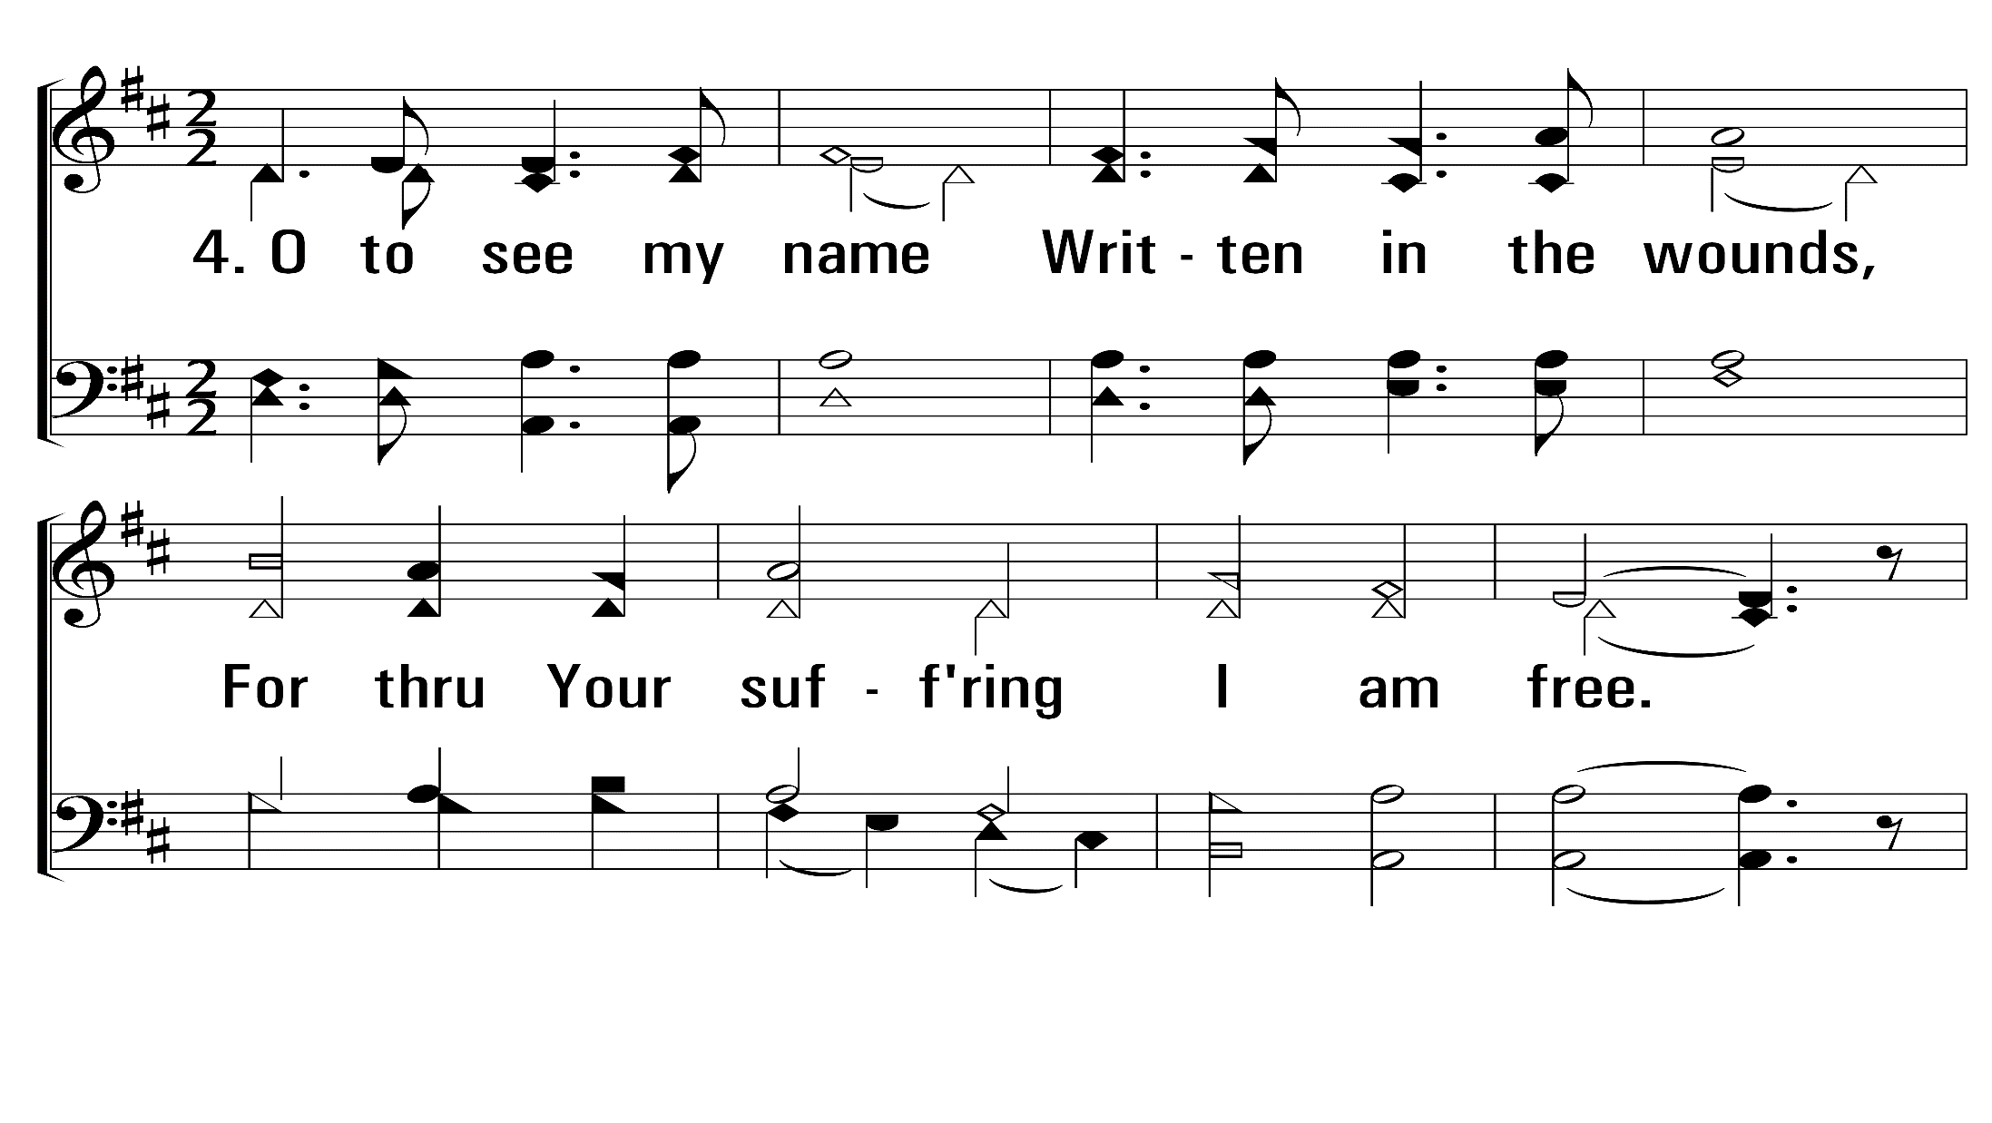
ThePowerOfTheCross_st4_a
Vs 4
© 2014 Sumphonia Productions, LLC

Slide 79
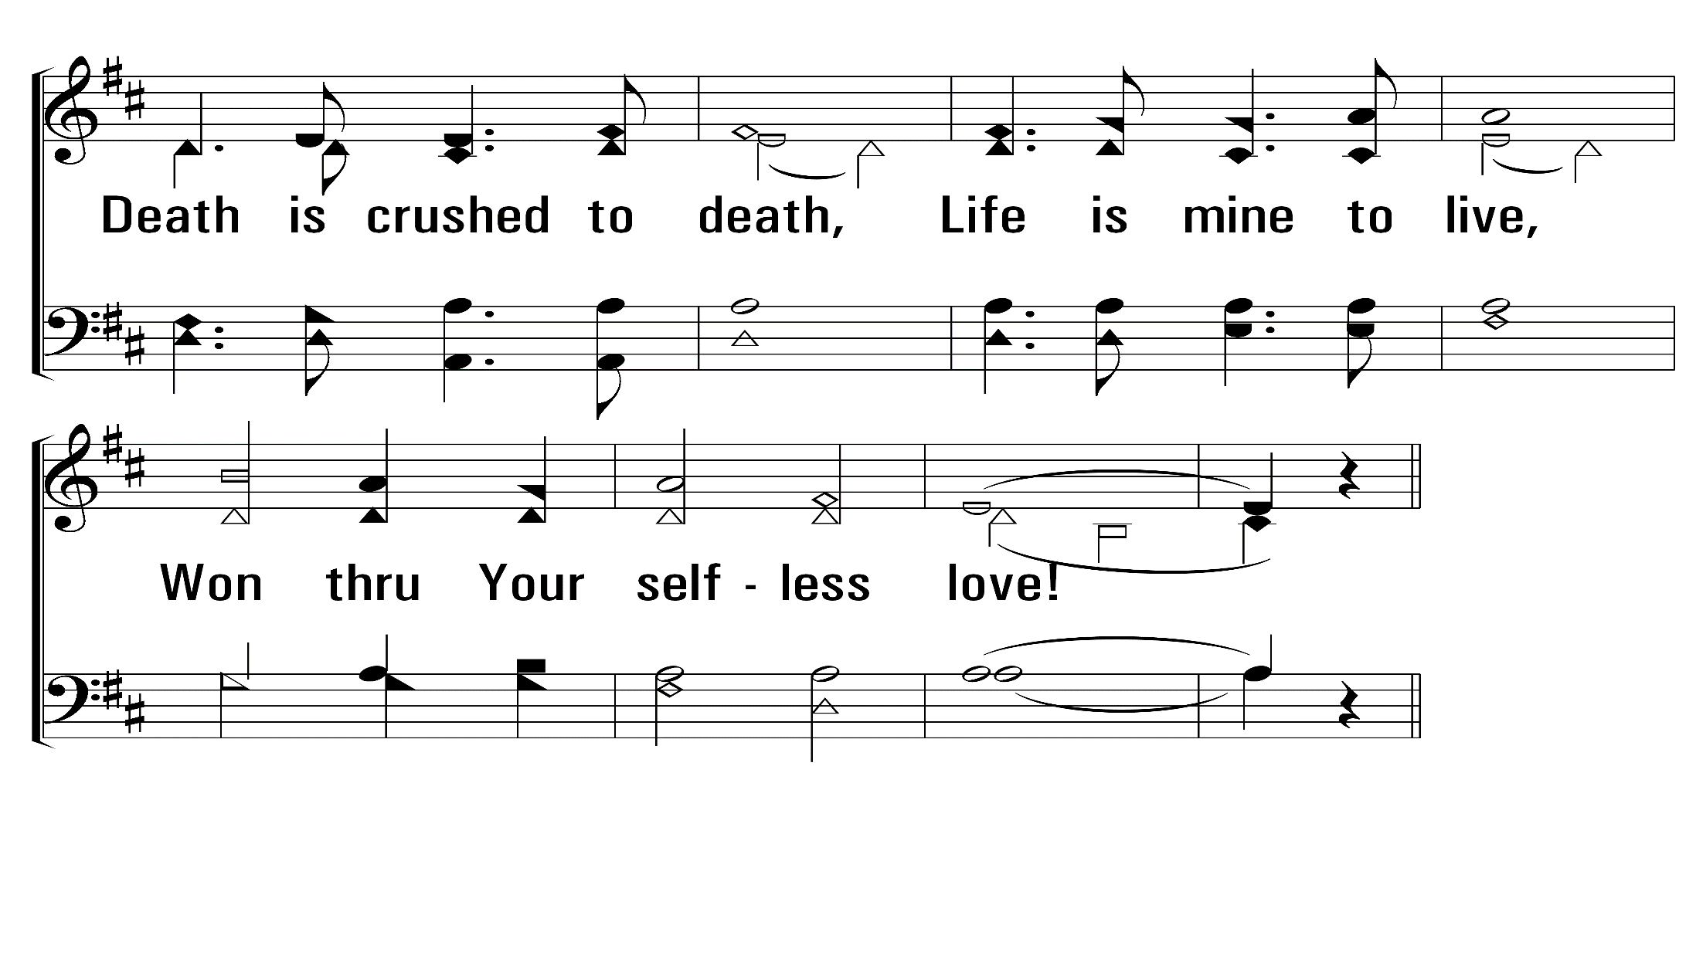
ThePowerOfTheCross_st4_b
Vs 4
© 2014 Sumphonia Productions, LLC

Slide 80
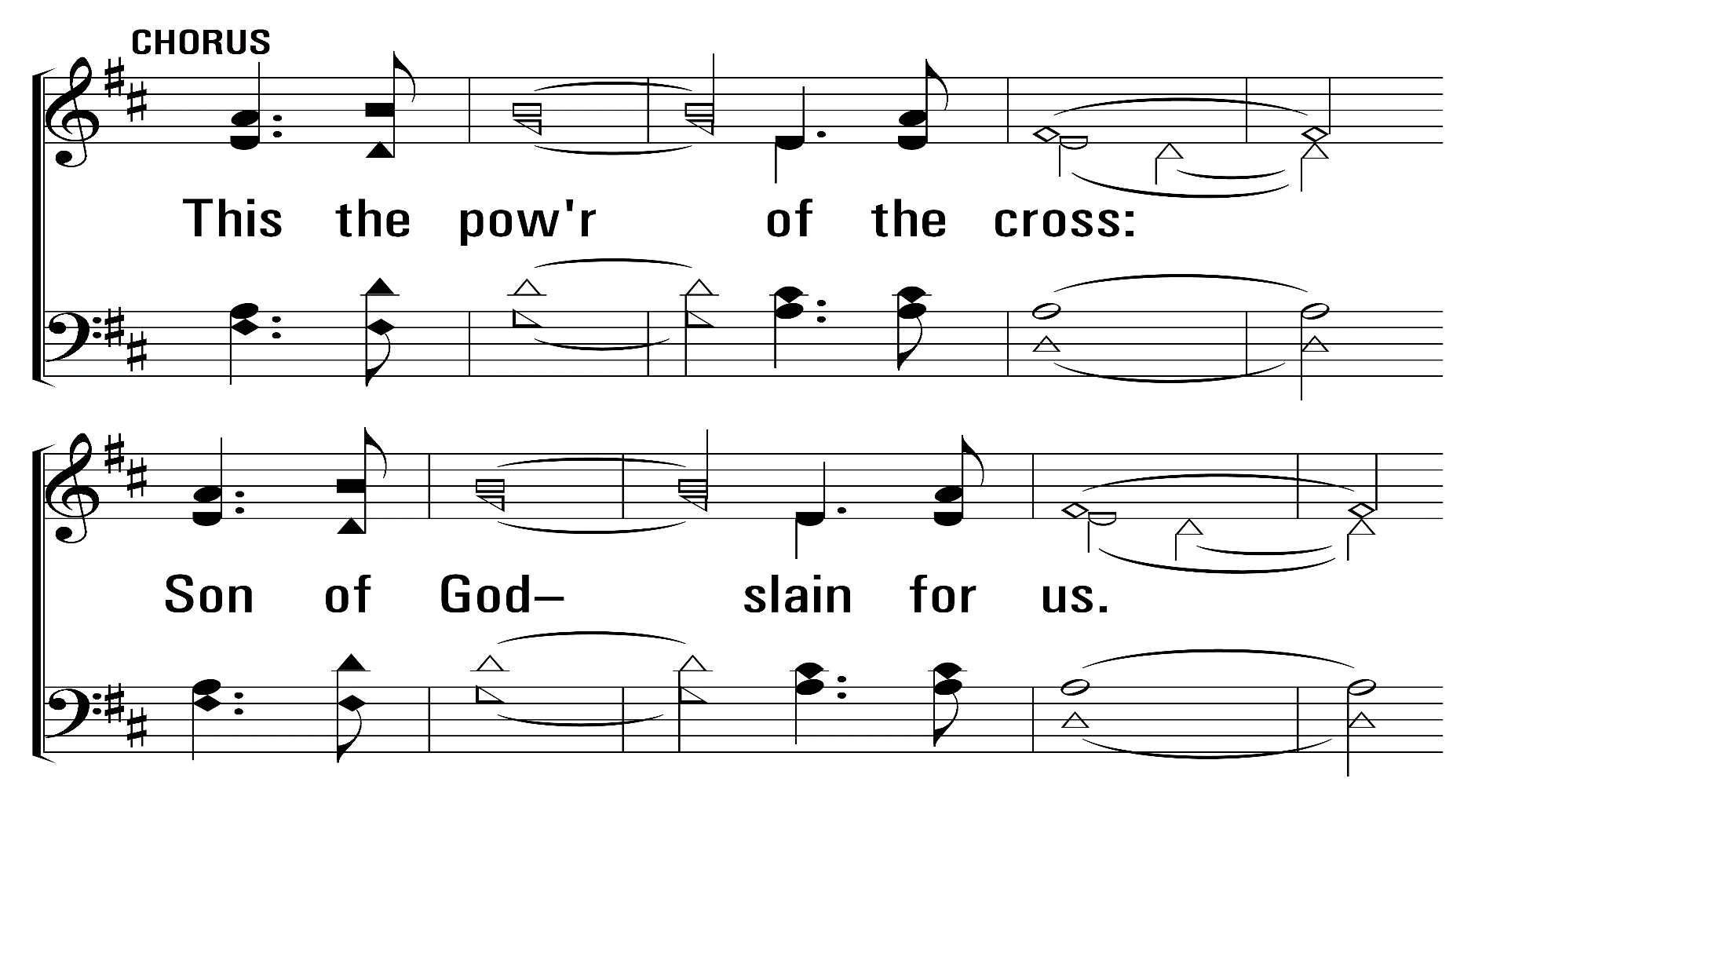
ThePowerOfTheCross_st4_c
Vs 4
© 2014 Sumphonia Productions, LLC

Slide 81
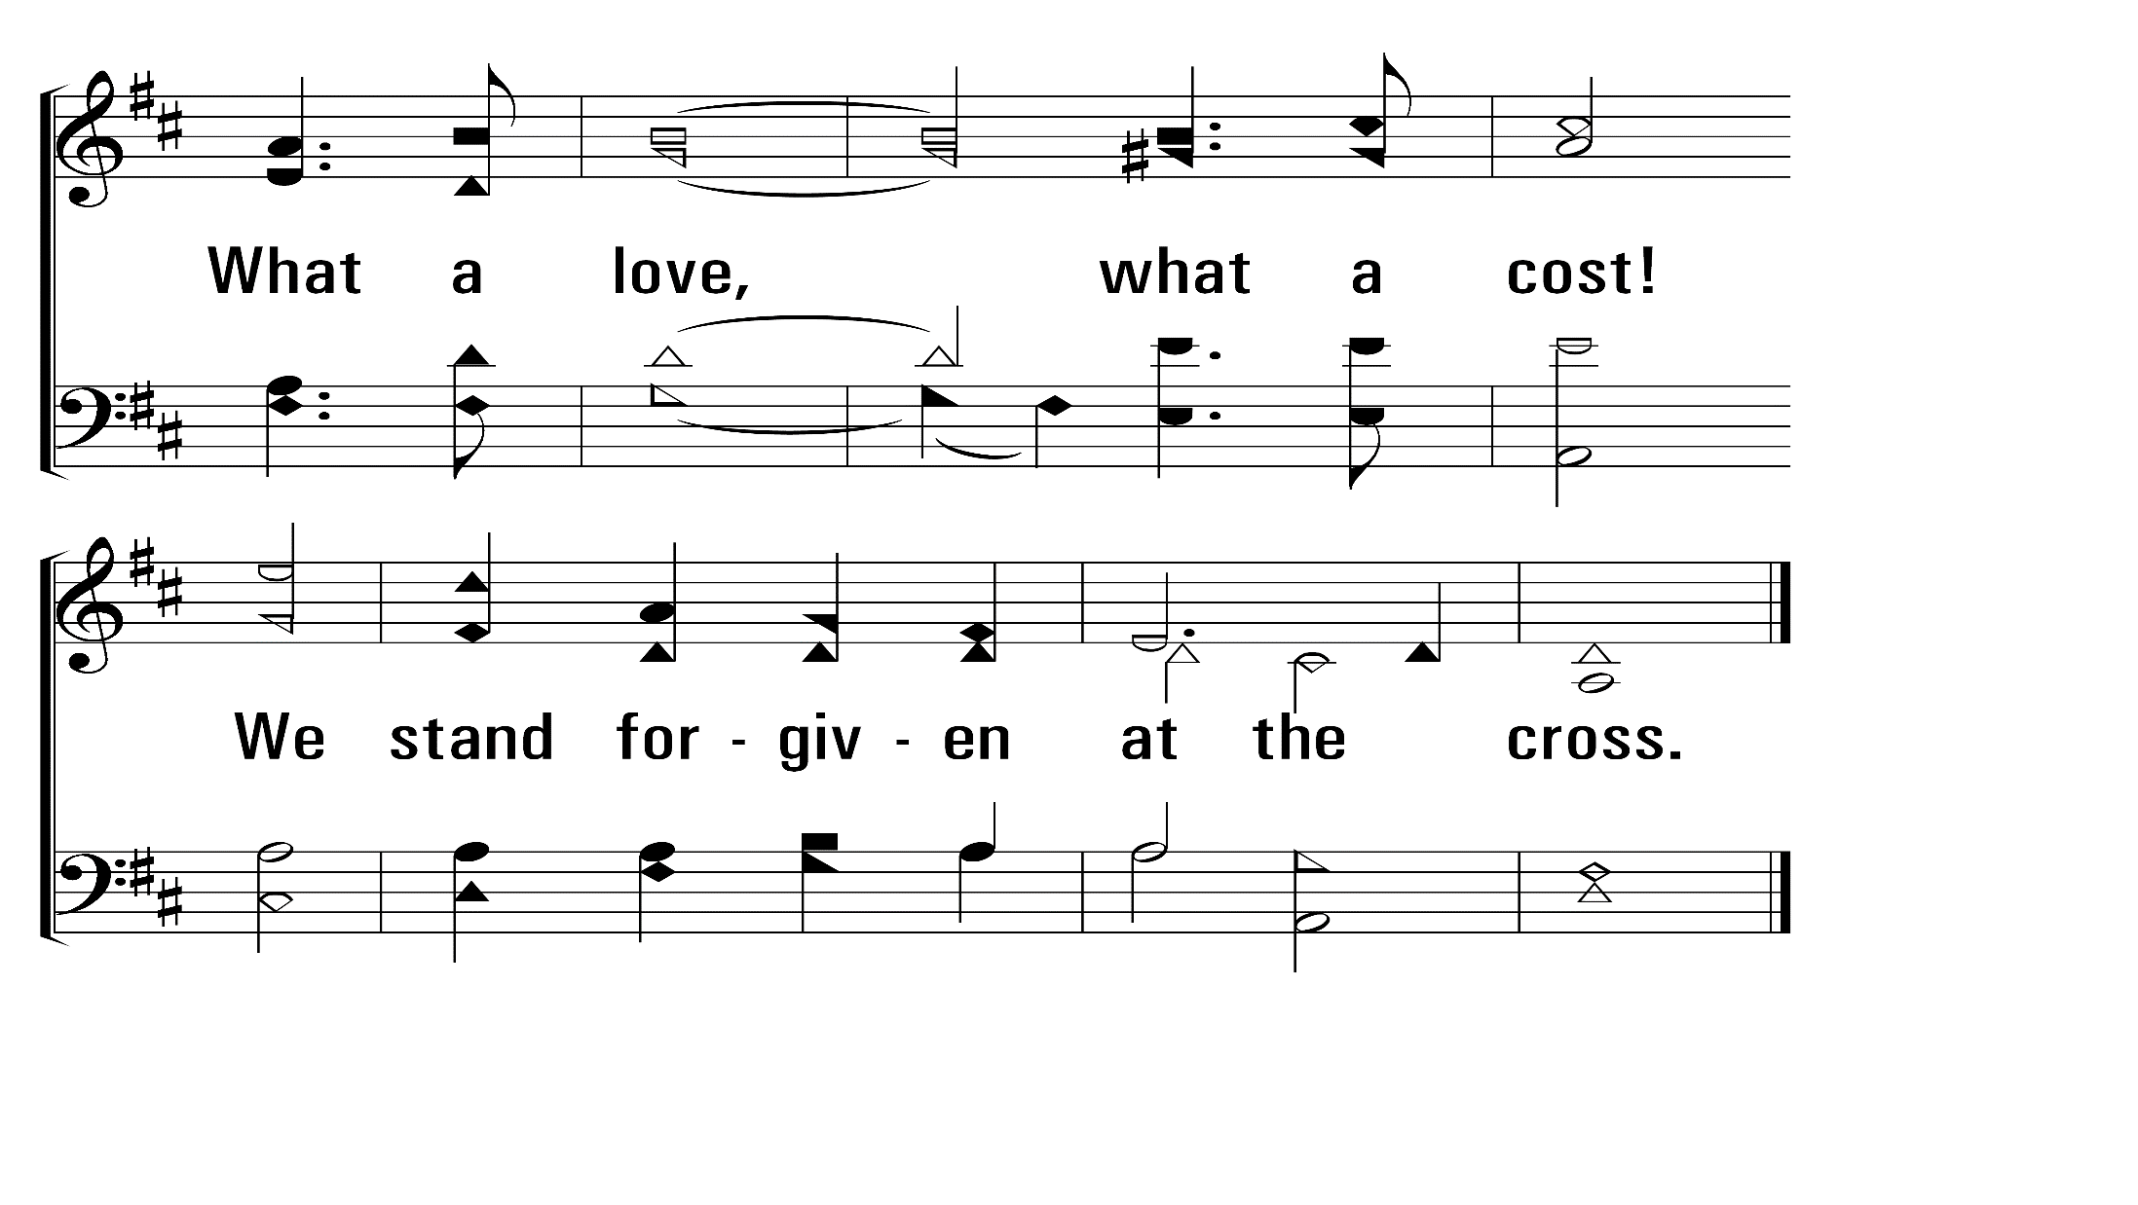
ThePowerOfTheCross_st4_d
End
Vs 4
© 2014 Sumphonia Productions, LLC

Slide 82
Comments in Preparation for the Lord’s Supper
Dale Smelser

Slide 83
The Lord’s Supper
Give thanks for the bread: Tim Driedger
Give thanks for the cup: Marty Lewis

Slide 84
Closing Prayer
Tyrone Reynolds

