Slide 1
Four Facts About Spiritual Enemies
Ephesians 6:12

Slide 2
1. You need to recognize them!
Psalm 97:10 - “You that love the Lord hate evil!”

Slide 3
1. You need to recognize them!
Psalm 119:104 - “Through your precepts I get understanding. Therefore I hate every false way.”

Slide 4
1. You need to recognize them!
Luke 6:26 - “Woe to you when all men speak well of you…”

Slide 5
2. Different enemies threaten more at different stages...
Stages of life (2 Tim. 2:22; Titus 2)

Slide 6
2. Different enemies threaten more at different stages...
Stages of Bible history
Egyptian “gods” - Josh. 24:14
Canaanite “gods” - Judges 2:12
Apathy, Discouragement - Haggai
Spiritual Pride - Matthew 23
Judaizing teachers - Galatians
Gnosticism - 1 John, 1,2 Corinthians
Persecution - Revelation

Slide 7
2. Different enemies threaten more at different stages...
In “recent” history - known disciples:
1800 - 1860 - Denominations
1860 - 1900 - Prosperity, Desire to copy denominations
1900 - 1950 - Infighting
1950 - 1970 - Prosperity, Desire to copy denominations
1970 - 2000 - Infighting
2000 - Worldliness

Slide 8
3. Different generations often fear different enemies
Christians over 40 often fear…
Denominational error
“Institutionalism”
“Liberalism”

Slide 9
3. Different generations often fear different enemies
Christians under 40 often fear…
Overemphasis on externals
Pharisaism
Under emphasis on God’s grace and mercy

Slide 10
3. Different generations often fear different enemies

Slide 11
4. The enemy that “gets us” is usually the one we don’t fear.
Numbers 13:32, 33 -
…“All the people whom we saw in it are men of great stature.”
“There we saw the giants … and we were like grasshoppers in our own sight, and so we were in their sight.

Slide 12
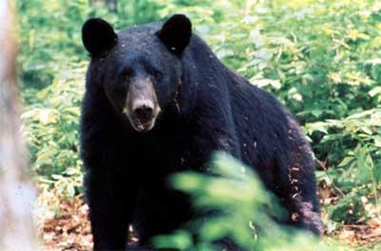
4. The enemy that “gets us” is usually the one we don’t fear.

Slide 13
Satan’s 10 most effective weapons
10. Antireligious scientific theories
9. False religions
8. Party spirit among Christians
7. Spirit of presumption
6. Postmodernism

Slide 14
Satan’s 10 most effective weapons
5. Materialism
4. Comfortable Christianity
3. Worldliness (TV, movies, entertainment culture)
2. Lust of flesh, pornography
1. Pride/selfishness, lack of love

Slide 15
Enemies Beyond Our Comprehension
Eph. 6:12 “…powers, against the rulers of the darkness of this age, against spiritual hosts of wickedness in the heavenly places.”

Slide 16
Enemies Beyond Our Comprehension
But God has not left us defenseless - Ephesians 6:14 - 18 - The armor of God
Our greatest defense - A fervent love for God

