Slide 2
I Am Not of This World
"You are from beneath;
I am from above.
You are of this world;
I am not of this world.
John 8:23; NKJV
Because of Him, neither am I.

Slide 3
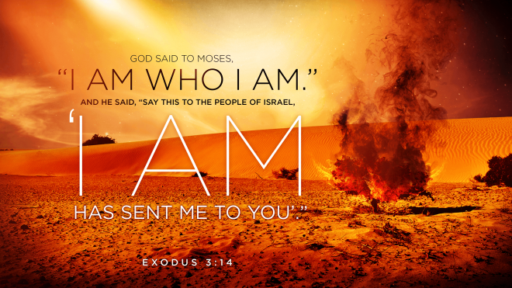
John 8:24, 28, 58
Believe in Him!

Slide 4
Who Jesus Is
Divine Titles
John 1:1 – The Word, God
John 20:28 – Lord, God
John 8:58 – I AM
Matthew 3:3 – LORD
Isaiah 40:3 – YHWH, Yahweh, Jehovah
John 12:41 – Isaiah saw Him
Isaiah 6 – Lord, YHWH of Hosts, King

Slide 5
Who Jesus Is
Divine Works
Creator – Colossians 1:16
Sustainer – Colossians 1:17
Miracles – Matthew 4:23-24; John 3:2
Forgave Sins – Mark 2:1-11
Judge – Acts 10:42; 17:30-31

Slide 6
Who Jesus Is
Accepted Worship
Jesus Accepted Worship – Matthew 2:1-11; 4:10; 8:2; 9:18; 14:33; 15:25; 21:9; 28:9, 17; Luke 4:8; 24:52; John 9:38
Angels Rejected Worship – Revelation 19:9-10; 22:8-9
Peter Rejected Worship – Acts 10:25-26
Paul Rejected Worship – Acts 14:8-18

Slide 7
Who Jesus Is
Jesus Claimed to be God
John 5:18; 8:58-59; 9:35-39; 10:31-39 – “For a good work we do not stone You, but for blasphemy, and because You, being a Man, make Yourself God.”
Matthew 26:63-64; Mark 14:61-62; Luke 22:70 – “You rightly say that I am.”
Mark 2:1-12 – “Who can forgive sins but God alone?”
John 19:7 – “We have a law, and according to our law He ought to die, because He made Himself the Son of God.”

Slide 8
Who Jesus Is
The Resurrection Declares Jesus to be the Son of God
Romans 1:4; Acts 2:32; 17:30-31
If Jesus arose, then there is a God.
Jesus arose.
Therefore, there is a God.

Slide 9
Who Jesus Is
If Jesus is God, then God is.
Jesus is God.
Therefore, God is.
Divine Titles
Divine Works
Accepted Worship
Claimed to be God
The Resurrection

Slide 10
Who Jesus Is
Jesus is God, therefore…

