Slide 1
The Great Physician
Exton
11 am Sunday
September 2, 2018
El Gran Médico

Slide 2
The Great Physician
Why is Jesus Called “The Great Physician”?
El Gran Médico
¿Por qué Jesús es llamado "El Gran Médico"?

Slide 3
The Great Physician
Luke 5 ²⁹ And Levi gave a big reception for Him in his house; and there was a great crowd of tax collectors and other people who were reclining at the table with them. ³⁰ The Pharisees and their scribes began grumbling at His disciples, saying, “Why do you eat and drink with the tax collectors and sinners?”
³¹ And Jesus answered and said to them, “It is not those who are well who need a physician, but those who are sick. ³² I have not come to call the righteous but sinners to repentance.”
Among other things, we see that Jesus clearly did not see scrupulous Torah observance as the prerequisite for fellowship with God.
https://www.ligonier.org/learn/devotionals/jesus-great-physician/
Commenting on Mark’s account
El Gran Médico
Lucas 5 ²⁹ Leví le hizo un gran banquete en su casa; y había mucha compañía de publicanos y de otros que estaban a la mesa con ellos. ³⁰ Los escribas y los fariseos murmuraban contra los discípulos, diciendo: —¿Por qué coméis y bebéis con publicanos y pecadores?
³¹ Respondiendo Jesús, les dijo:
—Los que están sanos no tienen necesidad de médico, sino los enfermos. ³² No he venido a llamar a justos, sino a pecadores al arrepentimiento.
Entre otras cosas, vemos que Jesús claramente no vio la observancia escrupulosa de la Torá como el requisito previo para la comunión con Dios. https://www.ligonier.org/learn/devotionals/jesus-great-physician/

Slide 4
The Great Physician
Mark 2 ¹ And when he returned to Capernaum after some days, it was reported that he was at home. ² And many were gathered together, so that there was no more room, not even at the door. And he was preaching the word to them. ³ And they came, bringing to him a paralytic carried by four men. ⁴ And when they could not get near him because of the crowd, they removed the roof above him, and when they had made an opening, they let down the bed on which the paralytic lay.
⁵ And when Jesus saw their faith, he said to the paralytic, “Son, your sins are forgiven.”
⁶ Now some of the scribes were sitting there, questioning in their hearts,⁷ “Why does this man speak like that? He is blaspheming! Who can forgive sins but God alone?”
¹² And he rose and immediately picked up his bed and went out before them all, so that they were all amazed and glorified God, saying, “We never saw anything like this!”
¹⁰ But that you may know that the Son of Man has authority on earth to forgive sins”—he said to the paralytic— ¹¹ “I say to you, rise, pick up your bed, and go home.”
El Gran Médico
Marcos 2 ¹ Después de algunos días, Jesús entró otra vez en Capernaúm. Cuando se supo que estaba en casa, ² inmediatamente se juntaron muchos, de manera que ya no cabían ni aun a la puerta; y les predicaba la palabra.³ Entonces vinieron a él unos trayendo a un paralítico, que era cargado por cuatro. ⁴ Y como no podían acercarse a él a causa de la multitud, quitaron parte del techo de donde él estaba y, a través de la abertura, bajaron la camilla en que yacía el paralítico.
⁵ Al ver Jesús la fe de ellos, dijo al paralítico:
—Hijo, tus pecados te son perdonados.
⁶ Estaban allí sentados algunos de los escribas, los cuales pensaban para sí: ⁷ «¿Por qué habla éste de ese modo? Blasfemias dice. ¿Quién puede perdonar pecados, sino sólo Dios?»
¹² Entonces él se levantó y, tomando su camilla, salió delante de todos, de manera que todos se asombraron y glorificaron a Dios, diciendo:
—Nunca hemos visto tal cosa.
¹⁰ Pues para que sepáis que el Hijo del hombre tiene potestad en la tierra para perdonar pecados —dijo al paralítico—: ¹¹ A ti te digo: Levántate, toma tu camilla y vete a tu casa.

Slide 5
The Great Physician
---------------------------John 9:39
--------------------------------Hebrews 12:12-13
--------- almost always, “cleansed”
-------------------------------- Matthew 13:9,13:13-15,18
---------------------------John 5:24
--- Matthew 5:3
Matthew 11
⁵ the blind receive sight
and the lame walk,
the lepers are cleansed
and the deaf hear,
the dead are raised up,
and the poor have the gospel preached to them.
El Gran Médico
---------------------------Juan 9:39
--------------------------------Hebreos 12:12-13
--------- casi siempre, “limpiado”
-------------------------------- Mateo 13:9,13:13-15,18
---------------------------Juan 5:24
--- Mateo 5:3
Matthew 11
⁵ Los ciegos ven,
los cojos andan,
los leprosos son limpiados,
los sordos oyen,
los muertos son resucitados
y a los pobres es anunciado el evangelio;

Slide 6
The Great Physician
Lesson #1
We trivialize the Gospel when…
Lesson #2
Does Jesus Care?
“Jesus knows all about our struggles” “I know He Cares”
Lesson #3
We must “come” to Jesus seeking healing
El Gran Médico
Lección #1
Trivializamos el Evangelio cuando ...
Lección #2
¿Le importa a Jesús?
"Jesús sabe todo sobre nuestras luchas" "Sé que le importa"
Lección #3
Debemos "venir" a Jesús buscando sanidad

Slide 7
The Great Physician
Matthew
8² And a leper came to Him
8⁵ And when Jesus entered Capernaum, a centurion came to Him
8¹⁶ …they brought to Him many who were demon-possessed
9¹⁸ … a synagogue official came and bowed down before Him, and said, “My daughter has just died”
9²⁷ …two blind men followed Him, crying out, “Have mercy on us, Son of David!”
9³² …a mute, demon-possessed man was brought to Him.
15²² …a Canaanite woman from that region came out and began to cry out…
15³⁰ And large crowds came to Him, bringing with them those who were lame, crippled, blind, mute…
El Gran Médico
Mateo
8² En esto se le acercó un leproso
8⁵ Al entrar Jesús en Capernaúm, se le acercó un centurión
8¹⁶ Al caer la noche le llevaron muchos endemoniados
9¹⁸ …llegó un dignatario y se postró ante él, diciendo:—Mi hija acaba de morir
9²⁷ …lo siguieron dos ciegos, diciéndole a gritos: —¡Ten misericordia de nosotros, Hijo de David!
9³² …le trajeron un mudo endemoniado.
15²² …una mujer cananea que había salido de aquella región comenzó a gritar y a decirle…
15³⁰ Se le acercó mucha gente que traía consigo cojos, ciegos, mudos, mancos…

Slide 8
The Great Physician
Luke 8⁴³ And there was a woman who had had a discharge of blood for twelve years, and though she had spent all her living on physicians, she could not be healed by anyone.
⁴⁴ She came up behind him and touched the fringe of his garment, and immediately her discharge of blood ceased.⁴⁵ And Jesus said, “Who was it that touched me?” When all denied it, Peter said, “Master, the crowds surround you and are pressing in on you!”
⁴⁶ But Jesus said, “Someone touched me, for I perceive that power has gone out from me.” ⁴⁷ And when the woman saw that she was not hidden, she came trembling, and falling down before him declared in the presence of all the people why she had touched him, and how she had been immediately healed. ⁴⁸ And he said to her, “Daughter, your faith has made you well; go in peace.”
El Gran Médico
Lucas 8⁴³ Pero una mujer que padecía de flujo de sangre desde hacía doce años, y que había gastado en médicos todo cuanto tenía y por ninguno había podido ser curada,
⁴⁴ se le acercó por detrás y tocó el borde de su manto. Al instante se detuvo el flujo de su sangre. ⁴⁵ Entonces Jesús dijo:—¿Quién es el que me ha tocado? Todos lo negaban, y dijo Pedro y los que con él estaban:—Maestro, la multitud te aprieta y oprime, y preguntas: “¿Quién es el que me ha tocado?”
⁴⁶ Pero Jesús dijo:—Alguien me ha tocado, porque yo he sentido que ha salido poder de mí. ⁴⁷ Entonces, cuando la mujer vio que había sido descubierta, vino temblando y, postrándose a sus pies, le declaró delante de todo el pueblo por qué causa lo había tocado y cómo al instante había sido sanada. ⁴⁸ Él le dijo: —Hija, tu fe te ha salvado; ve en paz.

Slide 9
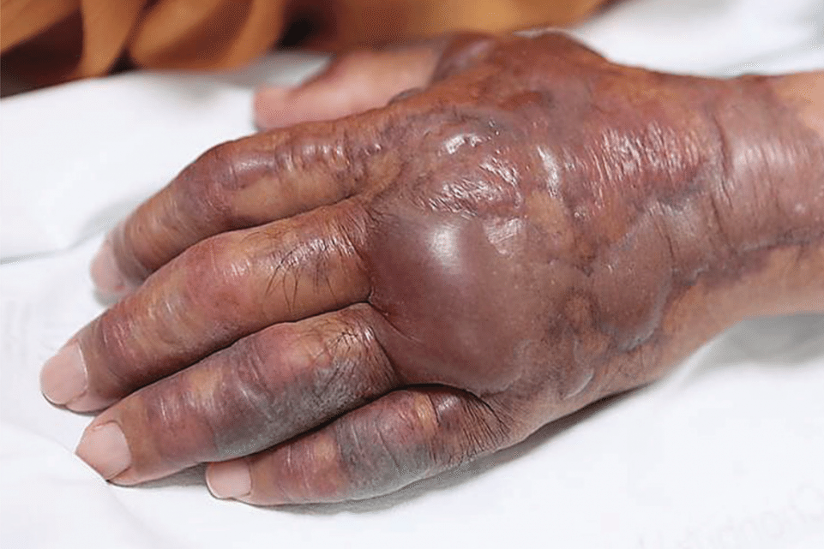
The Great Physician
El Gran Médico
Vibrio vulnificus

