Slide 1
Instrumental Music
Exton
Sunday 6 pm
September 9, 2018

Slide 2
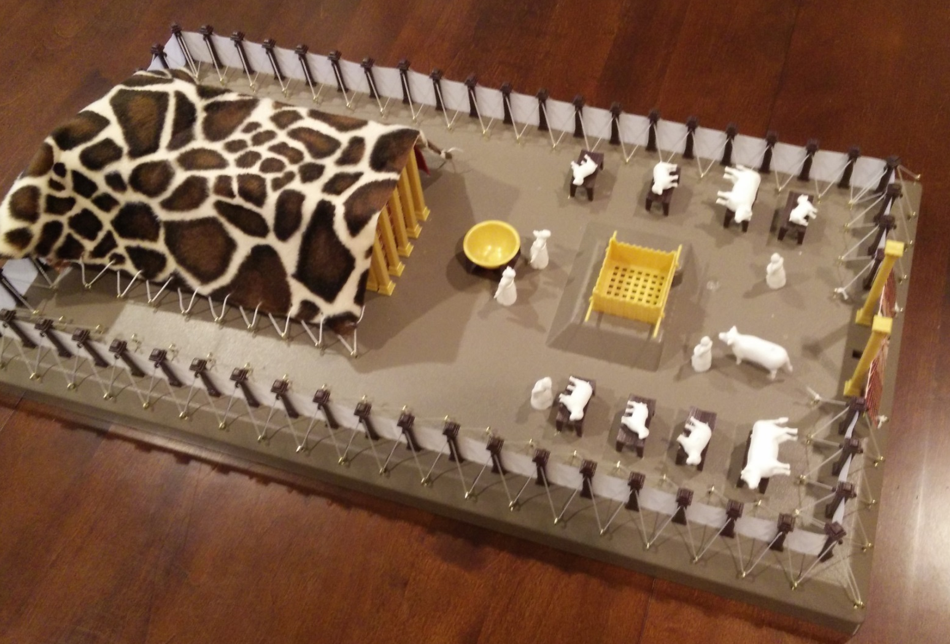
Shadow
REALITY
Hebrews 8-10
Ex 25:9, 49 & Hebrews 9
Solomon’s statement 1 Kings 8:27
Compare Isaiah 66:1
John 4
Instrumental Music
Hebrew 8 ⁴ Now if He were on earth, He would not be a priest at all, since there are those who offer the gifts according to the Law; ⁵ who serve a copy and shadow of the heavenly things, just as Moses was warned by God when he was about to erect the tabernacle; for, “See,” He says, “that you make all things according to the pattern which was shown you on the mountain.”
Hebrew 9 ⁹ which is a symbol for the present time.
ASV: which is a figure for the time present
Hebrew 9 ¹¹ But when Christ appeared as a high priest of the good things to come, He entered through the greater and more perfect tabernacle, not made with hands, that is to say, not of this creation
Hebrew 9 ²³ Therefore it was necessary for the copies of the things in the heavens to be cleansed with these, but the heavenly things themselves with better sacrifices than these. ²⁴ For Christ did not enter a holy place made with hands, a mere copy of the true one, but into heaven itself, now to appear in the presence of God for us
Hebrew 10 ¹For the Law, since it has only a shadow of the good things to come and not the very form of things, can never, by the same sacrifices which they offer continually year by year, make perfect those who draw near.
table
VEIL
Ex. 25:23-30
40:22-23
1 Kings 8
²⁷ “But will God indeed dwell on the earth? Behold, heaven and the highest heaven cannot contain You, how much less this house which I have built!”
Ex. 25:10-22,
26:34, 40:20-21
Ex. 30:1-6,
40:26-27
The Point:
The physical thing wasn’t the real thing
The physical thing foreshadowed the real thing
The spiritual thing is the real thing
Ark
Ex. 26:31-33
Ex. 25:31-40
40:24-25
Bronze altar
(Ex. 27:1-8)
Isaiah 66:1
Thus says the Lord,
“Heaven is My throne and the earth is My footstool. Where then is a house you could build for Me? And where is a place that I may rest?”
LAVER

Slide 3
Shadow
REALITY
Old Testament is a Teacher
OT Worship Teaches about Salvation

Slide 4
Shadow
REALITY
Old Testament is a Teacher
OT Worship Teaches about Salvation
table
VEIL
Ex. 25:23-30
40:22-23
Ex. 25:10-22,
26:34, 40:20-21
Ex. 26:31-33
Ex. 30:1-6,
40:26-27
Bronze altar
(Ex. 27:1-8)
Ark
Ex. 25:31-40
40:24-25
LAVER

Slide 5
Shadow
REALITY
Old Testament is a Teacher
OT Worship Teaches about Salvation
OT Worship Teaches about Worship!
Incense?
Revelation 5 ⁸ When He had taken the book, the four living creatures and the twenty-four elders fell down before the Lamb, each one holding a harp and golden bowls full of incense, which are the prayers of the saints.

Slide 6
Shadow
REALITY
Old Testament is a Teacher
OT Worship Teaches about Salvation
OT Worship Teaches about Worship!
Animal Sacrifice?
Romans 12 ¹ Therefore I urge you, brethren, by the mercies of God, to present your bodies a living and holy sacrifice, acceptable to God, which is your spiritual service of worship.

Slide 7
Shadow
REALITY
Old Testament is a Teacher
OT Worship Teaches about Salvation
OT Worship Teaches about Worship!
Instrumental Music?
Psalm 33
² Give thanks to the Lord with the lyre; Sing praises to Him with a harp of ten strings. ³ Sing to Him a new song; Play skillfully with a shout of joy.
JOHN CALVIN
“There is a distinction, however, to be observed here, that we may not indiscriminately consider as applicable to ourselves, every thing which was formerly enjoined upon the Jews.”

Slide 8
Shadow
REALITY
Old Testament is a Teacher
OT Worship Teaches about Salvation
OT Worship Teaches about Worship!
Instrumental Music?
Psalm 33
² Give thanks to the Lord with the lyre; Sing praises to Him with a harp of ten strings. ³ Sing to Him a new song; Play skillfully with a shout of joy.
JOHN CALVIN
“I have no doubt that playing upon cymbals, touching the harp and the viol, and all that kind of music, which is so frequently mentioned in the Psalms, was a part of the education; that is to say, the puerile instruction of the law.”

Slide 9
Shadow
REALITY
Old Testament is a Teacher
OT Worship Teaches about Salvation
OT Worship Teaches about Worship!
Instrumental Music?
Psalm 33
² Give thanks to the Lord with the lyre; Sing praises to Him with a harp of ten strings. ³ Sing to Him a new song; Play skillfully with a shout of joy.
Why would he say this?
JOHN CALVIN
“But when they frequent their sacred assemblies, musical instruments in celebrating the praises of God would be no more suitable than the burning of incense, the lighting up of lamps, and the restoration of the other shadows of the law.”

Slide 10
Shadow
REALITY
Old Testament is a Teacher
OT Worship Teaches about Salvation
OT Worship Teaches about Worship!
Instrumental Music?
Psalm 33
² Give thanks to the Lord with the lyre; Sing praises to Him with a harp of ten strings. ³ Sing to Him a new song; Play skillfully with a shout of joy.
Why would he say this?
JOHN CALVIN
“But when they frequent their sacred assemblies, musical instruments in celebrating the praises of God would be no more suitable than the burning of incense, the lighting up of lamps, and the restoration of the other shadows of the law.”

Slide 11
Shadow
REALITY
Old Testament is a Teacher
OT Worship Teaches about Salvation
OT Worship Teaches about Worship!
Instrumental Music?
Hebrews 10:1
For the Law, since it has only a shadow of the good things to come and not the very form of things…

Slide 12
Shadow
REALITY
Old Testament is a Teacher
OT Worship Teaches about Salvation
OT Worship Teaches about Worship!
Instrumental Music?
SHADOWS vs. REALITIES
OT
NT
Psalm 33:2
…Sing praises to Him with a harp of ten strings.
Ephesians 5:19
…singing and making melody with your heart to the Lord

Slide 13
Shadow
REALITY
Old Testament is a Teacher
OT Worship Teaches about Salvation
OT Worship Teaches about Worship!
Instrumental Music?
SHADOWS vs. REALITIES
OT
NT
Psalm 33:2
…Sing praises to Him with a harp of ten strings.
Ephesians 5:19
…singing and making melody with your heart to the Lord

Slide 14
Shadow
REALITY
Old Testament is a Teacher
OT Worship Teaches about Salvation
OT Worship Teaches about Worship!
Instrumental Music?
SHADOWS vs. REALITIES
OT
NT
Psalm 33:2
…Sing praises to Him with a harp of ten strings.
Ephesians 5:19
…singing and making melody with your heart to the Lord

Slide 15
Shadow
REALITY
Old Testament is a Teacher
OT Worship Teaches about Salvation
OT Worship Teaches about Worship!
Instrumental Music?
SHADOWS vs. REALITIES
OT
NT
Psalm 33:2
…Sing praises to Him with a harp of ten strings.
Ephesians 5:19
…singing and making melody with your heart to the Lord

Slide 16
Shadow
REALITY
Old Testament is a Teacher
OT Worship Teaches about Salvation
OT Worship Teaches about Worship!
People used to understand this…
Presbyterian Church, 1842:
"Question 6. Is there any authority for instrumental music in the worship of God under the present dispensation?
Answer. Not the least, only the singing of psalms and hymns and spiritual songs was appointed by the apostles; not a syllable is said in the New Testament in favor of instrumental music nor was it ever introduced into the Church until after the eighth century, after the Catholics had corrupted the simplicity of the gospel by their carnal inventions.“
(Questions on the Confession of Faith and Form of Government of The Presbyterian Church in the United States of America, published by the Presbyterian Board of Publications, Philadelphia, Pennsylvania, 1842, pg. 55)

Slide 17
Shadow
REALITY
Old Testament is a Teacher
OT Worship Teaches about Salvation
OT Worship Teaches about Worship!
People used to understand this…
"I here declare that I never knew them [musical instruments] productive of any good in the worship of God; and have had reason to believe that they were productive of much evil. Music, as a science, I esteem and admire; but instruments of music in the house of God I abominate and abhor. This is the abuse of music; and here I register my protest against all such corruptions in the worship of the Author of Christianity.“ Methodist, Adam Clarke, vol. 4, p. 686
“John Wesley,…when asked his opinion of instruments of music being introduced into the chapels of the Methodists, said,…I have no objection to instruments of music in our chapels, provided they are neither HEARD nor SEEN.’“ -Adam Clarke, vol. 4, p. 686
1843

Slide 18
Shadow
REALITY
Old Testament is a Teacher
OT Worship Teaches about Salvation
OT Worship Teaches about Worship!
People used to understand this…
“acapella”
Even Catholics didn’t always use musical instruments…
AQUINAS, 13th century
"Our church does not use musical instruments, as harps and psalteries, to praise God withal, that she may not seem to Judaize." (Thomas Aquinas, Bingham's Antiquities, Vol. 3, page 137)

Slide 19
Shadow
REALITY
Old Testament is a Teacher
OT Worship Teaches about Salvation
OT Worship Teaches about Worship!
INSTRUMENTAL MUSIC WAS USED BY GOD TO TEACH PEOPLE TO MAKE A JOYFUL SOUND TO THE LORD
NEW TESTAMENT CHRISTIANS SHOULD BE ABLE TO MAKE THAT JOYFUL SOUND FROM THEIR HEARTS

