Slide 2
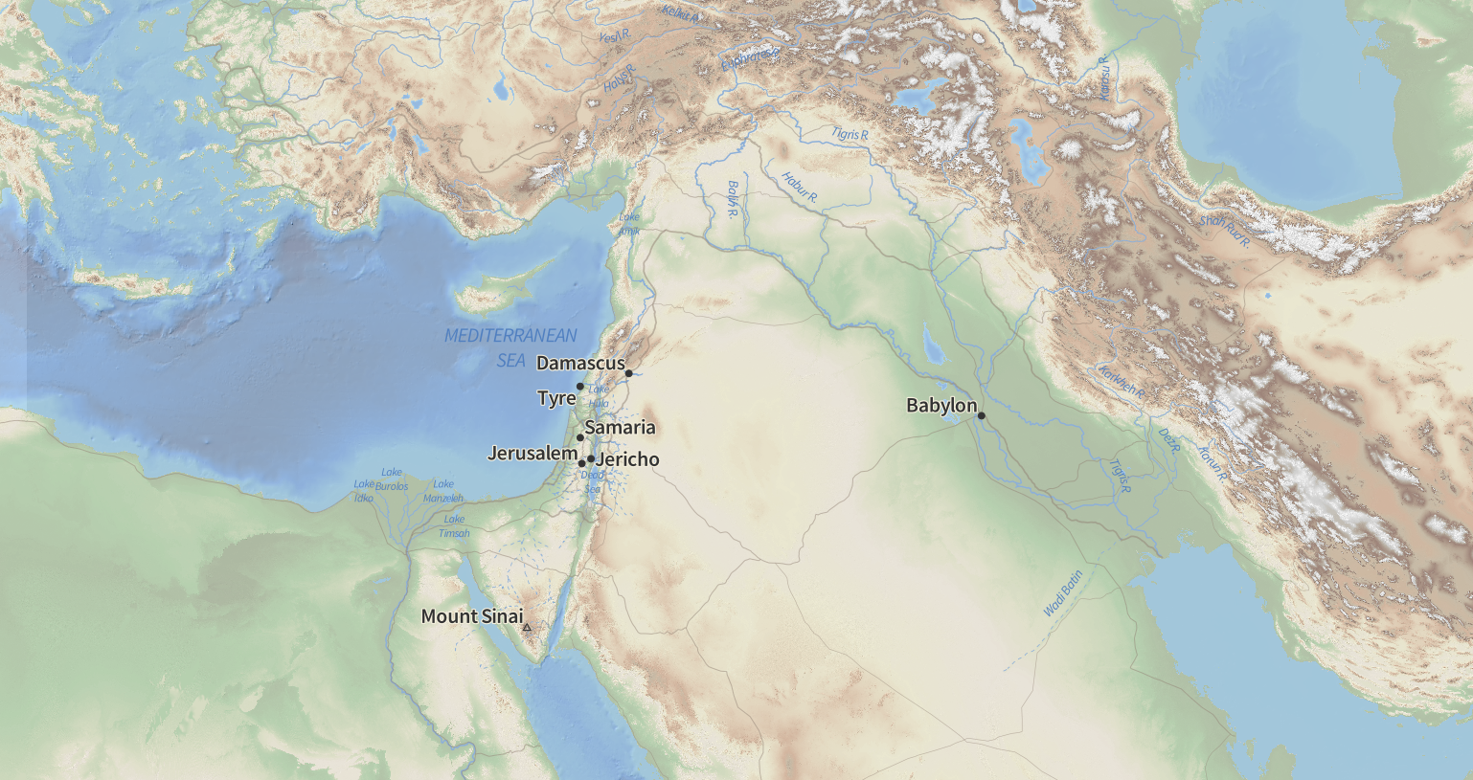
Nineveh

Slide 3
Nineveh

Slide 4
Nineveh
Babylon
616

Slide 5
Nineveh
612
Babylon

Slide 6
Harran
609
Nineveh
612
Megiddo
609
Babylon

Slide 7
Harran
609
Nineveh
612
Carchemish
605
Babylon

Slide 8
Babylon

Slide 9
Babylon
Jerusalem

Slide 10
“Nebuchadnezzar king of Babylon came to Jerusalem and besieged it” (Daniel 1:1 NASB)
“In his days Nebuchadnezzar king of Babylon came up, and Jehoiakim became servant for three years; then he turned and rebelled against him.” (2Ki. 24.1 NASB) (605 BC)
Babylon
Jerusalem

Slide 11
“At that time the servants of Nebuchadnezzar king of Babylon went up to Jerusalem, and the city came under siege…[Nebuchadnezzar] led Jehoiachin away into exile in Babylon” (2 Kings 24:10-16 NASB) (597 BC)
“Now on the seventh day of the fifth month, which was the nineteenth year of King Nebuchadnezzar, king of Babylon, Nebuzaradan the captain of the guard, a servant of the king of Babylon, came to Jerusalem.” (2 Kings 25:1-21 NASB) (586 BC)
Babylon
Jerusalem

Slide 12
Babylon
Jerusalem
Important Dates:
722 BC - Samaria destroyed
605 BC - 1st group taken
597 BC - 2nd group taken
586 BC - Jerusalem destroyed
→ (Daniel)
→ (Ezekiel)
Jerusalem
Jeremiah
Babylon

Slide 13
“the Lord gave Jehoiakim king of Judah into his hand” (Daniel 1:2 NASB)
If “you do not obey Me,...I will scatter among the nations and will draw out a sword after you, as your land becomes desolate and your cities become waste” (Leviticus 26:27-33 NASB).
Babylon
Jeremiah declared that because of Judah’s sin the “whole land will be a desolation and a horror, and these nations will serve the king of Babylon seventy years.” (25.11 NASB)
Jerusalem
“remove them from His sight” (2 Kings 24.1-5 NASB)

Slide 14
1
The Book of Daniel
2
The power of God
Godly living in difficult circumstances
3
NARRATIVE
4
5
6
7
8
Rise and fall of nations
Future of God’s people
God’s power to arrange and execute his plans throughout history
9
PROPHECY
10
11
12

Slide 15
Daniel
HEBREW
1
The Book of Daniel
ARAMAIC
2
3
NARRATIVE
4
5
COINCIDENCE?
DELIBRATE?
6
7
HEBREW
8
9
PROPHECY
10
11
12

Slide 16
Daniel
HEBREW
1
The Book of Daniel
ARAMAIC
2
3
NARRATIVE
Common Suggestion
The Aramaic section is material of interest to the Nations
The Hebrew section is material of interest to Hebrews
4
5
6
7
HEBREW
8
9
PROPHECY
10
11
12

Slide 17
Daniel
HEBREW
1
The Book of Daniel
ARAMAIC
2
3
NARRATIVE
Two or three sections in separate circulation?
4
5
Unity between the sections of Daniel
Progression in prophecy
Prophecy and Narrative build on each other
6
7
HEBREW
8
9
PROPHECY
10
11
12

Slide 18
Daniel
HEBREW
1
CHIASM IN 2-7?
ARAMAIC
2
Four Kingdoms
3
Protection of God’s People
NARRATIVE
4
Judgement on Kings
5
Judgement on Kings
6
Protection of God’s People
Daniel 2-7 as a whole would serve as a strong message to the kings of the earth (or the nations under them) about God’s rule, God’s people, and about those kings who get in his way (and eventually providing confidence to the Hebrew reader as well).
7
Four Kingdoms
HEBREW
8
9
PROPHECY
10
11
Proclamations of kings:
2.47; 3.28-29; 4.1, 37; 5.29; 6.25-27; 7.27
12

Slide 19
Daniel
HEBREW
1
Chiastic Structure?
ARAMAIC
2
Four Kingdoms
Whether or not there is a chiasm in Daniel 2-7,
It highlights a message to kings in particular which gives a possible explanation of it being written in Aramaic.
It does call legitimate attention to chapter 4 and 5 as containing a core message of the section and of the book: “the Most High reigns in the kingdoms of men” (Dan. 4:17, 25, 32; 5.21).
3
Protection of God’s People
NARRATIVE
4
Judgement on Kings
5
Judgement on Kings
6
Protection of God’s People
7
Four Kingdoms
HEBREW
8
Daniel 2-7 as a whole would serve as a strong message to the kings of the earth about God’s rule, God’s people, and about those kings who get in his way.
9
PROPHECY
10
11
Proclamations of kings:
2.47; 3.28-29; 4.1, 37; 5.29; 6.25-27; 7.27
12

Slide 20
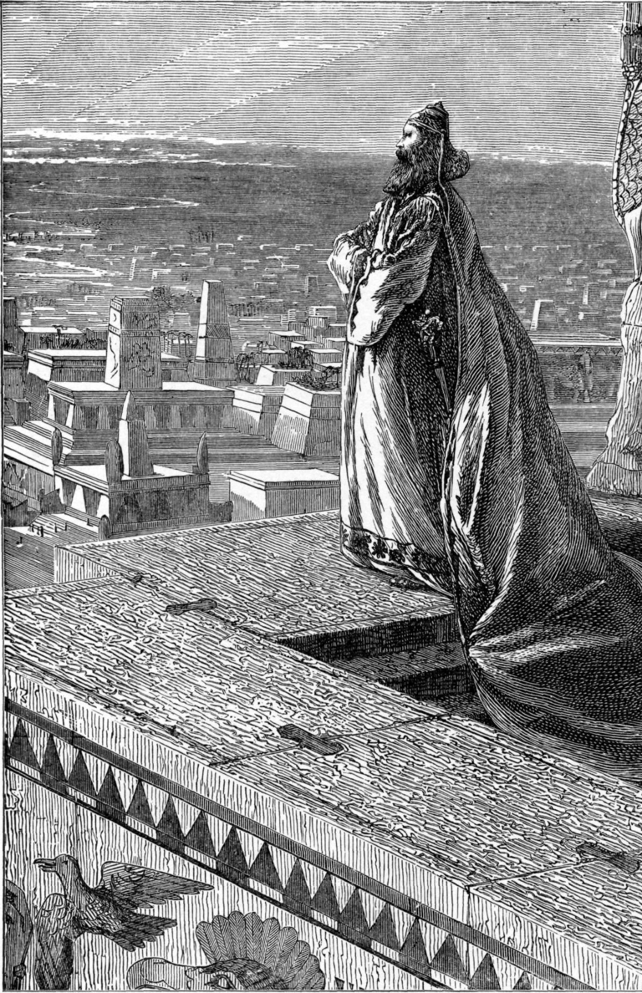
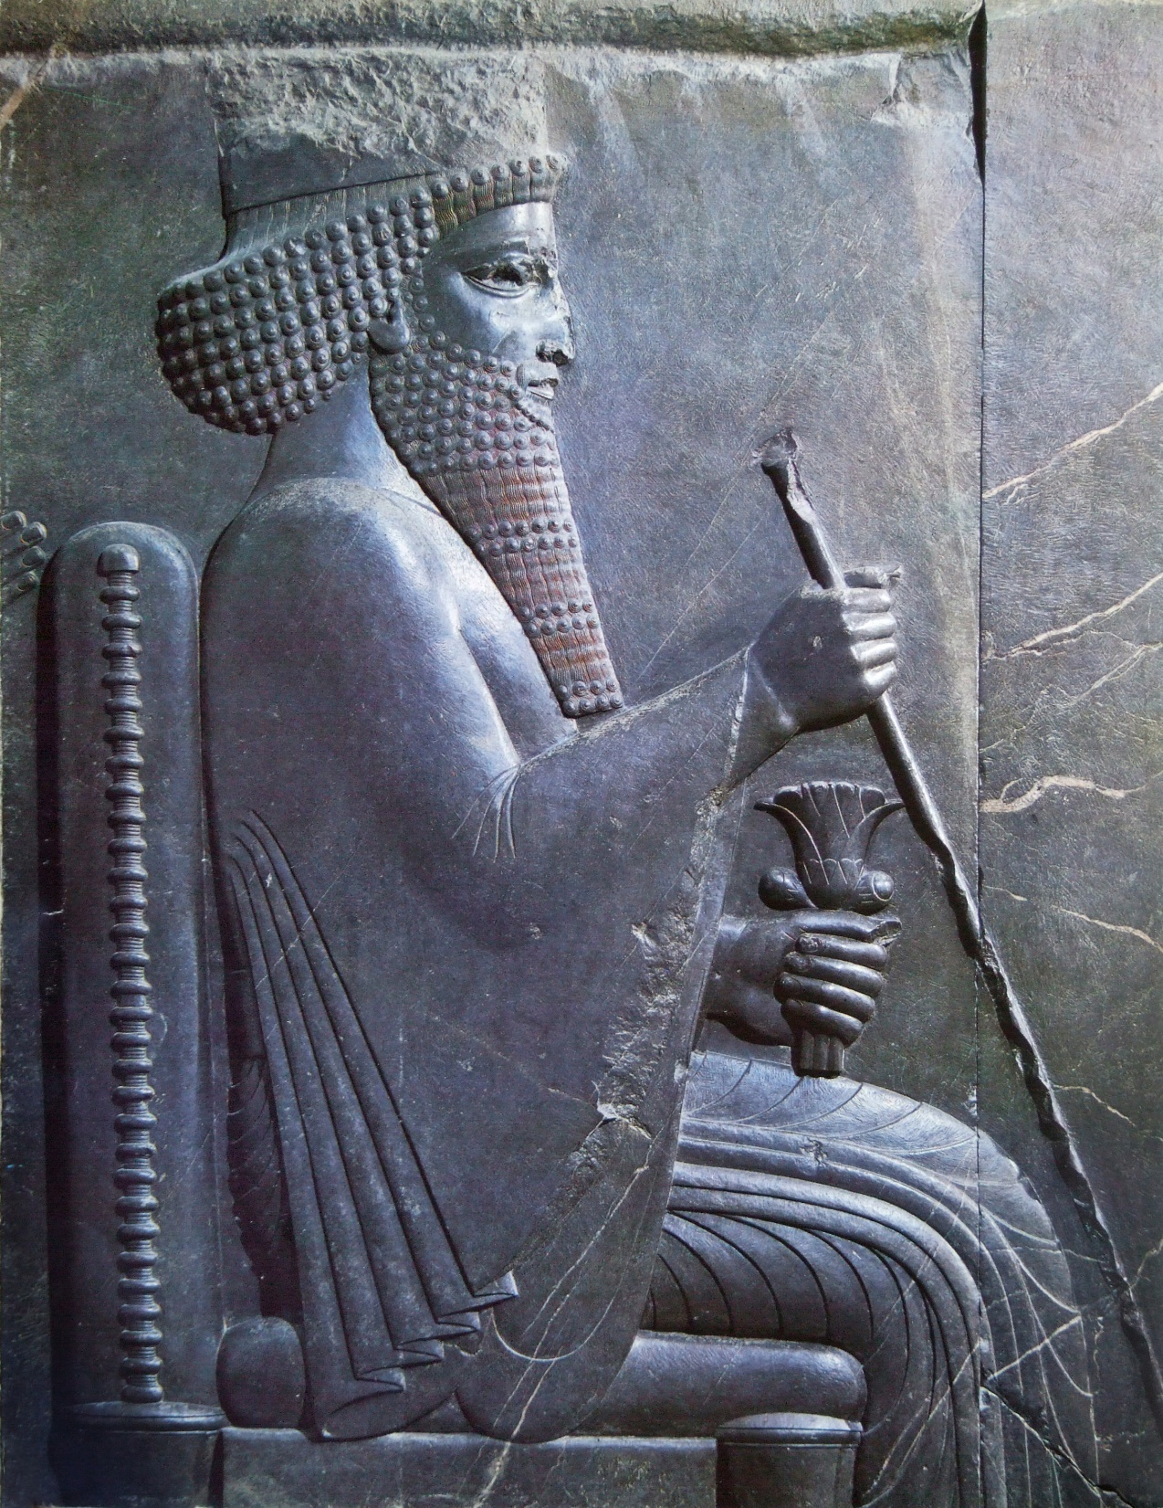
Daniel 4 – The Most High Rules in the Kingdoms of Men
4:1-3 - Nebuchadnezzar acknowledged God.
4:5-18 - Nebuchadnezzar has a dream.

Slide 21
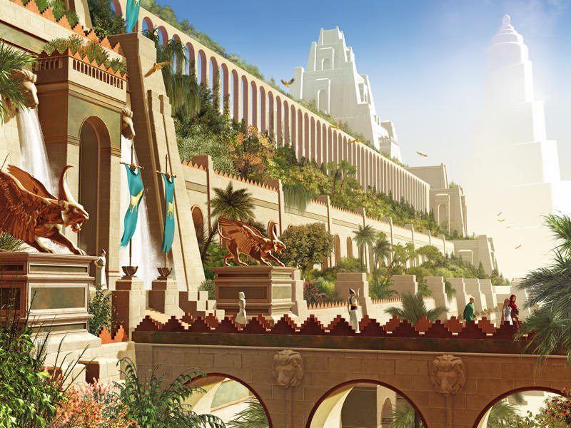

Slide 22
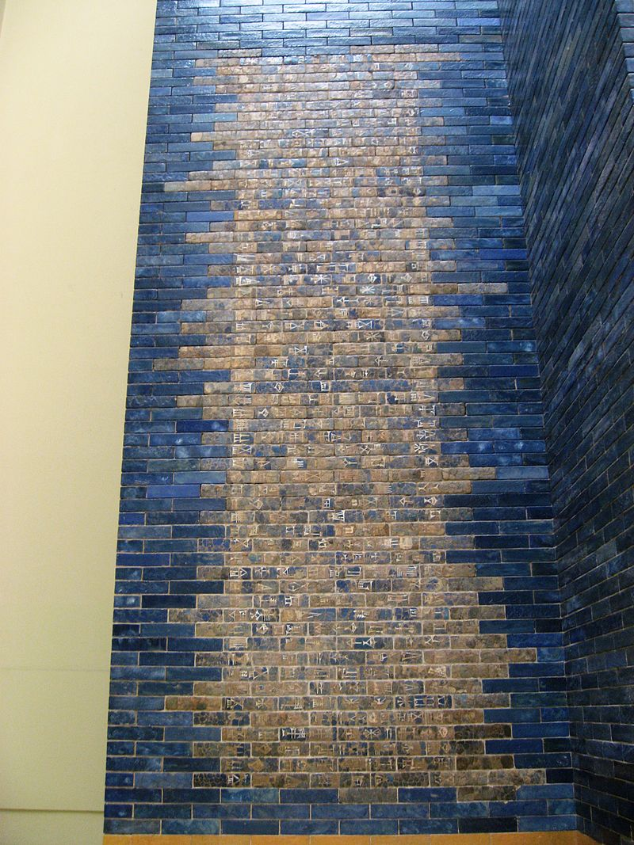
"I (Nebuchadnezzar) laid the foundation of the gates down to the ground water level and had them built out of pure blue stone. Upon the walls in the inner room of the gate are bulls and dragons and thus I magnificently adorned them with luxurious splendour for all mankind to behold in awe.“
https://en.wikipedia.org/wiki/Nebuchadnezzar_II#/media/File:Pergamon_Museum_Berlin_2007085.jpg

Slide 24
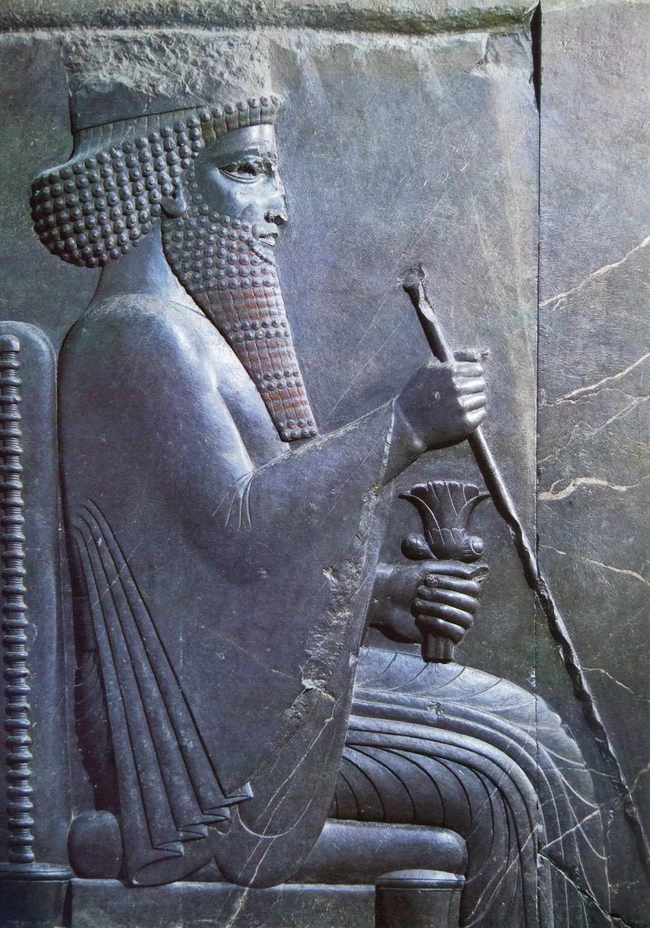
Daniel 4 – The Most High Rules in the Kingdoms of Men
4:1-3 - Nebuchadnezzar acknowledged God.
4:5-18 - Nebuchadnezzar has a dream.

Slide 25
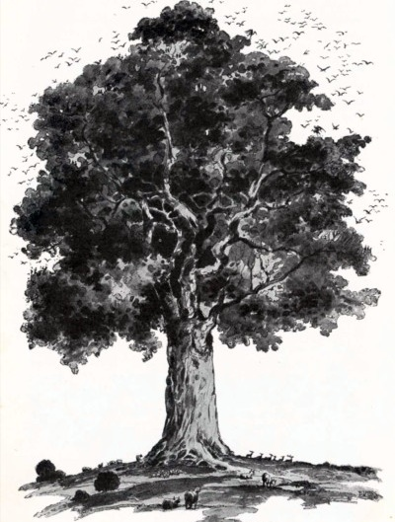
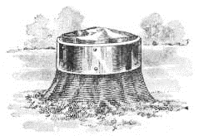
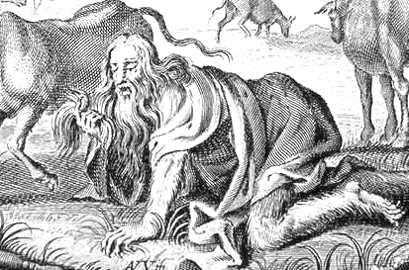
Daniel 4 – The Most High Rules in the Kingdoms of Men
4:1-3 - Nebuchadnezzar acknowledged God.
4:5-18 - Nebuchadnezzar has a dream.

Slide 26
Daniel 4 – The Most High Rules in the Kingdoms of Men
4:1-3 - Nebuchadnezzar acknowledges God.
4:5-18 - Nebuchadnezzar has a dream.
4:19-27 - Daniel explains the vision and gives advice.
4:28-33 - Nebuchadnezzar repents only after punishment.
4:34-37 - Nebuchadnezzar acknowledges God.

Slide 27
Daniel 4 – The Most High Rules in the Kingdoms of Men
Applications:
God is in control of the “big” things of life.
God is in control of the “small” things of life.
God is merciful to the humble.

Slide 28
Daniel’s Message for Today
The Most High Reigns in the kingdoms of men In “good” times and “bad” remember that God is in control.
Kings of the earth cannot control their own future. The United States will rise or fall by the will of God, not by the power of its leaders or military.
Daniel: “God is my judge” On an individual level, we must be more worried about what God thinks that what man thinks or does. We must keep ourselves separate from the world.

