Slide 1
Johanan
Talk is cheap
Sunday
March 12, 2017
11:00 am

Slide 2
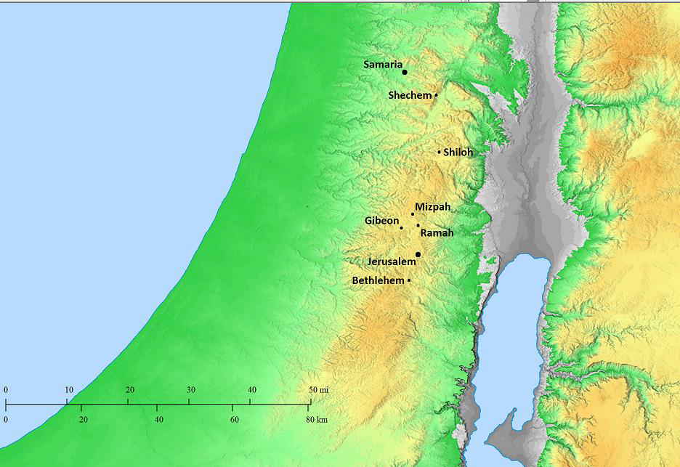
Jeremiah 41-42
The Characters
Gedaliah appointed over Judah by Babylonians
Johanan Jew, military leader
Ishmael Jew, military leader
Jeremiah, prophet of God

Slide 3
The Story
Ishmael
assassinates Gedaliah at Mizpah
kills Jews & Chaldeans who were with Gedaliah
the next day, kills many worshipers
takes captives and flees to Ammon
Jeremiah 41-42

Slide 4
The Story
Johanan
“heard of all the evil that Ishmael the son of Nethaniah had done”
went to fight Ishmael
Ishmael fled
the captives that Ishmael had taken rallied to Johanan
Jeremiah 41-42
They & the people left in Mizpah made preparations to go to Egypt, fearing the retribution of the Chaldeans for what Ishmael had done

Slide 5
The Story
Johanan declares his intent
to do God’s will,
whether he likes it or not…
Jeremiah 41-42
Jeremiah 42 ⁵ And they said to Jeremiah, “May the Lord be a true and faithful witness against us if we do not follow all the instructions the Lord, your God, sends us through you. ⁶ Whether we like it or not, we will obey the command of the Lord, our God, to whom we are sending you, so that it may go well with us for obeying the command of the Lord, our God.”

Slide 6
The Story
Johanan declares his intent
to do God’s will,
whether he likes it or not…
Jeremiah 41-42
Jeremiah tells him God says,
Don’t go to Egypt.
Jeremiah 42 ¹⁹ “The Lord has spoken to you, remnant of Judah. Do not go to Egypt!”

Slide 7
The Story
Johanan declares his intent
to do God’s will,
whether he likes it or not…
Jeremiah 41-42
Jeremiah tells him God says,
Don’t go to Egypt.
Johanan doesn’t like it
, and goes to Egypt!
Jeremiah 43 ² “…You lie; the Lord, our God, did not send you to tell us, ‘Do not go to Egypt to live there.’ ³ Baruch, son of Neriah, is inciting you against us, to hand us over to the Chaldeans to be killed or exiled to Babylon.”

Slide 8
The Presumptuous Presumption that God’s Will Must Accord With My Own
Johanan & those with him had already made up their minds what they were going to do
Asking about God’s will was less about seeking God’s will, more about seeking God’s endorsement of their own will.

Slide 9
The Presumptuous Presumption that God’s Will Must Accord With My Own
Some study the Bible that way
The danger of Proof texting
The danger of issue oriented studying

Slide 10
Talk is Cheap
When We Were Baptized, What Did We Say We Would Do?
We didn’t know everything required
Consider the Ethiopian Eunuch
But we repented
Repentance is a change of heart
Not merely sorrow, 2 Cor. 7:10
Not merely turning from sin, Ac 20:21
We promised to do whatever God says
It’s writing a blank check to God
What if we don’t follow through?

Slide 11
Jesus’ critics claimed to follow God, but didn’t;
others who had not followed God but now repented, were in better standing with God.
Talk is Cheap
Matthew 21 ²⁸ “What is your opinion? A man had two sons. He came to the first and said, ‘Son, go out and work in the vineyard today.’ ²⁹ He said in reply, ‘I will not,’ but afterwards he changed his mind and went. ³⁰ The man came to the other son and gave the same order. He said in reply, ‘Yes, sir,’ but did not go. ³¹ Which of the two did his father’s will?” They answered, “The first.” Jesus said to them, “Amen, I say to you, tax collectors and prostitutes are entering the kingdom of God before you. ³² When John came to you in the way of righteousness, you did not believe him; but tax collectors and prostitutes did. Yet even when you saw that, you did not later change your minds and believe him.”

Slide 12
Talk is Cheap
illustrated by Peter
Peter’s said he would never deny the Lord
1. Luke 22:33, 34
2. Mt. 26:34, 35
3. consistent with Peter’s impetuous character (Mt. 14:28-30)
Like us sometimes?
This trait can be overcome if we will see ourselves as the Lord sees us, Luke 22:61-62
The Lord turned and looked at Peter. And Peter remembered the word of the Lord, how He had told him, “Before a rooster crows today, you will deny Me three times.” And he went out and wept bitterly.
The Pharisees “say and do not” (Mt. 23:3) for they are preoccupied with how they are seen by others (Mt. 23:5)
Peter saw himself when he saw how the Lord saw him.

Slide 13
Talk is Cheap
HERE IS THE KEY: SEEING OURSELVES FOR WHAT WE ARE, RATHER THAN SEEING OURSELVES AS WE WISH OTHERS TO SEE US
a. Luke 16:15
b. Luke 18:9-14

