Slide 1
Daniel - Revelation
The connection

Slide 12
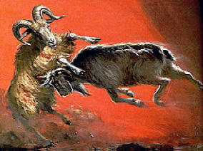
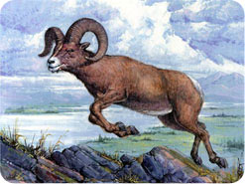
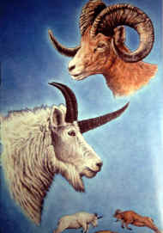
Daniel 8:3-4 Then I lifted up mine eyes, and saw, and, behold, there stood before the river a ram which had two horns: and the two horns were high; but one was higher than the other, and the higher came up last. 4 I saw the ram pushing westward, and northward, and southward; and no beasts could stand before him, neither was there any that could deliver out of his hand; but he did according to his will, and magnified himself.
Daniel 8:5-7 And as I was considering, behold, a he-goat came from the west over the face of the whole earth, and touched not the ground: and the goat had a notable horn between his eyes. 6 And he came to the ram that had the two horns, which I saw standing before the river, and ran upon him in the fury of his power. 7 And I saw him come close unto the ram, and he was moved with anger against him, and smote the ram, and brake his two horns; and there was no power in the ram to stand before him; but he cast him down to the ground, and trampled upon him; and there was none that could deliver the ram out of his hand.
Daniel 8:20 – the ram (w/ 2 horns) Medes and Persians
Daniel 8:21 – the he-goat: Greece
The great horn: Alexander, the Great
The 4 notable horns: Cassander, Lysimachus, Ptolemy, Seleucius
Daniel 8:20-22 The ram which thou sawest, that had the two horns, they are the kings of Media and Persia. 21 And the rough he-goat is the king of Greece: and the great horn that is between his eyes is the first king. 22 And as for that which was broken, in the place whereof four stood up, four kingdoms shall stand up out of the nation, but not with his power.

Slide 13
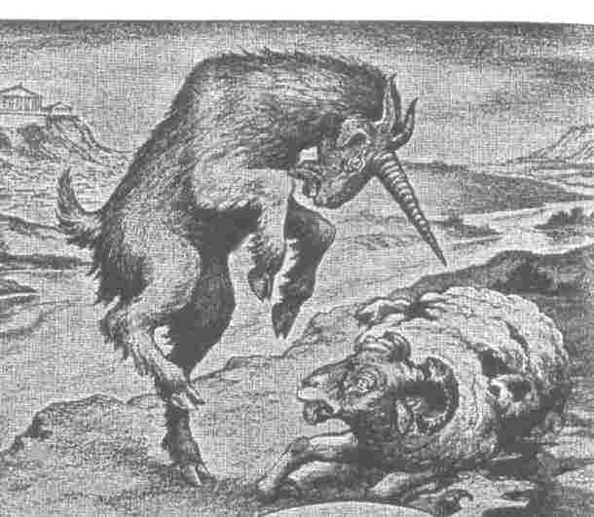

Slide 14
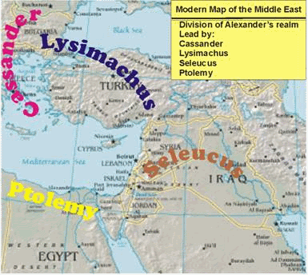

Slide 16
10+1 kings in Daniel vs. 8+1 kings in Revelation
One variation between the vision seen by Daniel and that seen by John is the Beast of Revelation has 7 heads which are revealed to be 7 kings. In Revelation 17:12 there are another 10 horns who are a different 10 kings who “have received no kingdom as yet”.
It is my view that the 7+1 kings represented by heads on the Revelation beast are the same kings that Daniel saw on the 4th beast of his vision.
The difference between these two visions involves the three kings in Daniel that are “plucked up by the roots” (Daniel 7:8). The little horn (the 11th king of Daniel) will “put down” these three kings (Daniel 8:24), or it is said that they will “fall” before the little horn (Daniel 7:20). How can the number of kings in Daniel 7 be reconciled with the number of kings in Revelation 17?

Slide 17
How do the heads / horns on the beast of Revelation compare to the horns / kings of Daniel 7?
Revelation 13:1 and he stood upon the sand of the sea. And I saw a beast coming up out of the sea, having ten horns, and seven heads, and on his horns ten diadems, and upon his heads names of blasphemy.
Revelation 17:7 And the angel said unto me, Wherefore didst thou wonder? I will tell thee the mystery of the woman, and of the beast that carrieth her, which hath the seven heads and the ten horns.
Revelation 17:9-11 Here is the mind that hath wisdom. The seven heads are seven mountains, on which the woman sitteth: 10 and they are seven kings; the five are fallen, the one is, the other is not yet come; and when he cometh, he must continue a little while. 11 And the beast that was, and is not, is himself also an eighth, and is of the seven; and he goeth into perdition.

Slide 20
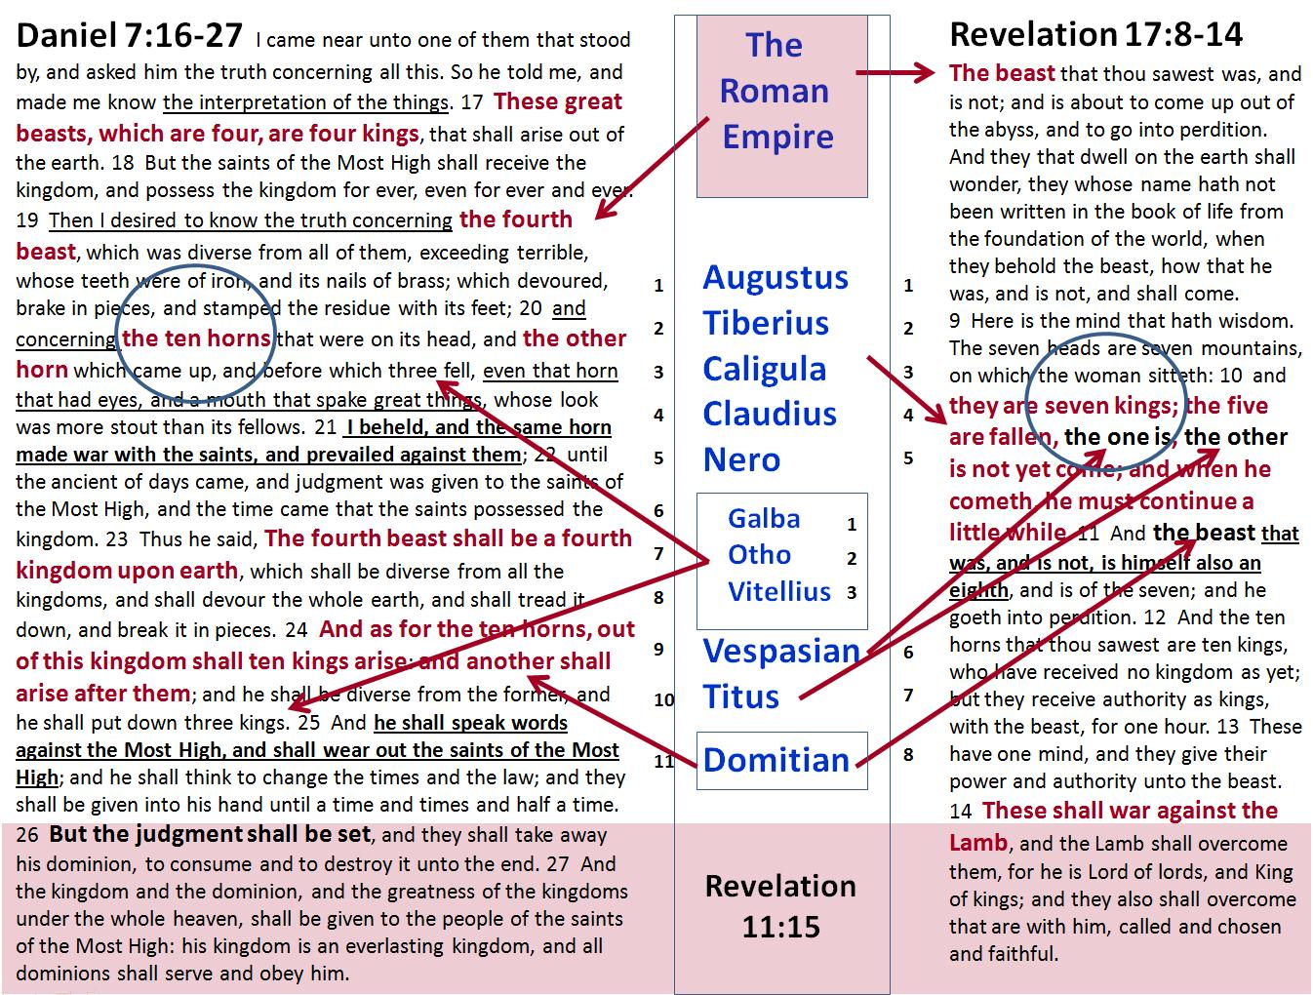

Slide 21
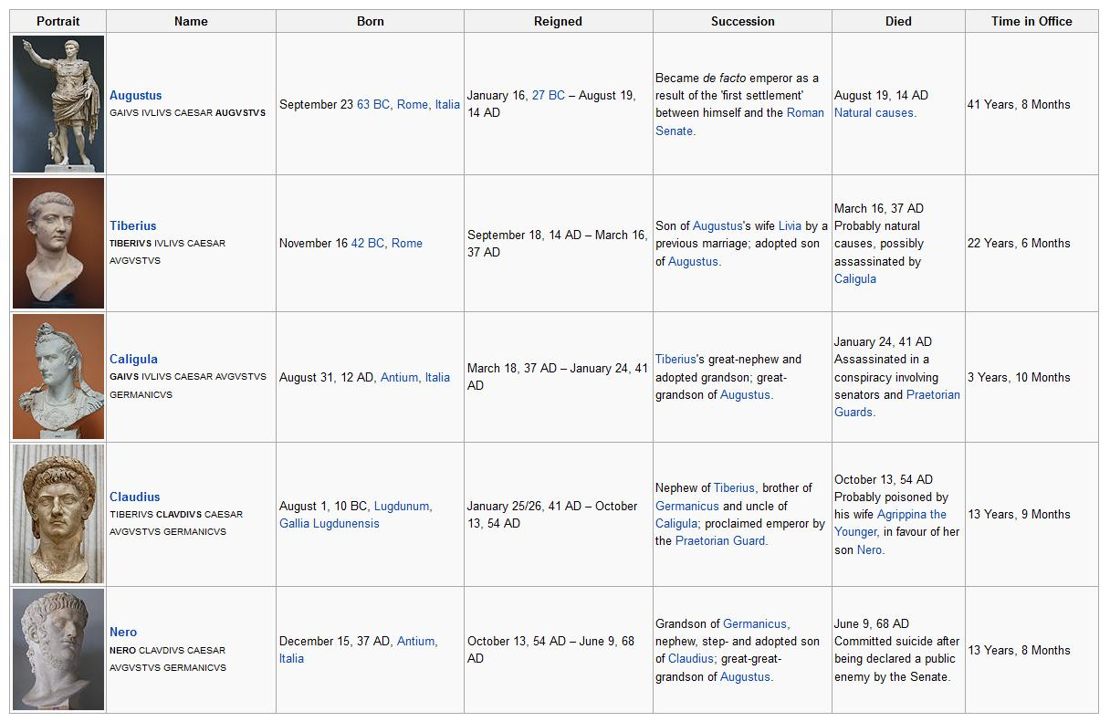

Slide 22
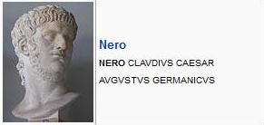
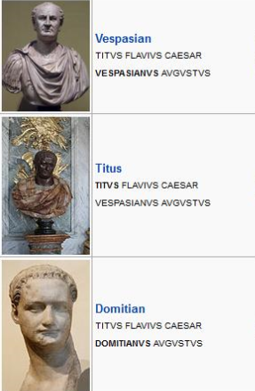
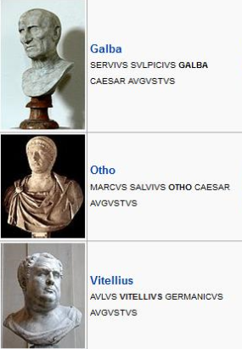

Slide 33
